Slide 1
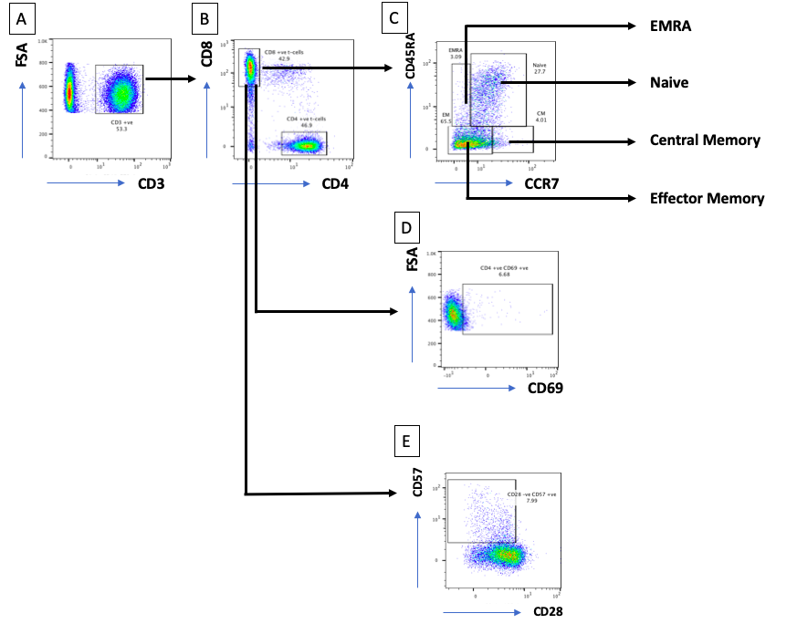
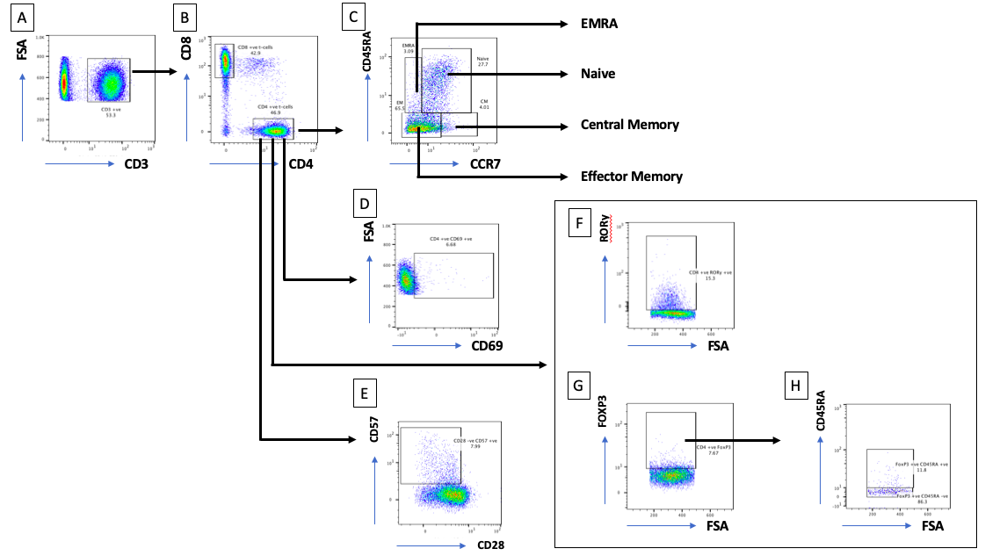
Supplementary Figure 1A: Gating strategies for CD8 flow cytometry analysis
Supplementary Figure 1B: Gating strategies for CD4 flow cytometry analysis

Slide 2
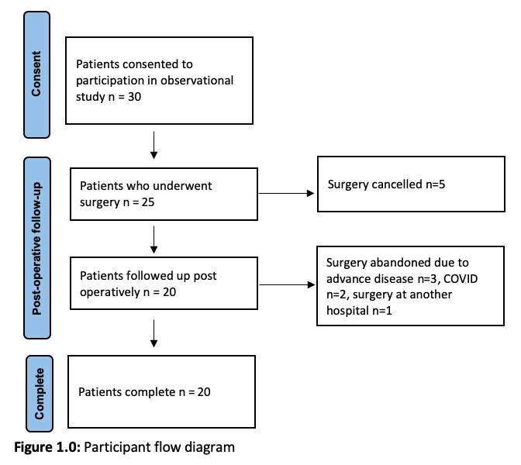
Supplementary Figure 2: Study flow chart demonstrating recruitment of upper gastrointestinal (UGI) surgery patients from consent to study completion.

Slide 3
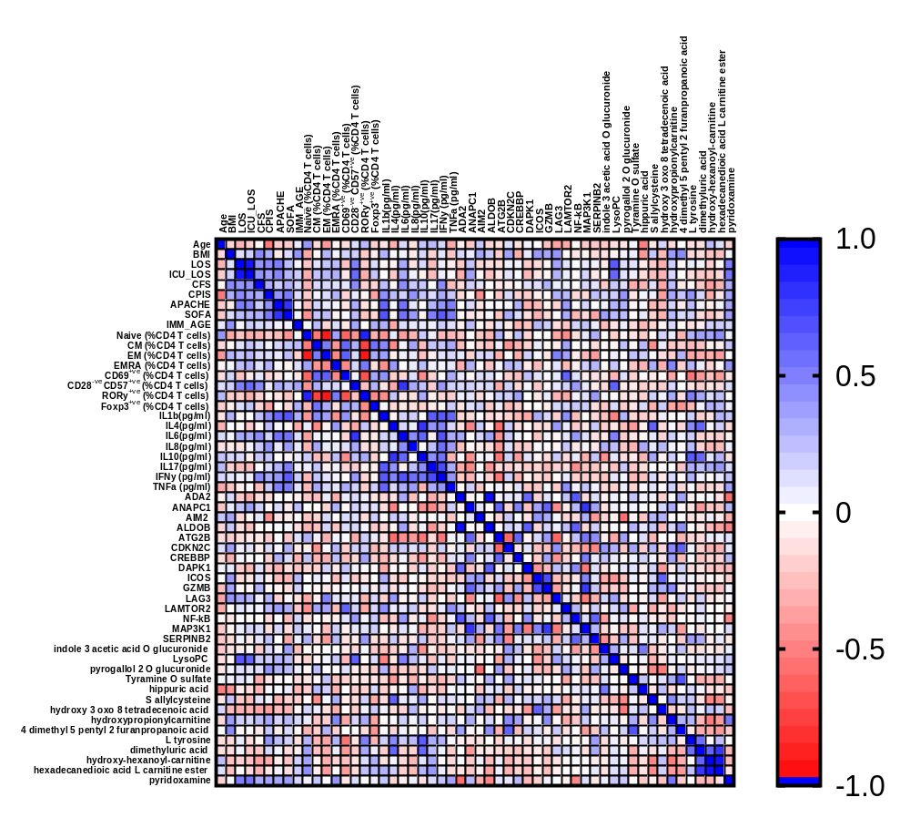
Supplementary Figure 3: Heatmap highlighting Spearman based associations between clinical features and immune ageing hallmarks, IMM-AGE score, serum cytokines, metabolomic and transcriptomic signatures in upper gastrointestinal (UGI) surgery patients pre-operatively.

Slide 4
Supplementary Table 1: Demographics and clinical data for upper gastrointestinal (UGI) surgery patients pre-operatively and post-operative outcomes; with and without subsequent pneumonia.
 | All Surgical Patients | UGI Surgical Patients Pre-Operative ( n = 20 ) |  | p value ª
 |  | No Pneumonia | Pneumonia
n | 20 | 7 | 13 | N/A
Demographics & Baseline Data
Age | 63.60 ± 11.70 | 70.43 ± 6.55 | 59.92 ± 12.39 | 0.047
Males (%) | 15 (75%) | 6 (85.7%) | 9 (69.2%) | N/A
Chemotherapy | 19 (95%) | 7 (100%) | 12 (92.3%) | N/A
Smoking history | 13 (65%) | 5 (71.4%) | 8 (61.5%) | N/A
Pre-operative BMI | 28.49 ± 8.36 | 24.67 ± 4.10 | 30.55 ± 9.45 | 0.134
Charlson Comorbidity Index | 5.10 ± 2.07 | 4.86 ± 0.69 | 5.23 ± 2.55 | 0.756
Predicted Clinical Frailty Score | 2.25 ± 0.85 | 2.54 ± 0.77 | 1.71 ± 0.75 | 0.049
Lymphocyte count (10⁹/L) | 1.65 ± 0.71 | 1.36 ± 0.67 | 1.80 ± 0.70 | 0.157
Neutrophil : Lymphocyte (10⁹/L) | 4.26 ± 2.54 | 3.83 ± 2.04 | 5.06 ± 3.32 | 0.437
Albumin mg/dl | 2.24 ± 0.519 | 2.31 ± 0.46 | 2.11 ± 0.63 | 0.985
Creatinine mg/dl | 0.833 ± 0.487 | 0.94 ± 0.58 | 0.63 ± 0.08 | 0.240
CRP mg/L | 273.9 ± 120.6 | 312.4 ± 123.5 | 202.3 ± 79.74 | 0.135
WBC 10³/ul | 12.61 ± 5.605 | 14.65 ± 5.38 | 8.83 ± 3.99 | 0.014 *
Outcomes
ICU LOS (days) | 11.10 ± 3.35 | 3.71 ± 2.29 | 15.08 ± 15.18 | 0.038
Ventilator days | 6.00 ± 11.49 | 0.00 ± 0.00 | 9.23 ± 13.30 | 0.038
Hospital LOS (days) | 23.50 ± 17.89 | 12.86 ± 6.52 | 29.23 ± 19.59 | 0.024
SOFA score at the clinical onset of pneumonia or day 4 | 4.50 ± 4.14 | 1.42 ± 1.51 | 6.23 ± 4.16 | 0.001
APACHE score at the clinical onset of pneumonia or day 4 | 11.0 ± 5.83 | 7.14 ± 1.86 | 13.08 ± 6.22 | 0.011
CPIS at the clinical onset of pneumonia or day 4 | 6.70 ± 3.09 | 3.286 ± 1.890 | 8.538 ± 1.71 | <0.0001
Post-operative delirium | 10 (50%) | 2 (28.6%) | 8 (61.5%) | N/A
Post-operative anastomotic leak | 10 (50%) | 2 (28.6%) | 8 (61.5%) | N/A
Discharge to home | 17 (85%) | 7 (100%) | 10 (76.9%) | N/A
Discharge with ongoing care | 2 (10%) | 0 (0%) | 2 (15.4%) | N/A
Inpatient mortality | 1 (5%) | 0 (0%) | 1 (7.7%) | N/A
Mortality at 3 months | 3 (15%) | 0 (%) | 3 (23.1%) | N/A
ª p = pneumonia vs no pneumonia with p<0.05 statistically significant indicated by *
Data presented as mean ± standard deviation
Abbreviations: APACHE = acute physiology and chronic health evaluation; BMI = body mass index; CPIS = clinical pulmonary infection score; ICU = intensive care unit; LOS = length of stay; SOFA = sequential organ failure assessment; UGI = upper gastrointestinal.

Slide 5
Supplementary Table 2: CD8 T cells subset distribution in upper gastrointestinal (UGI) surgery patients (pre-operatively, day 2-5 post-operatively, hospital discharge) and healthy controls.
 | Healthy controls ( n = 20 ) | UGI Surgical Patients ( n = 20 ) |  |  | p value
 |  | Pre Op | Day 2-5 Post Op | Hospital Discharge
CD8 T cells (%) | 39.18 ± 8.16 | 41.31 ± 15.34 | 38.94 ± 15.20 | 42.59 ± 14.99 | 0.82
CD8 T cell count (10⁹/L) | 0.43 ± 0.15^{b} | 0.52 ± 0.36 | 0.24 ± 0.21 | 0.39 ± 0.25 | 0.02
Naïve CD8 T cells (%) | 32.72 ± 16.36^{a,c} | 21.07 ± 5.40 | 28.93 ± 12.93 | 20.53 ± 6.78 | 0.005
Naive CD8 T cells (10⁹/L) | 0.15 ± 0.09 ^{a,b,c} | 0.09 ± 0.08 | 0.07 ± 0.07 | 0.09 ± 0.08 | 0.02
CM CD8 T cells (%) | 21.30 ± 16.82 | 15.20 ± 7.07 | 14.20 ± 8.3 | 15.1 ± 6.92 | 0.16
CM CD8 T cells (10⁹/L) | 0.09 ± 0.07 | 0.08 ± 0.08 | 0.04 ± 0.07 | 0.06 ± 0.05 | 0.13
EM CD8 T cells (%) | 30.77 ± 13.39 | 34.62 ± 17.33 | 27.72 ± 16.41 | 34.06 ± 17.64 | 0.57
EM CD8 l count (10⁹/L) | 0.13 ± 0.06 | 0.17 ± 0.17 | 0.07 ± 0.09 | 0.12 ± 0.12 | 0.08
EMRA CD8 T cells (%) | 14.90 ± 13.69^{a,b,c} | 31.28 ± 17.11 | 31.23 ± 17.75 | 31.97 ± 17.0 | 0.003
EMRA CD8 T cell (10⁹/L) | 0.06 ± 0.07^{a,c} | 0.12 ± 0.12 | 0.09 ± 0.05 | 0.13 ± 0.12 | 0.01
Total memory CD8 T cell (%) | 67.77 ± 16.18^{a,c} | 81.76 ± 7.68 | 73.15 ± 13.22 | 81.52 ± 7.47 | 0.0004
Memory CD8 T cell (10⁹/L) | 0.28 ± 0.10ª | 0.41 ± 0.29 | 0.17 ± 0.15 | 0.30 ± 0.19 | 0.005
CD69^{+ve} CD8 T cells (%) | 6.71 ± 7.86^{b,c} | 10.98 ± 4.69 | 12.10 ± 4.71 | 13.72 ± 5.04 | 0.002
CD28^{-ve} CD8 T cells (%) | 6.56 ± 4.64^{a,b,c} | 50.09 ± 19.27 | 46.65 ± 21.55 | 49.48 ± 19.66 | <0.0001
CD28^{-ve} CD8 T cells (10⁹/L) | 0.03 ± 0.03^{a,b,c} | 0.24 ± 0.23 | 0.12 ± 0.11 | 0.19 ± 0.17 | 0.0005
CD57^{+ve} CD8 T cells (%) | 6.73 ± 3.77^{a,b,c} | 34.59 ± 16.20 | 36.17 ± 18.48 | 34.16 ± 17.05 | <0.0001
CD57^{+ve} CD8 T cells (10⁹/L) | 0.04 ± 0.03^{a,c} | 0.15 ± 0.13 | 0.08 ± 0.08 | 0.13 ± 0.11 | 0.005
CD28^{-ve} CD57^{+ve} CD8 (%) | 3.32 ± 1.85^{a,b,c} | 23.42 ± 13.58 | 26.86 ± 19.45 | 23.90 ± 15.43 | <0.0001
CD28^{-ve} CD57^{+ve} CD8 (10⁹/L) | 0.02 ± 0.01^{a,b,c} | 0.10 ± 0.10 | 0.06 ± 0.07 | 0.09 ± 0.09 | 0.004
Data are presented as mean ± standard deviation. Overall group differences were assessed using a one‑way ANOVA with multiple comparisons, comparing the mean of each UGI surgical patient timepoint with the mean of the healthy control group. Statistically significant differences are denoted as ^{a,b,c}: ª healthy control vs UGI surgical patients at pre-operative timepoint; ^{b} healthy control vs UGI surgical patients at day 2-5 post-operative timepoint; ^{c} healthy control vs UGI surgical patients at hospital discharge timepoint. A p=value <0.05 was considered statistically significant throughout.

Slide 6
Supplementary Table 3: CD4 T cells subset distribution in upper gastrointestinal (UGI) surgery patients (pre-operatively, day 2-5 post-operatively, hospital discharge) and healthy controls.
 | Healthy controls ( n = 20 ) | UGI Surgical Patients ( n = 20 ) |  |  | p value
 |  | Pre Op | Day 2-5 Post Op | Hospital Discharge
CD4 T cells (%) | 52.15 ± 8.57 | 58.85 ± 15.08 | 60.64 ± 15.18 | 58.18 ± 15.31 | 0.26
CD4 T cell count (10⁹/L) | 0.59 ± 0.23^{b} | 0.71 ± 0.35 | 0.36 ± 0.29 | 0.53 ± 0.30 | 0.008
Naïve CD4 T cells (%) | 43.30 ± 14.77 | 36.23 ± 14.30 | 39.11 ± 15.82 | 36.70 ± 15.05 | 0.46
Naive CD4 T cells (10⁹/L) | 0.27 ± 0.16 | 0.25 ± 0.20 | 0.15 ± 0.17 | 0.20 ± 0.19 | 0.19
CM CD4 T cells (%) | 10.49 ± 12.57 | 19.84 ± 5.89 | 18.82 ± 11.98 | 18.33 ± 7.38 | 0.01
CM CD4 T cells (10⁹/L) | 0.05 ± 0.07^{b} | 0.13 ± 0.06 | 0.06 ± 0.04 | 0.09 ± 0.04 | 0.0002
EM CD4 T cells (%) | 13.62 ± 7.61^{a,b,c} | 41.76 ± 15.80 | 38.18 ± 17.79 | 41.72 ± 17.53 | <0.0001
EM CD4 count (10⁹/L) | 0.08 ± 0.05^{a,c} | 0.27 ± 0.15 | 0.12 ± 0.11 | 0.19 ± 0.11 | <0.0001
EMRA CD4 T cells (%) | 31.60 ± 16.77^{a,b,c} | 7.59 ± 3.55 | 8.92 ± 3.19 | 8.47 ± 4.44 | <0.0001
EMRA CD4 T cell (10⁹/L) | 0.18 ± 0.10^{a,b.c} | 0.06 ± 0.05 | 0.04 ± 0.04 | 0.05 ± 0.05 | <0.0001
Total memory CD4 T cell (%) | 52.99 ± 18.39^{a,b,c} | 69.18 ± 17.02 | 65.91 ± 17.92 | 68.52 ± 17.21 | 0.02
Total memory CD4 T cell(10⁹/L) | 0.31 ± 0.11ª | 0.46 ± 0.22 | 0.22 ± 0.16 | 0.33 ± 0.15 | 0.0004
CD69^{+ve} CD4 T cells (%) | 4.29 ± 3.28^{b,c} | 5.56 ± 1.45 | 6.43 ± 2.01 | 7.18 ± 2.56 | 0.003
CD28^{-ve} CD4 T cells (%) | 3.85 ± 3.00^{b} | 5.35 ± 4.15 | 6.44 ± 4.03 | 6.28 ± 3.72 | 0.13
CD28^{-ve} CD4 T cells (10⁹/L) | 0.02 ± 0.02 | 0.03 ± 0.01 | 0.02 ± 0.01 | 0.03 ± 0.02 | 0.28
CD57^{+ve} CD4 T cells (%) | 4.81 ± 4.16 | 3.98 ± 2.41 | 4.75 ± 3.42 | 4.82 ± 3.26 | 0.83
CD57^{+ve} CD4 T cells (10⁹/L) | 0.03 ± 0.03 | 0.02 ± 0.01 | 0.01 ± 0.01 | 0.02 ± 0.01 | 0.042
CD28^{-ve} CD57^{+ve} CD4 (10⁹/L) | 0.023 ± 0.019 ^{a,b,c} | 0.007 ± 0.008 | 0.004 ± 0.004 | 0.006 ± 0.005 | <0.0001
FoxP3 ^{+ve} CD4 T cells (%) | 2.21 ± 1.09^{a,b,c} | 4.84 ± 1.46 | 6.35 ± 3.97 | 5.91 ± 1.42 | <0.0001
CD45RA^{+ve} FoxP3^{+ve} CD4 T cells (%) | 41.45 ± 21.03 | 38.70 ± 20.84 | 36.72 ± 22.90 | 35.96 ± 21.63 | 0.86
RORy CD4 T cells (%) | 4.64 ± 4.62^{a,b,c} | 34.93 ± 16.57 | 38.20 ± 18.56 | 36.52 ± 18.11 | <0.0001
Data are presented as mean ± standard deviation. Overall group differences were assessed using a one‑way ANOVA with multiple comparisons, comparing the mean of each UGI surgical patient timepoint with the mean of the healthy control group. Statistically significant differences are denoted as ^{a,b,c}: ª healthy control vs UGI surgical patients at pre-operative timepoint; ^{b} healthy control vs UGI surgical patients at day 2-5 post-operative timepoint; ^{c} healthy control vs UGI surgical patients at hospital discharge timepoint. A p=value <0.05 was considered statistically significant throughout.

Slide 7
Supplementary Table 4a: Genes differentially expressed in PBMCs of upper gastrointestinal (UGI) surgery patients pre-operatively and healthy controls (mean gene expression).
 | Healthy Controls | UGI Surgical Pre-Operatively | p value
AP1S1 | 294.04 | 474.04 | 0.03
AP2S1 | 806.89 | 1906.89 | 0.002
CIITA | 361.57 | 514.06 | 0.03
ATP6V1E1 | 937.6 | 633.84 | 0.04
ATG2B | 896.12 | 504.97 | 0.05
CFLAR | 2314.57 | 1660.65 | 0.03
DAPK1 | 598.23 | 466.22 | 0.03
VAMP8 | 1899.16 | 1404.37 | 0.04
BAX | 1524.36 | 1023.13 | 0.03
CASP3 | 632.76 | 488.32 | 0.04
CASP4 | 545.02 | 336.7 | 0.01
CASP8 | 2085.18 | 1488.02 | 0.03
ACTR1A | 456.6 | 1657.26 | 0.004
ANAPC1 | 271.17 | 469.86 | 0.03
ANAPC10 | 206.3 | 277.24 | 0.01
GNLY | 1766.9 | 2671.76 | 0.04
GZMA | 3563.55 | 5582.41 | 0.03
GZMB | 5018.36 | 7617.49 | 0.02
KIR2DL3 | 247.75 | 462.13 | 0.04
NCR1 | 115.09 | 242.89 | 0.01
LAG3 | 227.28 | 368.64 | 0.03
PTGER4 | 639.38 | 869.75 | 0.03
CD3 | 1703.25 | 977.18 | 0.04
CD4 | 2349 | 2002.32 | 0.05
CD19 | 187.51 | 117.8 | 0.05
CD244 | 117.37 | 245.01 | 0.01
CD86 | 210.1 | 927.75 | 0.002
FOXP3 | 20 | 47.48 | 0.05
ICOS | 78.9 | 190.93 | 0.04
IL2RB | 786.38 | 1515.58 | 0.02
AIM2 | 112.25 | 175.86 | 0.01
CXCL8 | 355.51 | 462.92 | 0.03
CXCL10 | 27.36 | 74.86 | 0.01
CXCR4 | 3188.15 | 4339.98 | 0.04
INPP5D | 734.56 | 1242.72 | 0.03
ITGA4 | 890.13 | 1787.41 | 0.04
NCF4 | 534.66 | 1272.19 | 0.01
ABCA1 | 59.07 | 181.77 | 0.04
ACSL4 | 460.51 | 764.55 | 0.03
ADIPOR1 | 114.25 | 157.53 | 0.04
ALDOB | 20.85 | 48.12 | 0.03
CETP | 24.91 | 55.58 | 0.05
Data presented as mean gene expression. p<0.05 statistically significant.

Slide 8
Supplementary Table 4b: Genes differentially expressed in PBMCs of upper gastrointestinal (UGI) surgery patients pre-operatively and healthy controls (mean gene expression).
 | Healthy Controls | UGI Surgical Pre-Operatively | p value
CPT1A | 718.81 | 938.43 | 0.01
FABP5 | 477.9 | 655.05 | 0.05
INSR | 334.03 | 576.16 | 0.05
NCOR2 | 940.24 | 2044.57 | 0.01
PLTP | 34.73 | 65.31 | 0.01
TBC1D4 | 457.7 | 664.39 | 0.07
LAMTOR2 | 567.5 | 1110.91 | 0.02
LAMTOR4 | 1567.2 | 3664.84 | 0.001
MTOR | 364.55 | 469.03 | 0.04
CDKN1A | 277.26 | 442.22 | 0.03
CDKN2C | 59.25 | 133.04 | 0.05
CREBBP | 1295.12 | 1983.03 | 0.04
CSNK1E | 361.2 | 598.4 | 0.03
FGD2 | 789.23 | 2228.72 | 0.001
GNG2 | 1562.3 | 2314.88 | 0.05
LAMC1 | 34.67 | 111.88 | 0.05
LATS1 | 791.4 | 654.83 | 0.05
MAML1 | 797.34 | 852.88 | 0.05
UBA52 | 1045.6 | 2181.92 | 0.001
ADAM9 | 204.32 | 422.79 | 0.01
CCL2 | 20 | 33.74 | 0.05
CCL4 | 882.12 | 1709.09 | 0.03
IL1β | 69.45 | 148.61 | 0.02
IL6 | 22.18 | 61.71 | 0.03
MMP1 | 21.35 | 38.48 | 0.03
MMP 9 | 26.72 | 68.38 | 0.02
PTGS2 | 62.19 | 193.15 | 0.02
S100A12 | 739.73 | 2286.33 | 0.001
SERPING1 | 80.08 | 169.64 | 0.02
TRAF6 | 232.7 | 449.71 | 0.01
TGFB1 | 3052.16 | 4770.62 | 0.04
TXN | 1034.52 | 2261.96 | 0.004
VEGFA | 67.78 | 122.92 | 0.05
AKT1 | 487.03 | 762.06 | 0.04
ATF6 | 3926.24 | 5809.2 | 0.03
JAK2 | 852.54 | 1277.45 | 0.01
MAP2K1 | 604.2 | 720.98 | 0.04
MAP3K1 | 1647.2 | 2501.18 | 0.03
Data presented as mean gene expression. p<0.05 statistically significant.

Slide 9
Supplementary Table 4c: Genes differentially expressed in PBMCs of upper gastrointestinal (UGI) surgery patients pre-operatively and healthy controls (mean gene expression).
 | Healthy Controls | UGI Surgical Pre-Operatively | p value
NFKB1 | 108.9 | 252.26 | 0.03
NOTCH2 | 1642.19 | 2483.6 | 0.05
NLRP3 | 200.91 | 372.93 | 0.04
STAT1 | 3918.99 | 6085.64 | 0.02
CKAP4 | 345.6 | 1445.41 | 0.01
CREB1 | 289.1 | 572.67 | 0.03
CTSB | 1456.78 | 6495.25 | 0.002
CXCL2 | 20 | 133.15 | 0.02
CXCR6 | 20 | 61.43 | 0.04
CYFIP1 | 467.8 | 863.04 | 0.01
DOCK1 | 20 | 51.21 | 0.02
EOMES | 76.4 | 163.64 | 0.03
FCRL2 | 56.78 | 237.99 | 0.01
FGF2 | 21.28 | 48.6 | 0.05
FGL2 | 345.6 | 1480.54 | 0.003
FURIN | 245.2 | 679.47 | 0.01
GCNT1 | 113 | 363 | 0.04
ITGB3 | 234.1 | 2227.46 | 0.002
PSMB8 | 457.8 | 2974.91 | 0.001
Data presented as mean gene expression. p<0.05 statistically significant.

Slide 10
Supplementary Table 5a: Genes differentially expressed in PBMCs of upper gastrointestinal (UGI) surgery patients at day 2-5 post-operatively and healthy controls (mean gene expression).
 | Healthy Controls | UGI Surgical Day 2-5 Post-Op | p value
AP2S1 | 806.89 | 1224.66 | 0.04
ATP6V1E1 | 937.6 | 612.68 | 0.04
ATG101 | 456.72 | 222.93 | 0.03
ATG2B | 896.12 | 296.7 | 0.006
CFLAR | 2314.57 | 1427.63 | 0.02
CTSB | 5467.12 | 3483.16 | 0.04
CTSD | 5987.45 | 4124.95 | 0.01
DAPK1 | 598.23 | 482.1 | 0.03
VAMP8 | 1899.16 | 1276.36 | 0.02
CASP4 | 545.02 | 368.9 | 0.01
ACTR1A | 456.6 | 1738.87 | 0.004
ANAPC1 | 271.17 | 453.86 | 0.03
GNLY | 1766.9 | 2355.01 | 0.05
GZMA | 3563.55 | 5190.97 | 0.03
GZMB | 5018.36 | 7159.47 | 0.03
LAG3 | 227.28 | 426.47 | 0.03
PTGER4 | 639.38 | 873.11 | 0.03
CD3 | 1703.25 | 1088.92 | 0.05
CD4 | 2349 | 1594.65 | 0.04
CD19 | 187.51 | 112.2 | 0.05
CD244 | 117.37 | 239.61 | 0.01
CD86 | 210.1 | 425.54 | 0.03
FOXP3 | 20 | 54.08 | 0.05
ICOS | 78.9 | 166.8 | 0.05
IL2RB | 786.38 | 1432.9 | 0.02
CXCL8 | 355.51 | 552.8 | 0.02
CXCL10 | 27.36 | 49.21 | 0.04
CXCR4 | 3188.15 | 5654 | 0.04
INPP5D | 734.56 | 1460.85 | 0.02
ITGA4 | 890.13 | 2306.71 | 0.01
NCF4 | 534.66 | 799.89 | 0.04
TLR4 | 782.1 | 1428.12 | 0.006
ABCA1 | 59.07 | 237.82 | 0.01
ACSL4 | 460.51 | 700.29 | 0.03
ADIPOR1 | 114.25 | 139.13 | 0.04
CETP | 24.91 | 57.99 | 0.05
NCOR2 | 940.24 | 1716.94 | 0.03
TBC1D4 | 457.7 | 918.56 | 0.02
LAMTOR2 | 567.5 | 1023.75 | 0.02
LAMTOR4 | 1567.2 | 3453.69 | 0.001
MTOR | 364.55 | 498.97 | 0.04
Data presented as mean gene expression. p<0.05 statistically significant.

Slide 11
Supplementary Table 5b: Genes differentially expressed in PBMCs of upper gastrointestinal (UGI) surgery patients at day 2-5 post-operatively and healthy controls (mean gene expression).
 | Healthy Controls | UGI Surgical Day 2-5 Post-Op | p value
CDKN1A | 277.26 | 421.41 | 0.03
CDKN2C | 59.25 | 134.42 | 0.05
CREBBP | 1295.12 | 1988.65 | 0.05
CSNK1E | 361.2 | 531.79 | 0.03
FGD2 | 789.23 | 2005.06 | 0.001
GNG2 | 1562.3 | 3388.04 | 0.02
LATS1 | 791.4 | 631.83 | 0.05
UBA52 | 1045.6 | 1949.47 | 0.004
ADAM9 | 204.32 | 356.7 | 0.01
CCL2 | 20 | 36.38 | 0.01
CCL4 | 882.12 | 1268.24 | 0.05
IL1B | 69.45 | 238.49 | 0.007
IL6 | 22.18 | 53.81 | 0.04
MMP1 | 21.35 | 36.27 | 0.03
MMP 9 | 26.72 | 41.28 | 0.15
PTGS2 | 62.19 | 168.42 | 0.03
S100A12 | 739.73 | 1987.6 | 0.02
SERPING1 | 80.08 | 157.98 | 0.02
TRAF6 | 232.7 | 412.11 | 0.01
TGFB1 | 3052.16 | 5568.63 | 0.02
TXN | 1034.52 | 2049.8 | 0.002
VEGFA | 67.78 | 109.68 | 0.05
AKT1 | 487.03 | 743.94 | 0.04
ATF6 | 3926.24 | 6302.02 | 0.02
JAK2 | 852.54 | 1312.72 | 0.01
MAP2K1 | 604.2 | 978.19 | 0.01
MAP3K1 | 1647.2 | 3193.55 | 0.01
NFKB1 | 108.9 | 285.51 | 0.01
NOTCH2 | 1642.19 | 3204.16 | 0.03
NLRP3 | 200.91 | 392.47 | 0.04
STAT1 | 3918.99 | 6601.83 | 0.02
CKAP4 | 345.6 | 854.71 | 0.05
CREB1 | 289.1 | 406.73 | 0.01
CTSB | 1456.78 | 4957.75 | 0.01
CXCR6 | 20 | 127.85 | 0.02
CYFIP1 | 467.8 | 591.15 | 0.04
DOCK1 | 20 | 31.06 | 0.03
FCRL2 | 56.78 | 133.12 | 0.03
FGL2 | 345.6 | 756.51 | 0.04
FURIN | 245.2 | 467.27 | 0.04
GCNT1 | 113 | 284.8 | 0.05
ITGB3 | 234.1 | 871.53 | 0.01
PSMB8 | 457.8 | 1947.97 | 0.02
Data presented as mean gene expression. p<0.05 statistically significant.

Slide 12
Supplementary Table 6a: Genes differentially expressed in PBMCs of upper gastrointestinal (UGI) surgery patients at hospital discharge and healthy controls (mean gene expression).
 | Healthy Controls | UGI Surgical Hospital Discharge | p value
AP2S1 | 806.89 | 1363.41 | 0.03
ATG2B | 896.12 | 465.27 | 0.05
CFLAR | 2314.57 | 1789.3 | 0.03
DAPK1 | 598.23 | 369.09 | 0.009
ACTR1A | 456.6 | 1161.33 | 0.02
GZMA | 3563.55 | 5416.32 | 0.03
GZMB | 5018.36 | 7239.44 | 0.03
LAG3 | 227.28 | 302.17 | 0.03
PTGER4 | 639.38 | 895.54 | 0.03
CD19 | 187.51 | 112.2 | 0.05
CD244 | 117.37 | 216.28 | 0.02
CXCL8 | 355.51 | 552.8 | 0.02
CXCL10 | 27.36 | 49.21 | 0.04
CXCR4 | 3188.15 | 5654 | 0.04
ABCA1 | 59.07 | 192.8 | 0.04
LAMTOR2 | 567.5 | 800.59 | 0.02
CDKN1A | 277.26 | 467.02 | 0.03
CDKN2C | 59.25 | 149.32 | 0.05
CREBBP | 1295.12 | 1965.2 | 0.05
CSNK1E | 361.2 | 554.3 | 0.03
FGD2 | 789.23 | 1319.22 | 0.02
GNG2 | 1562.3 | 2607.1 | 0.04
CCL2 | 20 | 31.9 | 0.05
CCL4 | 882.12 | 1345.6 | 0.05
IL1B | 69.45 | 129.55 | 0.02
S100A12 | 739.73 | 1493.56 | 0.03
SERPING1 | 80.08 | 128.66 | 0.04
TRAF6 | 232.7 | 360.49 | 0.04
TGFB1 | 3052.16 | 4252.16 | 0.04
TXN | 1034.52 | 1624.49 | 0.03
AKT1 | 487.03 | 723.19 | 0.04
ATF6 | 3926.24 | 5926.24 | 0.03
JAK2 | 852.54 | 1841.48 | 0.005
MAP2K1 | 604.2 | 904.81 | 0.01
MAP3K1 | 1647.2 | 1647.2 | 0.03
NFKB1 | 108.9 | 221.72 | 0.05
NOTCH2 | 1642.19 | 25423.3 | 0.05
NLRP3 | 200.91 | 376.1 | 0.04
STAT1 | 3918.99 | 5897.02 | 0.04
CKAP4 | 345.6 | 908.36 | 0.05
CREB1 | 289.1 | 441.54 | 0.04
Data presented as mean gene expression. p<0.05 statistically significant.

Slide 13
Supplementary Table 6b: Genes differentially expressed in PBMCs of upper gastrointestinal (UGI) surgery patients at hospital discharge and healthy controls (mean gene expression).
 | Healthy Controls | UGI Surgical Hospital Discharge | p value
CTSB | 1456.78 | 3723.05 | 0.04
CXCL2 | 20 | 141.85 | 0.02
CXCR6 | 20 | 89.6 | 0.02
CYFIP1 | 467.8 | 556.46 | 0.04
DOCK1 | 20 | 35.25 | 0.03
FCRL2 | 56.78 | 124.18 | 0.03
FURIN | 245.2 | 458.01 | 0.04
GCNT1 | 113 | 252.18 | 0.05
ITGB3 | 234.1 | 786.5 | 0.01
PSMB8 | 457.8 | 1789.4 | 0.02
Data presented as mean gene expression. p<0.05 statistically significant.

Slide 14
Supplementary Table 7: Serum cytokine levels in upper gastrointestinal (UGI) surgery patients (pre-operatively, day 2-5 post-operatively, hospital discharge) and healthy controls.
 | Healthy controls ( n = 20 ) | UGI Surgical Patients ( n = 20 ) |  |  | p value
 |  | Pre Op | Day 2-5 Post Op | Hospital Discharge
IFNα | 4.85 ± 2.31ª | 3.87 ± 1.41 | 5.45 ± 2.27 | 3.94 ± 1.16 | 0.04
IL1RA | 710.9 ± 339^{b,c} | 674.4 ± 308.5 | 1807 ± 829.8 | 1661 ± 1289 | <0.0001
IL6 | 3.73 ± 1.35^{b,c} | 4.68 ± 2.19 | 67.99 ± 41.95 | 18.36 ± 19.78 | <0.0001
TNFα | 17.20 ± 13.84 | 12.13 ± 7.79 | 14.13 ± 12.59 | 10.47 ± 5.58 | 0.29
IL8 | 8.24 ± 4.01^{b,c} | 8.79 ± 3.39 | 29.35 ± 15.09 | 18.17 ± 7.28 | <0.0001
IFNg | 5.31 ± 4.52 | 4.26 ± 3.05 | 3.43 ± 2.33 | 3.92 ± 3.49 | 0.46
IL10 | 13.35 ± 5.35 | 11.97 ± 4.04 | 13.14 ± 3.92 | 12.20 ± 3.95 | 0.74
GM-CSF | 9.04 ± 4.27 | 6.82 ± 2.77 | 8.08 ± 4.36 | 7.42 ± 4.00 | 0.38
IFNβ | 5.87 ± 1.01 | 6.08 ± 1.07 | 6.21 ± 1.05 | 6.39 ± 1.40 | 0.59
IL1β | 10.93 ± 4.90 | 8.13 ± 2.96 | 9.68 ± 3.68 | 8.38 ± 2.74 | 0.09
IL4 | 27.03 ± 31.12^{a,b,c} | 9.24 ± 4.44 | 10.86 ± 6.78 | 8.35 ± 3.25 | 0.01
IL17 | 8.99 ± 2.96 | 7.95 ± 2.25 | 9.06 ± 4.20 | 7.99 ± 2.29 | 0.58
Data are presented as mean ± standard deviation. Overall group differences were assessed using a one‑way ANOVA with multiple comparisons, comparing the mean of each UGI surgical patient timepoint with the mean of the healthy control group. Statistically significant differences are denoted as ^{a,b,c}: ª healthy control vs UGI surgical patients at pre-operative timepoint; ^{b} healthy control vs UGI surgical patients at day 2-5 post-operative timepoint; ^{c} healthy control vs UGI surgical patients at hospital discharge timepoint. A p=value <0.05 was considered statistically significant throughout.

Slide 15
Supplementary Table 8: Metabolites differentially expressed in serum of upper gastrointestinal (UGI) surgery patients pre-operatively and healthy controls (mean expression).
 | Healthy Controls | UGI Surgical Pre-Operatively | p value
4-Acetamidobutanoic acid | 2366530.5 | 2929171.52 | 0.0032
N4-Acetylcytidine | 1719889.17 | 2409220.27 | 0.0019
N-Acetylputrescine | 166190.48 | 218473.62 | 0.0021
3-Amino-1-hydroxy-5-methylhexanoic acid | 304270.28 | 486938.06 | 0.0016
Anhydrovitamin A | 6871371.11 | 8189462.69 | 0.0001
L‑Citrulline | 6394042.88 | 6857798.21 | 0.0015
Docosahexaenoyloxy-4-butanoate | 276089.96 | 111559.32 | 0.0008
6-Dehydrotestosterone glucuronide | 23122949.2 | 17087978.9 | 0.0245
2‑Eicosapentaenoyl‑glycerol | 130420.33 | 299433.72 | 0.0050
3-Hydroxyhexanoylcarnitine | 1746443.1 | 2641903.53 | 0.0136
Hexadecanedioic acid L-carnitine ester | 1044202.92 | 1836335.57 | 0.0007
Hydroxypropionylcarnitine | 571863.93 | 663962.92 | 0.0017
1-linoleoyl-sn-glycero-3-phosphoethanolamine [ Lyso-PE] | 37698604.2 | 48748597.3 | 0.0023
2-Methylbutyroylcarnitine | 34667382.9 | 17155622.5 | 0.0006
4‑methoxyphenyl‑pent‑1‑en‑3‑yl hydrogen sulfate | 77909.42 | 123157.82 | 0.0005
5-methylhexanoic acid | 304270.28 | 486938.06 | 0.0034
9-Methyluric acid | 1078467.08 | 1228523.04 | 0.00317
6-Hydroxy-3-oxo-8-tetradecenoic acid | 12260125.73 | 6023549.53 | 0.0045
4-phenyl hexopyranosiduronic acid | 1335299.4 | 902927.71 | 0.0047
LysoPE 18:2 (linoleoyl‑LPE) | 37698604.2 | 48748597.3 | 0.0008
Leucyltryptophan | 2038966.14 | 1592588.21 | 0.0100
L-Tyrosine | 1523929.21 | 7017579.12 | 0.0014
18-Oxocortisol | 1298738.6 | 201911.08 | 0.0036
1-Methylinosine | 1231804.15 | 1700308.13 | 0.0235
11-Nitro-1-undecene | 3910633.33 | 3562816.81 | 0.0002
Prolylaspartic acid | 441374.26 | 613213.09 | 0.0191
Pyridoxamine | 5331086.12 | 18082682.1 | 0.0002
Tyramine-O-sulfate | 93120.35 | 479569.19 | 0.0142
Tryptophan | 2069752875 | 1228888650 | 0.0017
Ubiquinones | 147859.33 | 225737.61 | 0.006
Uric acid | 672435918 | 669487289 | 0.0345
Data presented as mean expression. p<0.05 statistically significant.

Slide 16
Supplementary Table 9a: Metabolites differentially expressed in serum of upper gastrointestinal (UGI) surgery patients at day 2-5 post-operatively and healthy controls (mean expression).
 | Healthy Controls | UGI Surgical Day 2-5 Post-Op | p value
DL-α-Aminocaprylic acid | 15097600.5 | 5000901.02 | 0.0015
4-Acetamidobutanoic acid | 2366530.5 | 3481720.3 | 0.0001
cis-Aconitic acid | 6366970.56 | 3518197.47 | 0.0009
N2-Acetylornithine | 55295325.5 | 32314210.4 | 0.0091
N-Acetylputrescine | 166190.48 | 492123.74 | 0.0018
Anhydrovitamin A | 6871371.11 | 1987573.33 | 0.0006
L‑Citrulline | 6394042.88 | 2222972.99 | 0.0006
Docosahexaenoyloxy-4-butanoate | 276089.96 | 170087.69 | 0.0008
1,3-Dimethyluric acid | 795203.37 | 75366.41 | 0.0411
6-Dehydrotestosterone glucuronide | 23122949.2 | 12586378.99 | 0.0087
γ-Glutamyl-valine | 738887.34 | 1301871.37 | 0.0001
3-Hydroxyhexanoylcarnitine | 1746443.1 | 4105476.77 | 0.0001
Hexadecanedioic acid L-carnitine ester | 1044202.92 | 7192312.82 | 0.0022
Hydroxypropionylcarnitine | 571863.93 | 2870894.5 | 0.0028
9-Methyluric acid | 1078467.08 | 65987.19 | 0.0004
2‑Eicosapentaenoyl‑glycerol | 130420.33 | 618908.79 | 0.0002
4‑methoxyphenyl‑pent‑1‑en‑3‑yl hydrogen sulfate | 77909.42 | 567058.95 | 0.0001
5-methyl-4-Isoxalepropionic acid | 7784428.47 | 19429546.7 | 0.0036
6-Hydroxy-3-oxo-8-tetradecenoic acid | 12260125.73 | 65523.95 | 0.0006
3b-Hydroxy-5-cholenoic acid | 2612171.57 | 338359.32 | 0.0008
5-Hydantoinpropionic acid | 99199.32 | 610290.12 | 0.0357
4-phenyl hexopyranosiduronic acid | 1335299.4 | 558259.98 | 0.0012
LysoPE 18:2 (linoleoyl‑LPE) | 37698604.2 | 15789342.9 | 0.0064
Leucyltryptophan | 2038966.14 | 1018548.19 | 0.0062
L-Tyrosine | 1523929.21 | 35878155.5 | 0.0046
Homocysteine | 3296123.15 | 1136057.61 | 0.0009
1-Methylinosine | 1231804.15 | 2678263.5 | 0.0041
Methylimidazoleacetic acid | 186174.54 | 766893.86 | 0.0015
11-Nitro-1-undecene | 3910633.33 | 3562816.81 | 0.0021
18-Oxocortisol | 1298738.6 | 93954.03 | 0.0341
3-Oxoglutaric acid | 9628636.15 | 5816249.79 | 0.0026
Data presented as mean expression. p<0.05 statistically significant.

Slide 17
Supplementary Table 9b: Metabolites differentially expressed in serum of upper gastrointestinal (UGI) surgery patients at day 2-5 post-operatively and healthy controls (mean expression).
 | Healthy Controls | UGI Surgical Day 2-5 Post-Op | p value
L-Phenylalanine | 2983964513 | 3837629684 | 0.0041
Prolylaspartic acid | 441374.26 | 681257.51 | 0.0047
Propionylcarnitine | 76177829.7 | 50454085.2 | 0.0034
Succinyladenosine | 2165536.36 | 2802482.82 | 0.0110
Trimethylamine N-oxide | 46697824.2 | 12747816.1 | 0.0342
Tyramine-O-sulfate | 93120.35 | 148167.0 | 0.0360
Tryptophan | 2069752875 | 1228888650 | 0.0012
Ubiquinones | 147859.33 | 267688.23 | 0.0374
Uric acid | 672435918 | 545589956 | 0.0018
3α-Hydroxyoreadone | 268276.59 | 43752.27 | 0.0002
Data presented as mean expression. p<0.05 statistically significant.

Slide 18
Supplementary Table 10: Metabolites differentially expressed in serum of upper gastrointestinal (UGI) surgery patients at hospital discharge and healthy controls (mean expression).
 | Healthy Controls | UGI Surgical Hospital Discharge | p value
DL-α-Aminocaprylic acid | 15097600.5 | 5684623.14 | 0.0015
4-Acetamidobutanoic acid | 2366530.5 | 3561880.55 | 0.0002
cis-Aconitic acid | 6366970.56 | 2846513.59 | 0.0021
N-Acetylputrescine | 166190.48 | 342949.97 | 0.0089
Anhydrovitamin A | 6871371.11 | 4447828.92 | 0.0034
L‑Citrulline | 6394042.88 | 3317466.56 | 0.0036
Dihomomethionine | 319022.24 | 144658.35 | 0.0012
1,3-Dimethyluric acid | 795203.37 | 128132.17 | 0.0001
6-Dehydrotestosterone glucuronide | 23122949.2 | 5682305 | 0.0003
2‑Eicosapentaenoyl‑glycerol | 130420.33 | 642982.62 | 0.0342
3-Hydroxyhexanoylcarnitine | 1746443.1 | 2761731.88 | 0.0046
Hexadecanedioic acid L-carnitine ester | 1044202.92 | 342949.97 | 0.0022
Hydroxypropionylcarnitine | 571863.93 | 2935321.68 | 0.0028
4‑methoxyphenyl‑pent‑1‑en‑3‑yl hydrogen sulfate | 77909.42 | 567058.95 | 0.0017
5-methyl-4-Isoxalepropionic acid | 7784428.47 | 45259440.5 | 0.0005
6-Hydroxy-3-oxo-8-tetradecenoic acid | 12260125.73 | 60299.72 | 0.0023
4-phenyl hexopyranosiduronic acid | 1335299.4 | 663207.65 | 0.0034
5-Hydantoinpropionic acid | 99199.32 | 1850567.32 | 0.0002
Homocysteine | 3296123.15 | 984284.12 | 0.0023
1-Methylinosine | 1231804.15 | 2922769.88 | 0.0121
Methylimidazoleacetic acid | 186174.54 | 1377619.68 | 0.0077
11-Nitro-1-undecene | 3910633.33 | 3120481.88 | 0.0249
18-Oxocortisol | 1298738.6 | 263670.76 | 0.0326
3-Oxoglutaric acid | 9628636.15 | 5291603.09 | 0.0001
Pyrraline | 1397383.28 | 613522.72 | 0.0243
LysoPE 18:2 (linoleoyl‑LPE) | 37698604.2 | 28077069.3 | 0.0049
Leucyltryptophan | 2038966.14 | 1154000.69 | 0.0056
L-Phenylalanine | 2983964513 | 3918145322 | 0.0038
Prolylaspartic acid | 441374.26 | 706383.07 | 0.0014
Propionylcarnitine | 76177829.7 | 60226672.3 | 0.0039
L-Tyrosine | 1523929.21 | 25845839.7 | 0.0026
Tyramine-O-sulfate | 93120.35 | 2678449.43 | 0.0106
Ubiquinones | 147859.33 | 432860.31 | 0.0374
Uric acid | 672435918 | 498082258 | 0.0059
3-Ureidopropionic acid | 373995.84 | 761852.73 | 0.0001
Data presented as mean expression. p<0.05 statistically significant.

Slide 19
Supplementary Table 11: Comparison of CD8 T cells subset distribution in upper gastrointestinal (UGI) surgery patients pre-operatively; with and without subsequent pneumonia.
 | UGI Surgical Patients Pre-Operative ( n = 20 ) |  | p value
 | Pneumonia (n=13) | No Pneumonia (n=7)
CD8 T cells (%) | 39.80 ± 10.91 | 44.57 ± 23.29 | 0.59
CD8 T cell count (10⁹/L) | 0.54 ± 0.34 | 0.48 ± 0.43 | 0.47
Naïve CD8 T cells (%) | 20.81 ± 5.90 | 21.64 ± 4.66 | 0.83
Naive CD8 T cells (10⁹/L) | 0.10 ± 0.07 | 0.09 ± 0.11 | 0.42
CM CD8 T cells (%) | 16.48 ± 7.89 | 12.42 ± 4.15 | 0.32
CM CD8 T cells (10⁹/L) | 0.09 ± 0.10 | 0.06 ± 0.05 | 0.42
EM CD8 T cells (%) | 34.30 ± 19.53 | 35.32 ± 12.86 | 0.70
EM CD8 T cells (10⁹/L) | 0.18 ± 0.19 | 0.15 ± 0.11 | >0.999
EMRA CD8 T cells (%) | 30.28 ± 20.48 | 33.47 ± 6.19 | 0.70
EMRA CD8 T cell (10⁹/L) | 0.15 ± 0.14 | 0.17 ± 0.19 | >0.999
Total memory CD8 T cell (%) | 81.06 ± 7.03 | 83.07 ± 9.23 | 0.59
Memory CD8 T cell (10⁹/L) | 0.44 ± 0.29 | 0.37 ± 0.29 | 0.44
CD69^{+ve} CD8 T cells (%) | 10.13 ± 4.91 | 12.58 ± 4.12 | 0.16
CD28^{-ve} CD8 T cells (%) | 53.69 ± 19.04 | 43.48 ± 19.54 | 0.46
CD28^{-ve} CD8 T cells (10⁹/L) | 0.29 ± 0.25 | 0.15 ± 0.16 | 0.26
CD57^{+ve} CD8 T cells (%) | 34.80 ± 17.12 | 34.20 ± 15.92 | >0.999
CD57^{+ve} CD8 T cells (10⁹/L) | 0.17 ± 0.14 | 0.12 ± 0.12 | 0.26
CD28^{-ve} CD57^{+ve} CD8 (10⁹/L) | 0.11 ± 0.11 | 0.08 ± 0.09 | 0.46
Data presented as mean ± standard deviation. p<0.05 statistically significant.

Slide 20
Supplementary Table 12: Comparison of CD4 T cells subset distribution in upper gastrointestinal (UGI) surgery patients pre-operatively; with and without subsequent pneumonia.
 | UGI Surgical Patients Pre-Operative ( n = 20 ) |  | p value
 | Pneumonia (n=13) | No Pneumonia (n=7)
CD4 T cells (%) | 59.85 ± 11.02 | 56.99 ± 21.70 | 0.82
CD4 T cell count (10⁹/L) | 0.77 ± 0.36 | 0.59 ± 0.34 | 0.31
Naïve CD4 T cells (%) | 33.63 ± 13.92 | 40.55 ± 15.14 | 0.37
Naive CD4 T cells (10⁹/L) | 0.26 ± 0.22 | 0.24 ± 0.19 | 0.99
CM CD 4T cells (%) | 20.43 ± 4.79 | 18.73 ± 7.85 | 0.60
CM CD 4T cells (10⁹/L) | 0.15 ± 0.05 | 0.09 ± 0.05 | 0.06
EM CD4 T cells (%) | 43.78 ± 16.67 | 38.00 ± 14.49 | 0.43
EM CD4 count (10⁹/L) | 0.31 ± 0.14 | 0.20 ± 0.15 | 0.18
EMRA CD4 T cells (%) | 7.84 ± 3.52 | 7.12 ± 3.83 | 0.64
EMRA CD4 T cell (10⁹/L) | 0.07 ± 0.05 | 0.05 ± 0.05 | 0.54
Total memory CD4 T cell (%) | 72.05 ± 16.43 | 63.85 ± 18.08 | 0.28
Total memory C4 T cell(10⁹/L) | 0.52 ± 0.19 | 0.35 ± 0.22 | 0.11
CD69 % | 5.36 ± 1.29 | 5.91 ± 1.75 | 0.49
CD28^{-ve} CD4 T cells (%) | 4.80 ± 1.84 | 6.37 ± 6.77 | 0.57
CD28^{-ve} CD4 T cells (10⁹/L) | 0.03 ± 0.02 | 0.02 ± 0.009 | 0.18
CD57^{+ve} CD4 T cells (%) | 3.77 ± 1.78 | 4.35 ± 3.42 | 0.58
CD57^{+ve} CD4 T cells (10⁹/L) | 0.03 ± 0.02 | 0.02 ± 0.007 | 0.35
CD28^{-ve} CD57^{+ve} CD4 (10⁹/L) | 0.008 ± 0.009 | 0.004 ± 0.002 | 0.88
FoxP3 ^{+ve} CD4 T cells (%) | 4.54 ± 1.22 | 5.40 ± 1.80 | 0.28
CD45RA^{+ve} FoxP3^{+ve} CD4 T cells (%) | 39.07 ± 20.09 | 38.00 ± 23.82 | 0.82
RORy CD4 T cells (%) | 32.76 ± 15.96 | 38.94 ± 18.20 | 0.50
Data presented as mean ± standard deviation. p<0.05 statistically significant.

Slide 21
Supplementary Table 13: Comparison of serum cytokine levels in upper gastrointestinal (UGI) surgery patients pre-operatively; with and without subsequent pneumonia.
 | UGI Surgical Patients Pre-Operative ( n = 20 ) |  | p value
 | Pneumonia (n=13) | No Pneumonia (n=7)
IFNα | 4.42 ± 1.44 | 2.93 ± 0.68 | 0.01 *
IL1RA | 1180 ± 763.5 | 569.8 ± 272.2 | 0.04 *
IL6 | 6.22 ± 3.88 | 3.86 ± 1.89 | 0.12
TNFα | 13.78 ± 9.28 | 9.77 ± 4.64 | 0.62
IL8 | 9.47 ± 3.20 | 7.43 ± 3.63 | 0.11
IFNg | 5.11 ± 3.40 | 2.69 ± 1.41 | 0.19
IL10 | 13.25 ± 4.62 | 9.78 ± 0.89 | 0.02 *
GM-CSF | 7.55 ± 3.30 | 5.67 ± 1.04 | 0.09
IFNβ | 6.30 ± 0.80 | 5.69 ± 1.41 | 0.05
IL1β | 8.98 ± 3.44 | 6.66 ± 0.74 | 0.04 *
IL4 | 10.19 ± 4.53 | 6.52 ± 0.77 | 0.007 **
IL17 | 8.39 ± 2.62 | 7.32 ± 1.57 | 0.35
Data presented as mean ± standard deviation. p<0.05 statistically significant.

Slide 22
Supplementary Table 14: Comparison of metabolites differentially expressed in serum of upper gastrointestinal (UGI) surgery patients pre-operatively; with and without subsequent pneumonia (mean expression).
 | UGI Surgical Patients Pre-Operative ( n = 20 ) |  | p value
 | Pneumonia (n=13) | No Pneumonia (n=7)
1,3-Dimethyluric acid | 773418.10 | 1084075.17 | 0.03
2-Hexenoylcarnitine | 808447.74 | 554014.09 | 0.05
3-Hydroxyhexanoylcarnitine | 2951746.9 | 2066480.13 | 0.05
Corticosterone | 835364.7 | 579086.66 | 0.04
Hydroxypropionylcarnitine | 518008.85 | 935020.47 | 0.06
L-Tyrosine | 9079998.09 | 3187372.48 | 0.07
Methionylphenylalanine | 814366.38 | 618388.204 | 0.08
Methylimidazoleacetic acid | 249285.79 | 176589.63 | 0.08
N-Acetylputrescine | 245696.62 | 167916.63 | 0.008
Data presented as mean expression. p<0.05 statistically significant.

Slide 23
Supplementary Table 15a: Comparison of genes differentially expressed in PBMCs of upper gastrointestinal (UGI) surgery patients pre-operatively; with and without subsequent pneumonia (mean gene expression).
 | UGI Surgical Patients Pre-Operative ( n = 20 ) |  | p value
 | Pneumonia (n=13) | No Pneumonia (n=7)
ACSL4 | 645.55 | 468 | 0.05
ADCY7 | 277.34 | 384.03 | 0.03
AIM2 | 142.69 | 185.78 | 0.05
AKT1 | 724.11 | 630.66 | 0.04
ATF4 | 6006.02 | 5434.86 | 0.01
BCL2 | 656.71 | 488.64 | 0.04
BIRC3 | 216.95 | 157.56 | 0.04
BRAF | 539.72 | 464.24 | 0.05
CASP3 | 561.55 | 692.64 | 0.03
CD36 | 3104.09 | 3837.69 | 0.03
CD44 | 4360.11 | 3771.66 | 0.04
CD84 | 864.79 | 804.06 | 0.03
CD209 | 29.15 | 53.7 | 0.05
CDKN1A | 429.92 | 366.47 | 0.04
CPT1A | 784.72 | 621.62 | 0.04
CREBBP | 1866.38 | 1693.16 | 0.04
CSNK2B | 2765.43 | 2937.7 | 0.05
CTNND1 | 406.7 | 543.7 | 0.04
CTSL | 251.9 | 320.98 | 0.04
CXCL10 | 43.46 | 58.28 | 0.05
CXCR6 | 93.68 | 137.82 | 0.03
CYBB | 5641.65 | 6093.87 | 0.04
DAPK1 | 521.45 | 483.67 | 0.01
DUSP8 | 65.14 | 104.68 | 0.03
EGR1 | 155.54 | 63.13 | 0.04
FABP5 | 467.74 | 514.03 | 0.05
GATA3 | 875.01 | 768.56 | 0.04
GZMB | 6139.02 | 7074.46 | 0.04
HSP90AB1 | 6332.68 | 5644.9 | 0.03
Data presented as mean expression. p<0.05 statistically significant.

Slide 24
Supplementary Table 15b: Comparison of genes differentially expressed in PBMCs of upper gastrointestinal (UGI) surgery patients pre-operatively; with and without subsequent pneumonia (mean gene expression).
 | UGI Surgical Patients Pre-Operative ( n = 20 ) |  | p value
 | Pneumonia (n=13) | No Pneumonia (n=7)
ICOS | 194.86 | 126.98 | 0.02
IL1B | 142.1 | 98.09 | 0.03
IFNGR1 | 4168.56 | 4768.9 | 0.01
IKBKB | 676.34 | 614.05 | 0.04
IRAK3 | 367.08 | 434.66 | 0.03
ISG15 | 738.96 | 940.61 | 0.05
LAG3 | 332.97 | 259.07 | 0.04
LGMN | 153.79 | 112.97 | 0.04
LTA | 261.51 | 156.54 | 0.04
MTOR | 507.17 | 460.43 | 0.03
NLRP3 | 434.24 | 319.48 | 0.04
PANX1 | 583.96 | 481.6 | 0.05
PIK3CA | 565.95 | 507.9 | 0.05
RORA | 966.22 | 825.85 | 0.04
SERPINF1 | 243.02 | 165.57 | 0.05
TNF | 232.84 | 199.7 | 0.05
Data presented as mean expression. p<0.05 statistically significant.

