Slide 1
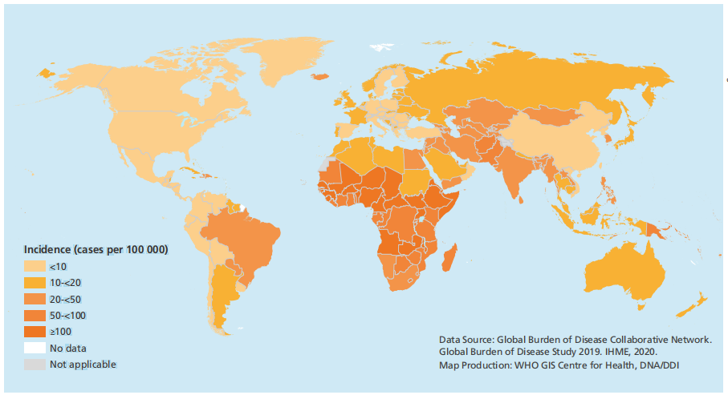
WHO: Defeating meningitis by 2030
elimination of bacterial meningitis epidemics
reduction of cases of vaccine-preventable bacterial meningitis by 50% and deaths by 70%
reduction of disability and improvement of quality of life after meningitis

Slide 2
Collecting cases 260
Disease group 160
Control group 100
Bacterial Meningitis group 70
Viral Meningitis group 90
1
2
3
Analyzing difference among these groups and establish ROC to estimate utilization
Using flow cytometry to test 12 cytokines of CSF, retrospect
Routine biochemical indexes in CSF
Bacterial or Viral culture
Polymerase Chain Reaction
High-Throughput Sequencing
The positivity rate is about 25.6% -33.6%
False positives caused by contamination bacteria or viral interference
Positive results must exclude interference, negative results cannot exclude infection
Constructing models based on screening indicators and comparing their discriminatory efficacy
Validate the optimal model

