Slide 1
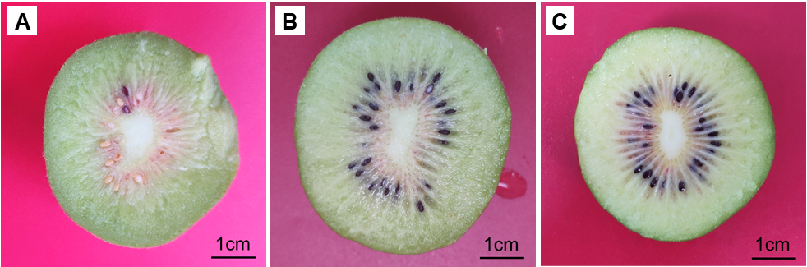
Supplementary Fig. S1. Kiwifruit samples representing different ripening stages. Cross-sections are shown for a young fruit (A), a turning fruit (B), and a mature fruit (C).

