Slide 1
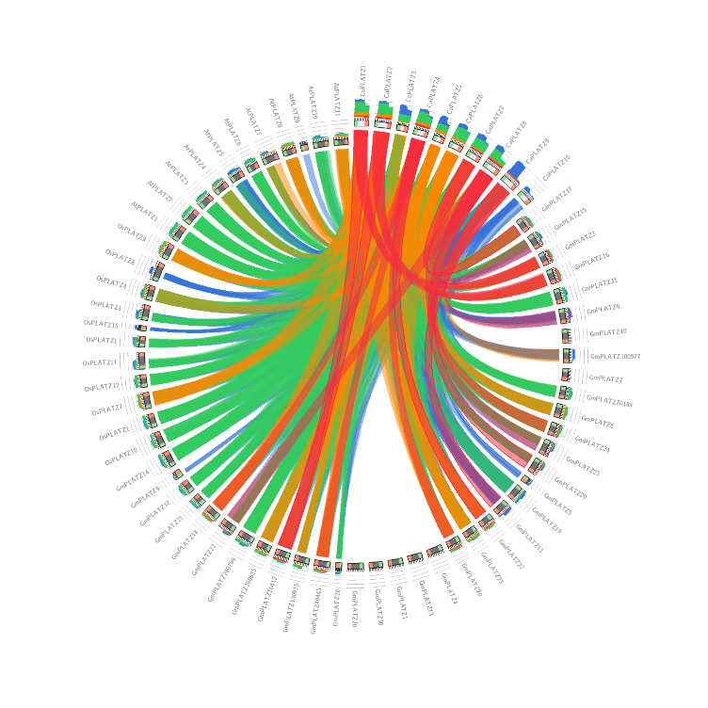
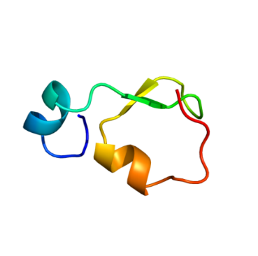
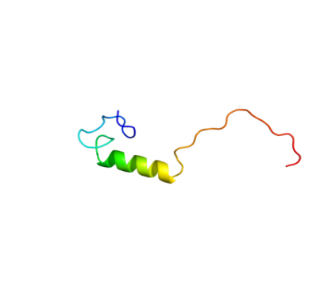

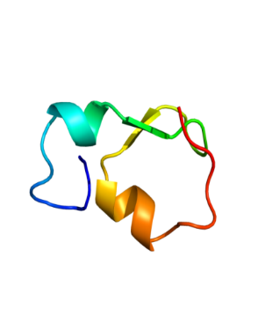
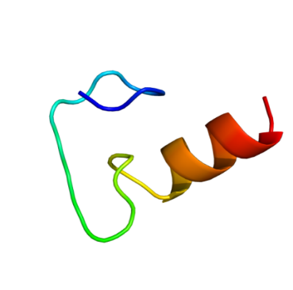
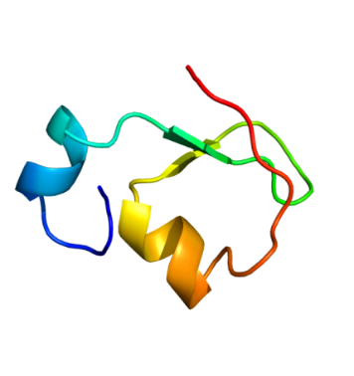
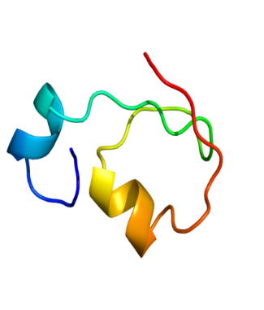
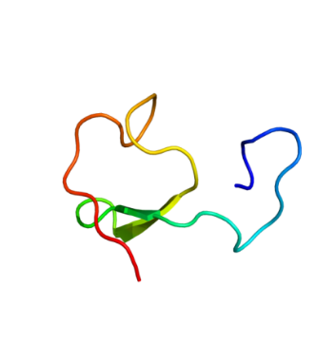
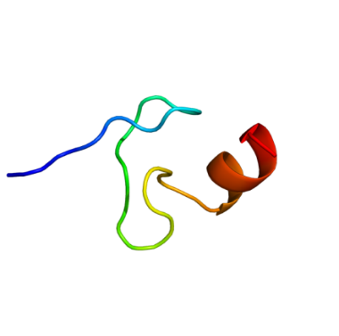
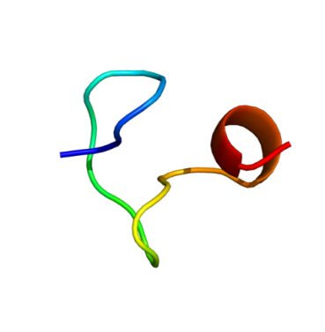
CaPLATZ1
CaPLATZ2
CaPLATZ3
CaPLATZ4
CaPLATZ5
Fig. S1. Circos-based syntenic relationship plot
CaPLATZ6
CaPLATZ7
CaPLATZ8
CaPLATZ9
CaPLATZ10
Fig. S2. Predicted 3D structures of CaPLATZ proteins

Slide 2
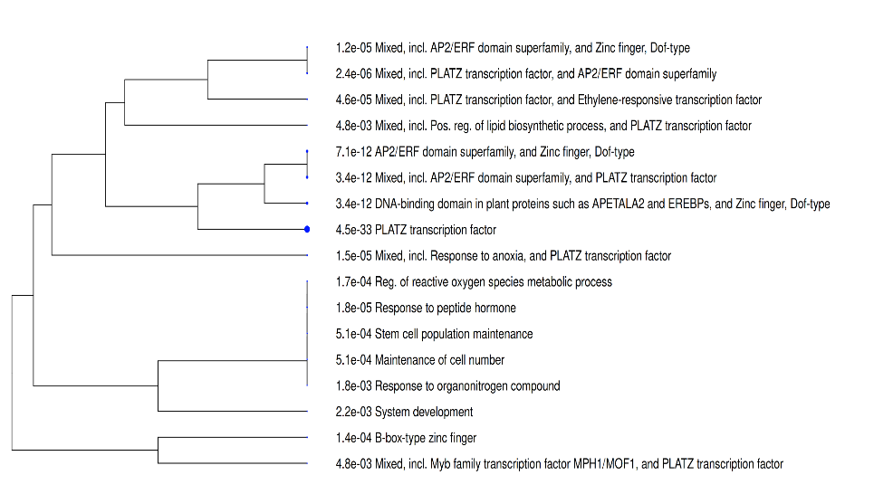
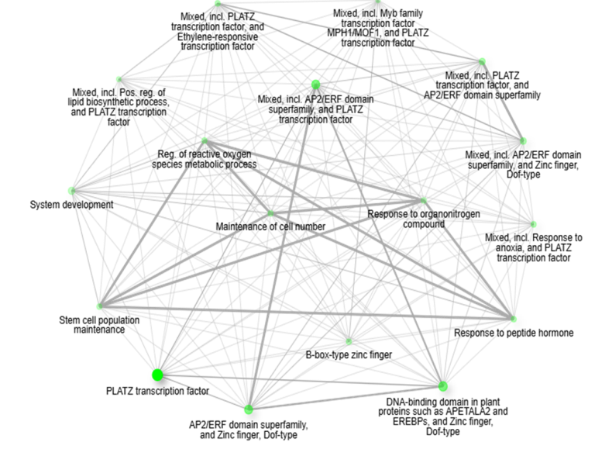
Fig. S3. Hierarchial clustering tree of CaPLATZ gene
Fig. S4. Functional interaction network of CaPLATZ and other Transcription factors

Slide 3
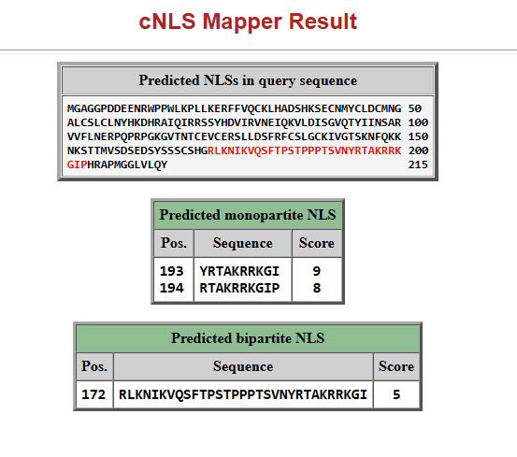
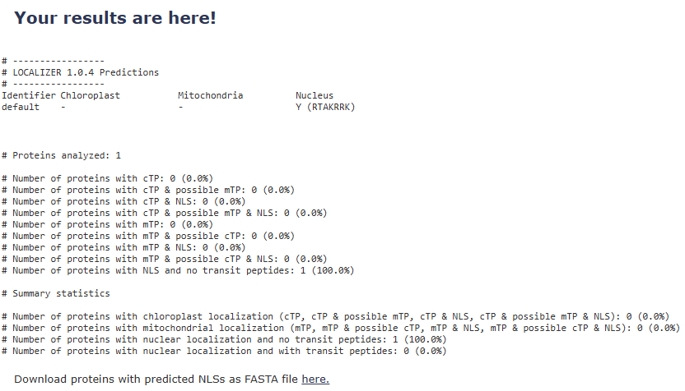
Fig S5. In silico prediction of nuclear localization signals in CaPLATZ1.
(A) Nuclear localization signals (NLSs) in the CaPLATZ1 protein were predicted using cNLS Mapper. Two overlapping monopartite NLSs were identified near the C-terminal region: YRTAKRRKGI beginning at amino acid position 193 with a score of 9.0, and RTAKRRKGIP beginning at position 194 with a score of 8.0. A bipartite NLS, RLKNIKVQSFTPSTPPPTSVNYRTAKRRKGI, was additionally predicted beginning at amino acid position 172 with a score of 5.0. (B) Independent analysis using LOCALIZER v1.0.4 predicted nuclear localization of CaPLATZ1 based on the basic RTAKRRK motif. No chloroplast transit peptide or mitochondrial targeting peptide was detected. Together, the two independent prediction approaches support a putative nuclear localization of CaPLATZ1.

