Slide 1
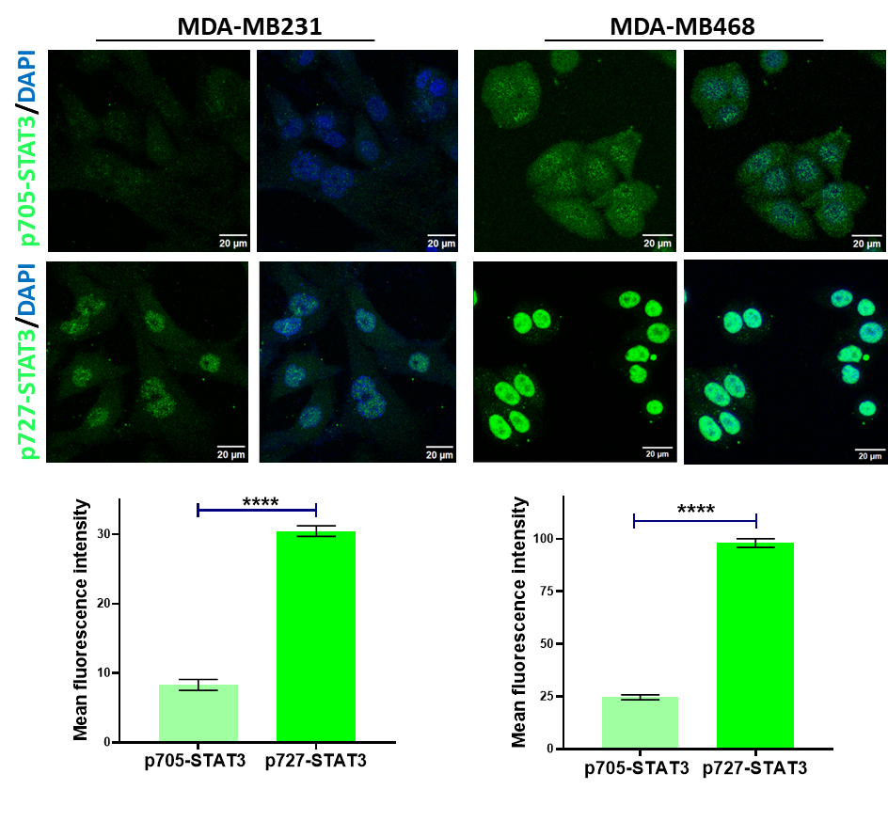
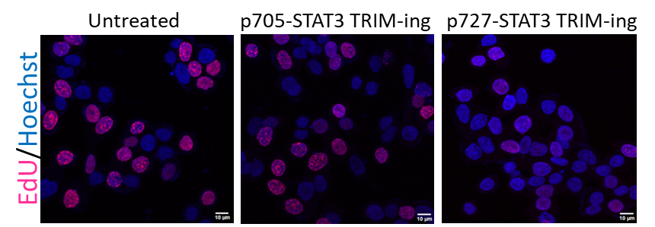
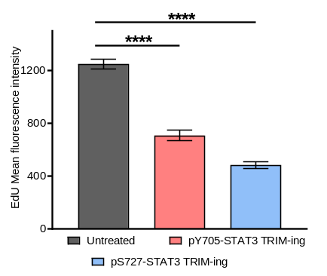
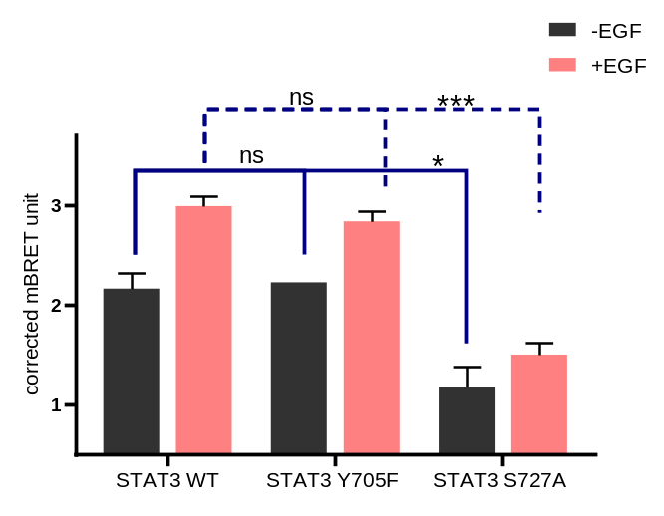


a.
b.
c.
d.
Suppl. Fig. 1. p727-STAT3 is overactivated and dominant in TNBC cells. (a). Immunofluorescence images and quantitative graphs for pY705-STAT3 (green), pS727-STAT3 (green), and DAPI (blue) in MDA-MB231 (left) and MDA-MB468 (right) cells. (n= 30) (b). Immunofluorescence images and quantitative graph for the EdU assay show the effect of pY705 and pS727-STAT3 TRIM-ing on TNBC cell proliferation in MDA-MB468 cells. (n= 30) (c). Cartoons for phospho-STAT3 Y705F and S727A BRET mutant constructs. (d). BRET assay for Y705F and S727A STAT3 mutants post-EGF treatment (n=3). Error bars represent ± standard deviation. *P < 0.05; **P < 0.01; ***P < 0.001, ****P < 0.0001; ns non-significant.
Notes:
Supplementary Figure 1. p727-STAT3 is overactivated and dominant in TNBC cells. (a). Immunofluorescence images and quantitative graphs for pY705-STAT3 (green), pS727-STAT3 (green), and DAPI (blue) in MDA-MB231 (left) and MDA-MB468 (right) cells. (b). Immunofluorescence images and quantitative graph for EdU assay show the effect of pY705 and pS727-STAT3 Trim-Away on TNBC cell proliferation in MDA-MB468 cells. (c). Schematic for phospho-STAT3 BRET assay with STAT3 mutant constructs. (d). BRET assay for Y705F and S727A STAT3 mutants post-EGF treatment. Error bars represent ± standard deviation. *P < 0.05; **P < 0.01; ***P < 0.001, ****P < 0.0001; ns non-significant.

Slide 2
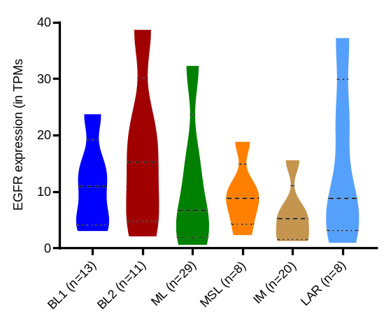
a.
Suppl. Fig. 2. (a). Graph for EGFR expression in different TNBC subtypes from the ULCAN database

Slide 3
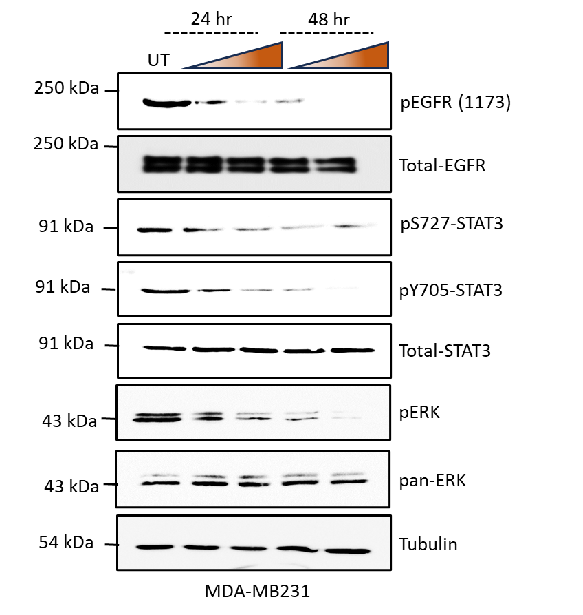
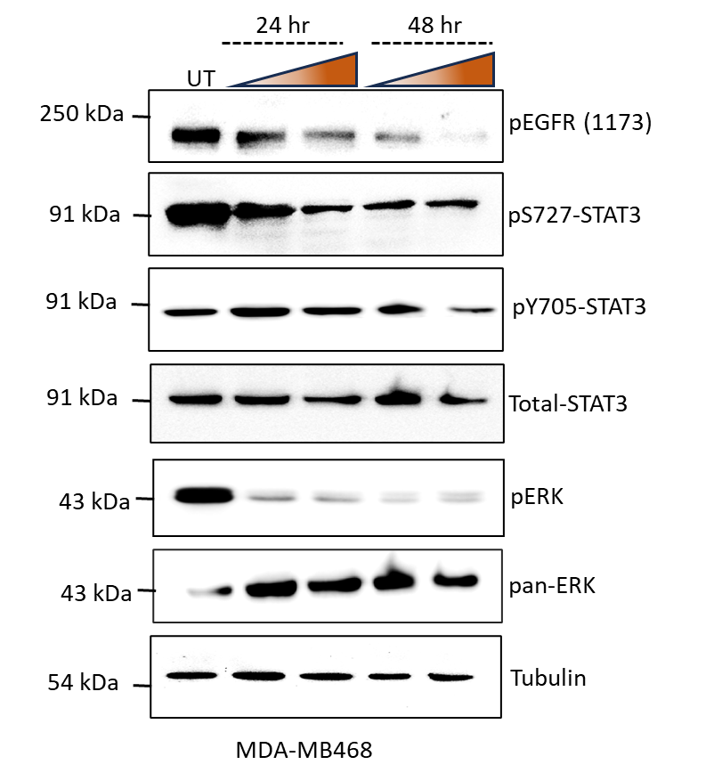
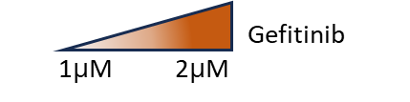
a.
Suppl. Fig. 3. (a). Western blot showing levels of pEGFR, total-EGFR, p705-STAT3, p727-STAT3, total-STAT3, phospho-ERK, pan-ERK, and tubulin post-gefitinib treatment in the MDA-MB231 (left) and MDA-MB468 (right) cell lines.
Notes:
Supplementary Figure 2. (a-b) Western blot showing levels of pEGFR, total-EGFR, p705-STAT3, p727-STAT3, total-STAT3, phospho-ERK, pan-ERK, and tubulin post-gefitinib treatment in MDA-MB231 and MDA-MB468 cells.

Slide 4
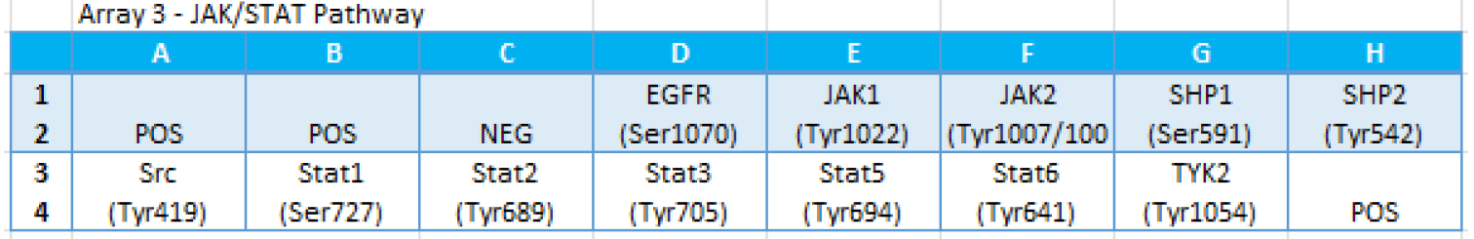
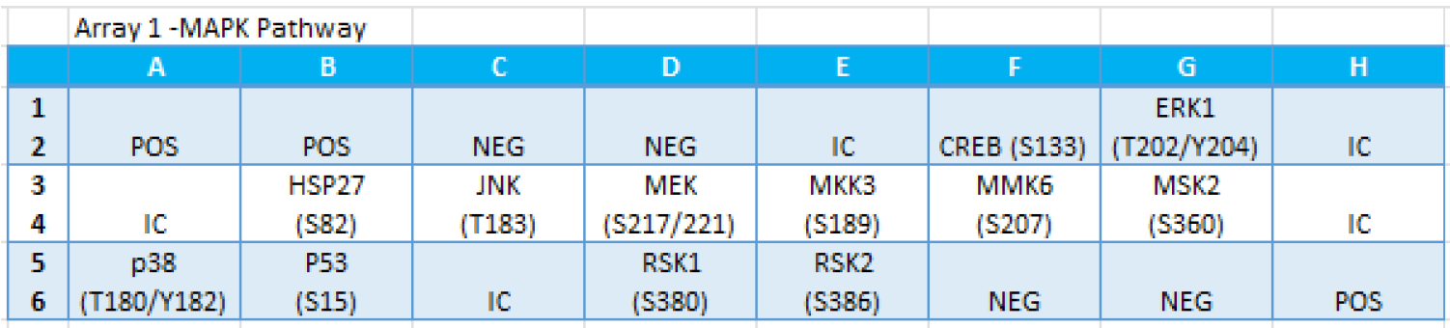
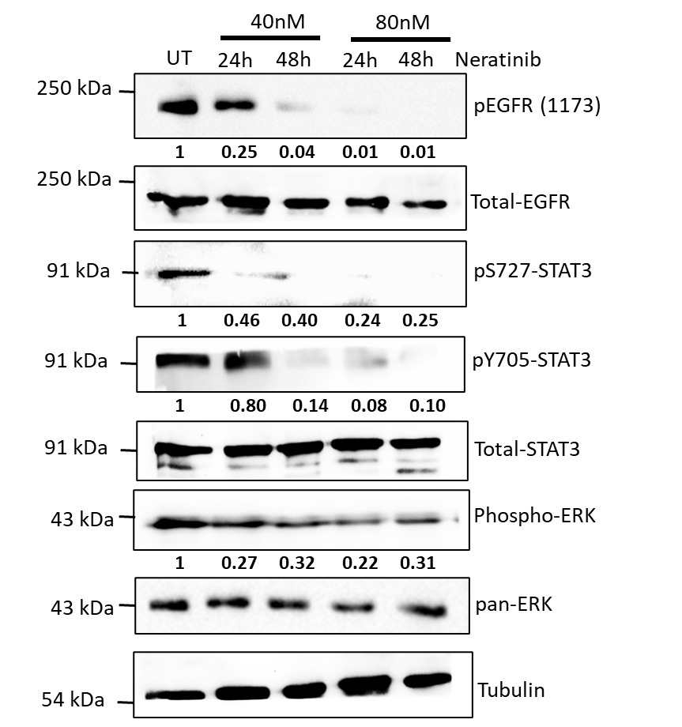
a.
b.
c.
Suppl. Fig. 4. (a, b). Maps for the JAK/STAT and MAPK phospho-proteome arrays, respectively. (c). Western blot showing levels of pEGFR, total-EGFR, p705-STAT3, p727-STAT3, total-STAT3, phospho-ERK, pan-ERK, and tubulin post-Neratinib treatment in the MDA-MB231 cell line.
Notes:
Supplementary Figure 3. Array Maps for JAK-STAT and MAPK pathway, respectively.

Slide 5
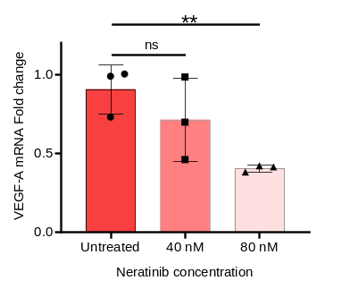
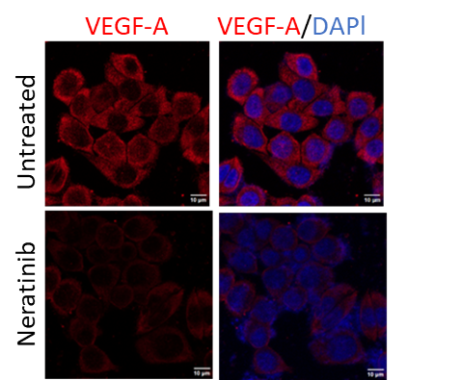
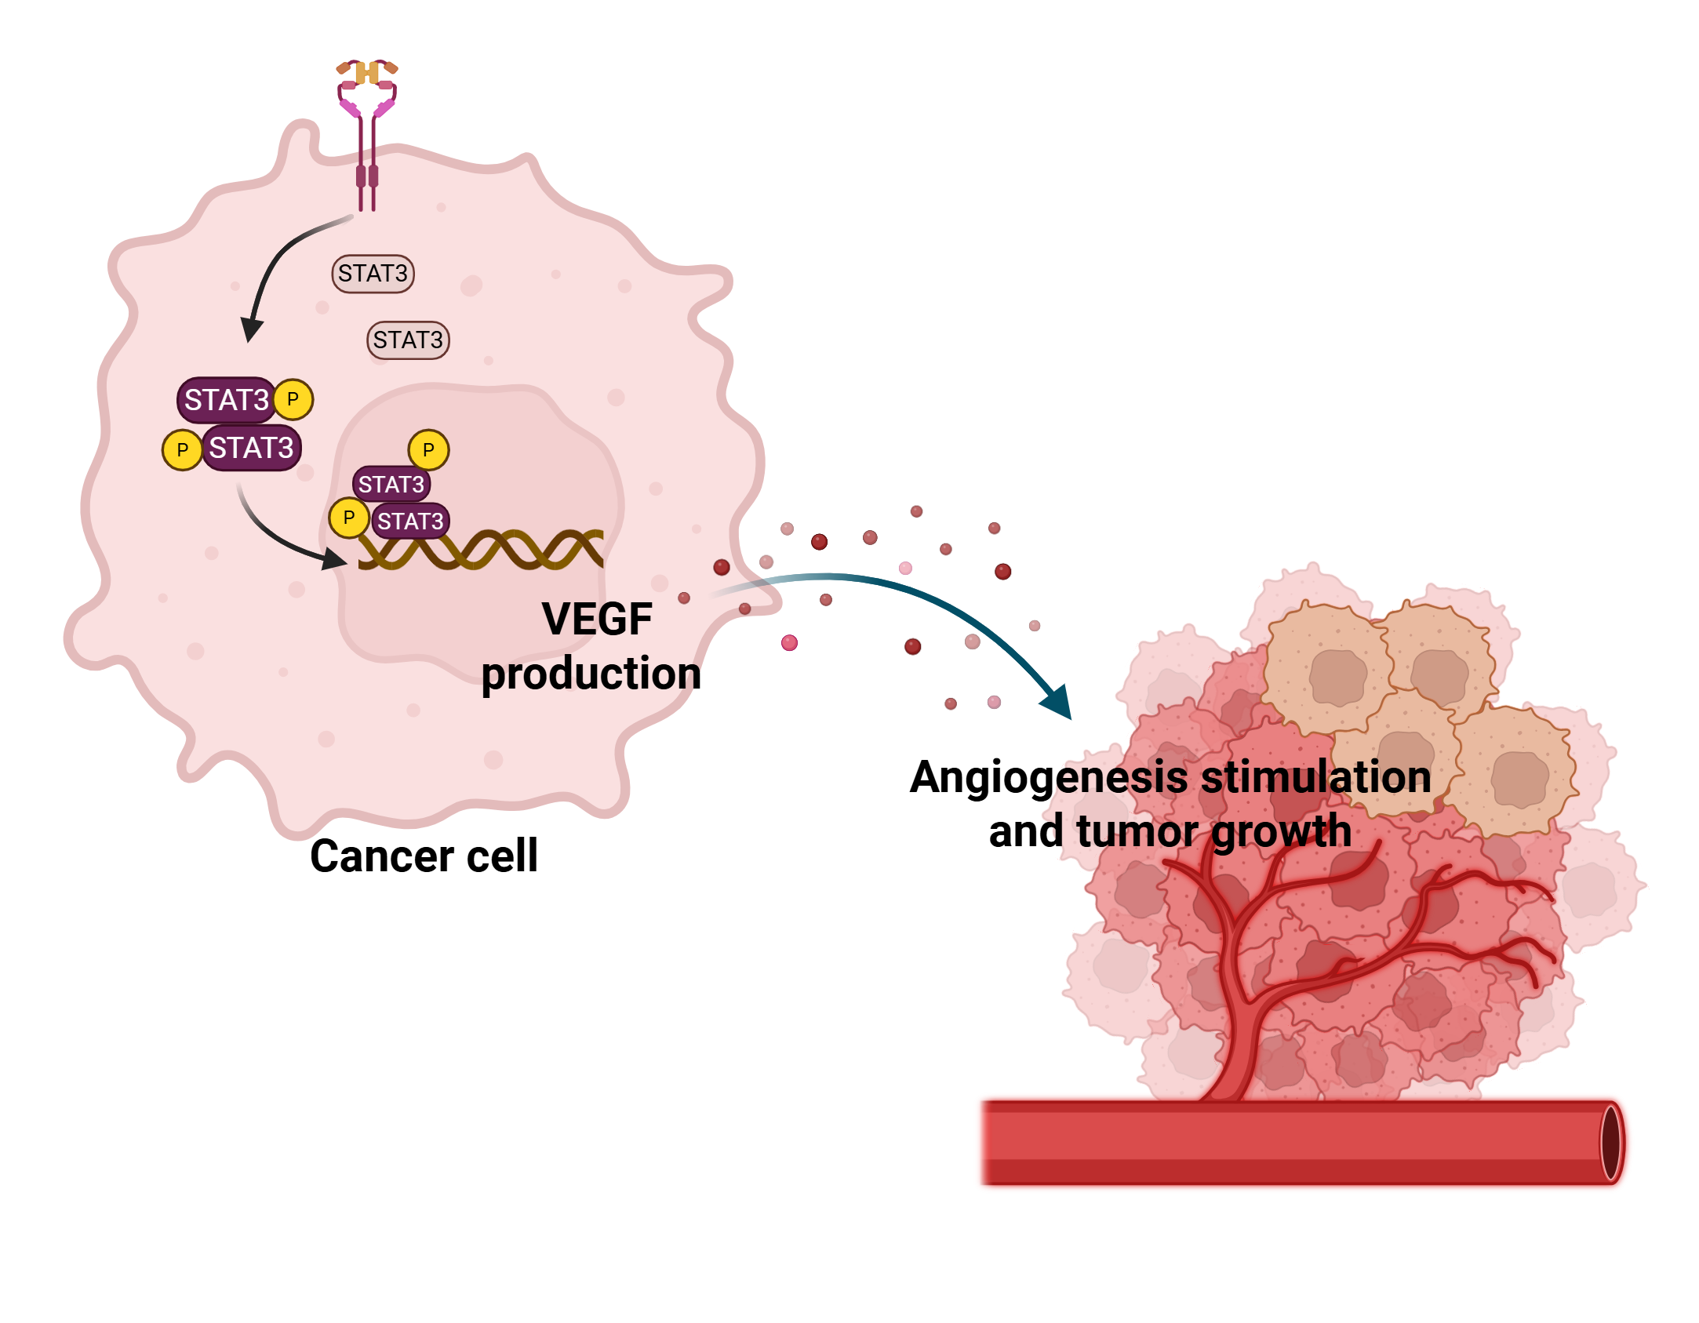
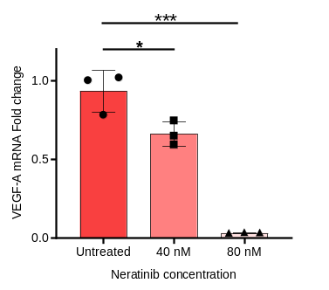
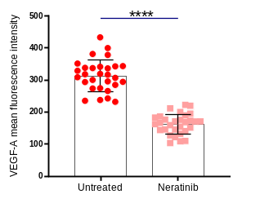
a.
b.
d.
Neratinib
c.
Suppl. Fig. 5. (a) Schematic for the effect of Neratinib on STAT3-mediated VEGF production and tumor angiogenesis. (b-c). Graphs for VEGF RNA expression post-Neratinib treatment in MDA-MB231 (upper) and MDA-MB468 (lower) cell lines. (d). Immunofluorescence images (upper) and quantitative graph (lower) for VEGF protein expression post-Neratinib treatment in MDA-MB468 cell lines. Scale bar represents 20µM. *P < 0.05; **P < 0.01; ***P < 0.001, ****P < 0.0001; ns non-significant.
Notes:
Figure 8. Effect of Neratinib on tumor angiogenesis in TNBC xenograft model. (a-b). Graphs for fold change in VEGF mRNA expression post Neratinib treatment in MDA-MB231 and MDA-MB468 cell lines. (c). Immunofluorescence images and quantitative graph for VEGF-A protein expression post Neratinib treatment in MDA-MB468 cells (n=30). (d). IHC images of tumor sections stained for CD31 and VEGF expression from the vehicle control and Neratinib-treated groups. (e). Western blot from tumor samples of the vehicle control and Neratinib-treated group for CD31 and tubulin. (f). Schematic for the effect of Neratinib on STAT3-mediated tumor angiogenesis.

