Slide 1
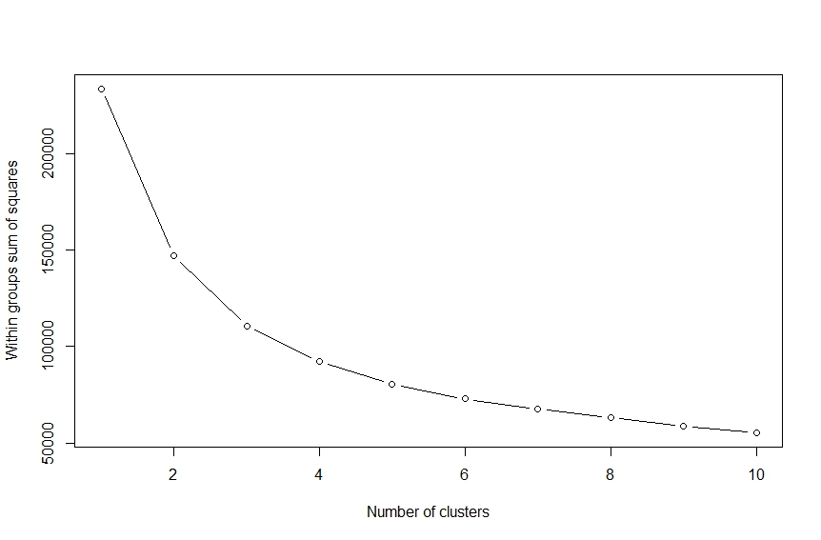
Fig.S1. K-means clustering elbow rule graph. The horizontal axis represents the number of clusters K, and the vertical axis represents the sum of squares within groups(WSS).

Slide 2
Fig.S2. Volcano plot of differentially expressed genes at 0, 10, 15, 20DPA.

Slide 3
Fig.S3. GO enrichment analysis of DEGs at 0, 10, 15, and 20 DPA.

