Slide 1
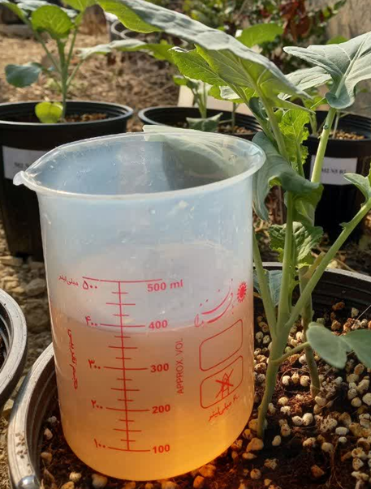
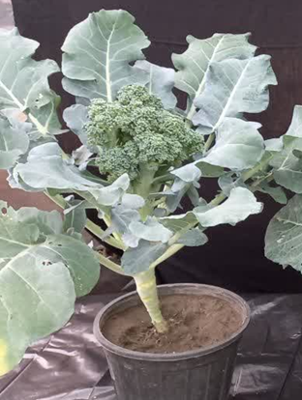
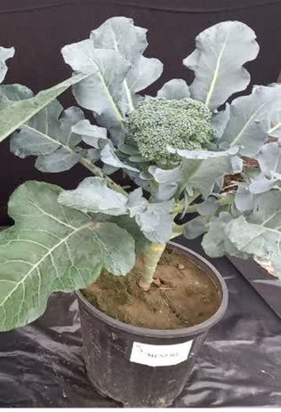
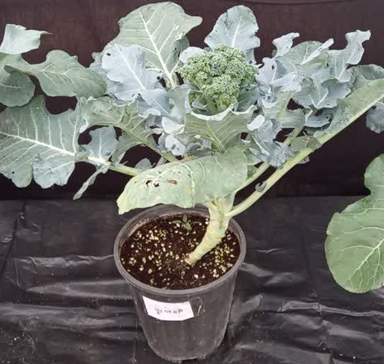
Growth Medium
Nutrient Solution
Curd Weight (g)
Day from Transplanting to Harvest
Sand
Hoagland
142.0
86.7
SANRU
170.7
87.0
SANRU+KH2PO4
222.8
84.66
Silty-Sand
135.5
88.7
Hoagland
SANRU
157.3
86.3
SANRU+KH2PO4
202.3
85.3
Coir Fiber + Perlite
Hoagland
136.3
87.3
SANRU
211.8
86.7
SANRU+KH2PO4
246.4
82.7

