Slide 1
3 cm apart
Upper
Water
3 cm apart
Middle
Ti
Lower
Water
Treatment (i)
Upper
ARK-1
Middle
Ti
Lower
ARK-1
Treatment (ii)
5 dai
Upper
Water
Middle
Ti
Lower
Water
Treatment (iii)
5 dai
Upper
ARK-1
Middle
Ti
Lower
ARK-1
Treatment (iv)
Fig. S1
Kawaguchi et al.

Slide 2
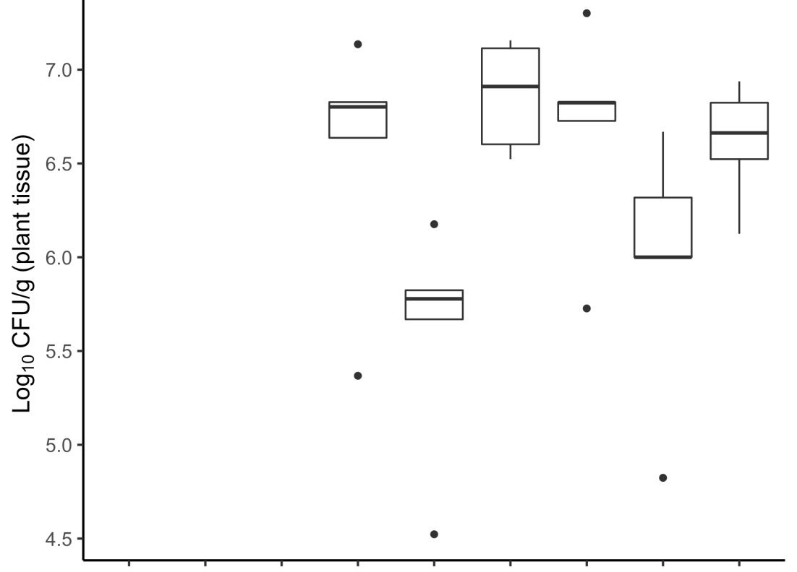
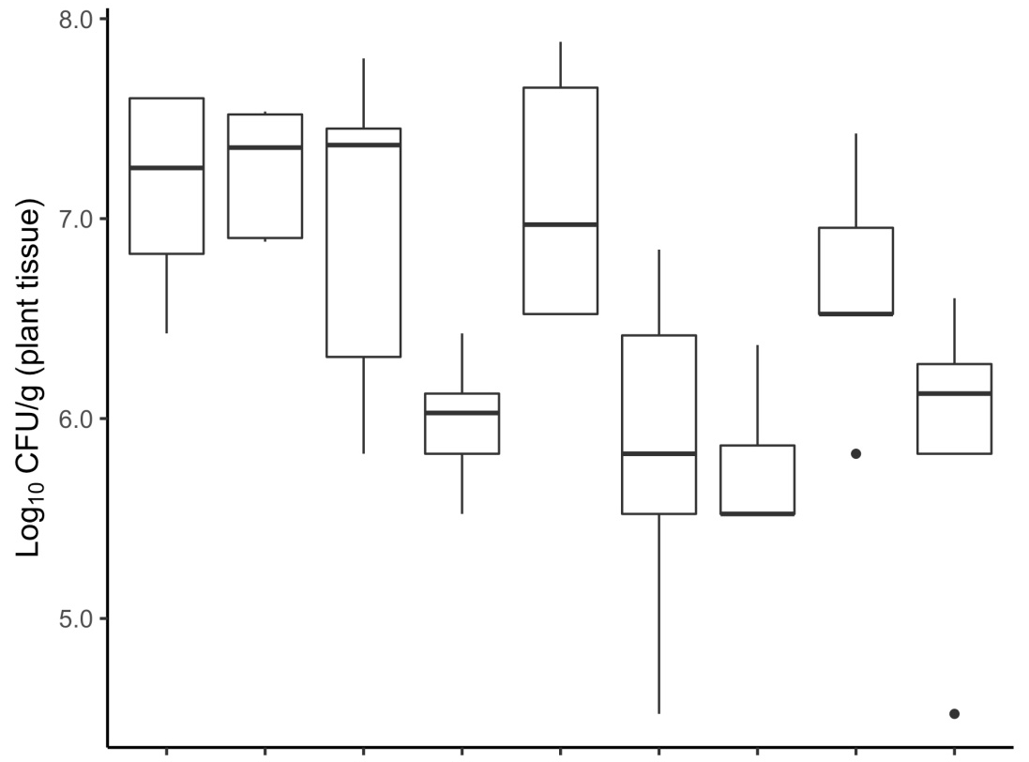
A
a
ab
ab
ab
ab
b
N.D.
N.D.
N.D.
B
ab
ab
a
a
ab
bc
ab
abc
c
Inoculum
W
Ti
W
ARK
Ti
ARK
ARK
Ti
ARK
Position
U
M
L
U
M
L
U
M
L
Treatment
(i)
(ii)
(iv)
Fig. S2
Kawaguchi et al.

Slide 3
Table S1
Kawaguchi et al.

Slide 4
Fig. S2
Kawaguchi et al.

