Slide 1
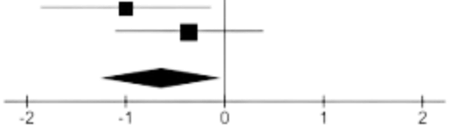
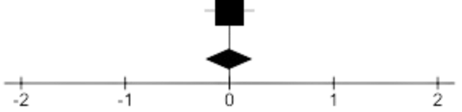
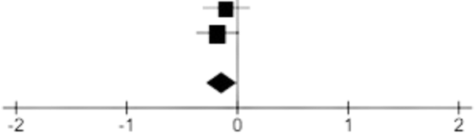
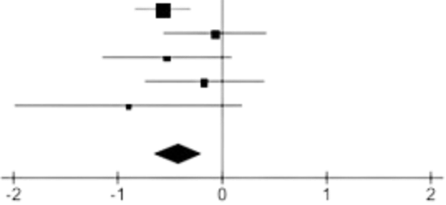
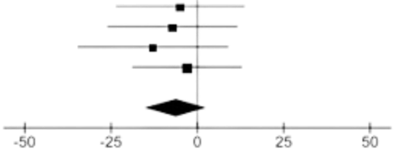

Effects of Mulberry Leaf Supplementation on Cardiometabolic Markers: A Systematic Review and Meta-Analysis
Non-Diabetic HbA1c
Pre-Diabetic HbA1c
Diabetic HbA1c
HOMA-IR
5.7 % ≤ A1c < 6.5%
5.7% < A1c
A1c ≥ 6.5%
1 RCT
n = 44
2 RCTs
5 RCTs
n = 119
n = 277
HOMA-IR Mean Difference: -0.64
[-1.27, -0.02]
A1c Mean Difference: -0.00% [-0.24, +0.24]
A1c Mean Difference: -0.14% [-0.28, -0.00]
A1c Mean Difference: -0.42% [-0.66, -0.18]
LDL-C
Increasing Baseline HbA1c
LDL-C Mean Difference: -6.21 mg/dL
[-15.37, 2.94]
Summary
Cardiometabolic benefits
Improved HbA1c and HOMA-IR
Favorable trend in LDL-C
All Mulberry Leaf Trials
8 RCTs, n = 440
Alternative A1c, HOMA-IR, and LDL-C lowering natural product
Notes:
Size 0 pill: 21.7 mm length, 7.65 mm diameter - 21.7/2-7.65/2 = 7.025 mm, 5% scale 0.3825 in dia, 0.35125 length

