Slide 1
Fig 1 AXL EXPRESSION
Achn
Shikonin (μM)
NAC (5 mM)
0 4 6 8 0 4 6 8
- - - - + + + +
110 kDa

Slide 2
Fig 1 AXL EXPRESSION
Caki-1
Shikonin (μM)
NAC (5 mM)
0 4 6 8 0 4 6 8
- - - - + + + +
110 kDa

Slide 3
Fig 1 GAPDH EXPRESSION
Achn
0 4 6 8 0 4 6 8
- - - - + + + +
35 kDa

Slide 4
Fig 1 GAPDH EXPRESSION
Caki-1
Shikonin (μM)
NAC (5 mM)
0 4 6 8 0 4 6 8
- - - - + + + +
35 kDa

Slide 5
Fig 2A AXL Expression
Achn
Caki-1
NC sh-AXL sh-AXL NC sh-AXL sh-AXL
574 575 574 575
110 kDa

Slide 6
Fig 2A GAPDH
Achn
Caki-1
NC sh-AXL sh-AXL NC sh-AXL sh-AXL
574 575 574 575
35 kDa

Slide 7
Fig 3C PARP
Achn
Caki-1
NC NC sh-AXL sh-AXL NC NC sh-AXL sh-AXL
575 575 575 575
Shikonin (μM) 0 2 0 2 0 2 0 2
110 kDa
85 kDa

Slide 8
Fig 3C tubulin
Achn
Caki-1
NC NC sh-AXL sh-AXL NC NC sh-AXL sh-AXL
575 575 575 575
Shikonin (μM) 0 2 0 2 0 2 0 2
56 kDa

Slide 9
Fig 4A HIF-1α expression
Achn
Shikonin (μM)
NAC (5 mM)
0 4 6 8 0 4 6 8
- - - - + + + +
110 kDa

Slide 10
Fig 4A HIF-1α expression
Caki-1
Shikonin (μM)
NAC (5 mM)
0 4 6 8 0 4 6 8
- - - - + + + +
110 kDa

Slide 11
Fig 4A GAPDH expression
Achn
Shikonin (μM)
NAC (5 mM)
0 4 6 8 0 4 6 8
- - - - + + + +
36 kDa

Slide 12
Fig 4A GAPDH expression
36 kDa

Slide 13
Fig 4B AXL expression
Achn
Shikonin (μM)
MG132
0 4 6 0 4 6
- - - + + +
110 kDa

Slide 14
Fig 4B GAPDH expression
Achn
Shikonin (μM)
MG132
0 4 6 0 4 6
- - - + + +
36 kDa

Slide 15
Fig 4B AXL expression
Caki-1
Shikonin (μM)
MG132
0 4 6 0 4 6
- - - + + +
110 kDa

Slide 16
Fig 4B GAPDH expression
Caki-1
Shikonin (μM)
MG132
0 4 6 0 4 6
- - - + + +
36 kDa

Slide 17
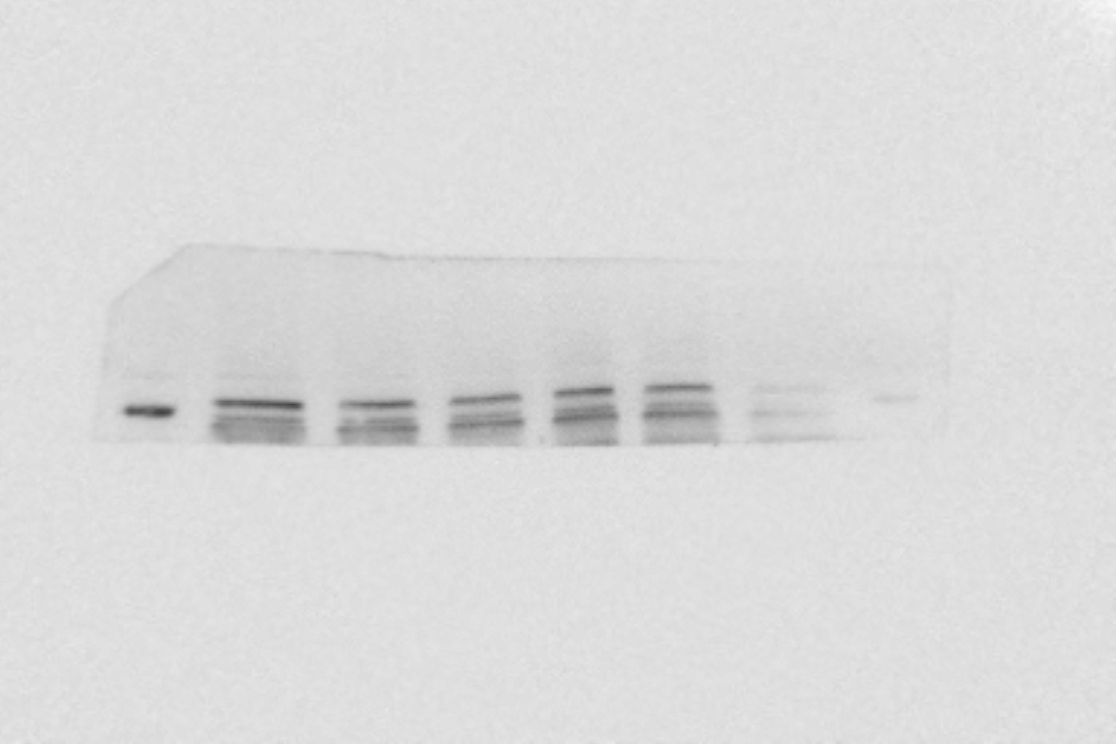
Fig 4B HIF-1 α expression
Achn
Shikonin (μM)
MG132
0 4 6 0 4 6
- - - + + +
110 kDa

Slide 18
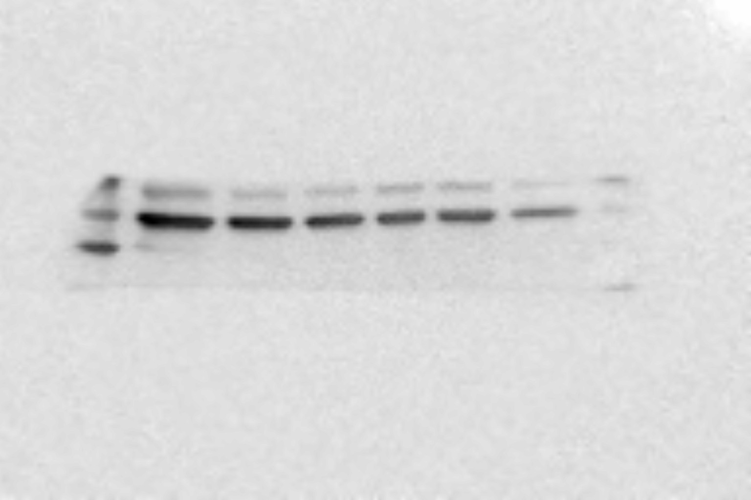
Fig 4B GAPDH expression
Achn
Shikonin (μM)
MG132
0 4 6 0 4 6
- - - + + +
36 kDa

Slide 19
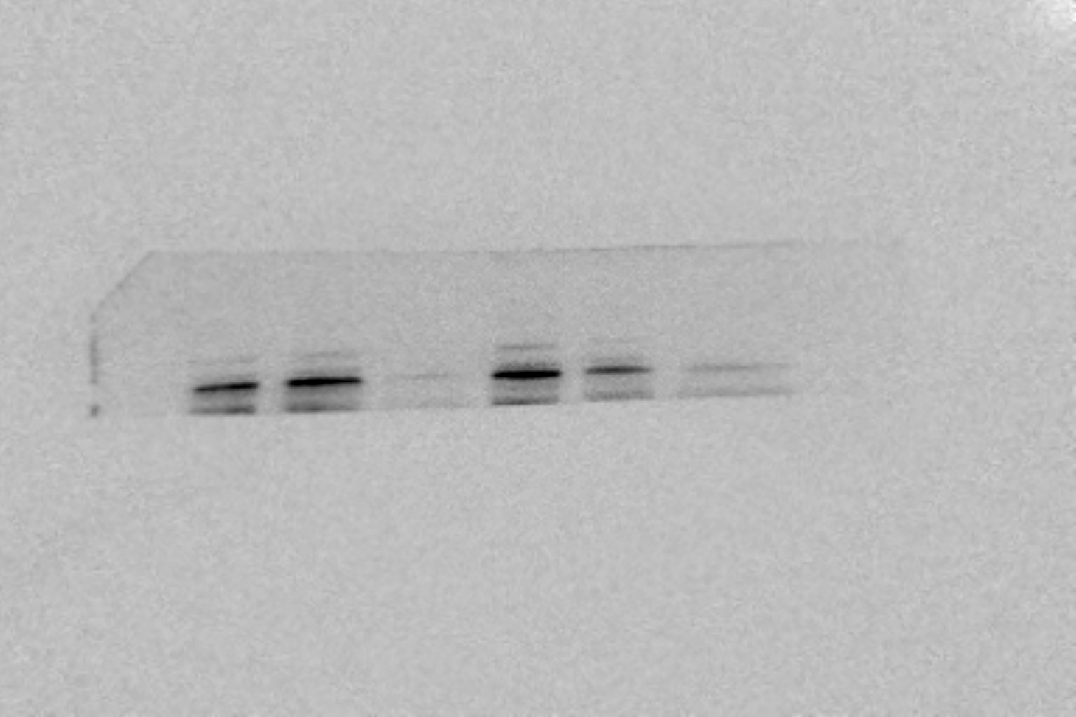
Fig 4B HIF-1 α expression
Caki-1
Shikonin (μM)
MG132
0 4 6 0 4 6
- - - + + +
110 kDa

Slide 20
Fig 4B GAPDH α expression
Caki-1
Shikonin (μM)
MG132
0 4 6 0 4 6
- - - + + +
36 kDa

