Slide 1
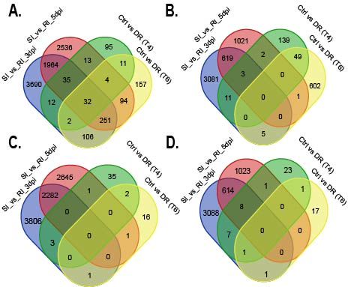
Supplementary Figure 1: Venn diagrams displaying the overlaps between up-regulated and down-regulated DEGs identified in the comparison between resistant versus susceptible isolines targeting the 3BL locus with DEGs responsive to drought in wheat. Panel A displays the overlap between up-regulated SI vs RI DEGs (3dpi and 5dpi) and Panel B displays down-regulated SI vs RI DEGs versus DEGs downregulated under drought (T4 and T6). Panel C displays the overlap between up-regulated SI vs RI DEGs (3dpi and 5dpi) and Panel D displays down-regulated SI vs RI DEGs versus DEGs up-regulated under drought (T4 and T6).

Slide 2
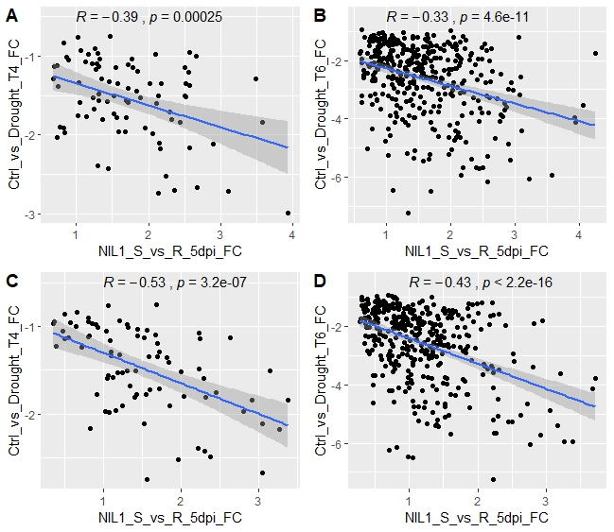
Supplementary Figure 2: Scatterplots showing the correlation between DEG expression values for SI vs RI up-regulated genes versus genes down-regulated under drought. Panels A and C compare 3dpi SI vs RI up-regulated genes with drought T4 and drought T6 down-regulated genes respectively. Panels B and D compare 5dpi SI vs RI up-regulated genes with drought T4 and drought T6 down-regulated genes, respectively. r values show the correlation co-efficient (Pearson) between DEG expression values. Axes display the log² differential expression fold-changes for SI vs RI (x-axis) versus log² differential expression fold-changes under drought (y-axis). Blue lines represent the line of best fit and shading shows the pointwise 95% confidence interval of the regression.

