Slide 1
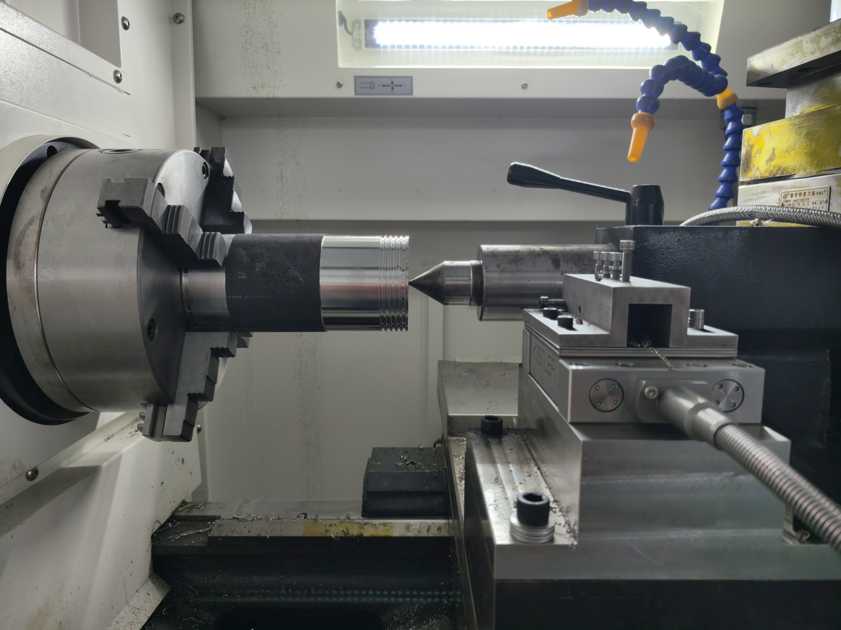








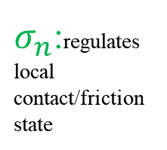
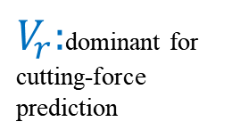
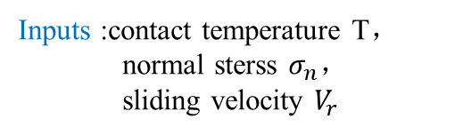

1
Coupled friction model
2
Inverse parameter identification
3
Model validation
4
Factor decomposition
FE model setup
Force error:20.8% 5.55%
$V_{r}:$dominant for cutting-force prediction
Experiments
Chip serration degree
Serrated chip
Abaqus FEM
T:affects thermal softening and chip segmentation
Abaqus–Python–Isight optimization
$$τ_{f}=μ(T,σ_{n},V_{r})∙σ_{n}$$
$σ_{n}$:regulates local contact/friction state
Inputs :contact temperature T，
normal sterss $σ_{n}，$
sliding velocity $V_{r}$
Optimal parameters
Serrated chip morphology reproduced
Framework:coupled model inverse identification validation mechanism insight

