Slide 1
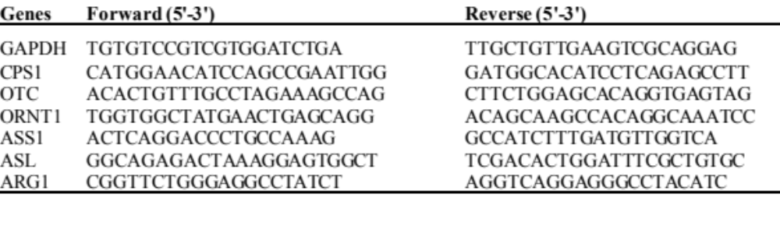
Notes:
Table S1. The sequences of primers used in the present study.
GAPDH, glyceraldehyde 3-phosphate dehydrogenase; CPS1, carbamoyl-phosphate synthase 1; OTC, ornithine transcarbamylase; ORNT1, mitochondrial ornithine transporter; ASS1, arginosuccinate synthase 1; ASL, arginosuccinate lyase; ARG1, arginase 1.

