Slide 1
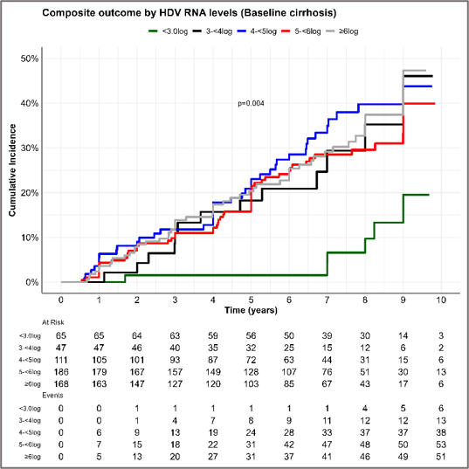
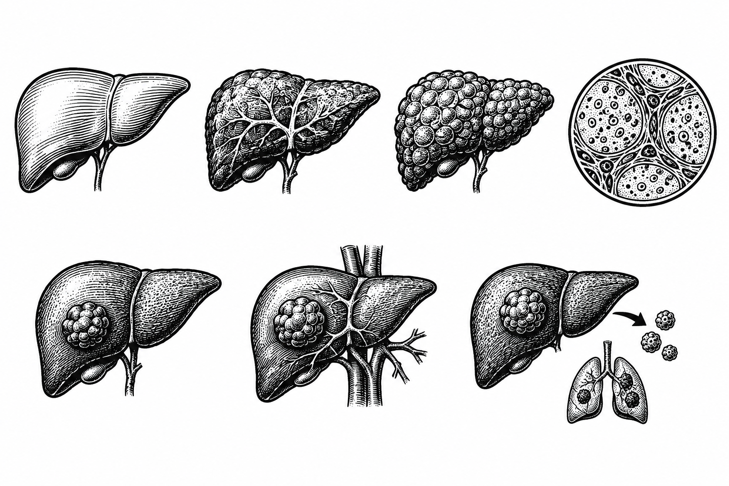


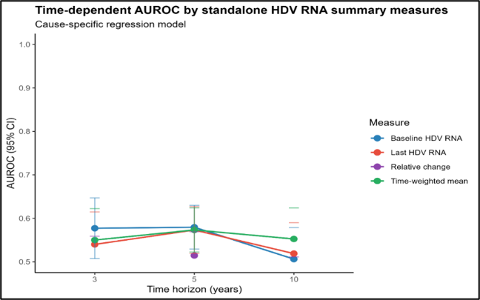
HDV RNA level shows a threshold pattern for liver disease progression but has limited prognostic value alone in chronic hepatitis D
Age (aHR=1.1)
Chronic hepatitis D (CHD) is associated with accelerated progression to cirrhosis.
We studied the association of HDV RNA levels and other liver-related parameters with the incidence of cirrhosis and major liver-related events.
Cirrhosis (aHR=2.6)
Smoking (aHR=1.8)
Low albumin (aHR=1.8)
High GGT (aHR=2.1)
Low platelets (aHR=2.1)
LSM (aHR=1.03)
A retrospective cohort study enrolling 2,447 patients with CHD (HDV RNA ≥50 IU/mL) from 2015 to 2025.
Single secondary-care center, Mongolia
Median follow-up is 7.3 (range; 0.6-12.7) years.
HBeAg+
(aHR=1.29)
High HDV RNA (aHR=2.4)
AUROC <0.70
HBV DNA (aHR=0.88)
Predictors of liver-events; aHR=adjusted hazard ratio
Conclusion:
HDV RNA levels showed a threshold, not a dose-response, association with HCC and liver-related events, with limited prognostic accuracy alone.
Adding other liver-related parameters improved risk stratification, potentially guiding monitoring, patient counselling and treatment decisions.

