Slide 1
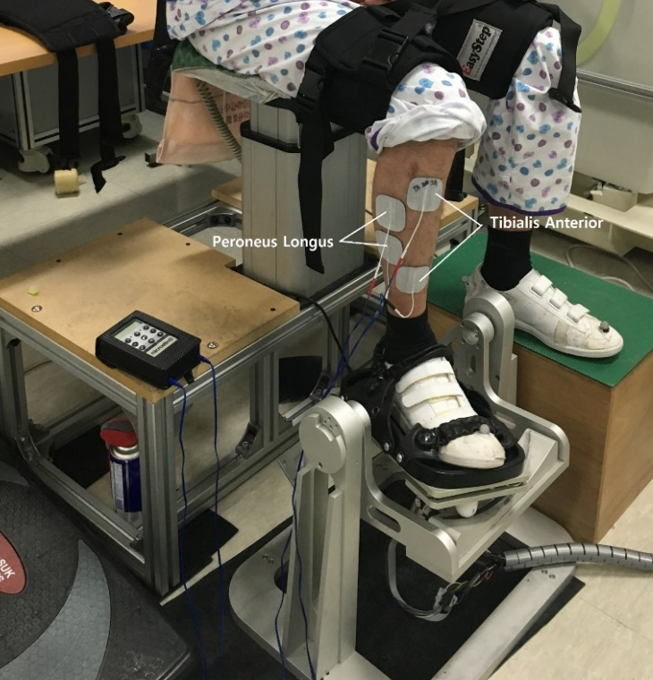
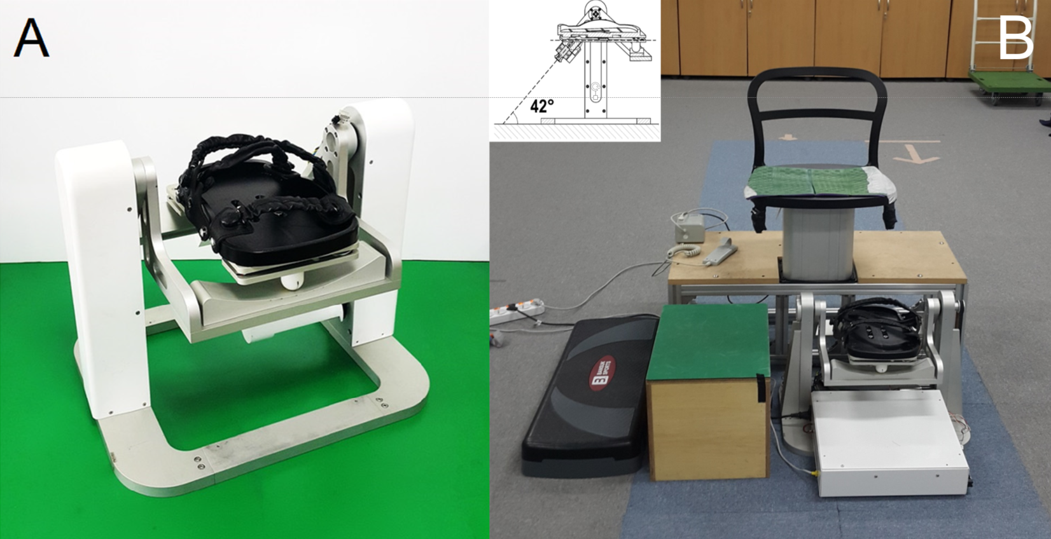
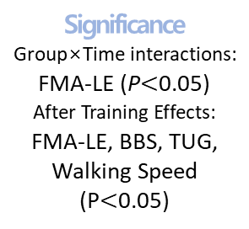
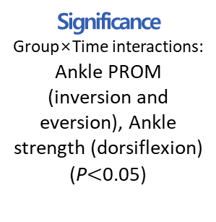
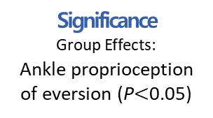

Objectives
Effects of Biaxial AMT-EST
in Chronic Stroke Patients
Main Findings
To find the effects of passive biaxial ankle movement training synchronized with electrical stimulation therapy (AMT-EST) to corresponding muscles on proprioception, strength, balance, and gait in chronic stroke patients.
Figure 1 Ankle Movement Training Device
Figure 2 Ankle movements training protocol
Primary Outcomes
Primary Outcomes
Secondary Outcomes
Correlations
with
Participants
Ankle Proprioception
Ankle ROM & Strength
Functional Abilities
Ankle Proprioception
Significance
Group Effects:
Ankle proprioception of eversion (P$<$0.05)
Significance
Group×Time interactions:
Ankle PROM (inversion and eversion), Ankle strength (dorsiflexion)
(P$<$0.05)
Significance
Group×Time interactions:
FMA-LE (P$<$0.05)
After Training Effects:
FMA-LE, BBS, TUG, Walking Speed (P$<$0.05)
Significance
Chronic Stroke
Ankle PROM (eversion)
Ankle Strength (dorsiflexion, eversion)
BBS
FMA-LE
30 stroke patients completed the trials
Group1 (Age: 51.8±12.0yrs, onset: 11.6±4.1months)
Group2 (Age: 55.0±10.9yrs, onset: 8.6±3.9months)
(0.3$≤$r$<$0.5, P$<$0.05)

