Slide 1
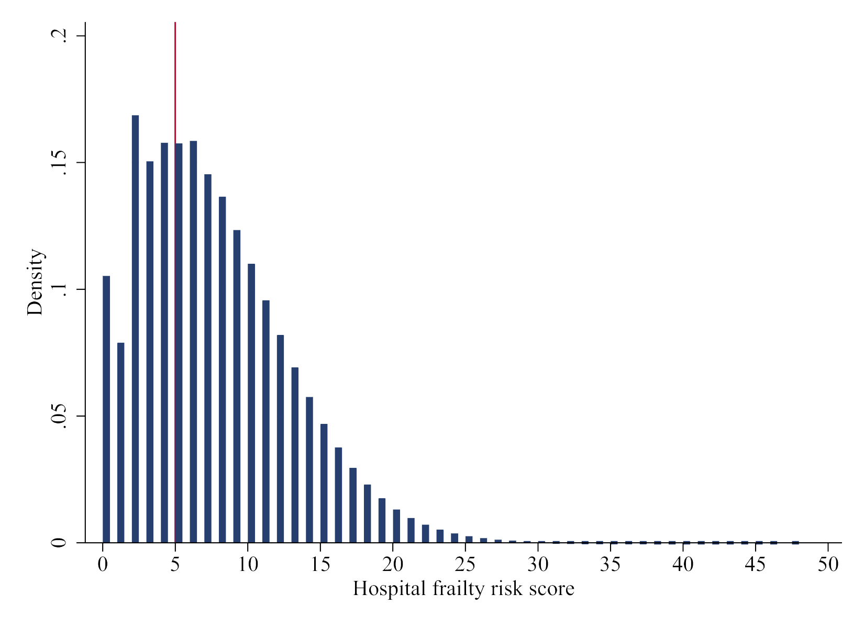

Validation of the Hospital Frailty Risk Score
among older adults receiving mechanical ventilation
Objective
Findings
To validate the Hospital Frailty Risk Score to predict prolonged hospitalization, in-hospital mortality and 30-day emergency hospital readmissions
Prolonged hospitalization:
  High frailty risk associated with adjusted odds ratio [aOR] of 5.59 (95% confidence interval [CI] 5.24-5.97) compared to low frailty risk (c-statistic 0.694, Brier score 0.216)
In-hospital mortality:
  High frailty risk associated with aOR 0.46 (95% CI 0.45-0.48), compared to low frailty risk (c-statistic 0.712, Brier score 0.214)
30-day emergency hospital readmissions:
  High frailty risk associated with aOR 1.20 (95% CI 1.13-1.27), compared to low frailty risk (c-statistic 0.595, Brier score 0.162)
Non-frail
Frail
Methods
Data Source: Nationwide Readmissions Database from January 1, 2016 to November 30, 2018
Population: 649,330 weighted index hospitalizations of older adults (age ≥75 years old) receiving invasive mechanical ventilation
Exposures: Hospitalizations classified into low, intermediate and high risks for frailty based on the Hospital Frailty Risk Score (Gilbert et al, Lancet 2018)
Analyses: Validation of the Hospital Frailty Risk Score using multivariable logistic regression, age, biological sex, income quartile, insurance status, do-not-resuscitate status, admission diagnosis, hospital characteristics, and year. Model performance assessed using the c-statistic, Brier score, and calibration plots
CONCLUSION: The HFRS is associated with prolonged hospitalization and 30-day readmissions in older adults receiving invasive mechanical ventilation.
Sy et al. 2021
Notes:
Use background eraser and magic eraser tools

