Slide 1
sBCMA_Peptides

Slide 2
Sequences of all five peptides along with their Binding Energy
Name | Sequence | Length | pTM Score | ΔG KCal/mol (Binding Energy)
sBCMA_P1_WT | GRADFLAAVIAAMAIYEKAPAEIIEAAAKAVDLLEPLSPEGKRVAELAIKIAAGEANEEEILEAAELAKELAKRAAEEGAVTEEQAQAVIDAIEEGLLK | 99 | 0.89 | -8.33
sBCMA_P2_WT | SLAETLAAQAASTAAAKAALKARGWEVAIAEAQELIKLAEEVEKKATAAAEKLGDEETIKEIKASAEKVKEKAQKIKDEAEKALAAEKAA | 90 | 0.74 | -6.7
sBCMA_P3_WT | GEAVSAATLAALERARARGASPEVLAAGEQAAKNAPEMVKYAEEAHRALNVDKDPLAAARAIAKVYELIGSPEAKRNAAQARAFI | 85 | 0.62 | -7.8
sBCMA_P4_WT | AEAKIEEVAEKLREDIKPINPEDAERLAEALRLFMRDPANAPVLQAAMKAASPEAAAIARKYVHEAAKAVREA | 73 | 0.84 | -7.1
sBCMA_P5_WT | AAEFEAKKKTIKETTAKLVAASTNPADKAKITAEGERSLAALEALAKAE | 49 | 0.71 | -9.3
Selection of Priority Peptide Candidates
5 Initial Peptide Hits
↓
Binding Energy Ranking
↓
Top 3 Peptides Selected
↓
Detailed Analysis & Affinity Maturation

Slide 3
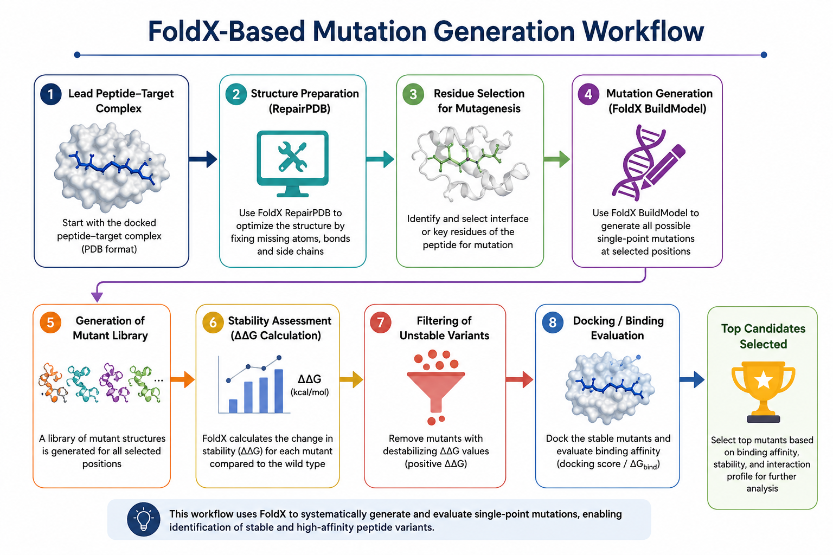
Variant Generation Strategy

Slide 4
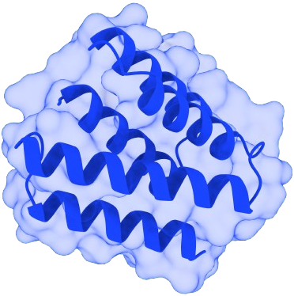
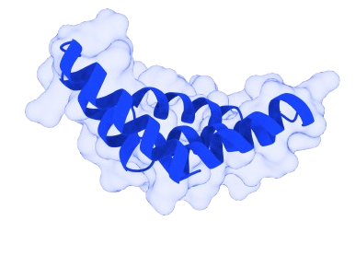
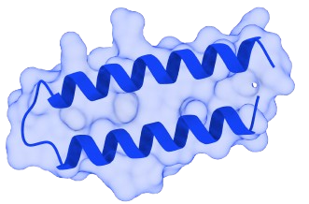
Optimization Workflow for Priority Peptide Candidates
Initial Peptide
↓
589 single Mutants Generated
↓
189 Stable Variants
(ΔΔG Filter)
↓
Using 189 single mutants we generate combination mutation of two;three and four
↓
Top 2 Selected
↓
MD Simulation
↓
Final Lead
A88H
Initial Peptide
↓
419 single Mutants Generated
↓
61 Stable Variants
(ΔΔG Filter)
↓
Using 61 single mutants we
generate combination mutation of two;
three and four
↓
Top 5 Selected
↓
MD Simulation
↓
Final Lead
N77I_A15W
PEPTIDE 1
Initial Peptide
↓
419 single Mutants Generated
↓
61 Stable Variants
(ΔΔG Filter)
↓
Using 61 single mutants we
generate combination mutation of two;
three and four
↓
Top 4 Selected
↓
MD Simulation
↓
Final Lead
L18M_L45F_I11L
L45W_I11N
I11N
PEPTIDE 3
PEPTIDE 5
P1
P3
P5

Slide 5
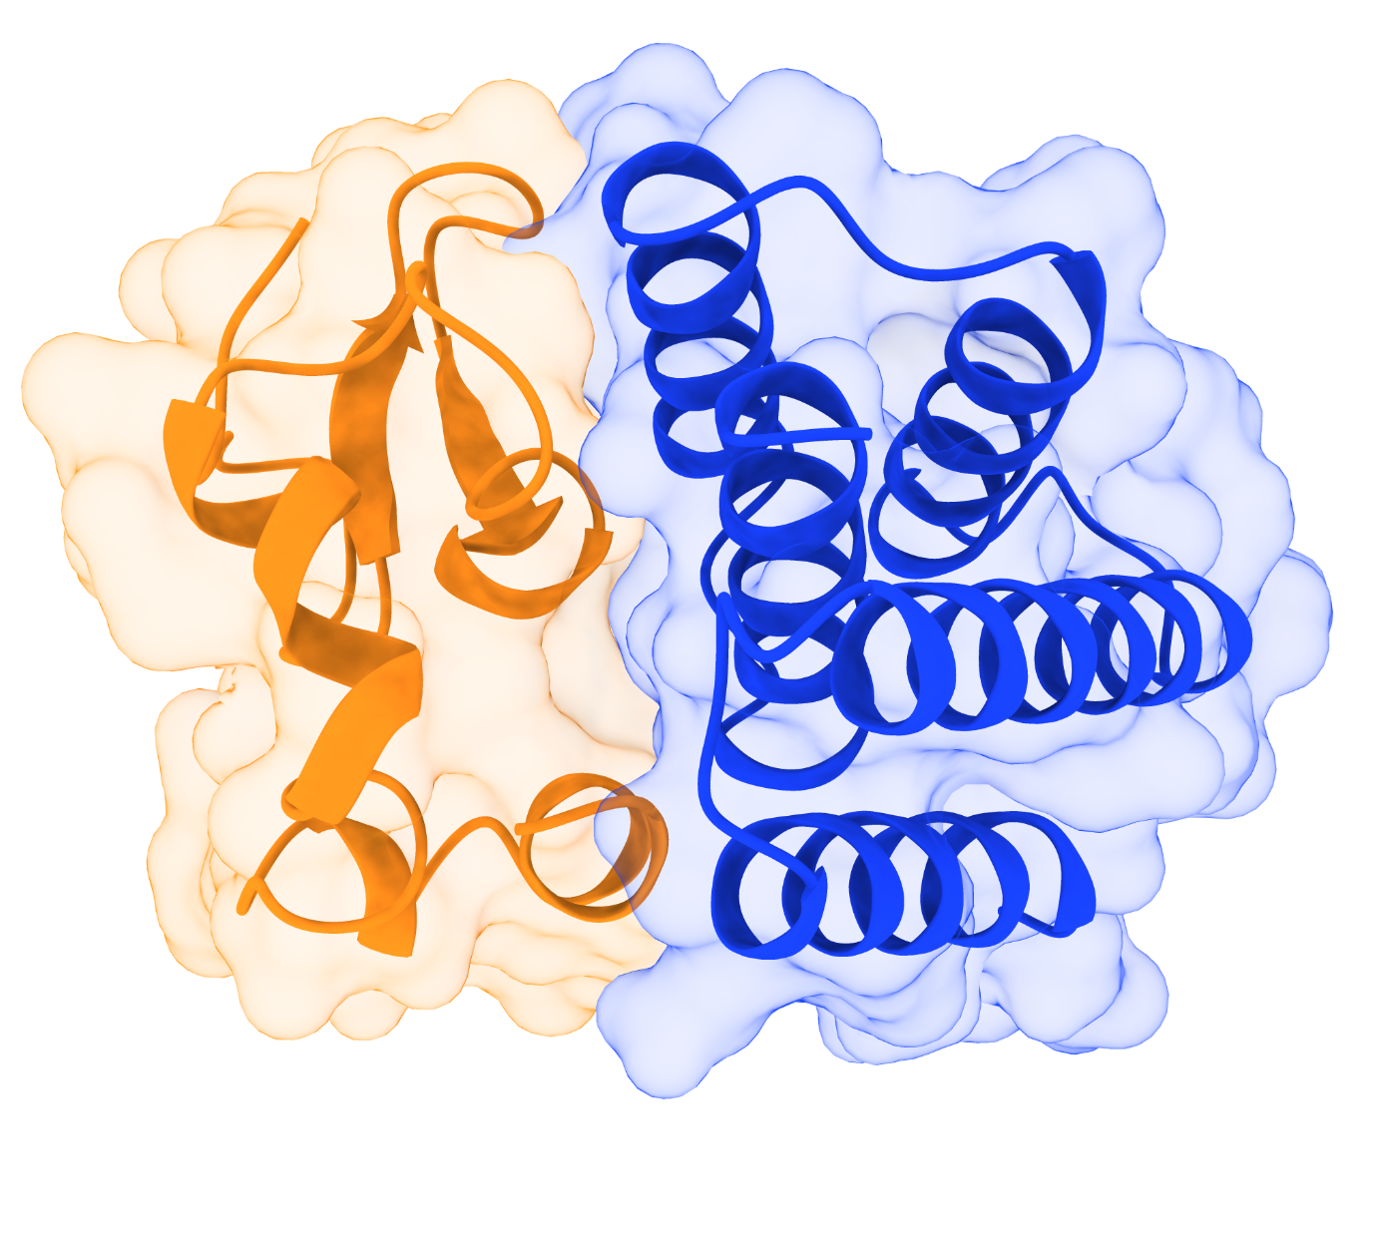
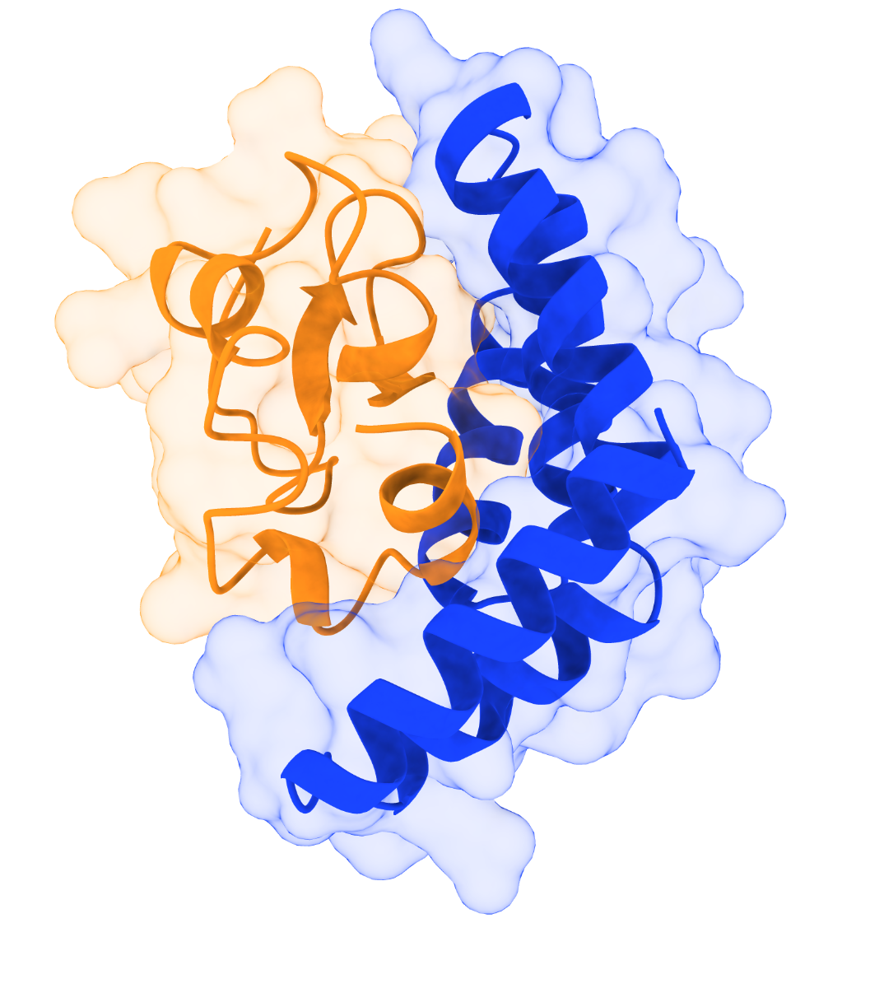
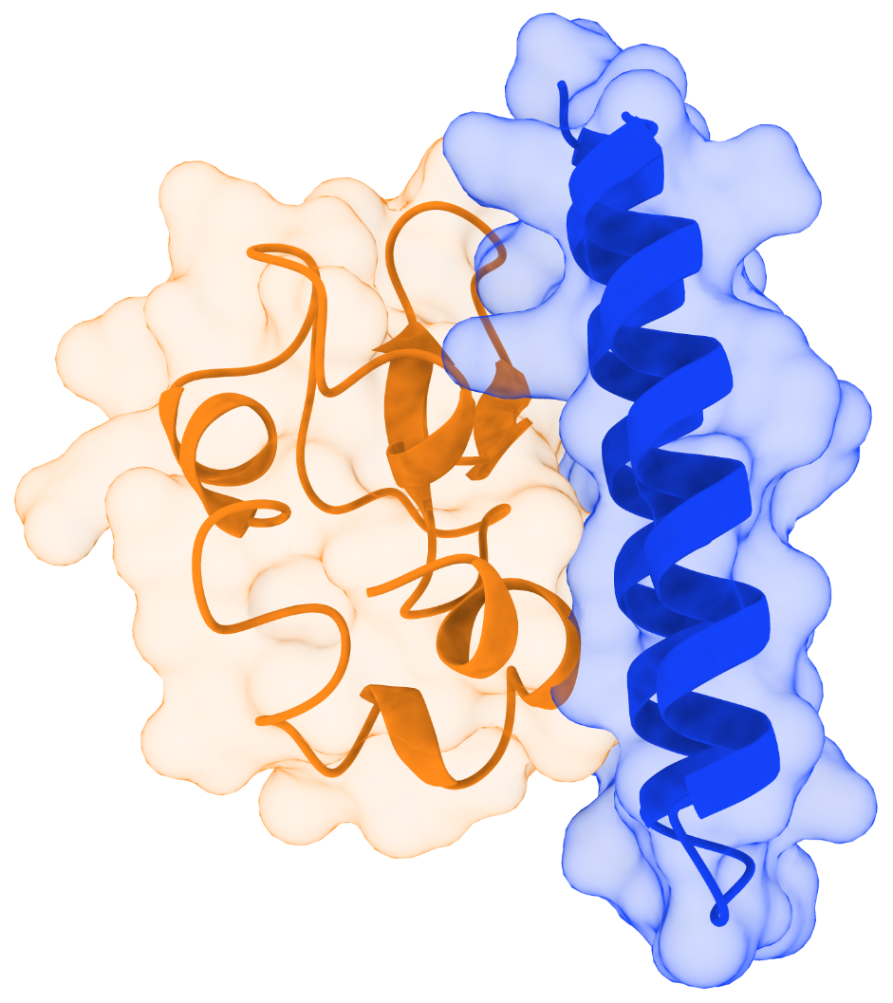
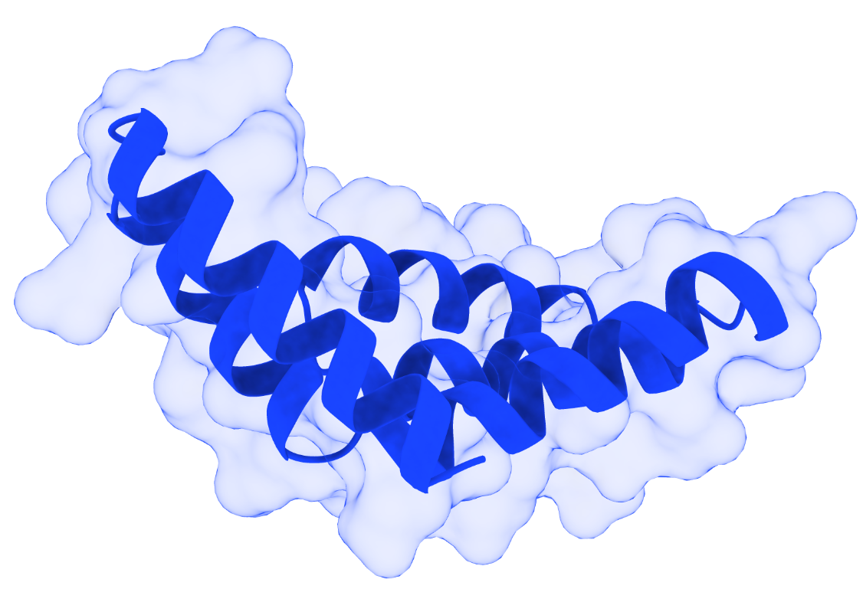
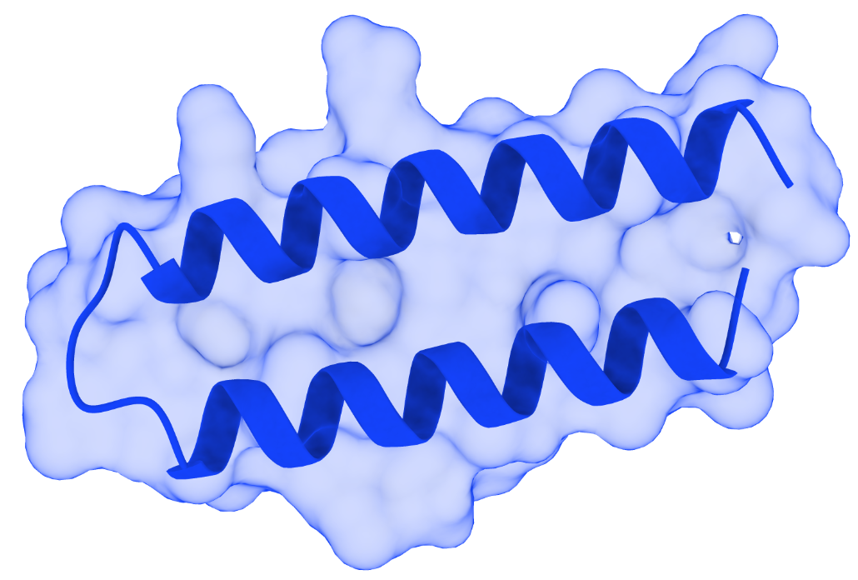
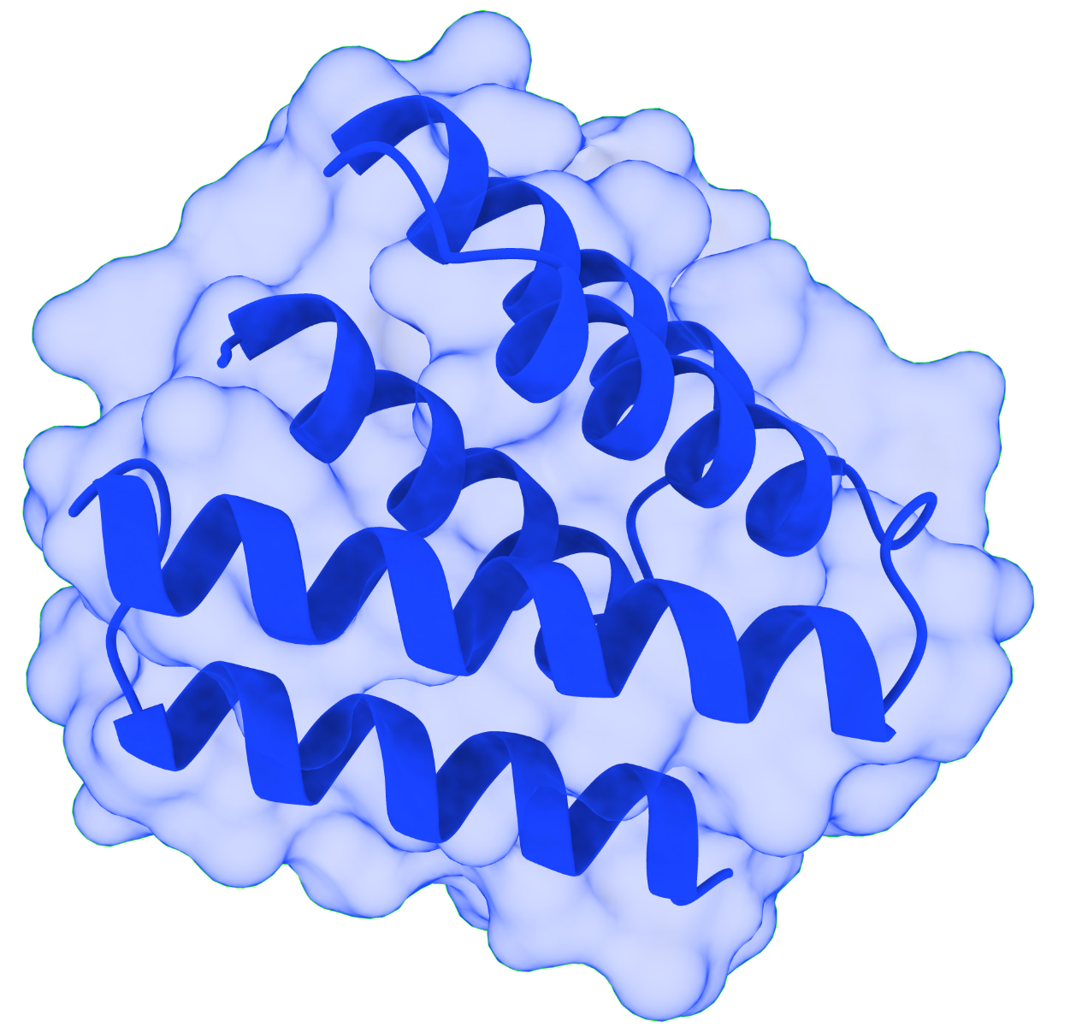
Three selected de novo designed minibinders (P1,P3&P5) in complex with sBCMA
Peptide 1
Peptide 3
Peptide 5
sBCMA
sBCMA
sBCMA
sBCMA_P1_WT
sBCMA_P3_WT
sBCMA_P5_WT

Slide 6
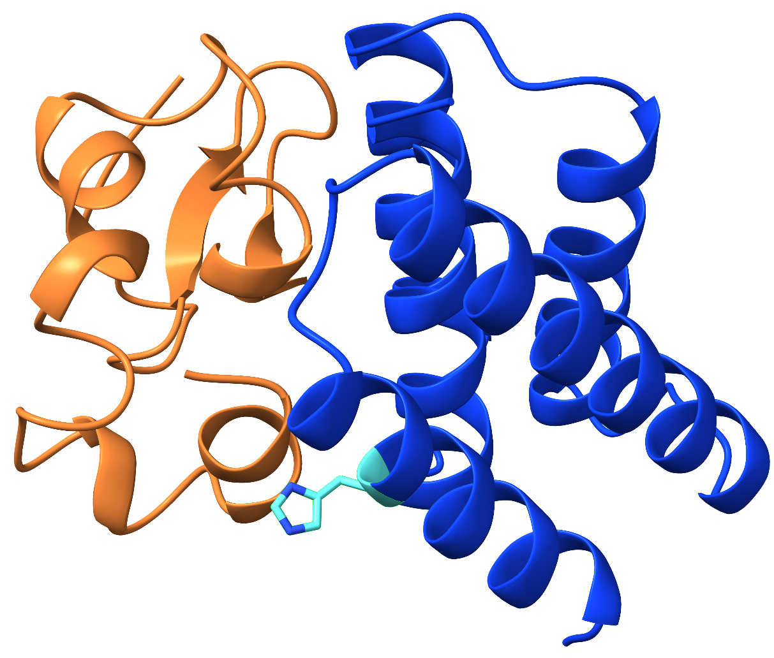
sBCMA_P1 Mutation Showing Improved Binding Compared with the Wild Type (Licorice Representation with Residue Labeling)
sBCMA_P1_WT
sBCMA_P1_mt_A88H
A88H
Structural comparison of the wild-type and A88H mutant sBCMA_P1 complexes. The wild-type sBCMA_P1 complex (left) and the A88H mutant (right) are shown in cartoon representation. The substituted residue (A88H) is highlighted in cyan licorice representation and labeled in red to illustrate the location of the engineered mutation within the sBCMA_P1 structure.

Slide 7
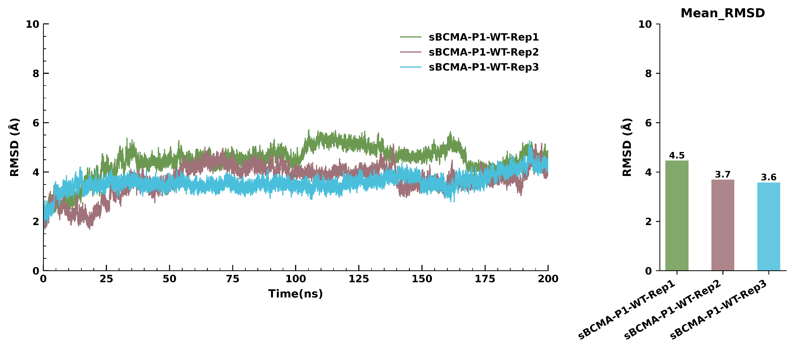
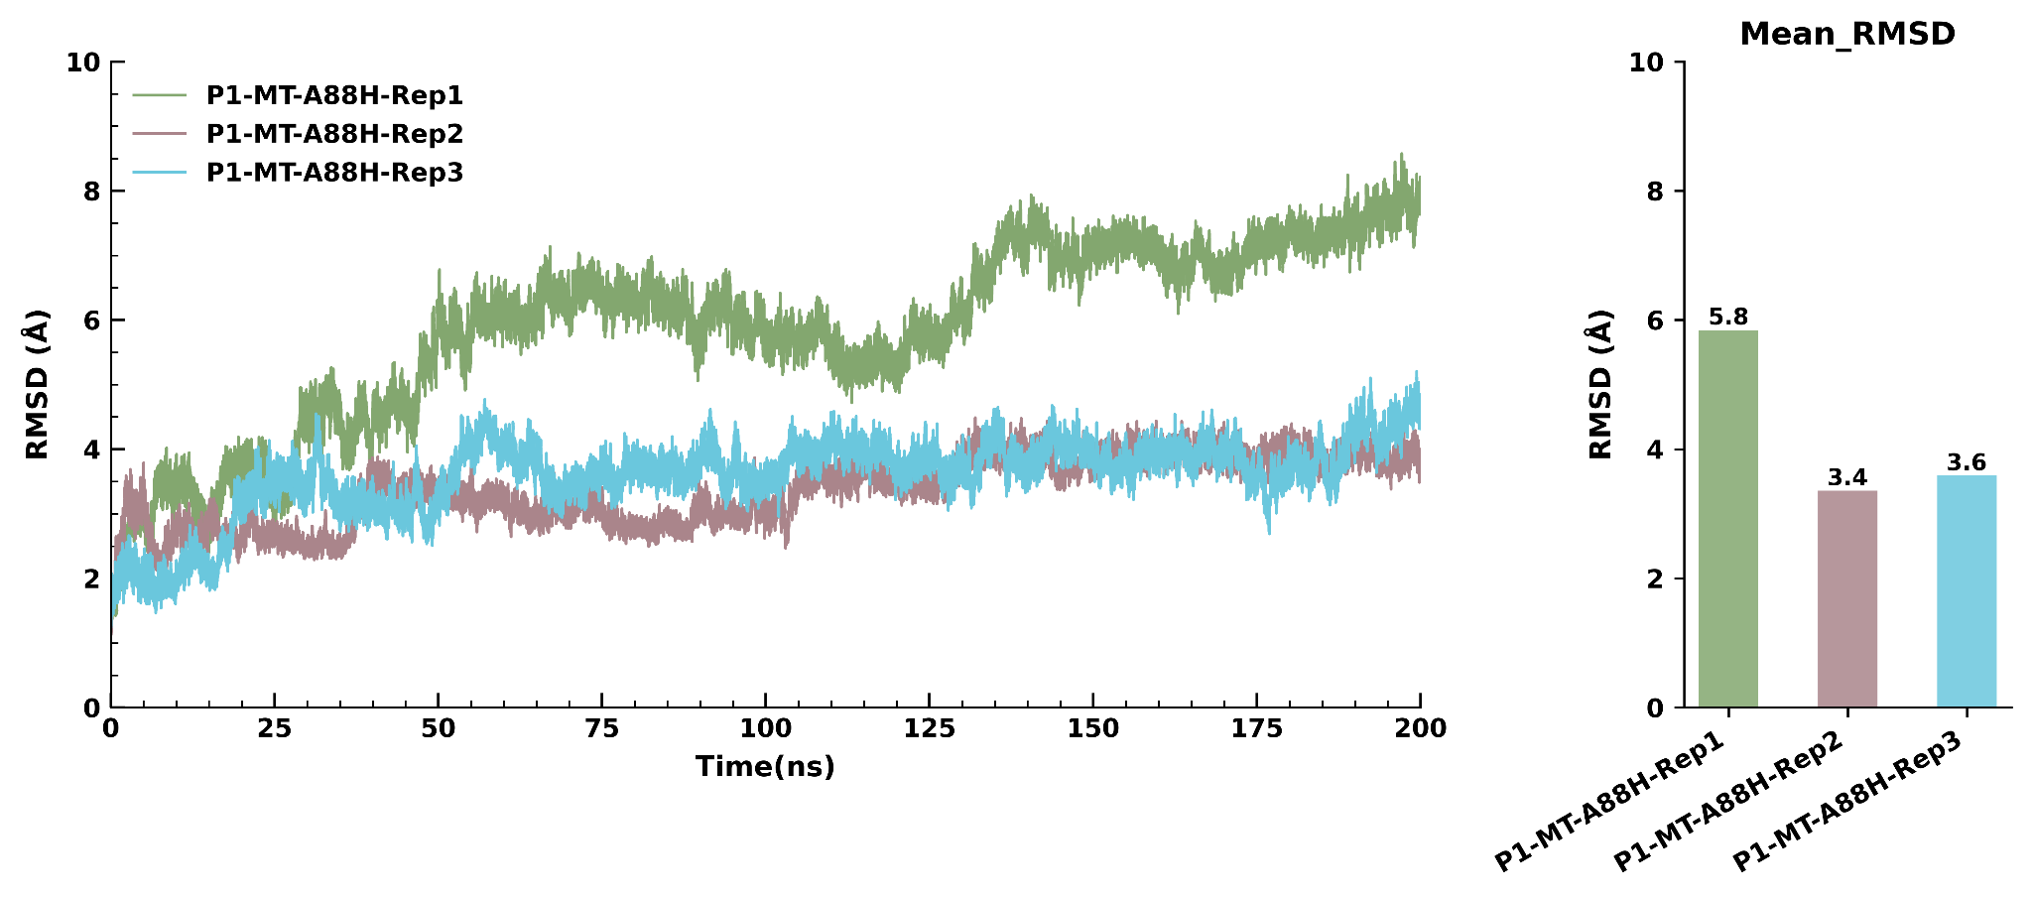
RMSD graph of sBCMA_P1 wild type
RMSD graph of mutant type sBCMA_P1_mt_A88H
RMSD Over Time
RMSD Over Time
Root mean square deviation (RMSD) profiles of the wild-type and A88H mutant sBCMA_P1 complexes during 200 ns molecular dynamics simulations. Backbone RMSD values were calculated relative to the initial structure for three independent simulation replicates of the wild-type sBCMA_P1 (left) and the A88H mutant (right). The wild-type system exhibited relatively consistent RMSD trajectories throughout the simulation, with mean RMSD values of 4.5 Å, 3.7 Å, and 3.6 Å for Replicates 1–3, respectively, indicating stable structural behavior after the initial equilibration period. The A88H mutant also maintained overall structural integrity during the simulations, although Replicate 1 displayed a higher RMSD profile (mean RMSD 5.8 Å) compared with Replicates 2 (3.4 Å) and 3 (3.6 Å), suggesting increased conformational sampling in one independent simulation while the remaining replicates converged to stable RMSD values. The bar plots summarize the mean RMSD obtained from each replicate over the 200 ns simulation.

Slide 8
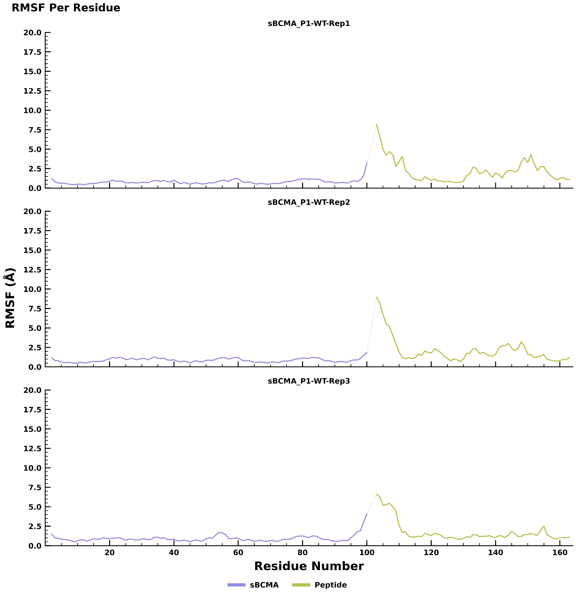
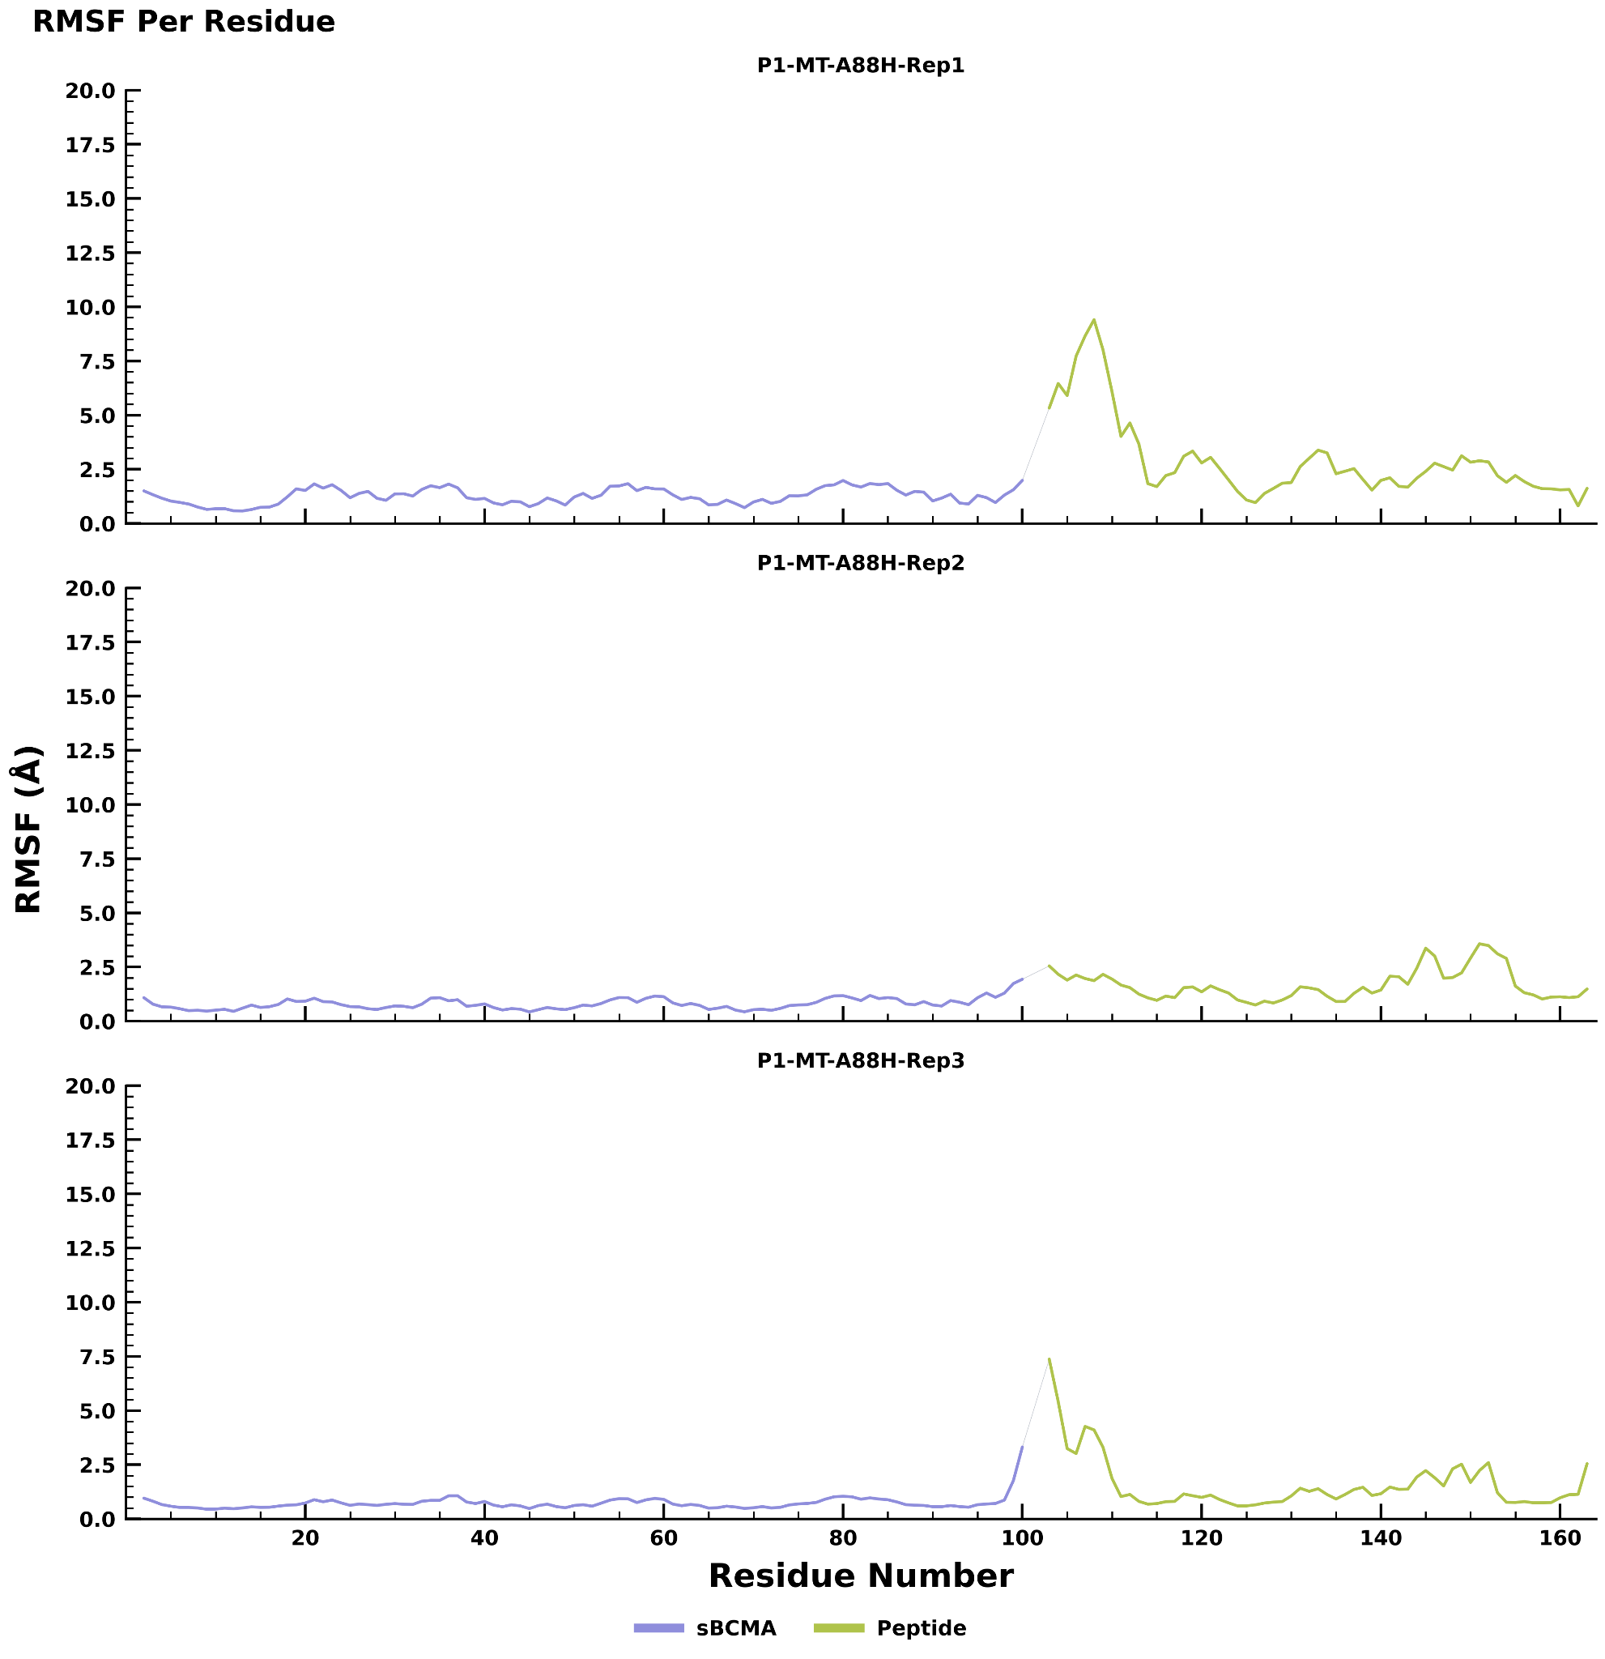
RMSF graph of sBCMA_P1 wild type
RMSF graph of mutant type sBCMA_P1_mt_A88H
Root mean square fluctuation (RMSF) profiles of the wild-type and A88H mutant sBCMA_P1 complexes during 200 ns molecular dynamics simulations. RMSF analysis was performed for three independent simulation replicates to evaluate residue-level flexibility of the sBCMA receptor (blue) and the bound peptide (green). Both the wild-type and A88H mutant complexes exhibited low fluctuations throughout the sBCMA receptor, indicating that the mutation does not compromise the global structural stability of the receptor. The A88H mutant displayed a localized increase in peptide flexibility around residues 100–115 while maintaining an overall fluctuation profile comparable to that of the wild type across all replicates. This localized conformational adaptability, together with the preserved structural stability of the receptor, suggests that the A88H substitution is well tolerated and is consistent with the enhanced binding characteristics observed in the structural and energetic analyses.

Slide 9
Binding free energy score of sBCMA_P1 wild type and mutant type
Delta Total
 | Replicate 1 | Replicate 2 | Replicate 3
sBCMA_P1_WT | -56.8460 | -45.8224 | -54.6271
sBCMA_P1_mt_A88H | -56.6941 | -49.5616 | -57.4050
MM/GBSA binding free energy analysis of the wild-type and A88H mutant sBCMA_P1 complexes. Binding free energy was evaluated from three independent molecular dynamics simulation replicates. Compared with the wild-type complex, the A88H mutant exhibited consistently more favorable binding free energy, indicating enhanced binding affinity and supporting the A88H substitution as a beneficial mutation for stabilizing the sBCMA_P1 complex.

Slide 10
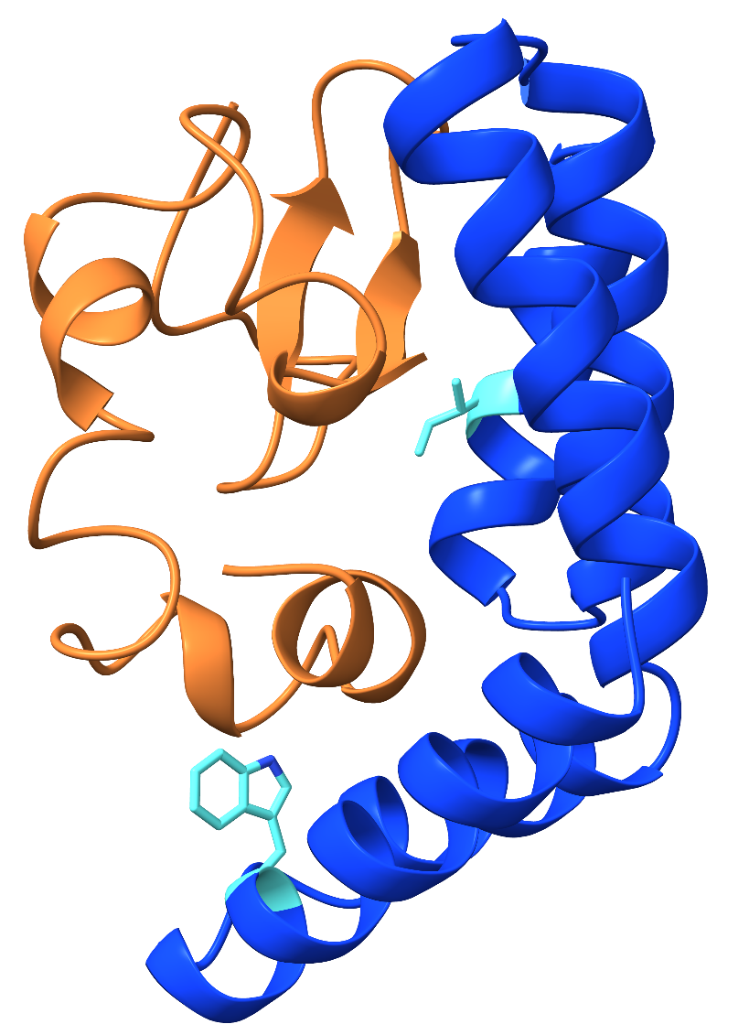
Wild type Peptide 3 graph representation of RMSD and RMSF along with Binding free energy score
sBCMA_P3 Mutation Showing Improved Binding Compared with the Wild Type (Licorice Representation with Residue Labeling)
sBCMA_P3_WT
sBCMA_P3_mt_N77I_A15W
N77I
A15W
Structural comparison of the wild-type and N77I/A15W mutant sBCMA_P3 complexes. The wild-type sBCMA_P3 complex (left) and the N77I/A15W mutant (right) are shown in cartoon representation. The substituted residues (N77I and A15W) are highlighted in cyan licorice representation and labeled in red to illustrate the locations of the engineered mutations within the protein structure.

Slide 11
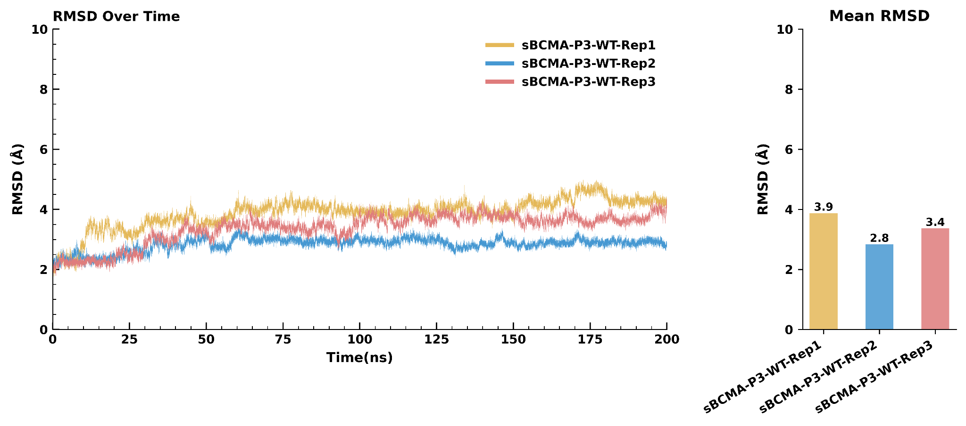
RMSD graph of sBCMA_P3 wild type
RMSD graph of mutant type sBCMA_P3_mt_N77I_A15W
RMSD analysis of the wild-type and N77I_A15W mutant sBCMA_P3 complexes during 200 ns molecular dynamics simulations. Backbone RMSD profiles were calculated for three independent simulation replicates of the wild-type sBCMA_P3 and the sBCMA_P3_mt_N77I_A15W variant to evaluate their structural stability and conformational dynamics throughout the simulation. Both the wild-type and mutant complexes exhibited stable RMSD trajectories following the initial equilibration period, with only minor differences in conformational fluctuations observed among individual replicates. The accompanying bar plots summarize the mean RMSD values for each replicate, providing an overall comparison of the structural behavior of the wild-type and mutant complexes during the simulations.

Slide 12
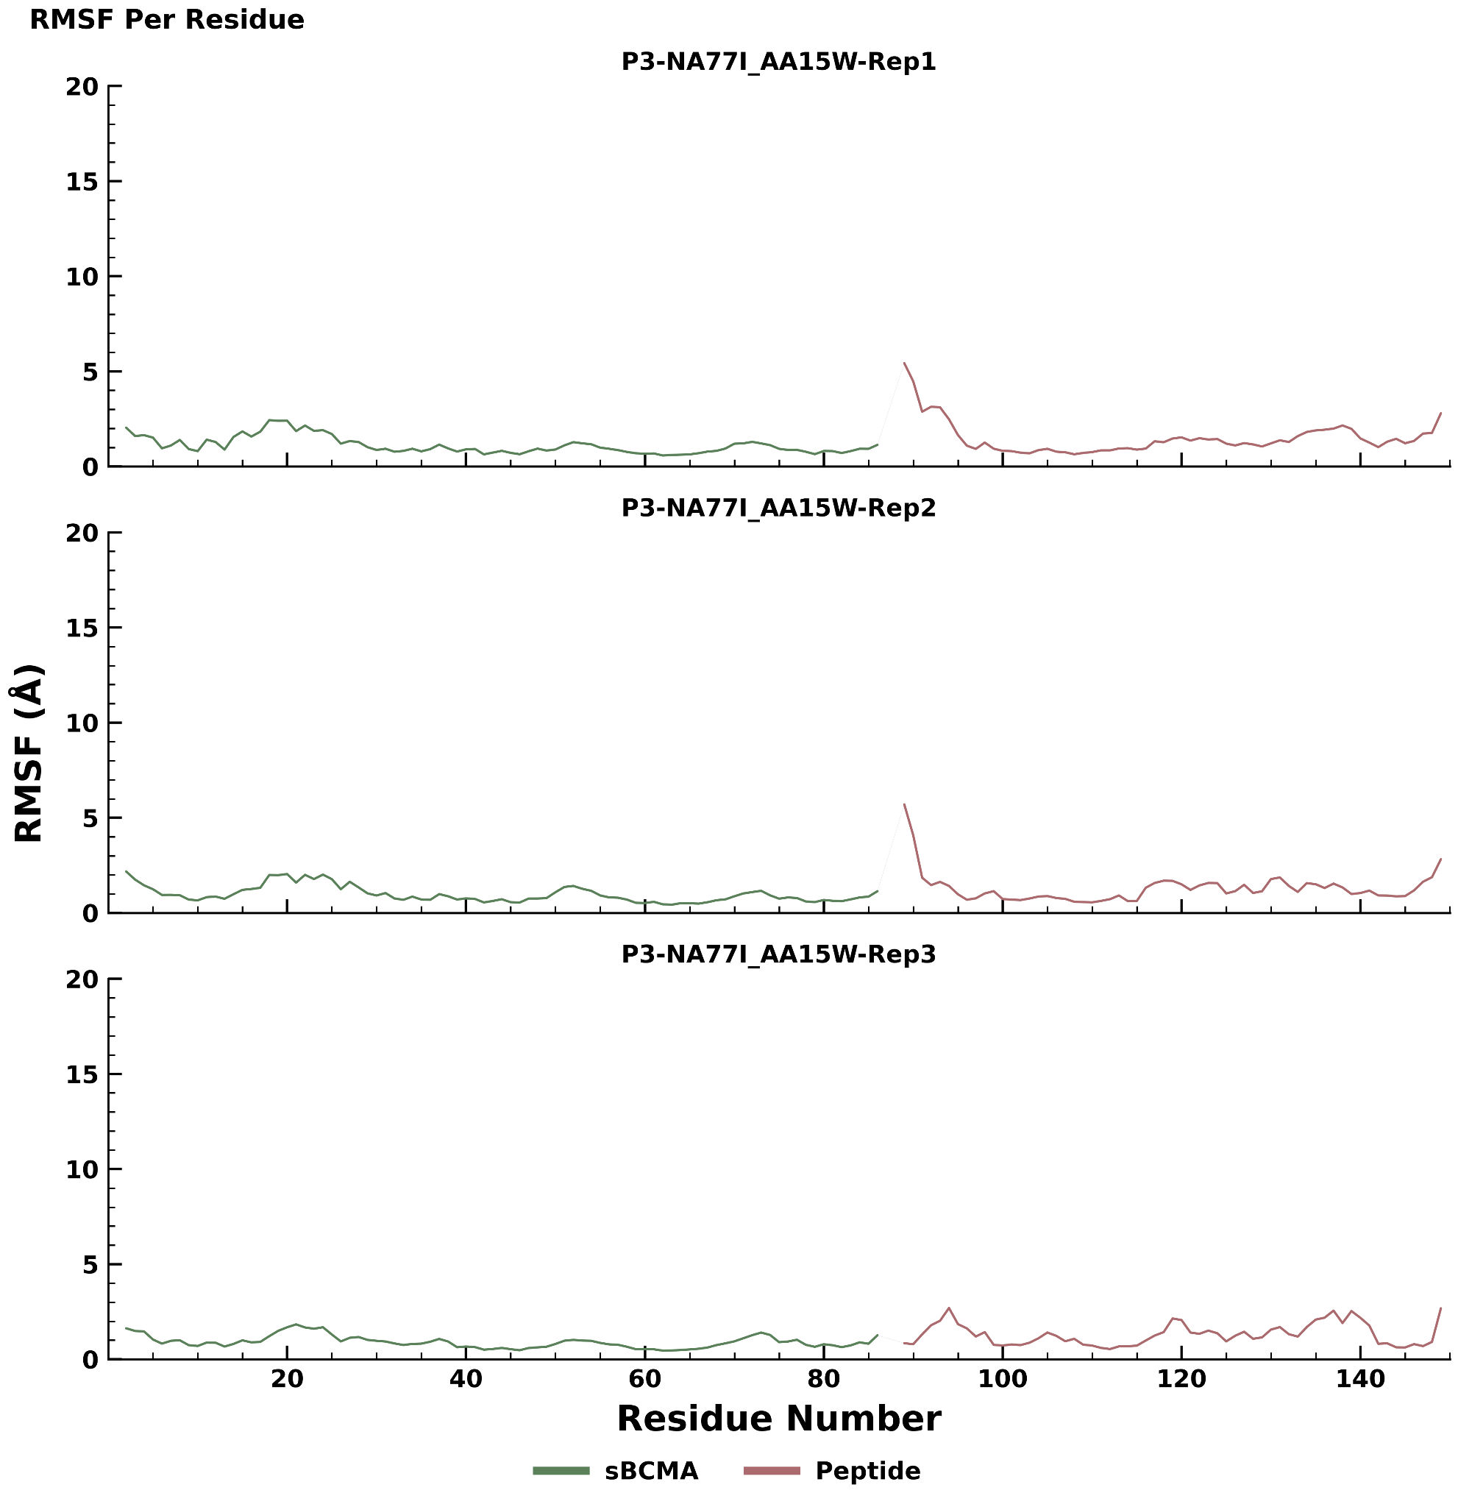
RMSF graph of sBCMA_P3 wild type
RMSF graph of mutant type sBCMA_P3_mt_N77I_A15W
RMSF analysis of the wild-type and N77I_A15W mutant sBCMA_P3 complexes during 200 ns molecular dynamics simulations. Root mean square fluctuation (RMSF) profiles were calculated on a per-residue basis for three independent simulation replicates of the wild-type sBCMA_P3 (left) and the sBCMA_P3_mt_N77I_A15W variant (right). RMSF values were determined for both the sBCMA receptor (green) and the bound peptide (red) to characterize residue-specific flexibility throughout the simulations. The overall fluctuation patterns were comparable between the wild-type and mutant complexes, with localized regions of increased mobility observed primarily in loop and terminal residues across individual replicates. The three independent replicates demonstrate reproducible residue-wise dynamic behavior for both complexes over the course of the simulations.

Slide 13
Binding free energy score of sBCMA_P3 wild type and mutant type
Delta Total
 | Replicate 1 | Replicate 2 | Replicate 3
sBCMA_P3_WT | -83.5923 | -69.8109 | -78.0201
sBCMA_P3_mt_N77I_A15W | -88.0383 | -92.1795 | -87.6741
MM/GBSA binding free energy analysis of the wild-type and N77I_A15W mutant sBCMA_P3 complexes. Total binding free energies were calculated using the MM/GBSA method from three independent 200 ns molecular dynamics simulation replicates for the wild-type sBCMA_P3 and the N77I_A15W mutant. The mutant complex consistently exhibited more negative binding free energy values than the wild-type across all three independent replicates, indicating a stronger predicted binding interaction. These results support the N77I_A15W substitution as a favorable mutation for improving the binding energetics of the sBCMA_P3 complex.

Slide 14
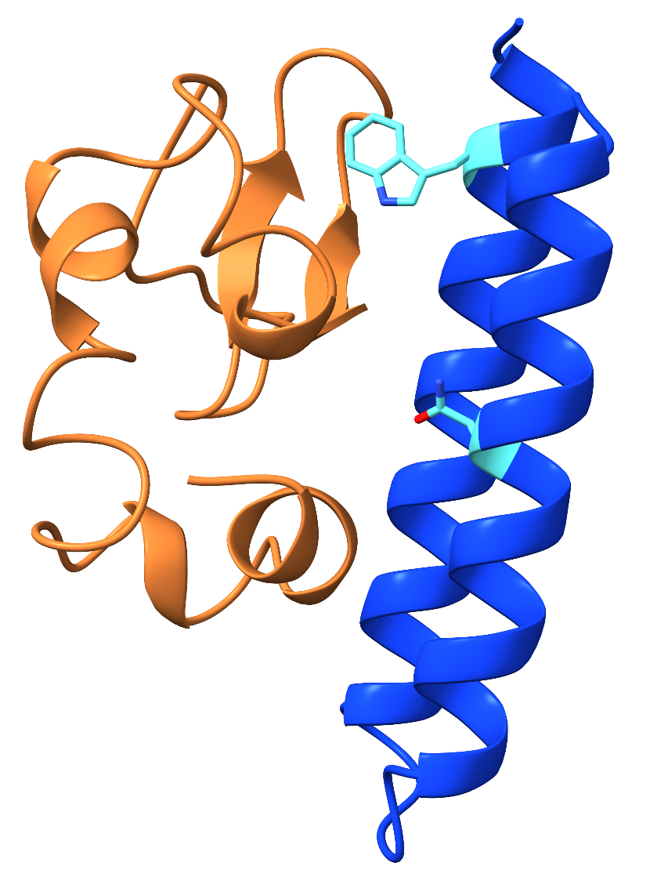
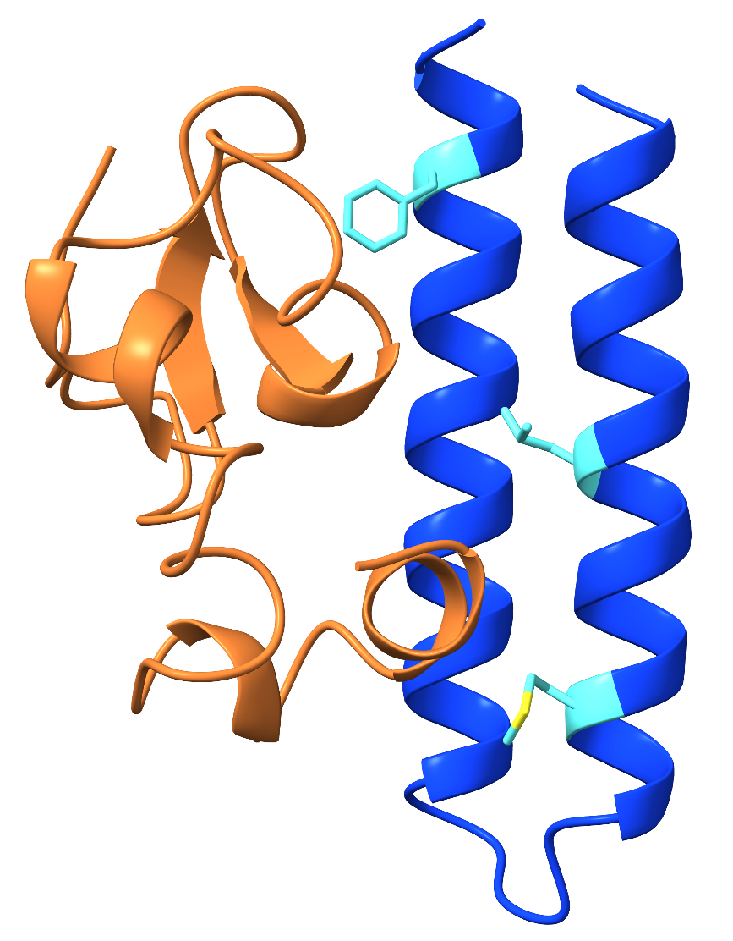
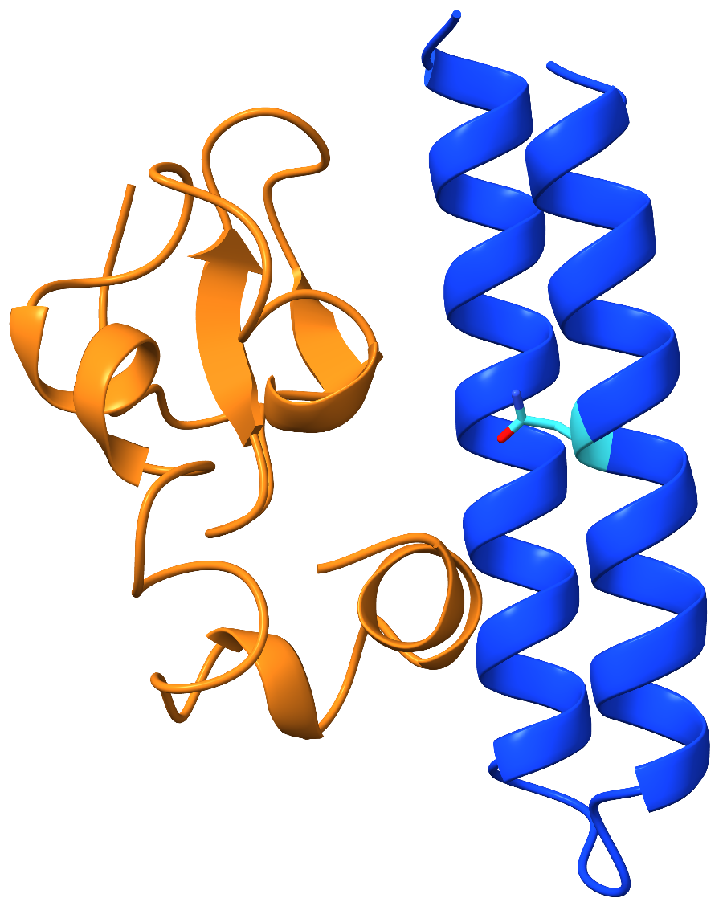
Top Three sBCMA_P5 Mutants Showing Improved Binding Compared with the Wild Type (Licorice Representation with Residue Labeling)
sBCMA_P5_mt_I11N
sBCMA_P5_mt_LA45W_IA11N
sBCMA_P5_mt_LA18M_LA45F_IA11L
L45F
L45W
I11L
I11N
I11N
L18M
Structural visualization of the top three sBCMA_P5 mutants with enhanced binding relative to the wild type. Cartoon representations of the three best-performing sBCMA_P5 variants are shown with mutated residues displayed in licorice representation (cyan) and labeled (red). The highlighted substitutions indicate the locations of the mutations that contributed to improved binding performance compared with the wild-type protein.

Slide 15
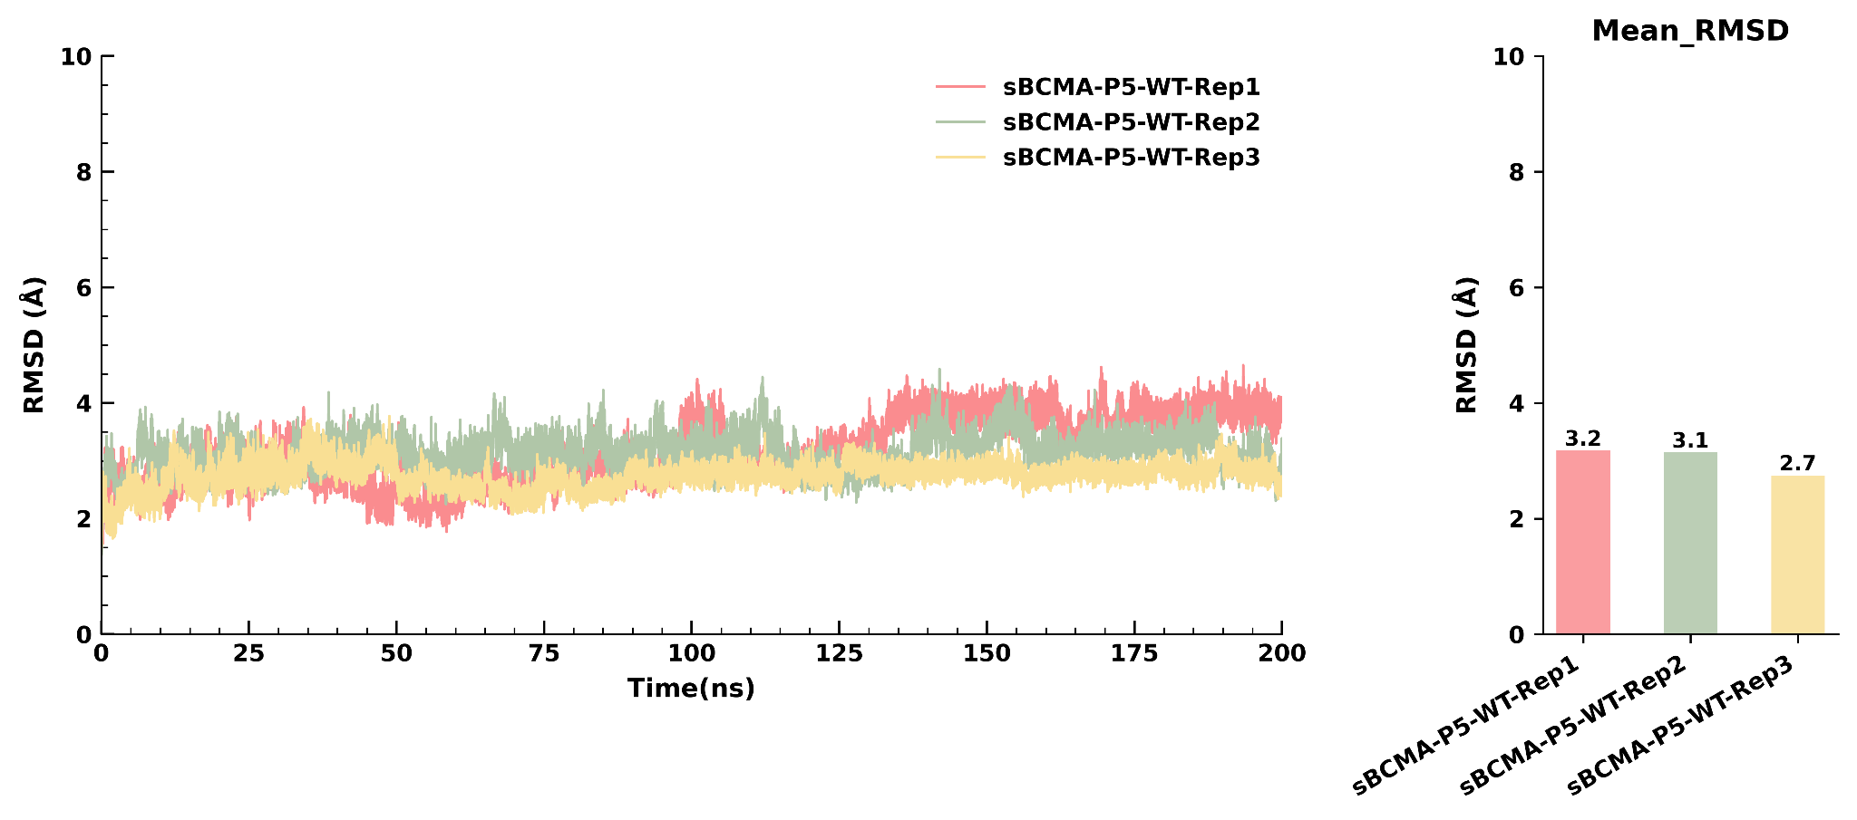
RMSD graph of sBCMA_P5 wild type
RMSD Over Time
RMSD analysis of the wild-type sBCMA_P5 complex during 200 ns molecular dynamics simulations. Backbone RMSD profiles for three independent simulation replicates demonstrate stable structural behavior throughout the simulation. Mean RMSD values of 3.2 Å, 3.1 Å, and 2.7 Å indicate good convergence with only minor conformational fluctuations. The accompanying bar plot summarizes the average RMSD for each replicate.

Slide 16
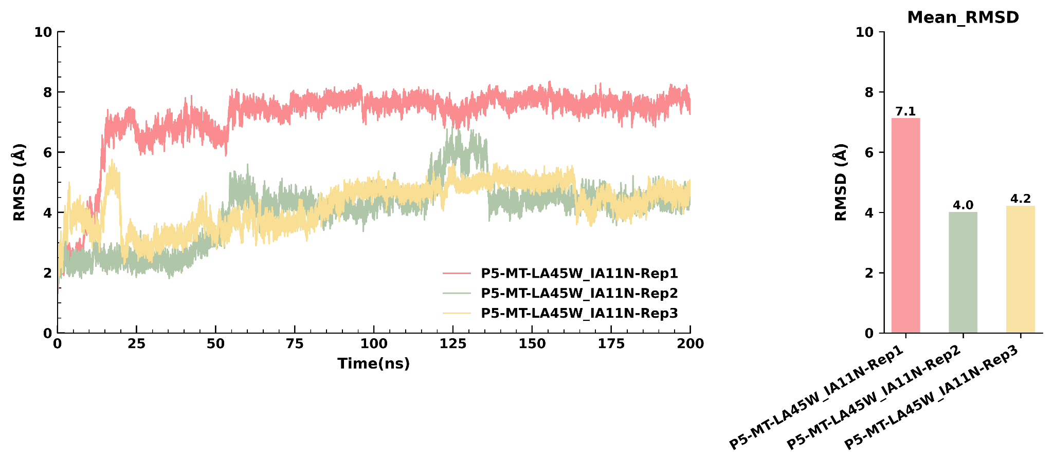
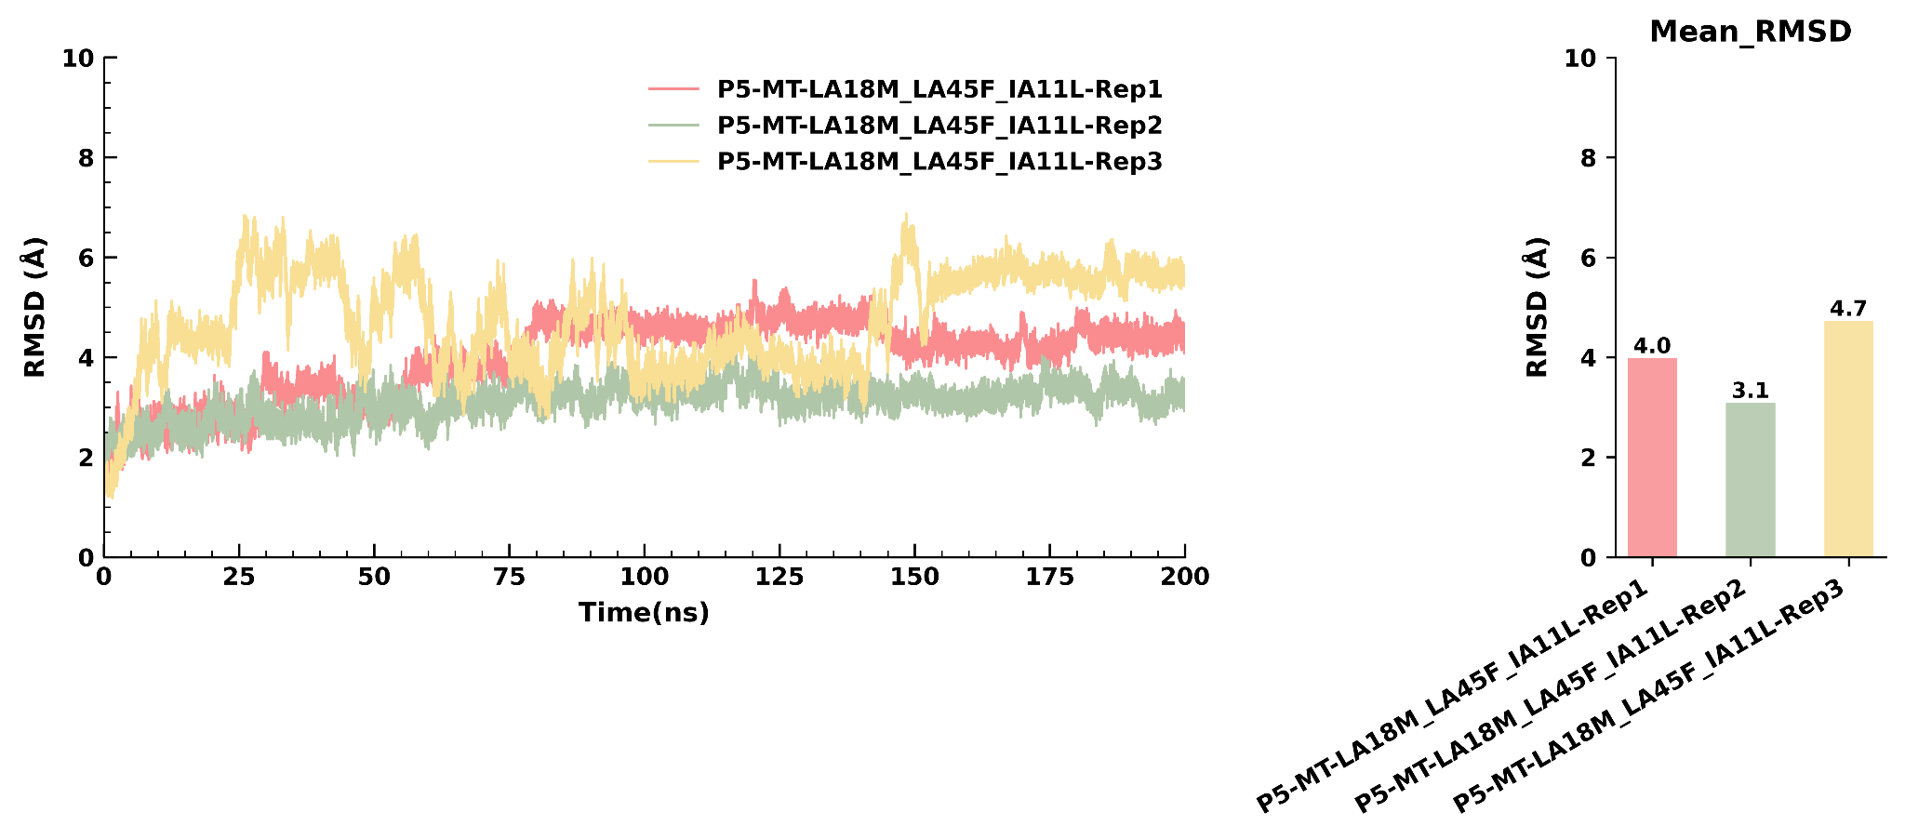
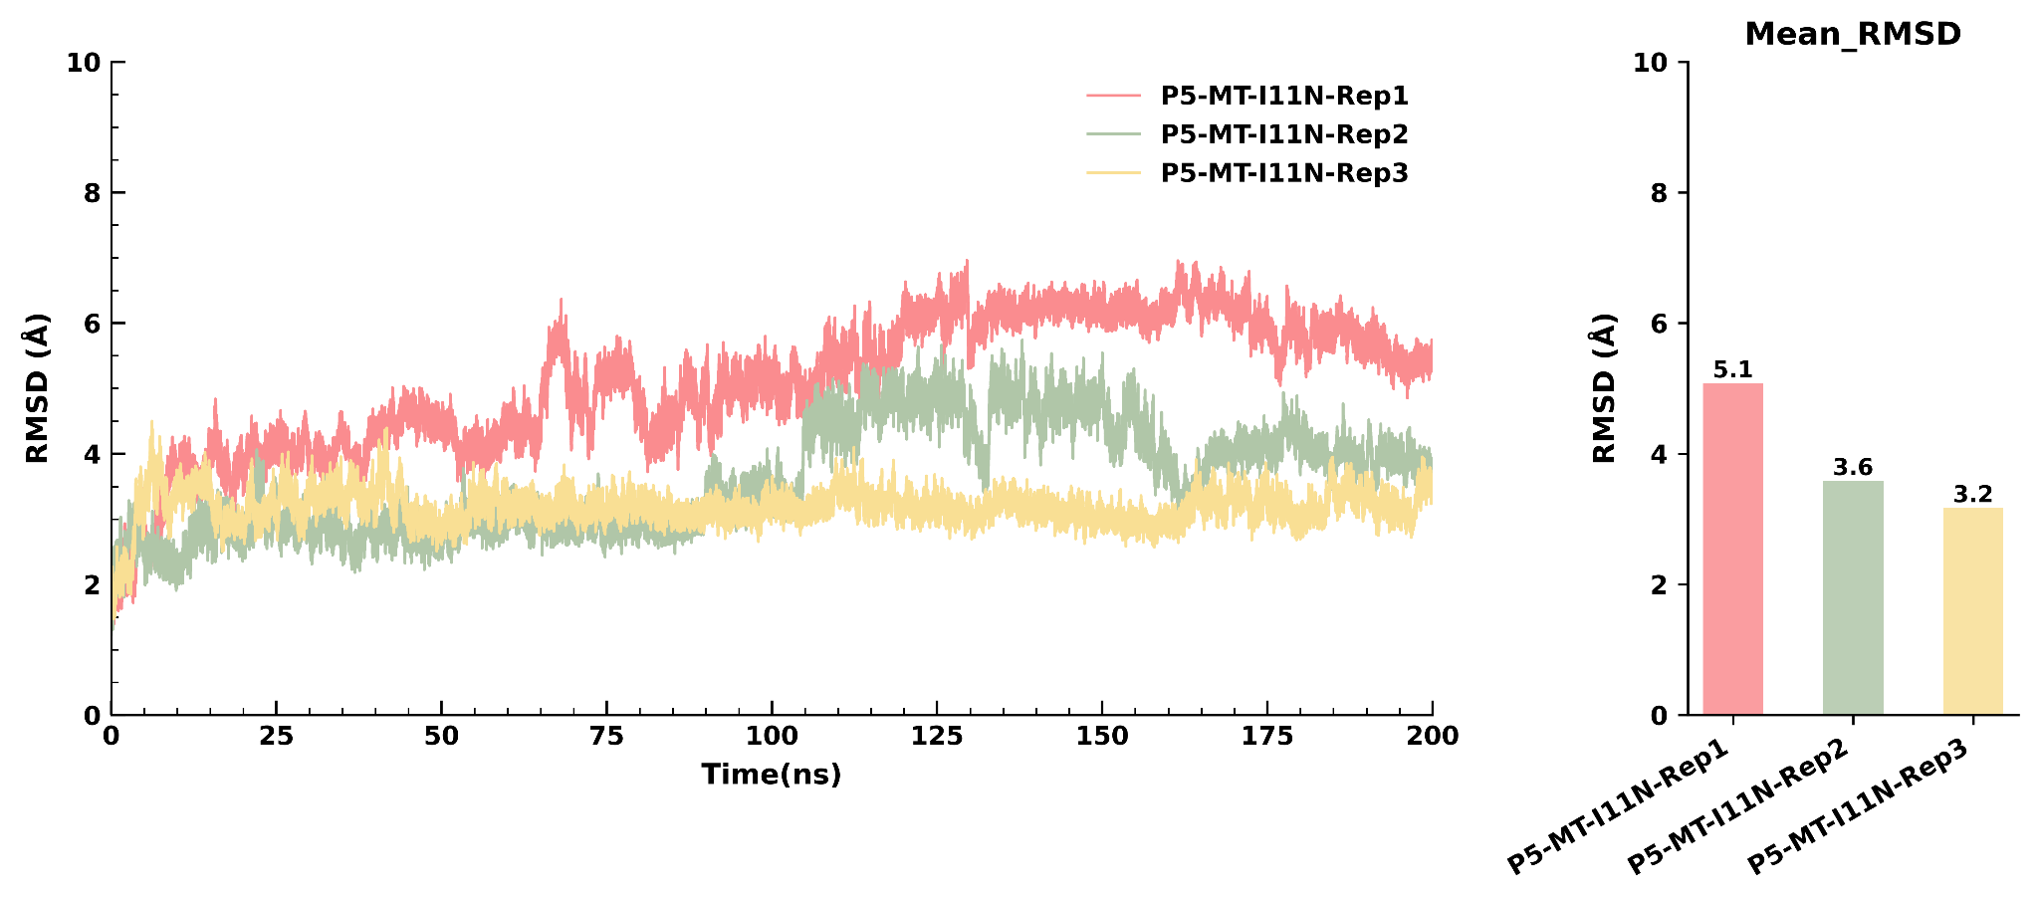
RMSD graph of sBCMA_P5 all mutants type with Replicates
sBCMA_P5_mt_L45W_I11N
sBCMA_P5_mt_L18M_L45F_I11L
RMSD Over Time
RMSD Over Time
sBCMA_P5_mt_I11N
RMSD Over Time
RMSD analysis of the top three sBCMA_P5 mutant complexes during 200 ns molecular dynamics simulations. Backbone RMSD profiles were calculated for three independent simulation replicates of the sBCMA_P5_mt_L45W_I11N, sBCMA_P5_mt_L18M_L45F_I11L, and sBCMA_P5_mt_I11N variants to evaluate their structural stability and conformational dynamics throughout the simulation. All three mutants maintained stable trajectories following the initial equilibration period, although differences in the extent of conformational fluctuations were observed among individual replicates.

Slide 17
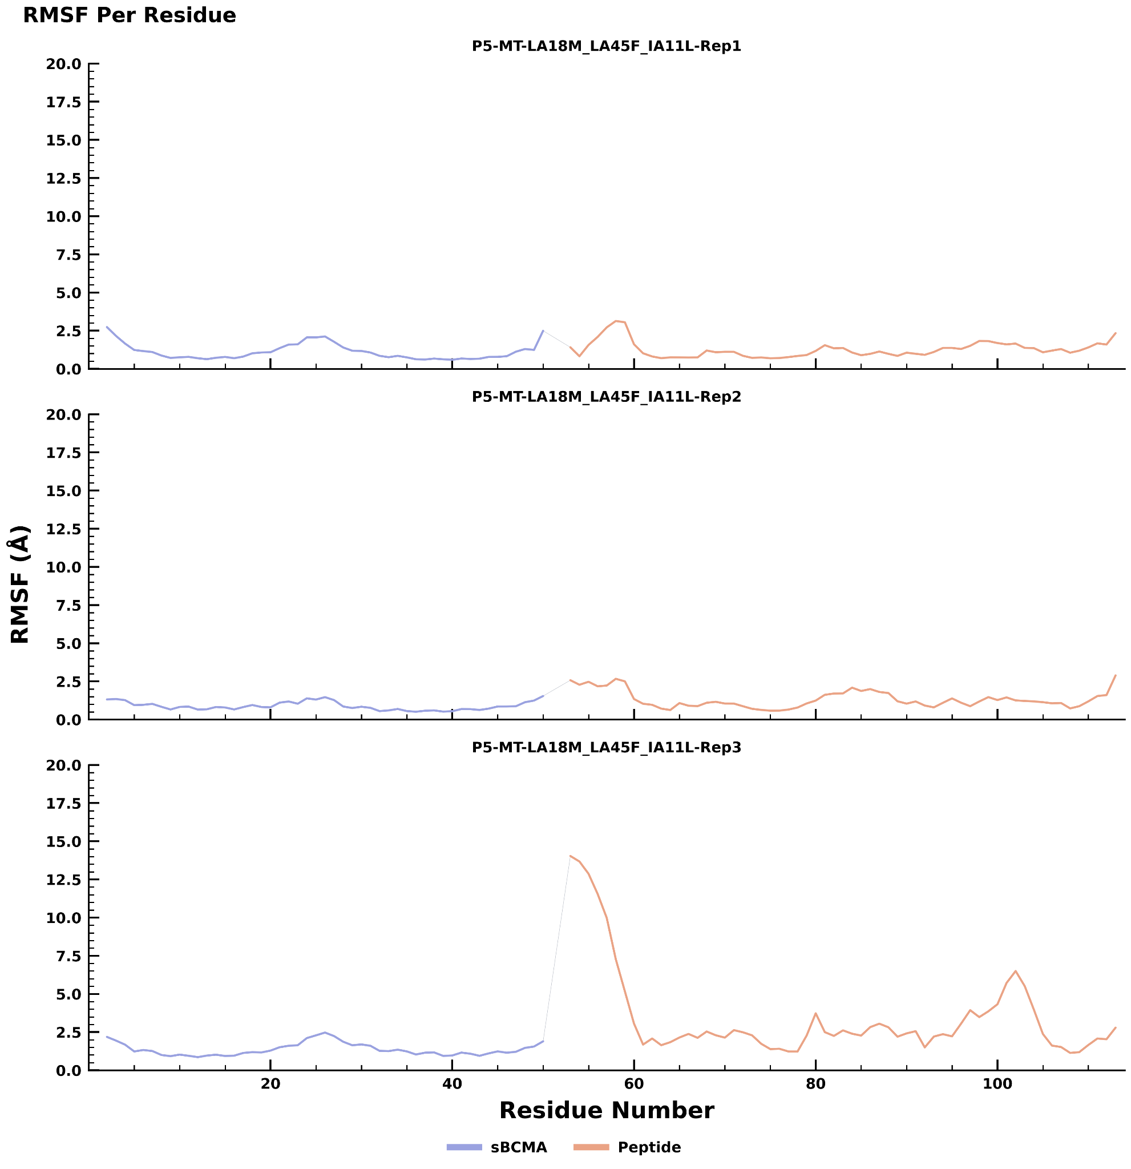
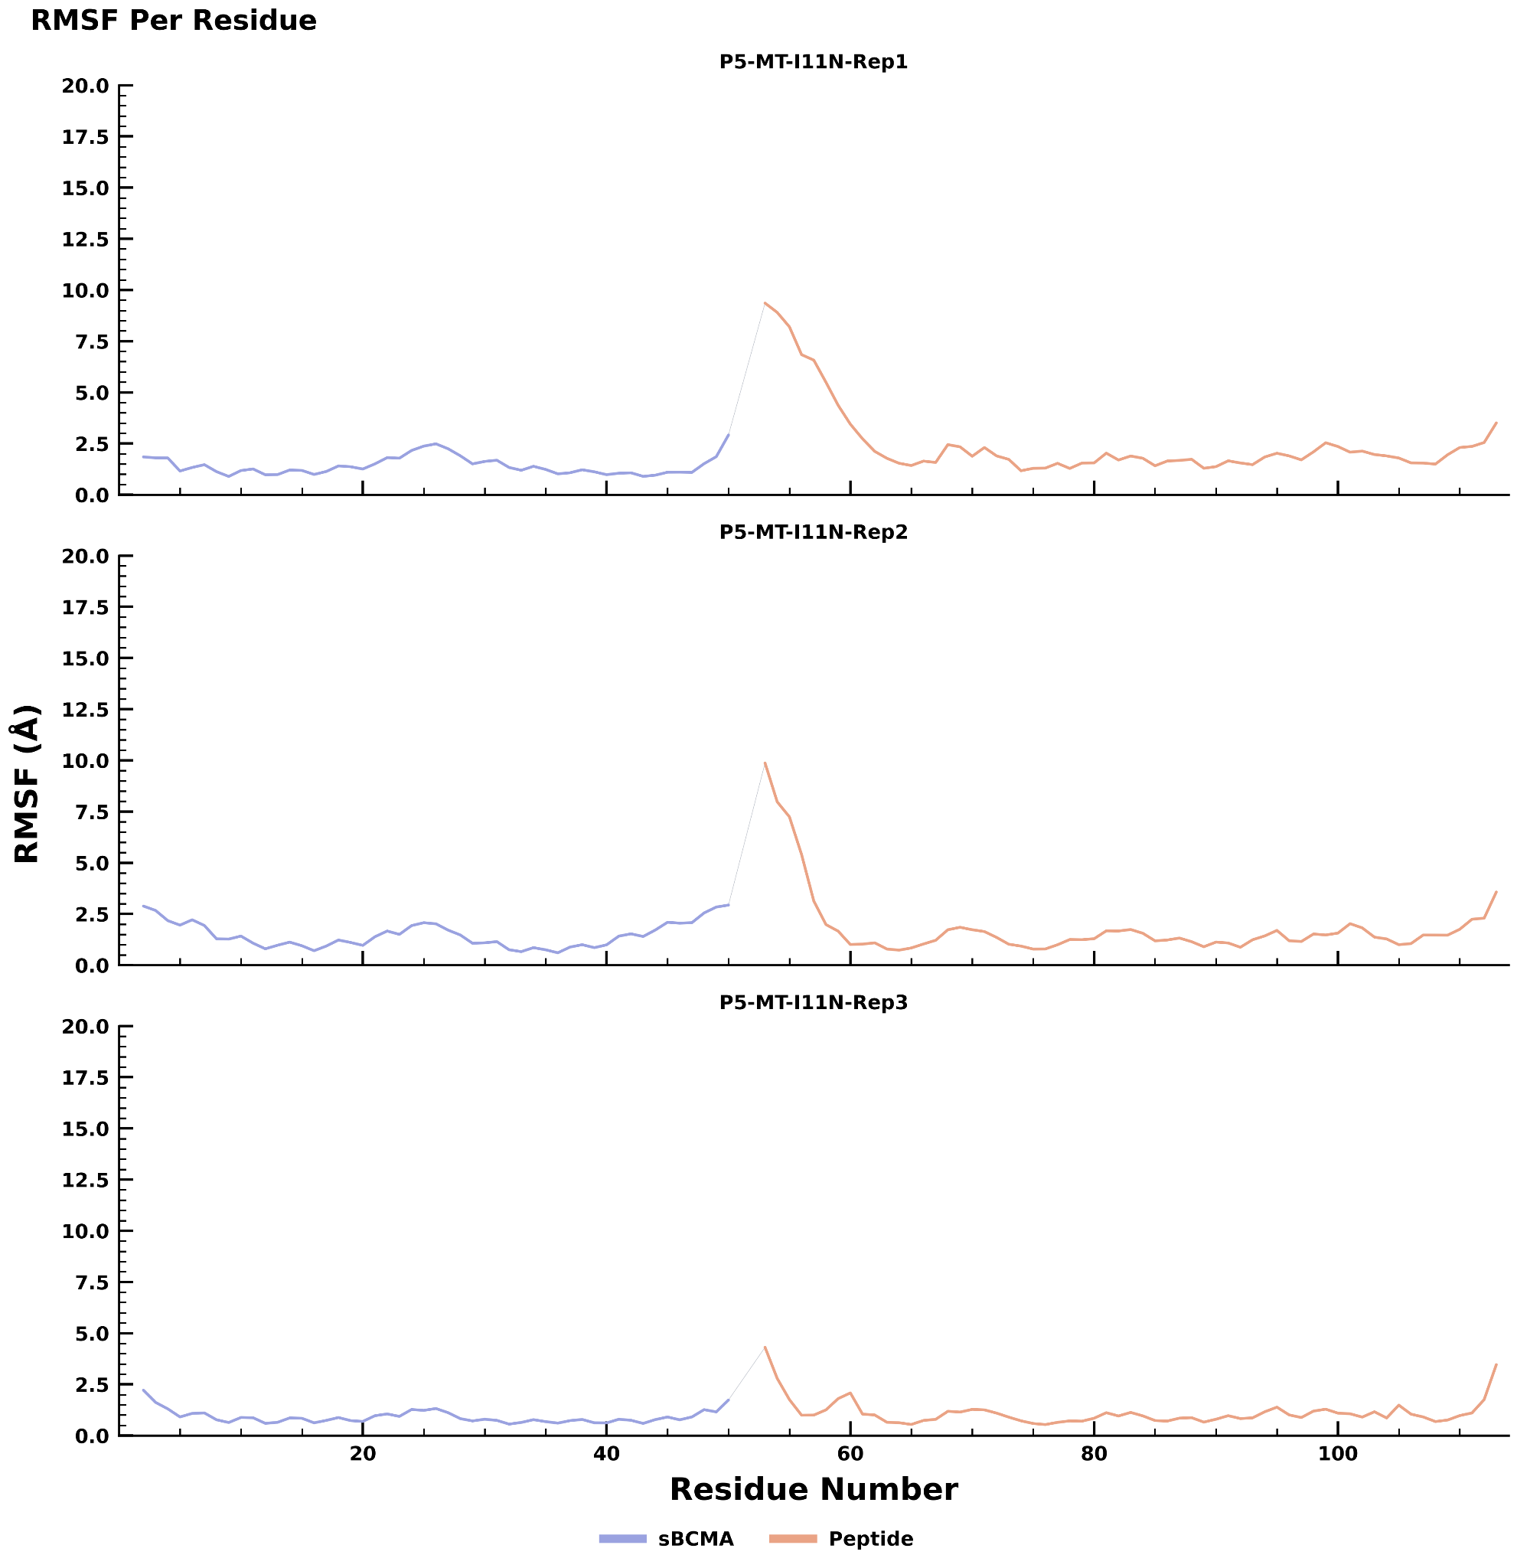
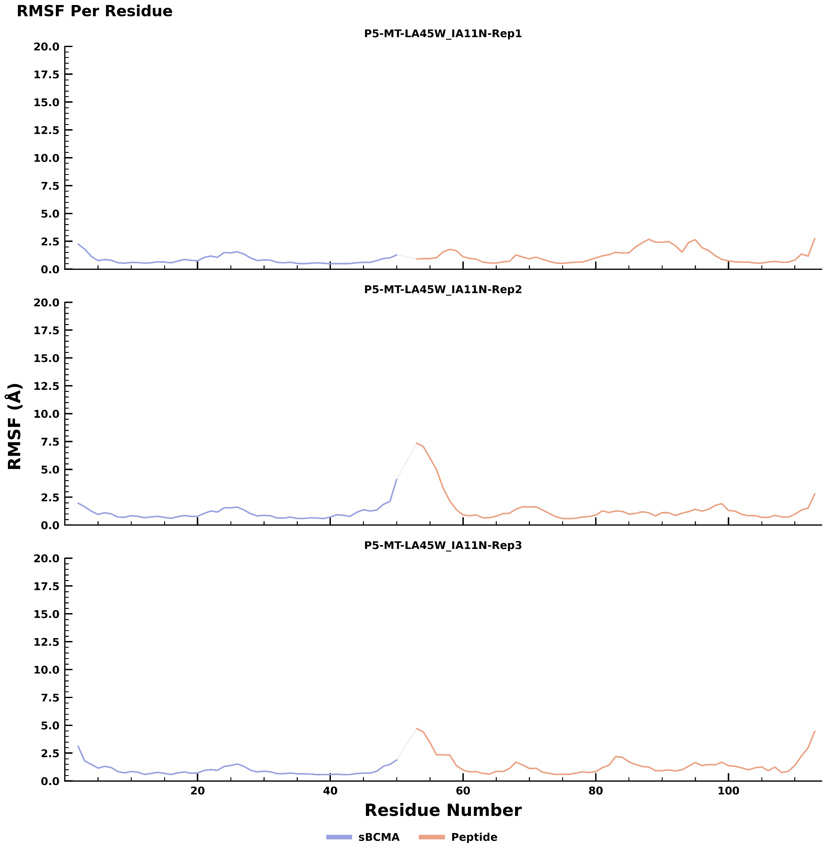
RMSF graph of sBCMA_P5 all mutants type with Replicates
sBCMA_P5_mt_L45W_I11N
sBCMA_P5_mt_L18M_L45F_I11L
sBCMA_P5_mt_I11N
Root mean square fluctuation (RMSF) profiles of the sBCMA_P5 mutant complexes during 200 ns molecular dynamics simulations. RMSF analysis was performed for three independent simulation replicates of the L45W_I11N, L18M_L45F_I11L, and I11N mutant complexes to evaluate residue-level flexibility. Across all mutants, the sBCMA receptor exhibited consistently low residue fluctuations, indicating preservation of the receptor's structural integrity throughout the simulations. The peptide displayed localized fluctuations primarily around the binding region, with the magnitude and extent varying among replicates. The L45W_I11N and I11N mutants showed relatively consistent fluctuation profiles across replicates, whereas the L18M_L45F_I11L mutant exhibited a transient increase in peptide flexibility in one replicate while maintaining low fluctuations in the remaining simulations. Overall, the RMSF profiles indicate that the introduced mutations are well tolerated, preserving the global structural stability of the complexes while allowing localized conformational adjustments that are compatible with stable peptide binding.

Slide 18
Binding free energy score of sBCMA_P5 wild type and mutant type
Delta Total
 | Replicate 1 | Replicate 2 | Replicate 3
sBCMA_P5_WT | -49.9951 | -45.7092 | -34.4257
sBCMA_P5_mt_I11N | -58.0898 | -45.8614 | -40.1667
sBCMA_P5_mt_L45W_I11N | -48.0536 | -49.6921 | -57.2111
sBCMA_P5_mt_L18M_L45F_IA11L | -58.8051 | -44.1454 | -51.1304
MM/GBSA binding free energy analysis of the wild-type and sBCMA_P5 mutant complexes. Total binding free energies were calculated using the MM/GBSA method from three independent 200 ns molecular dynamics simulation replicates for the wild-type sBCMA_P5 and the three selected mutants (I11N, L45W_I11N, and L18M_L45F_I11L). The mutant complexes consistently exhibited binding free energy values that were comparable to or more favorable than those of the wild-type across the independent replicates. Among the evaluated variants, I11N and L18M_L45F_I11L displayed the most favorable binding free energies in Replicate 1, whereas L45W_I11N exhibited the most favorable binding free energy in Replicate 3. Overall, the MM/GBSA analysis supports the selected mutations as promising variants with improved binding energetics relative to the wild-type complex.

Slide 19
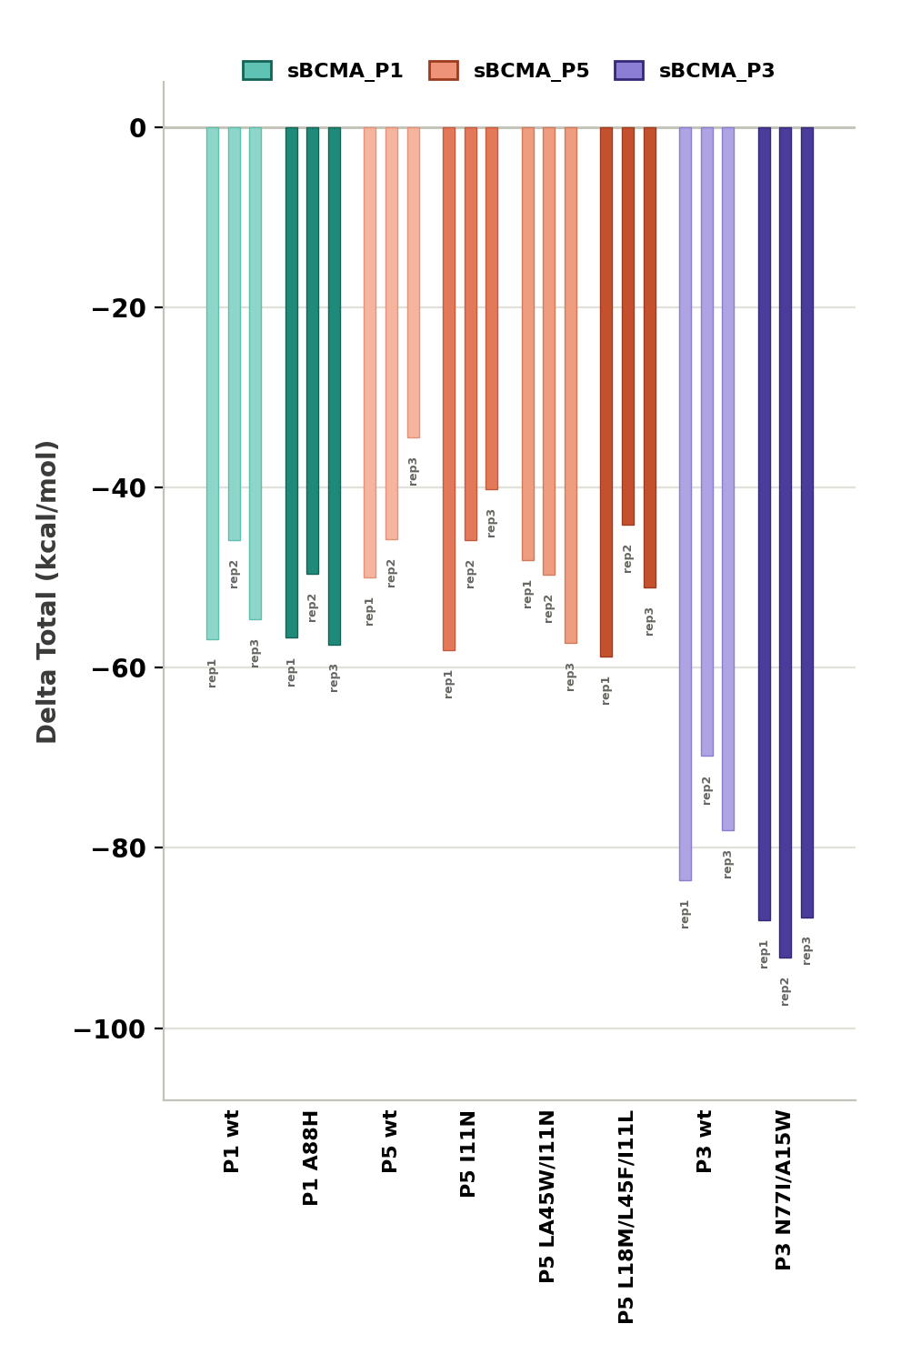
Comparison of MM/GBSA Binding Free Energies Between the Top Three Wild-Type Peptide Complexes and Their Corresponding Mutant Variants
Comparative MM/GBSA binding free energy analysis of the top three wild-type peptide complexes and their corresponding mutant variants. Total binding free energies , were calculated using the MM/GBSA method from three independent 200 ns molecular dynamics simulation replicates for the sBCMA_P1, sBCMA_P5, and sBCMA_P3 peptide complexes and their corresponding mutant variants. Bars represent the binding free energy obtained from each independent replicate. More negative values indicate more favorable predicted binding. Overall, the selected mutant variants exhibited binding free energy values that were comparable to or more favorable than those of their respective wild-type complexes, supporting their selection for subsequent structural and dynamic analyses.
ΔG (kcal/mol)

Slide 20
Sequence Overview of Wild-Type Peptides and Their Corresponding Mutant Variants Selected for Improved Binding Affinity
sBCMA_P1_WT | GRADFLAAVIAAMAIYEKAPAEIIEAAAKAVDLLEPLSPEGKRVAELAIKIAAGEANEEEILEAAELAKELAKRAAEEGAVTEEQAQAVIDAIEEGLLK
sBCMA_P1_mt_A88H (named as sBCP1) | GRADFLAAVIAAMAIYEKAPAEIIEAAAKAVDLLEPLSPEGKRVAELAIKIAAGEANEEEILEAAELAKELAKRAAEEGAVTEEQAQHVIDAIEEGLLK
sBCMA_P5_WT | AAEFEAKKKTIKETTAKLVAASTNPADKAKITAEGERSLAALEALAKAE
sBCMA_P5_mt_I11N (named as sBCP3) | AAEFEAKKKTNKETTAKLVAASTNPADKAKITAEGERSLAALEALAKAE
sBCMA_P5_mt_L45W_I11N | AAEFEAKKKTNKETTAKLVAASTNPADKAKITAEGERSLAALEAWAKAE
sBCMA_P5_mt_L18M_L45F_I11L | AAEFEAKKKTLKETTAKMVAASTNPADKAKITAEGERSLAALEAFAKAE
sBCMA_P3_WT | GEAVSAATLAALERARARGASPEVLAAGEQAAKNAPEMVKYAEEAHRALNVDKDPLAAARAIAKVYELIGSPEAKRNAAQARAFI
sBCMA_P3_mt_N77I_A15W (named as sBCP2) | GEAVSAATLAALERWRARGASPEVLAAGEQAAKNAPEMVKYAEEAHRALNVDKDPLAAARAIAKVYELIGSPEAKRIAAQARAFI

Slide 21
Structural Snapshots of the Wild-Type and Mutant sBCMA_P1 Complexes During 0 to 200 ns Molecular Dynamics Simulations Across Three Independent Replicates

Slide 22
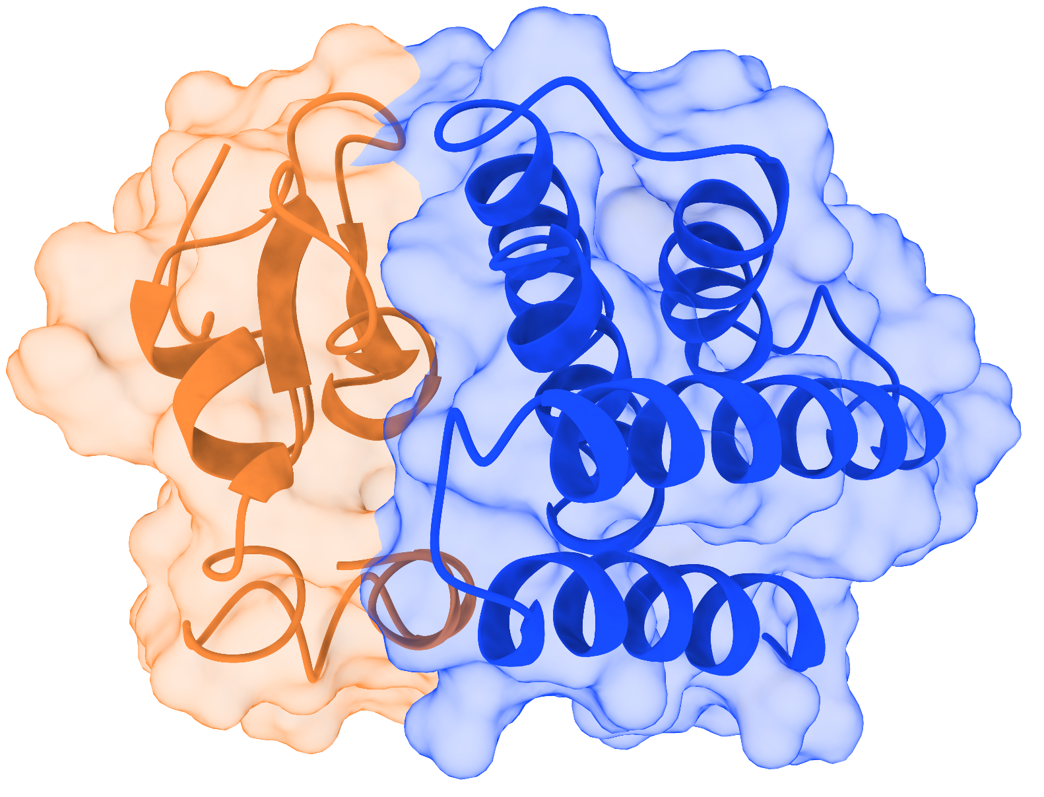
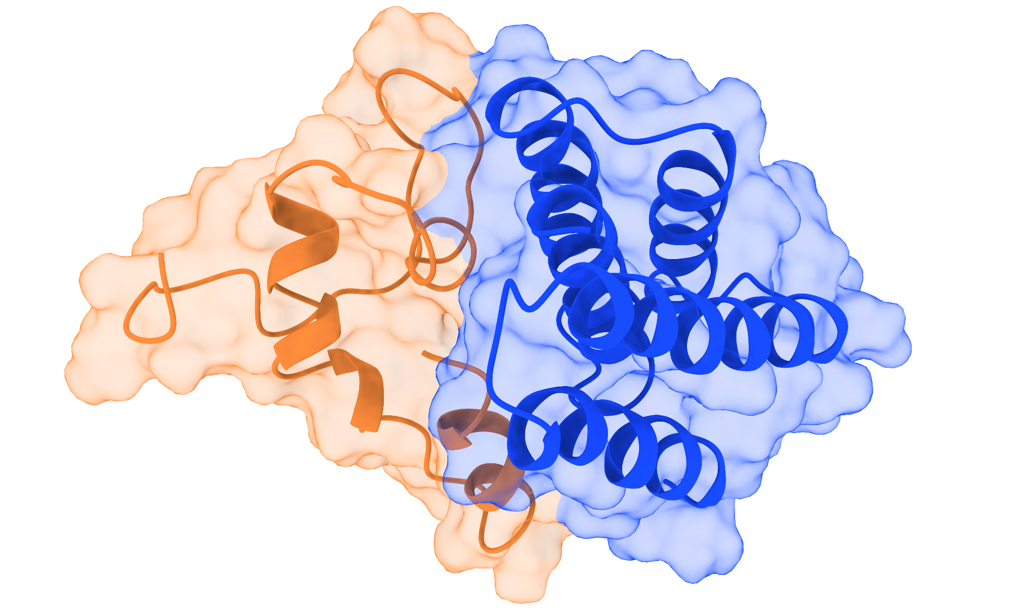
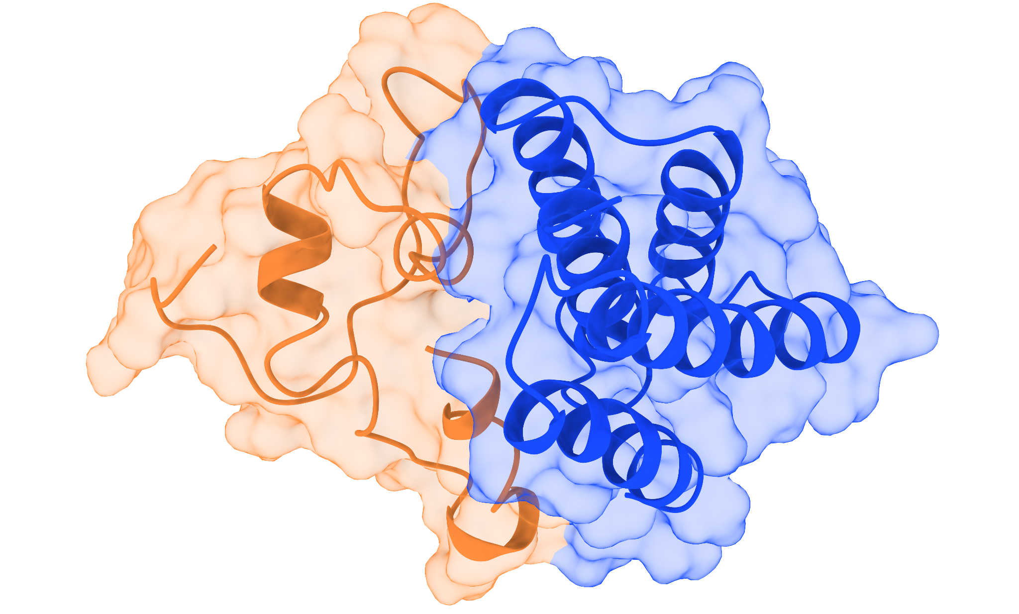
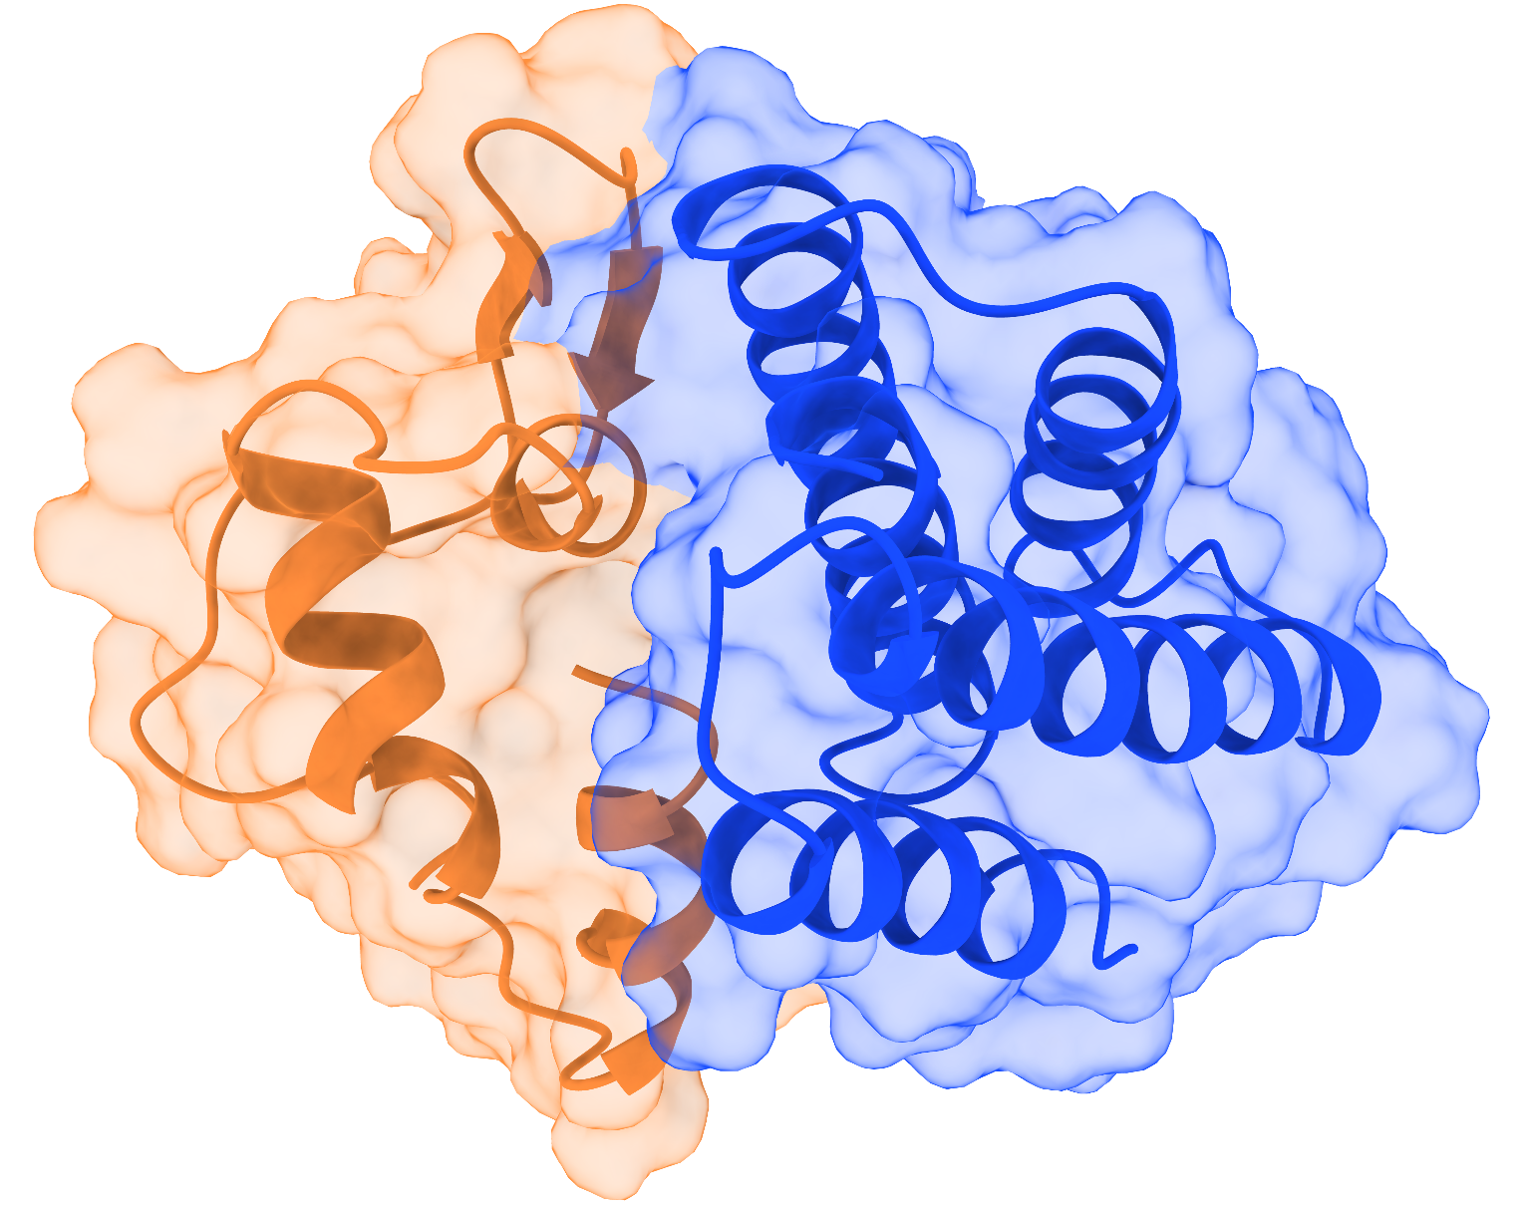
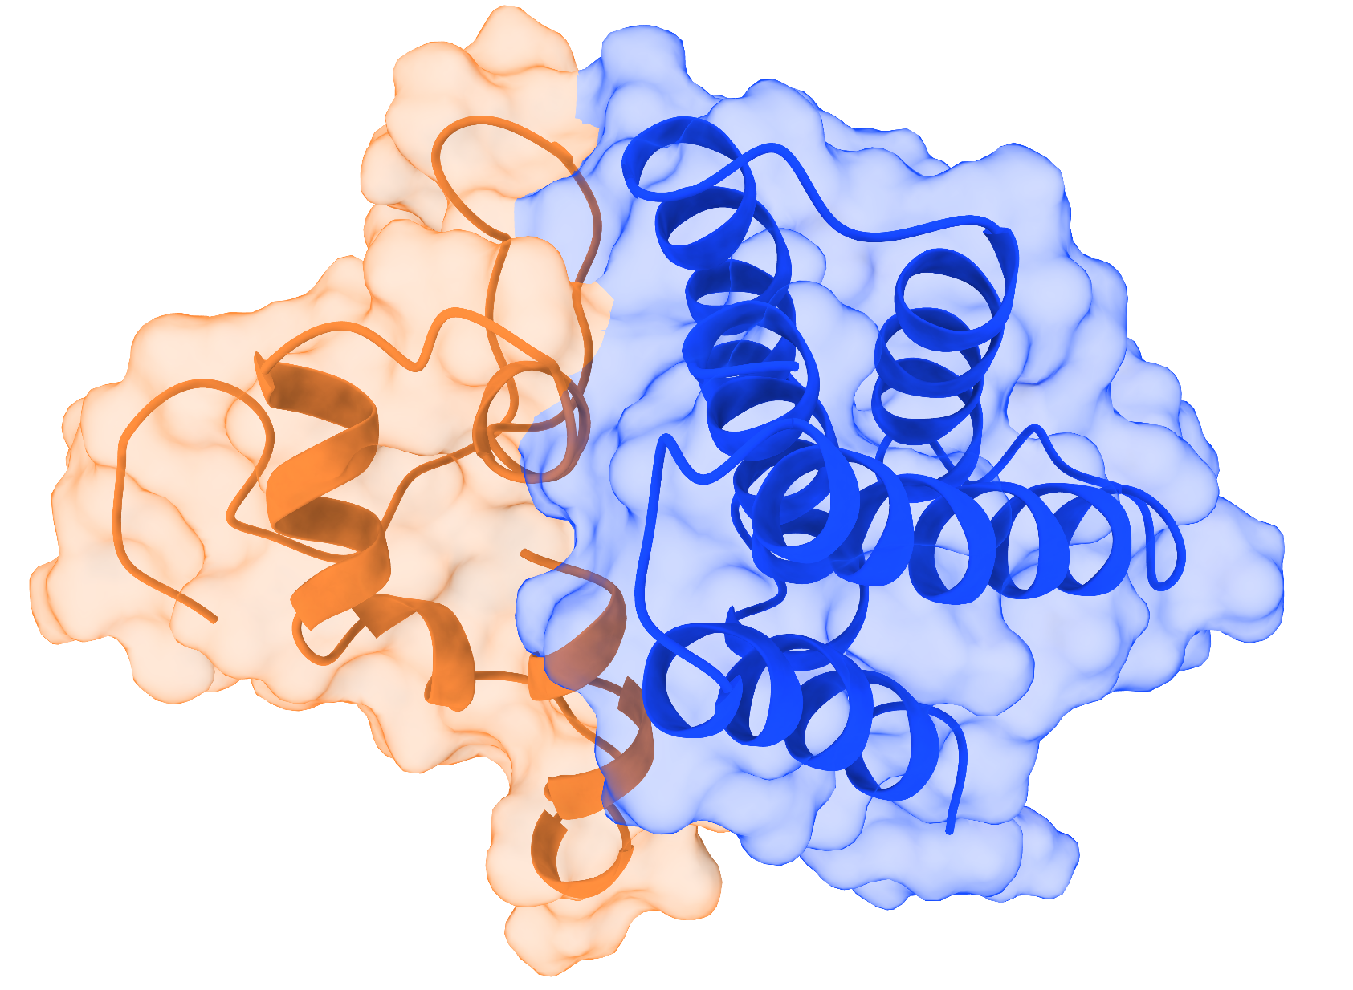
sBCMA_P1 wild type Replicate 1
50ns
100ns
0ns
150ns
200ns

Slide 23
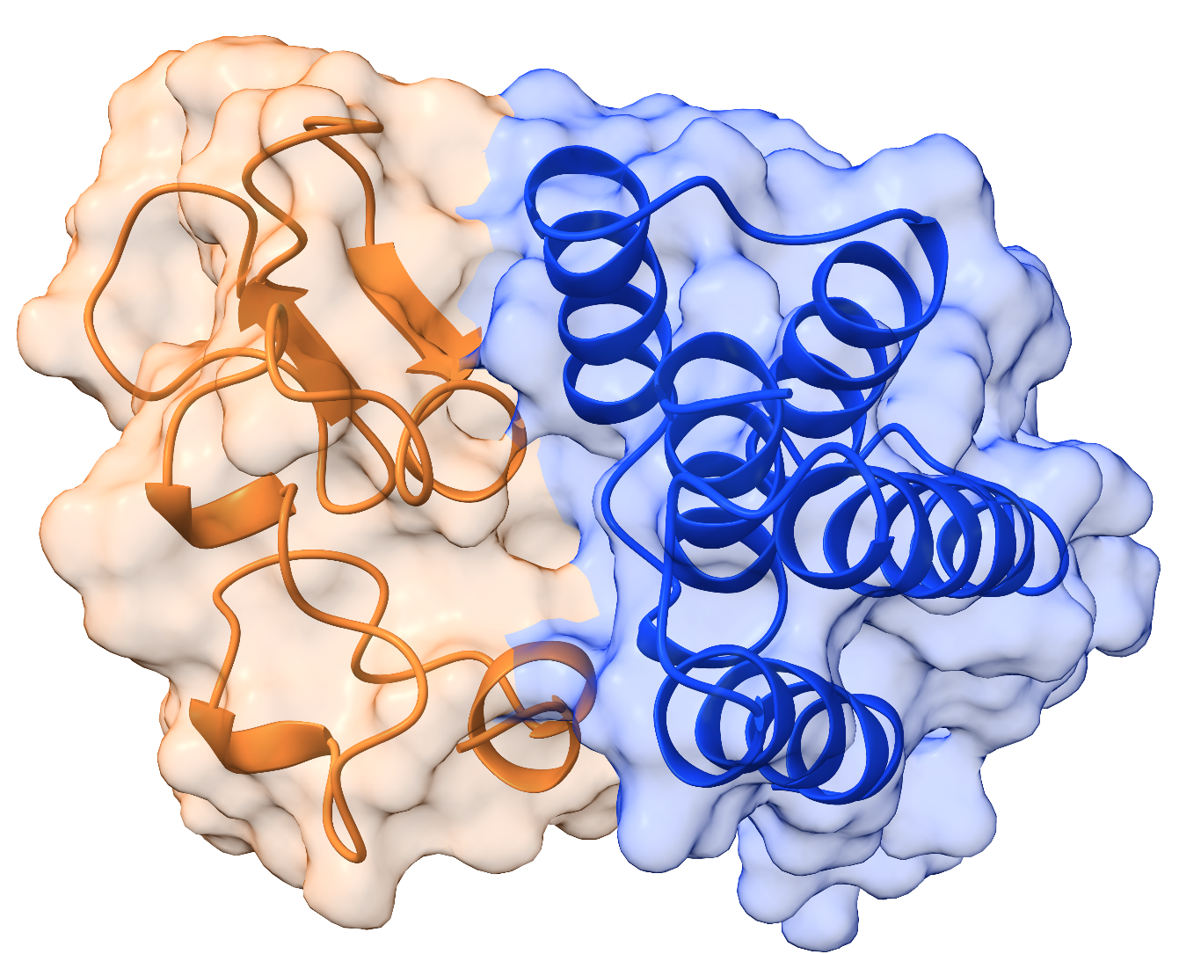
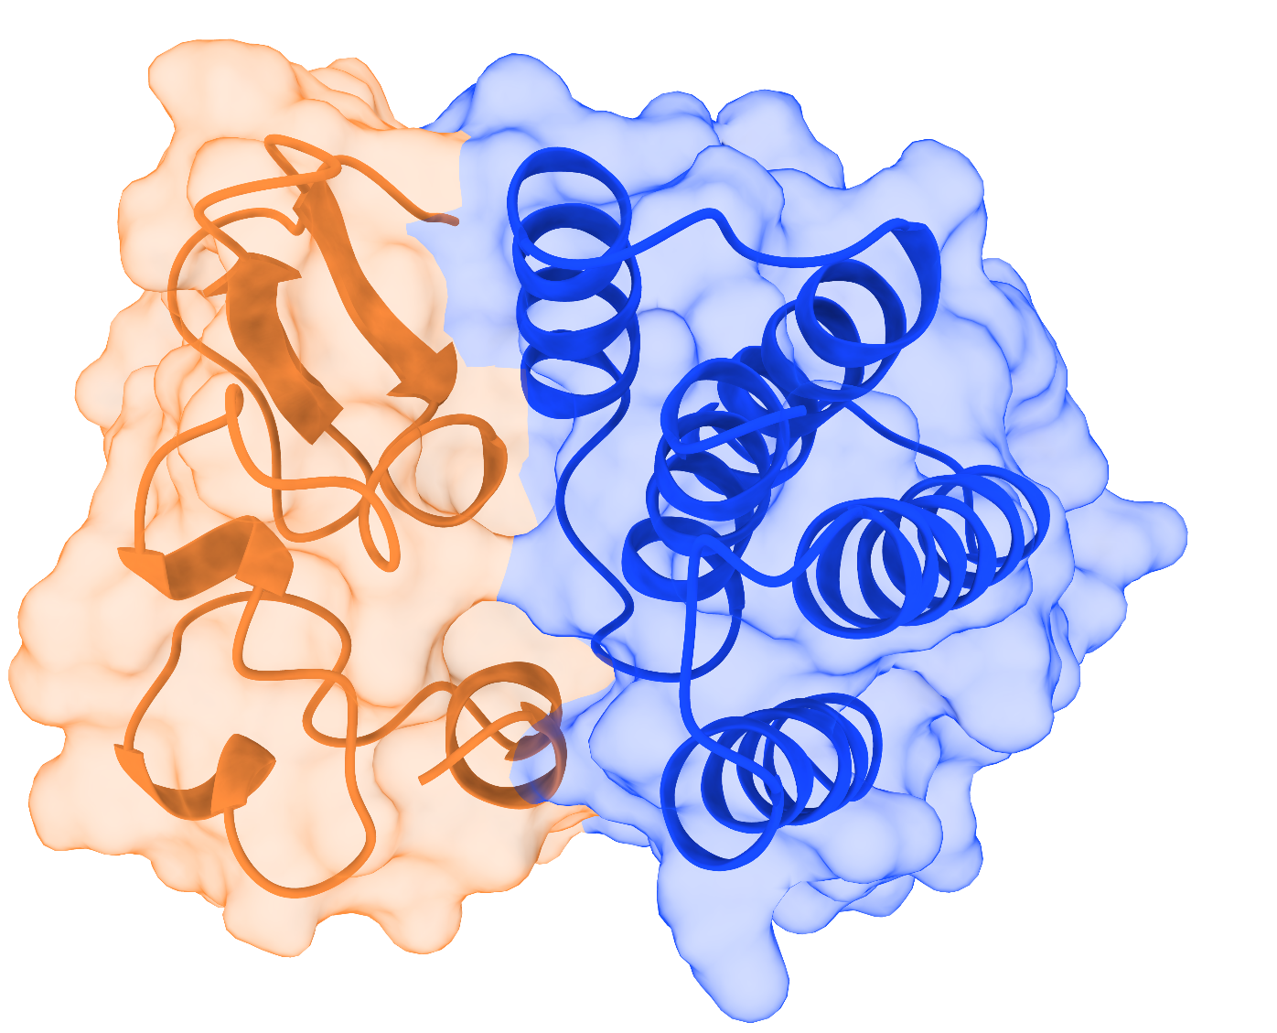
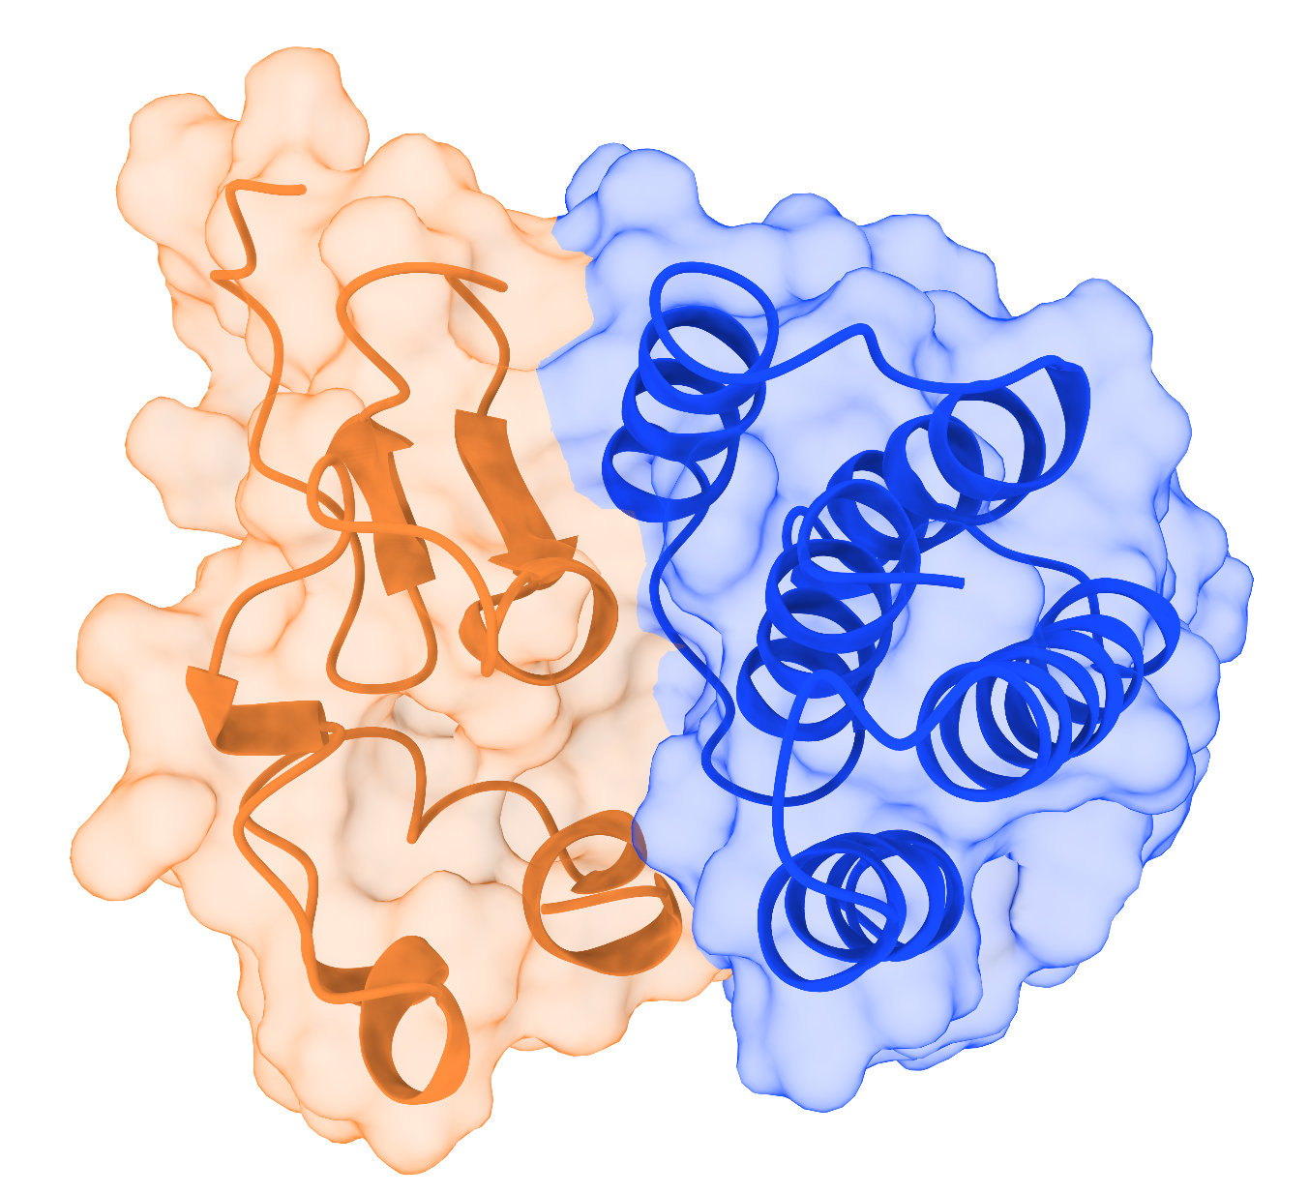
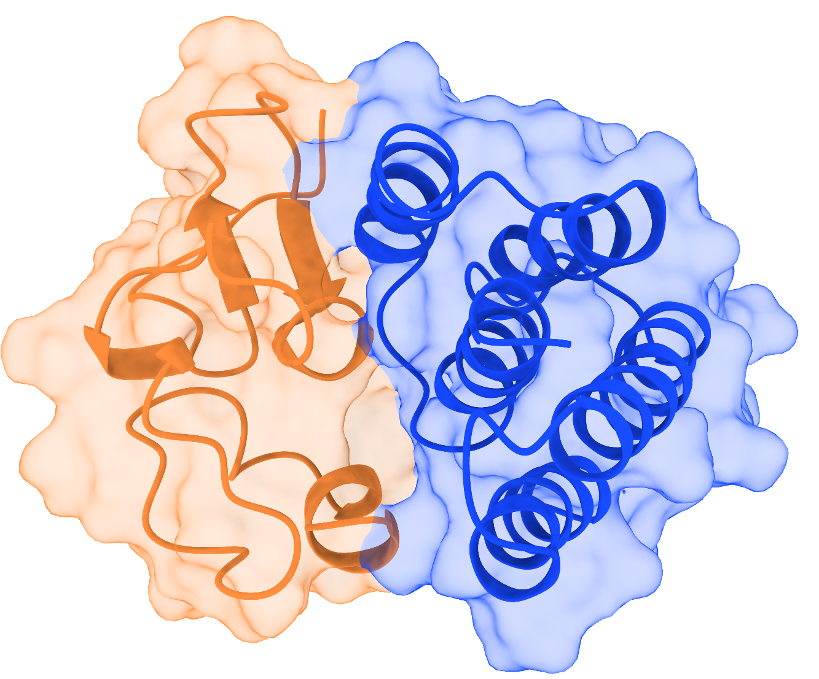
sBCMA_P1 wild type Replicate 2
50ns
100ns
0ns
150ns
200ns

Slide 24
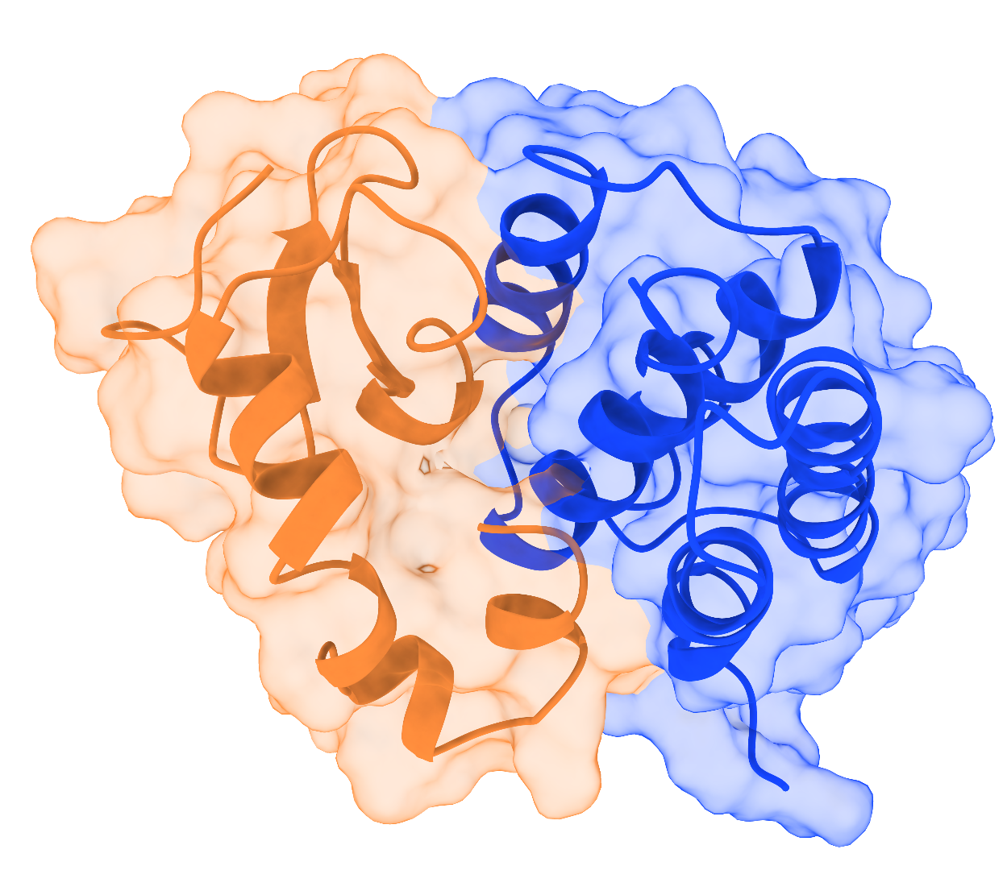
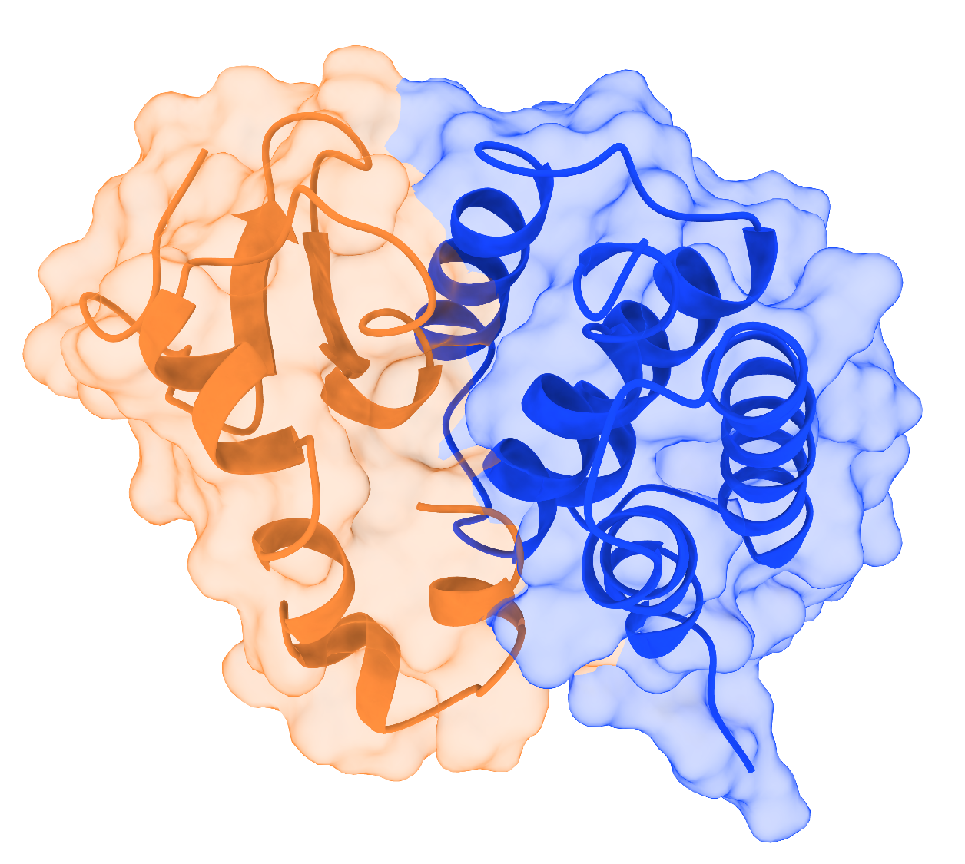
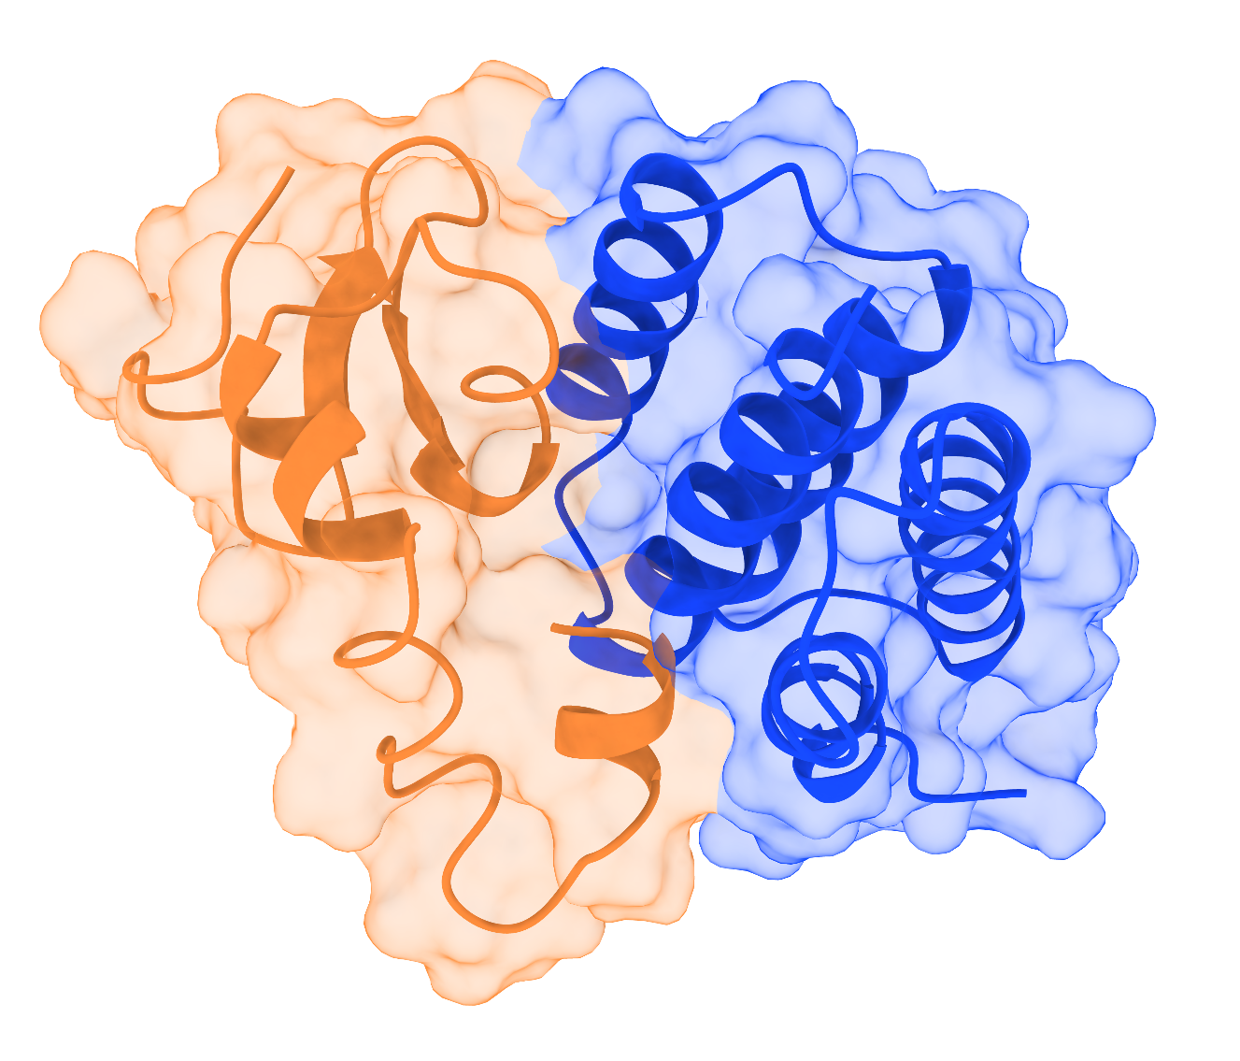
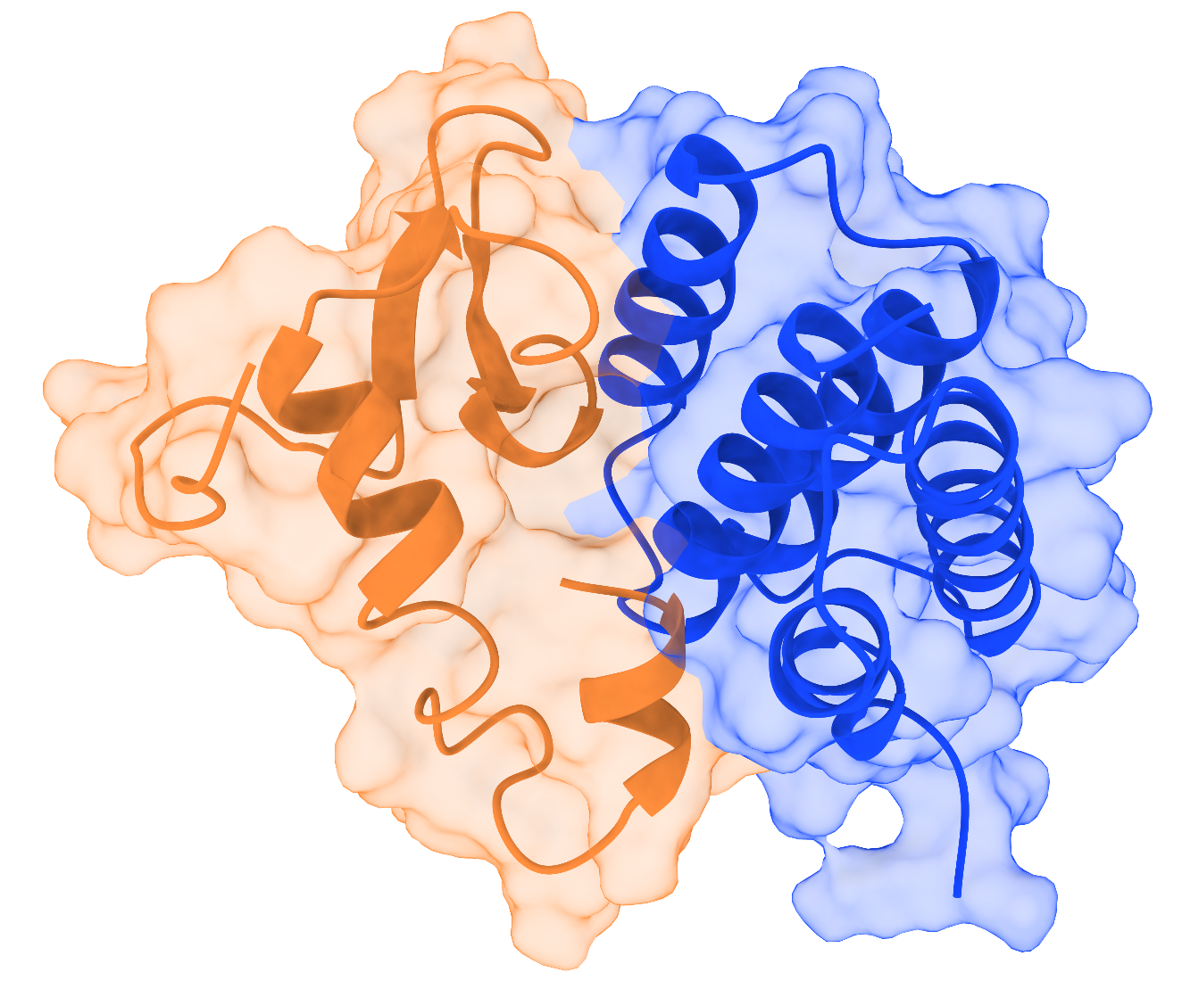
sBCMA_P1 wild type Replicate 3
50ns
100ns
0ns
150ns
200ns

Slide 25
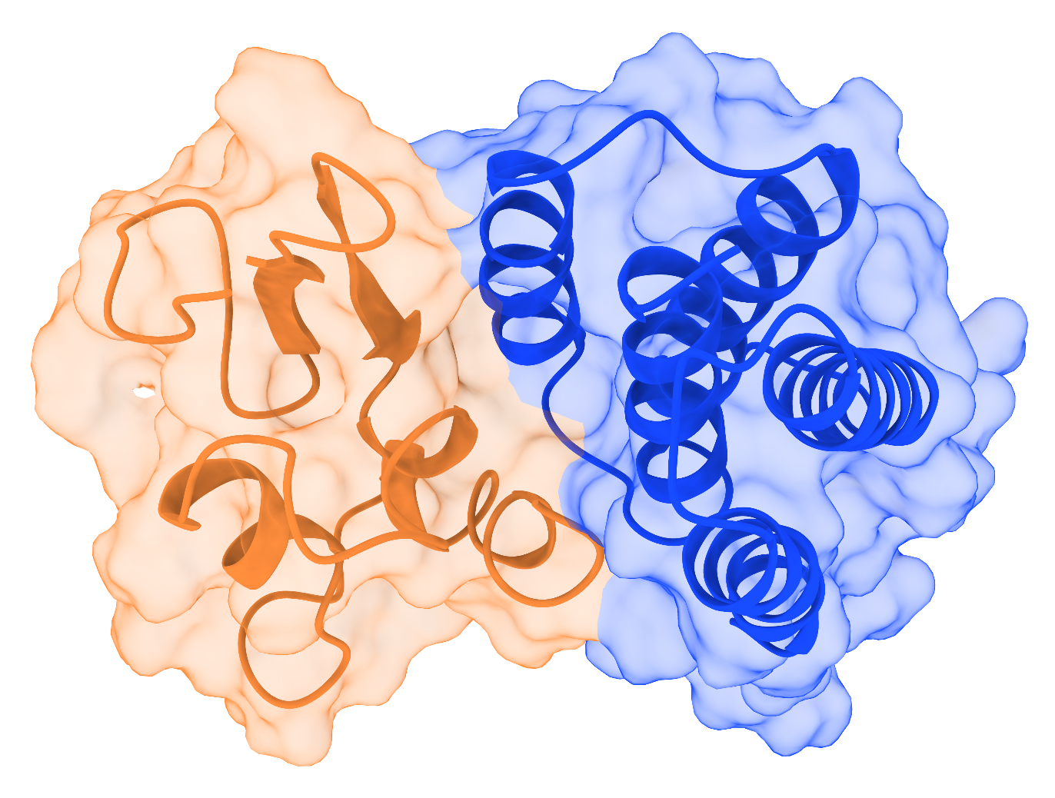
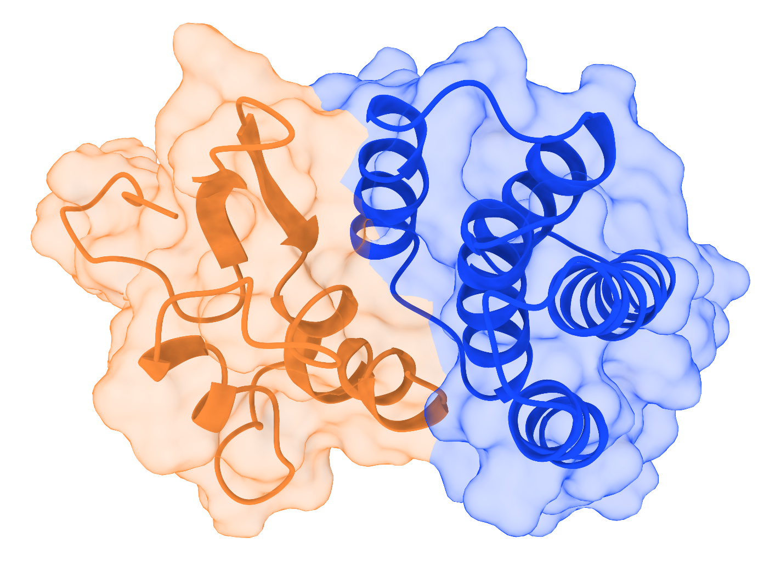
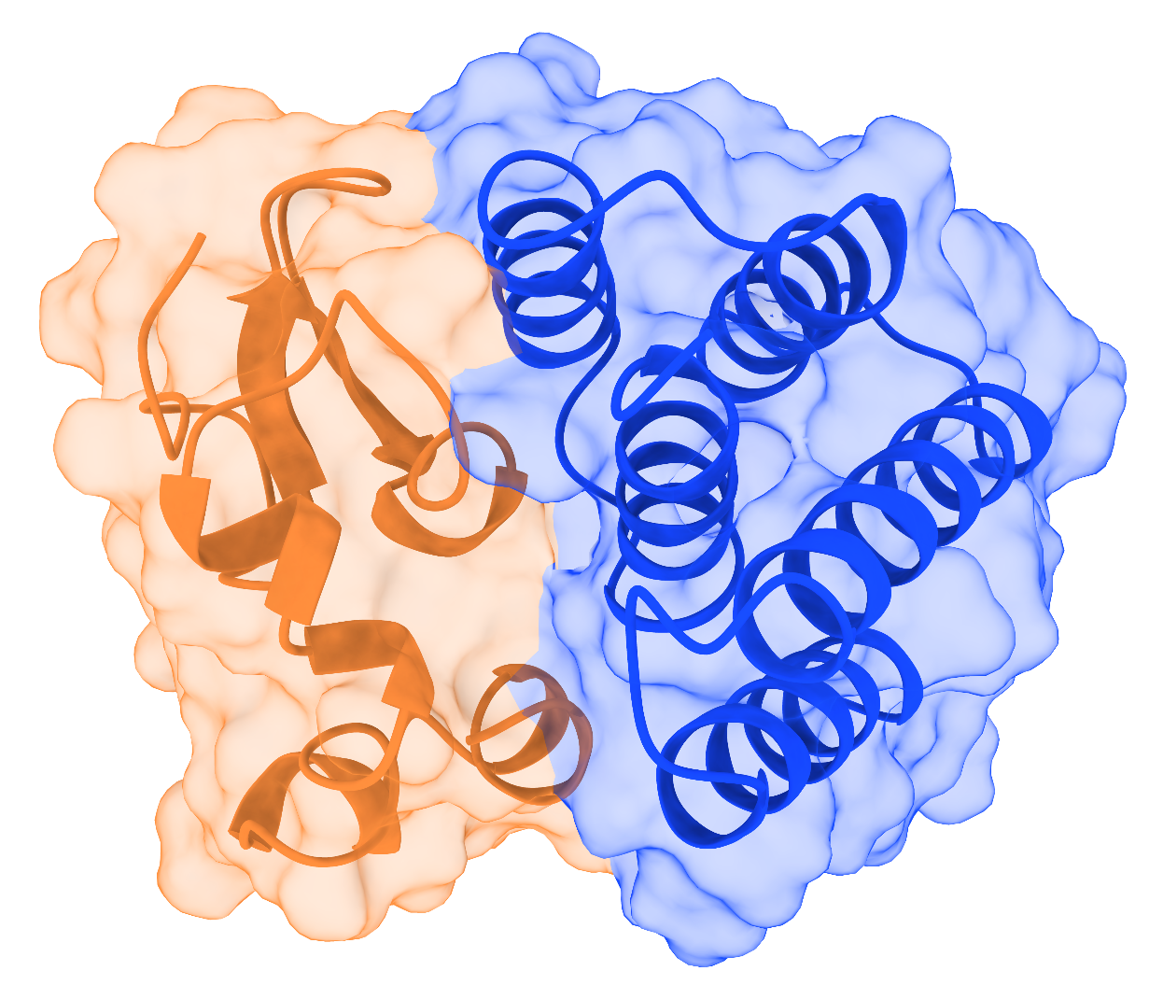
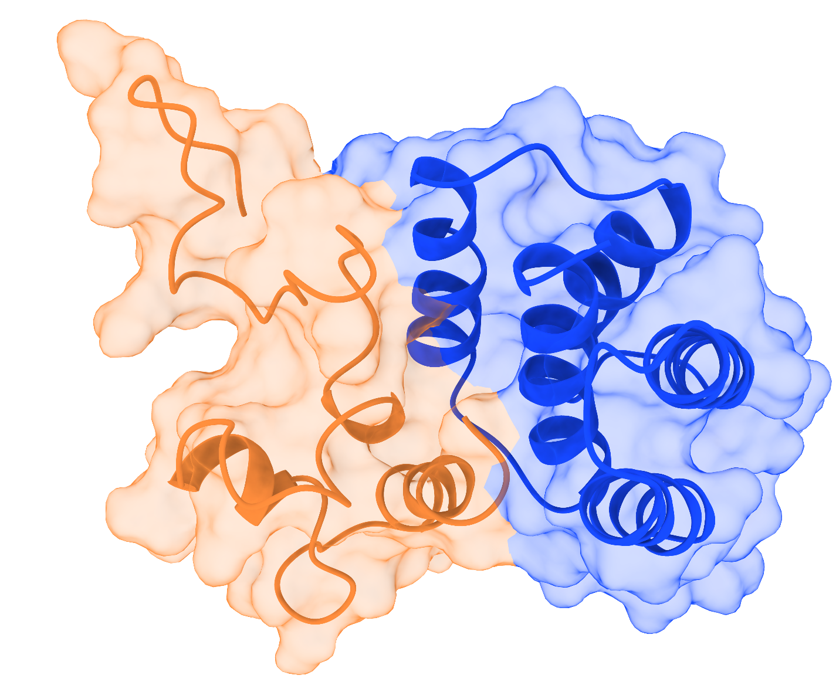
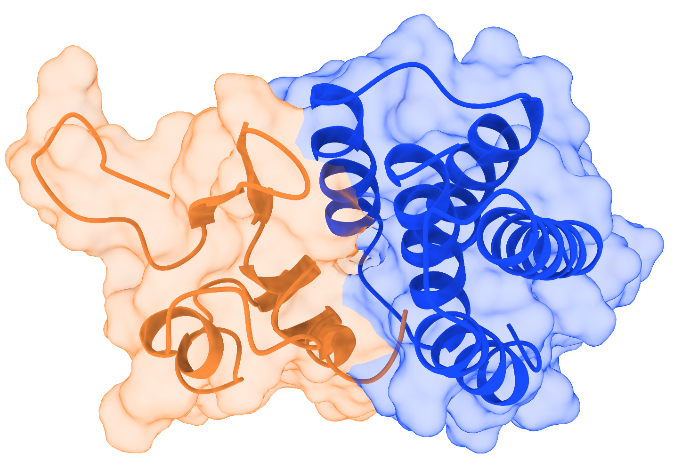
sBCMA_P1_mt_A88H (sBCP1) Replicate 1
50ns
100ns
0ns
150ns
200ns

Slide 26
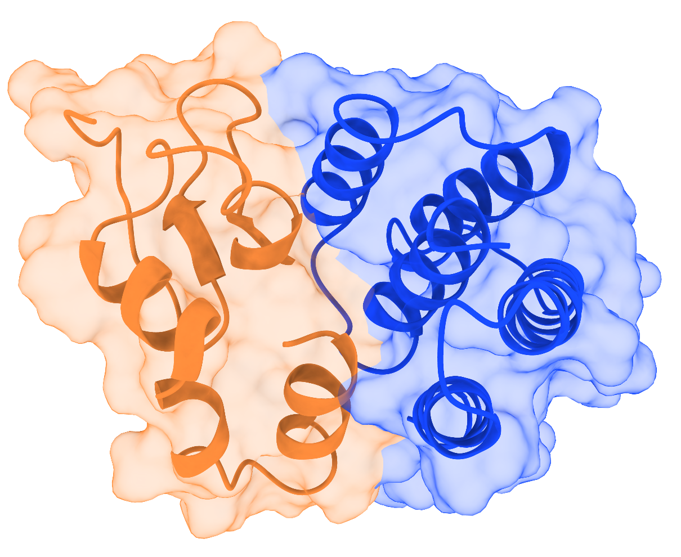
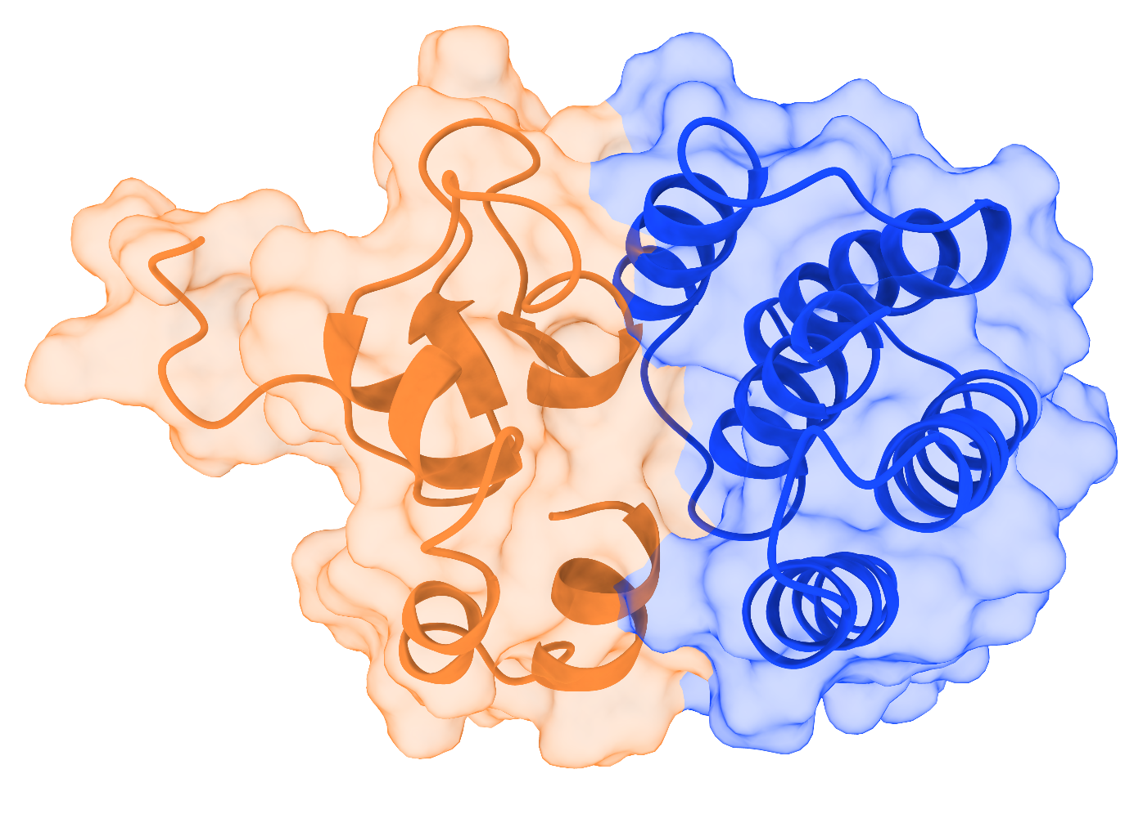
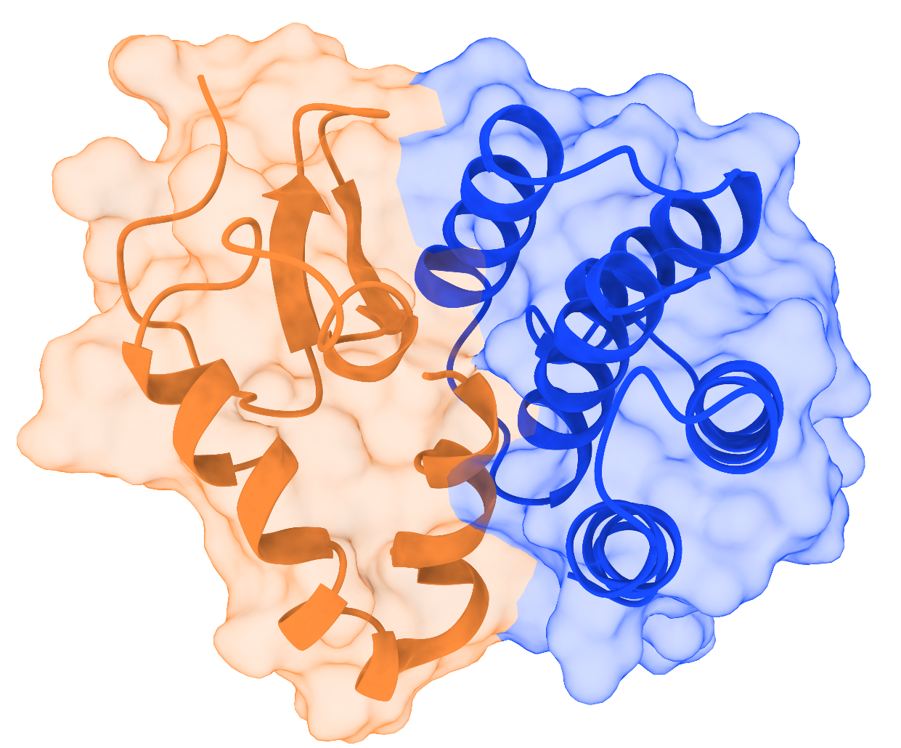

sBCMA_P1_mt_A88H (sBCP1) Replicate 2
50ns
100ns
0ns
200ns
150ns

Slide 27




sBCMA_P1_mt_A88H (sBCP1) Replicate 3
100ns
50ns
100ns
0ns
0ns
150ns
200ns
200ns

Slide 28
Structural Snapshots of the Wild-Type and Mutant sBCMA_P3 Complexes During 0 to 200 ns Molecular Dynamics Simulations Across Three Independent Replicates

Slide 29



sBCMA_P3 wild type Replicate 1
0ns
50ns
100ns
150ns
200ns

Slide 30
sBCMA_P3 wild type Replicate 2
0ns
50ns
100ns
150ns
200ns

Slide 31
sBCMA_P3 wild type Replicate 3
0ns
50ns
100ns
150ns
200ns

Slide 32
sBCMA_P1_mt_N77I_A15W (sBCP2) Replicate 1
0ns
50ns
100ns
150ns
200ns

Slide 33
sBCMA_P1_mt_N77I_A15W (sBCP2) Replicate 2
0ns
50ns
100ns
150ns
200ns

Slide 34
sBCMA_P1_mt_N77I_A15W (sBCP3) Replicate 3
0ns
100ns
50ns
150ns
200ns

Slide 35
Structural Snapshots of the Wild-Type and Mutant sBCMA_P5 Complexes During 0 to 200 ns Molecular Dynamics Simulations Across Three Independent Replicates

Slide 36
sBCMA_P5 Wild type Replicate 1
50ns
100ns
0ns
150ns
200ns

Slide 37
sBCMA_P5 Wild type Replicate 2
50ns
100ns
0ns
150ns
200ns

Slide 38
sBCMA_P5 Wild type Replicate 3
50ns
100ns
0ns
150ns
200ns

Slide 39

sBCMA_P5_mt_I11N (sBCP3) Replicate 1
50ns
100ns
0ns
150ns
200ns

Slide 40
sBCMA_P5_mt_I11N (sBCP3) Replicate 2
50ns
100ns
0ns
150ns
200ns

Slide 41
sBCMA_P5_mt_I11N (sBCP3) Replicate 3
50ns
100ns
0ns
150ns
200ns

Slide 42
sBCMA_P5_mt_LA45W_IA11N Replicate 1
50ns
0ns
100ns
150ns
200ns

Slide 43
sBCMA_P5_mt_LA45W_IA11N Replicate 2
50ns
0ns
100ns
150ns
200ns

Slide 44
sBCMA_P5_mt_LA45W_IA11N Replicate 3
50ns
0ns
100ns
150ns
200ns

Slide 45

sBCMA_P5_mt_LA18M_LA45F_IA11L Replicate 1
50ns
0ns
100ns
150ns
200ns

Slide 46




sBCMA_P5_mt_LA18M_LA45F_IA11L Replicate 2
50ns
0ns
100ns
150ns
200ns

Slide 47




sBCMA_P5_mt_LA18M_LA45F_IA11L Replicate 3
50ns
100ns
0ns
150ns
200ns

