Slide 1
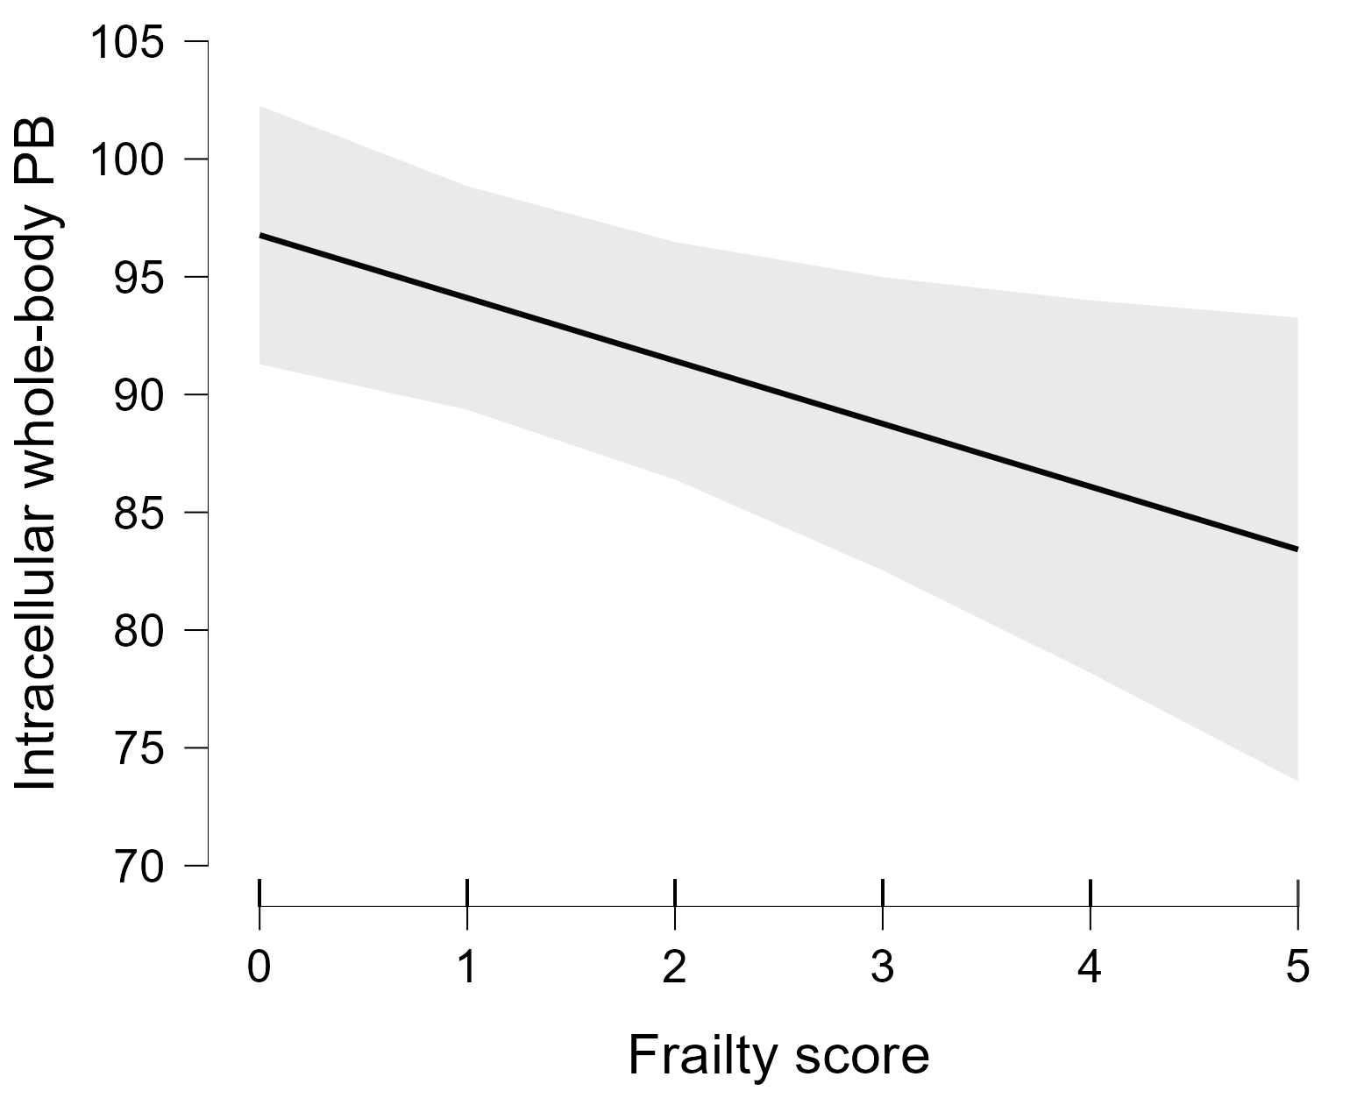
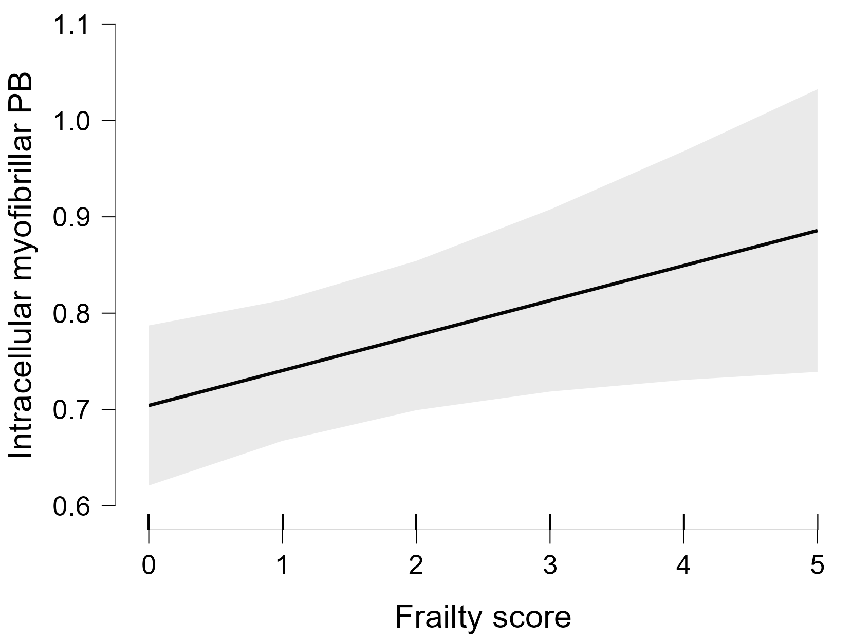
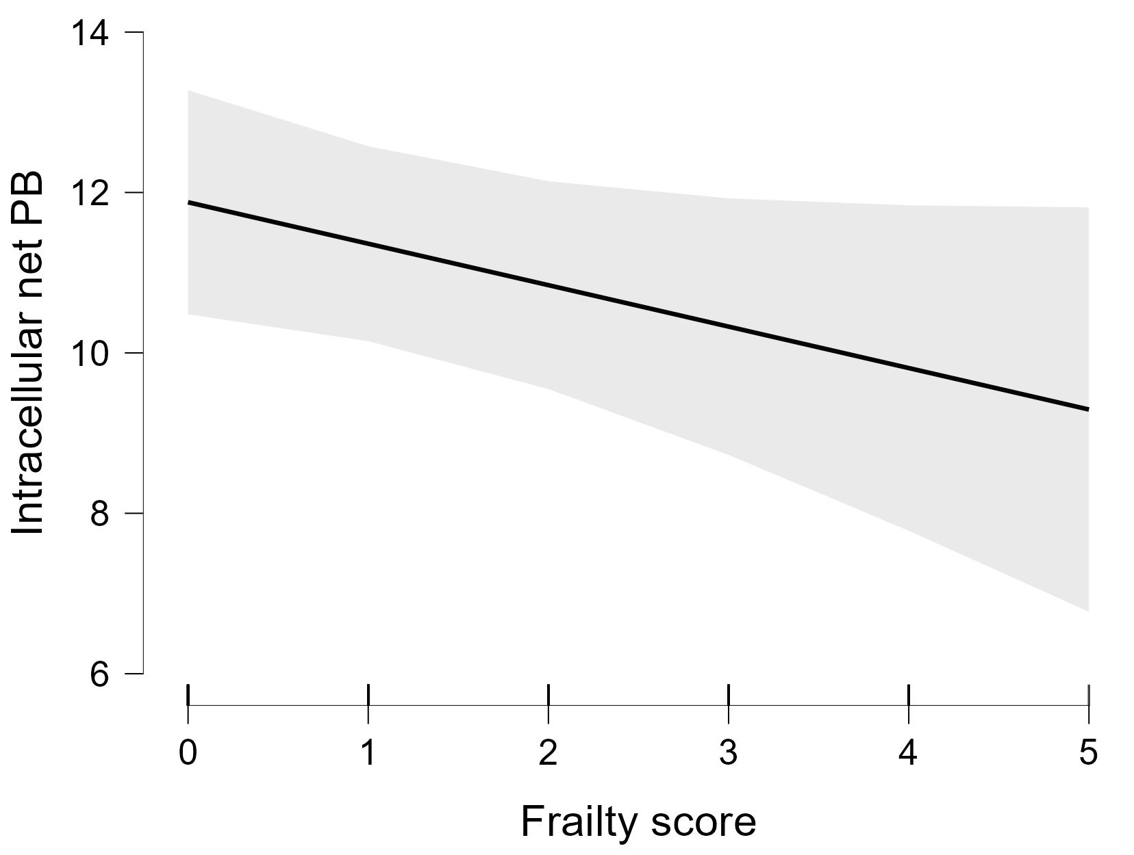
Supplemental Figure 1. Association between absolute frailty score and protein metabolism markers in the whole group
Partial correlation: 0.161
P = 0.034
Partial correlation:
-0.131
P = 0.082
(c)
Partial correlation:
-0.168
P value = 0.022
(a)
(b)

Slide 2
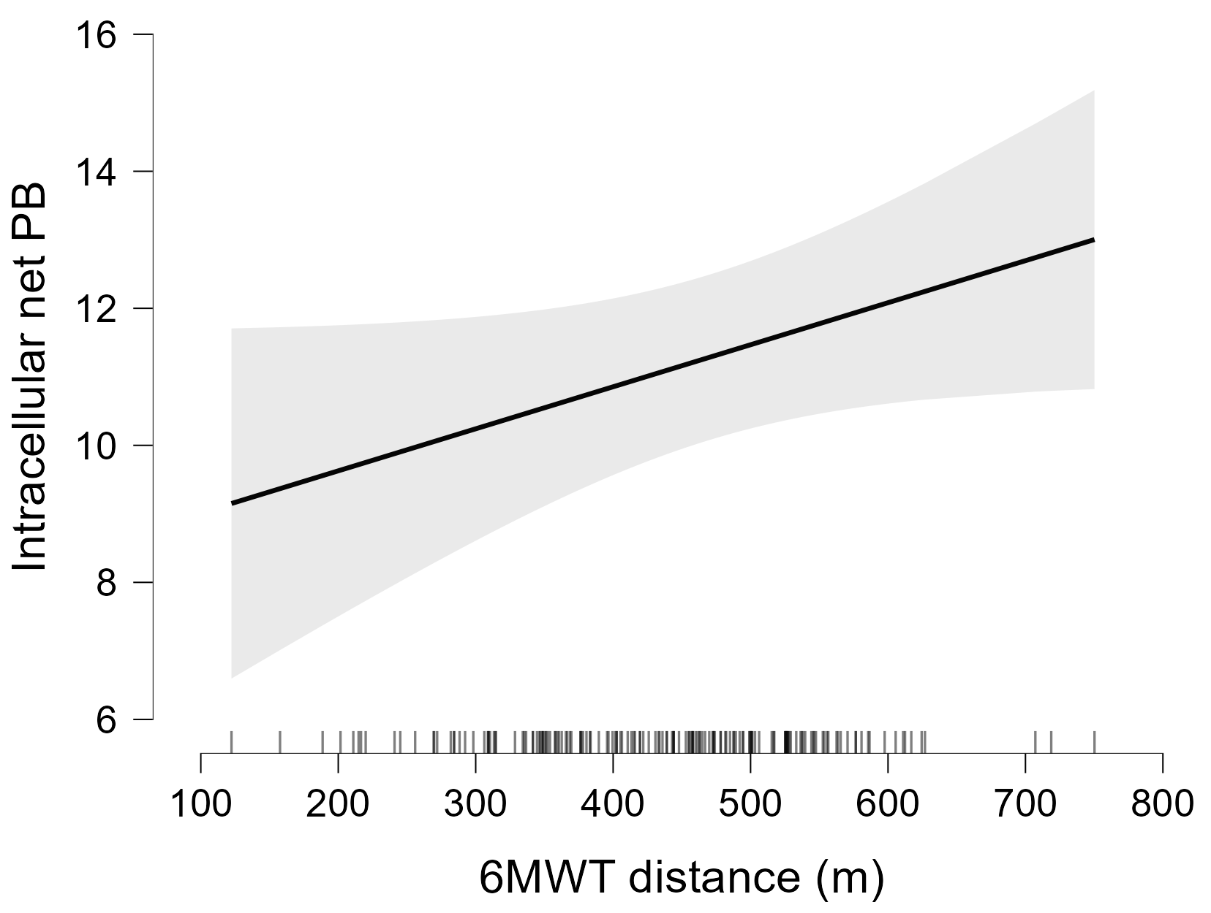
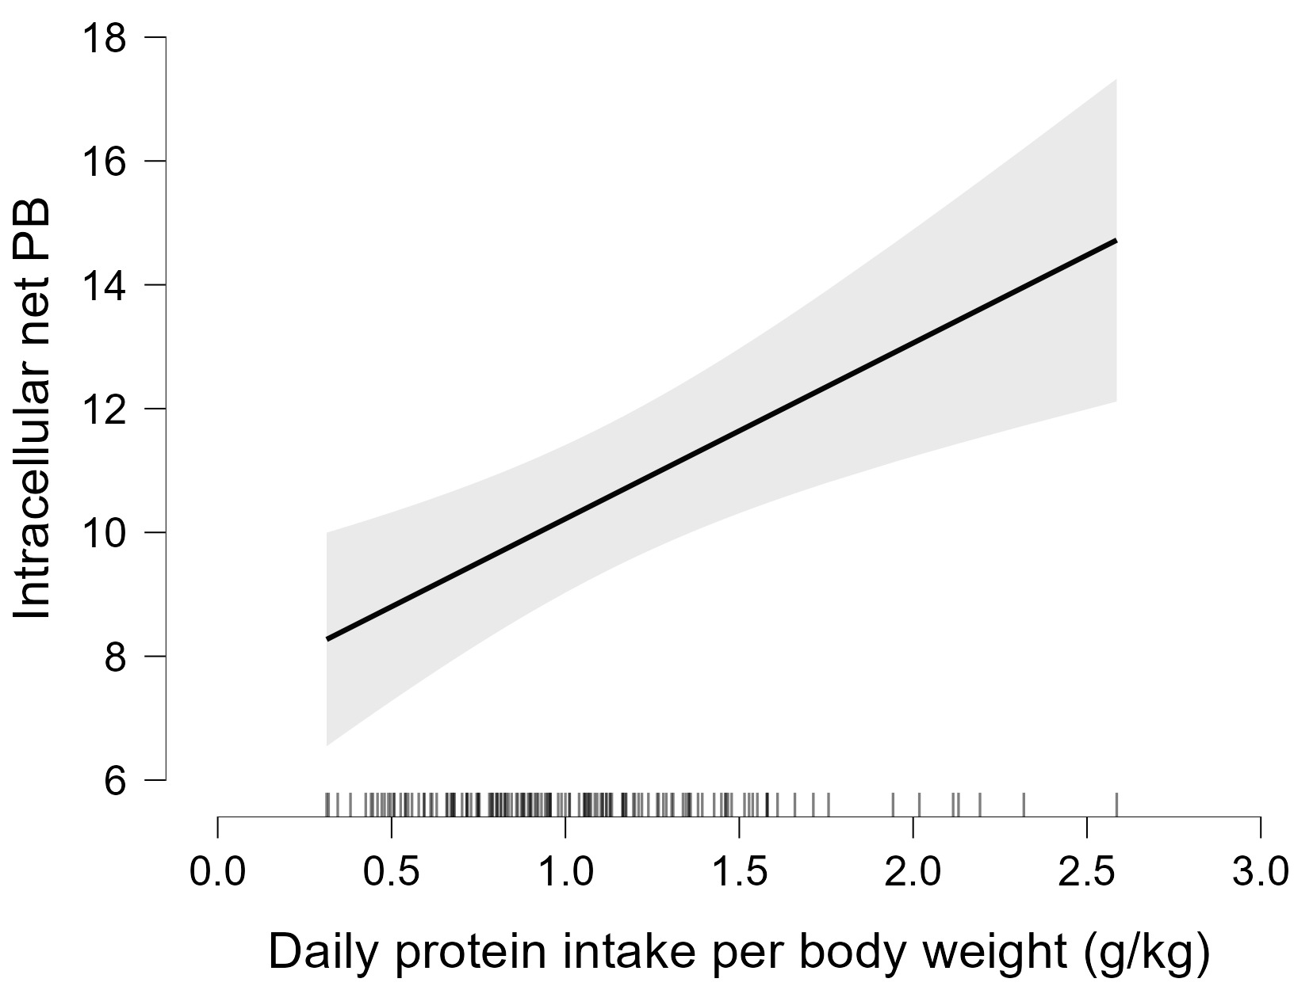
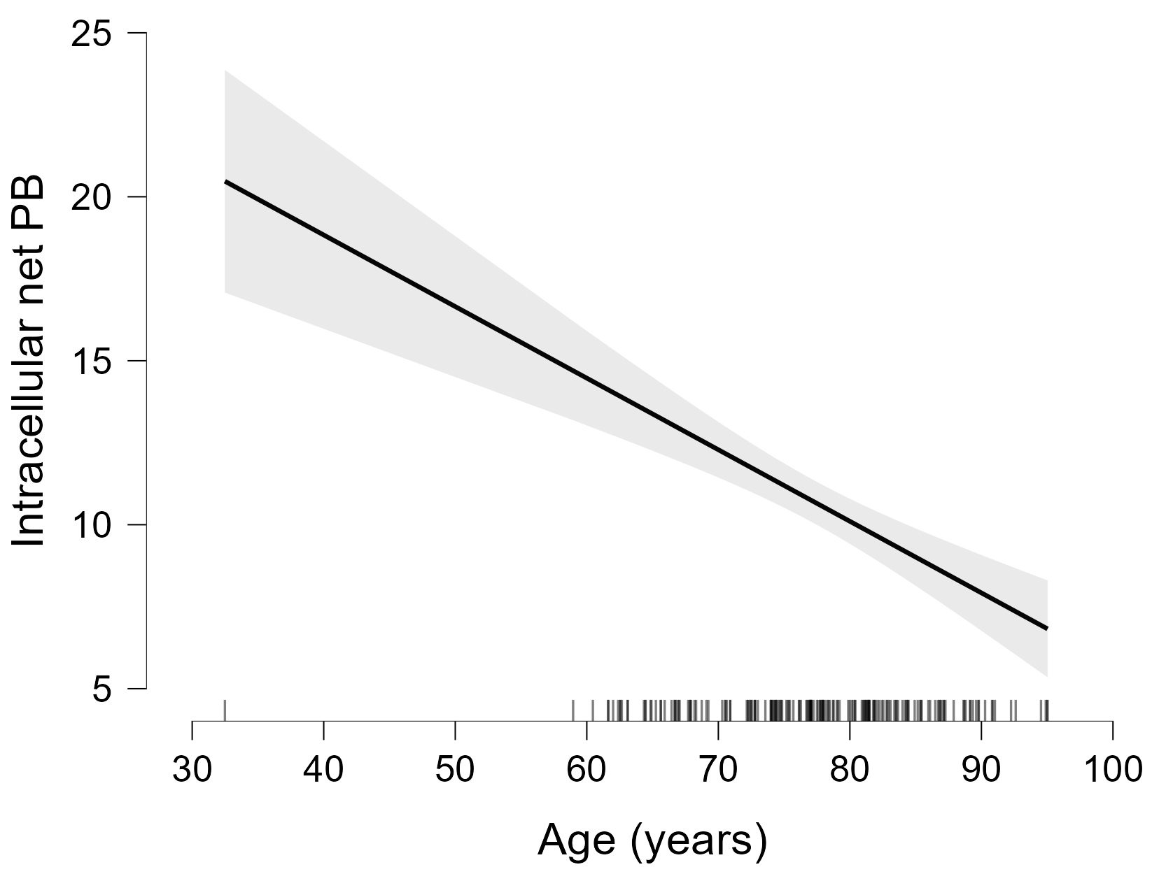
Supplemental Figure 2. Association between net protein breakdown and 6MWT distance, protein intake, and age in the whole group
Partial correlation: 0.143
P = 0.06
Partial correlation: 0.288
P < 0.001
(a)
(c)
(b)
Partial correlation:
-0.399
P < 0.001

