Slide 1
Supplementary
Pearson correlations for the dry-season and rainy-season snapshots (n = 12 stations each).
Eight core variables; total coliforms log₁₀-transformed.

Slide 2
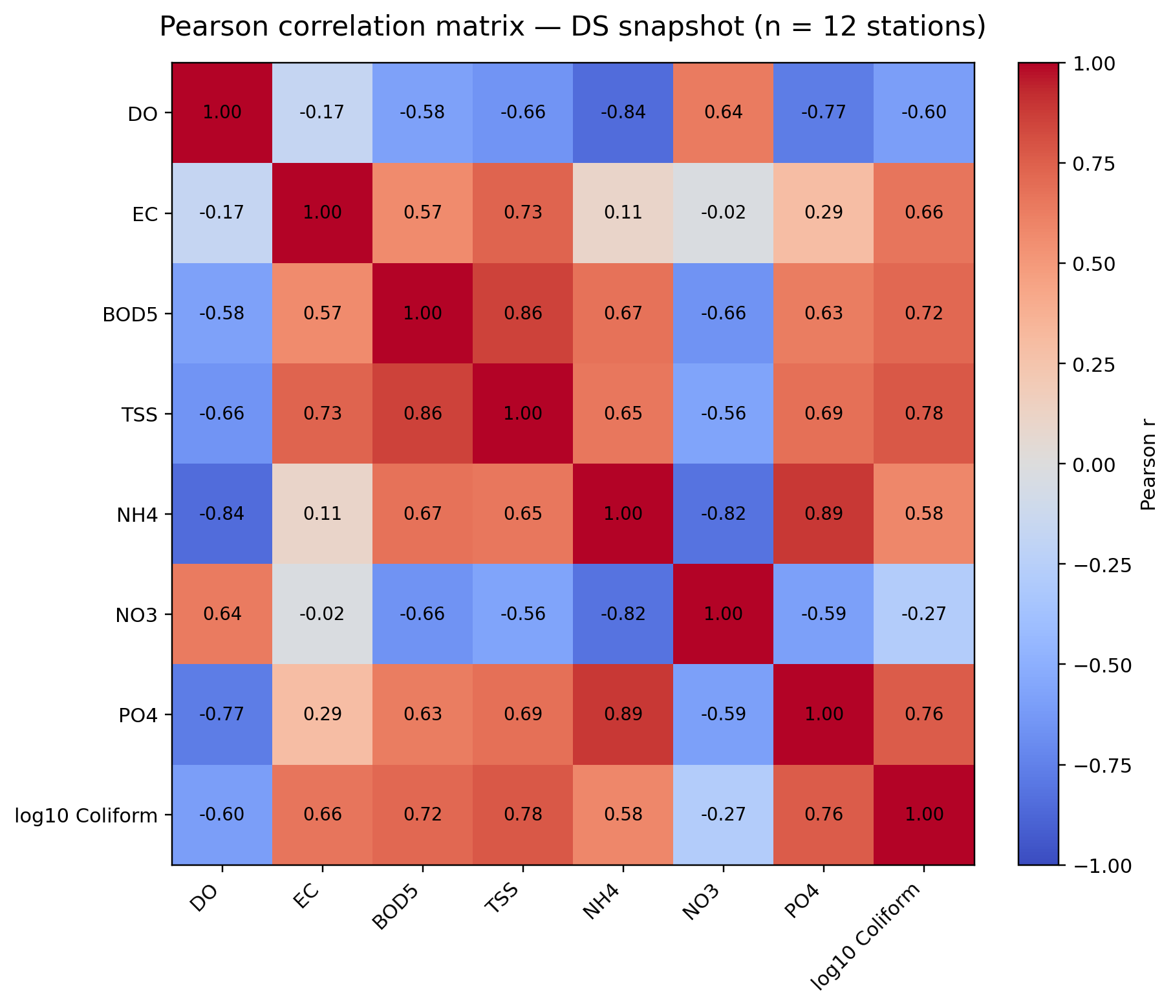
Supplementary— Dry-season (DS)
Pearson correlation matrix; exploratory co-variation, n = 12 stations
Core variables: DO, EC, BOD₅, TSS, NH₄, NO₃, PO₄, log₁₀ total coliforms

Slide 3
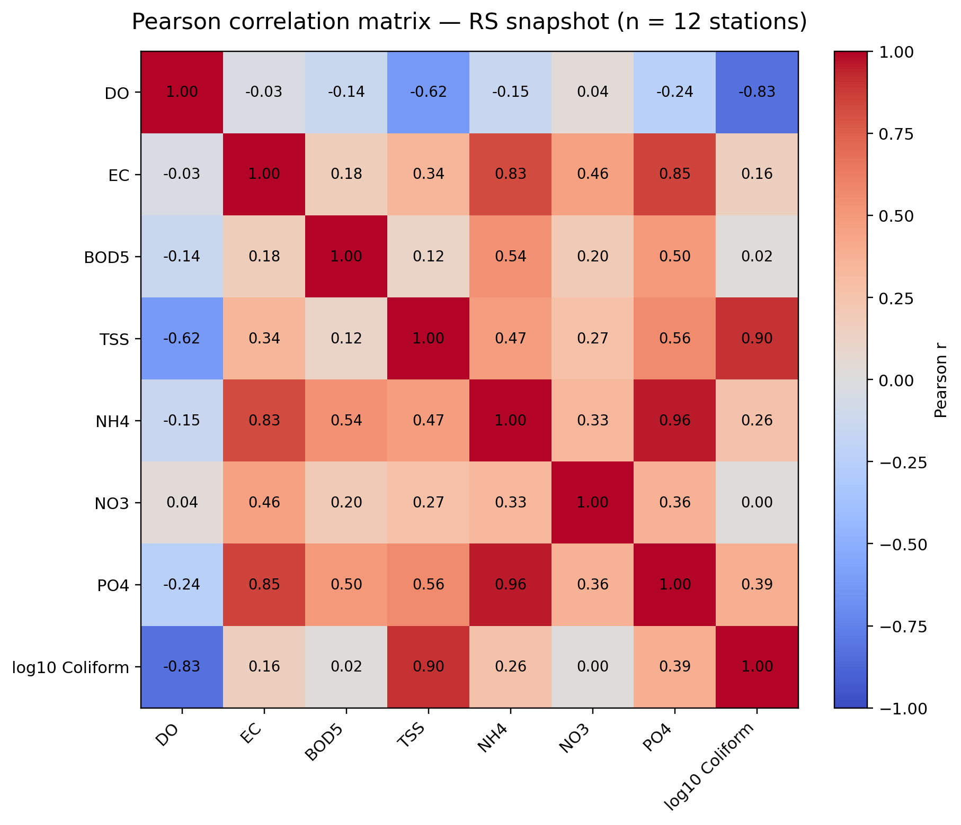
Supplementary — Rainy-season (RS)
Pearson correlation matrix; exploratory co-variation, n = 12 stations
Core variables: DO, EC, BOD₅, TSS, NH₄, NO₃, PO₄, log₁₀ total coliforms

