Slide 1
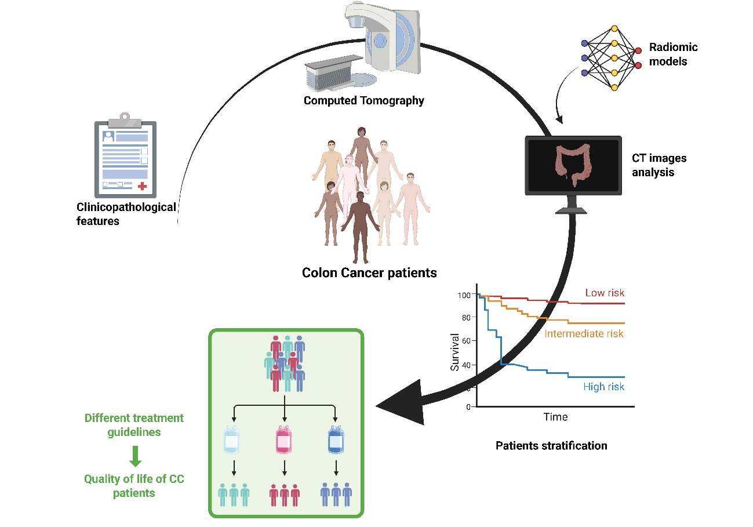
Figure Graphical Abstract: Overview of the study workflow and clinical application. Preoperative computed tomography images from patients with colon cancer are analyzed to extract radiomic features, which are combined with clinical data to develop predictive models. These models enable stratification of patients into risk groups based on relapse probability. This imaging-based risk stratification may support treatment decision-making, allowing adaptation of therapeutic strategies and potentially improving patient outcomes and quality of life.

