Slide 1
Combination of ^{64/67}Cu Theranostics and Immunotherapy Targeting Fibroblast Activation Protein in Triple-Negative Breast Cancer
Supplemental Figures

Slide 2
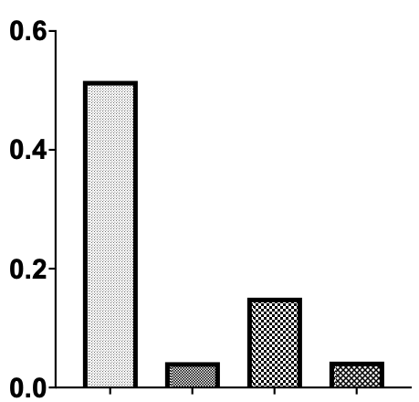


Supplemental Figures
a
b
4T1
E0771
TUBO
TS/A
FAP (95 kDa)
Relative Expression of FAP
ß Actin (42 kDa)
4T1
TS/A
E0771
TUBO
Notes:
Supplementary Fig 1: In Vitro biological validation of FAP expression in 4T1 TNBC model. (a) Representative in vitro western blot results of FAP expression in four different types of breast cancer cell lines with one replicate per sample and housekeeping gene beta-actin showing quantifiable expression of FAP in 4T1 cells. (b) Quantification of FAP protein band intensity from western blot with 4T1 cells showing the highest amount FAP.

Slide 3
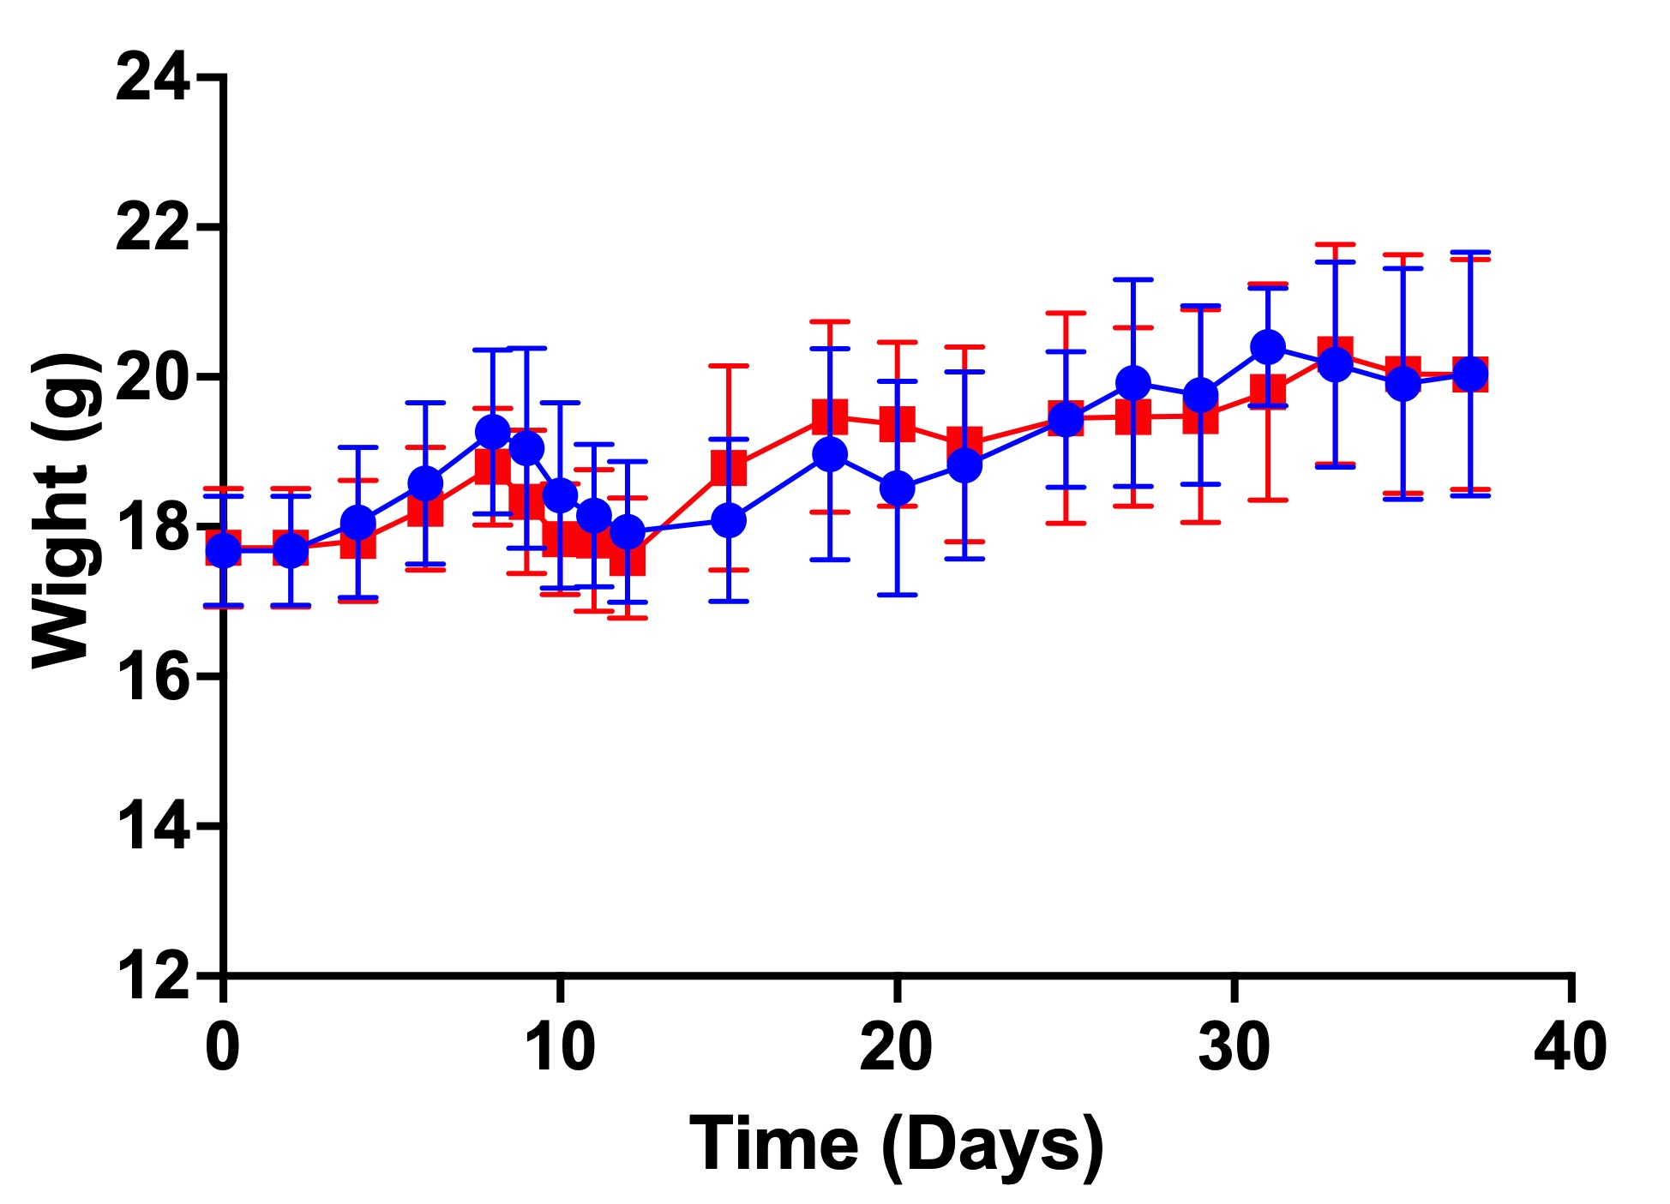
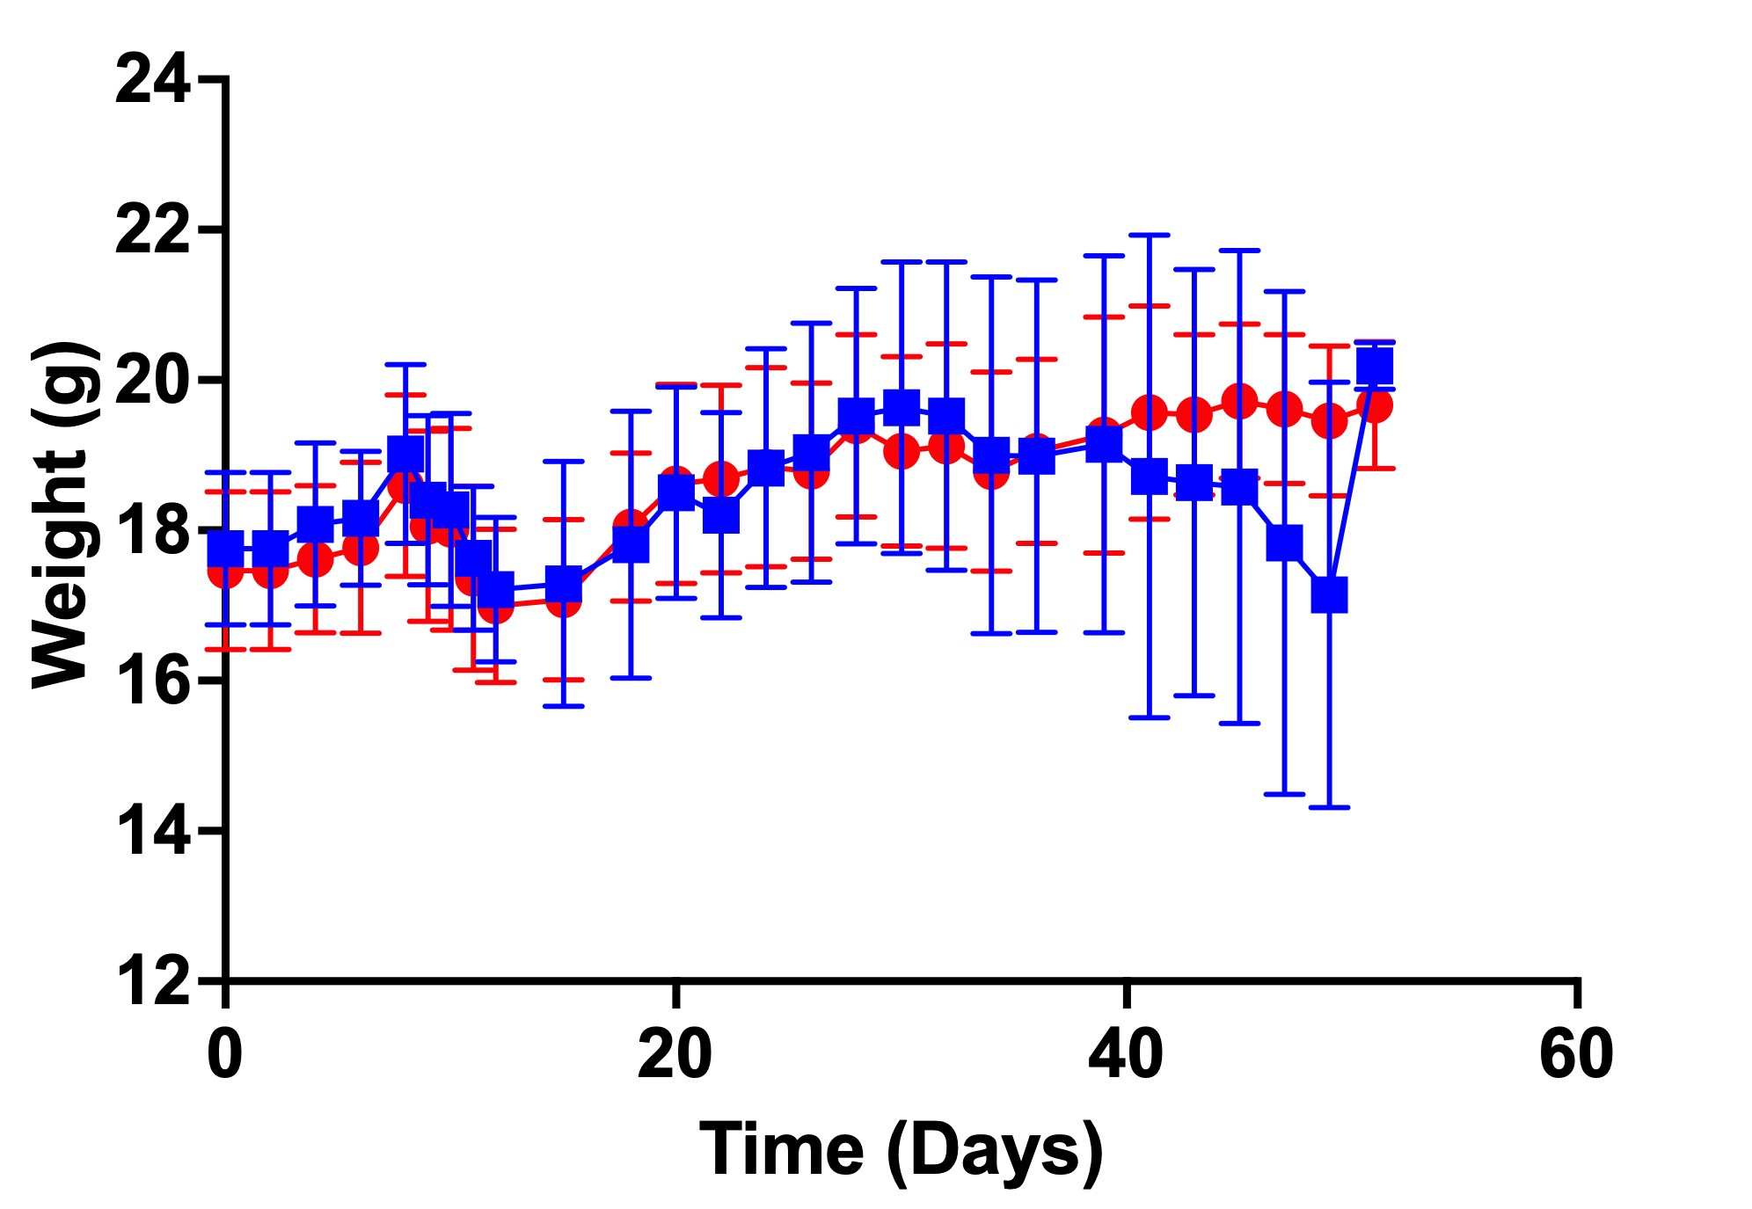
Supplemental Figures
a
800µCi [⁶⁷Cu]-FAP2287 ​
b
1600µCi [⁶⁷Cu]-FAP2287 ​
Notes:
Supplementary Fig 2: Long-term weight monitoring: Mice treated with (a) 800µCi [67Cu]-FAP2287±IMT and (b) 1600µCi [67Cu]-FAP2287±IMT were monitored for any visible changes in body posture and weight loss and we observed that over time there was no significant decrease in their weights and they had no visible changes in their body postures in both doses of TRT.

Slide 4
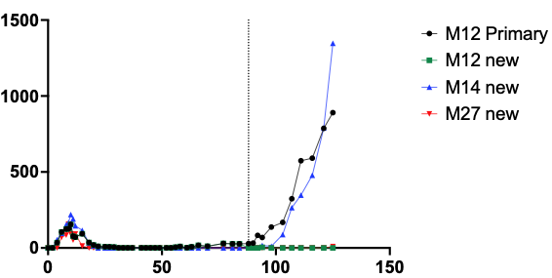
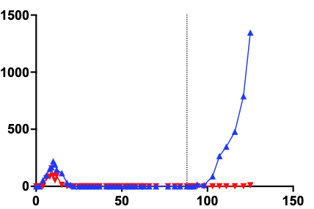
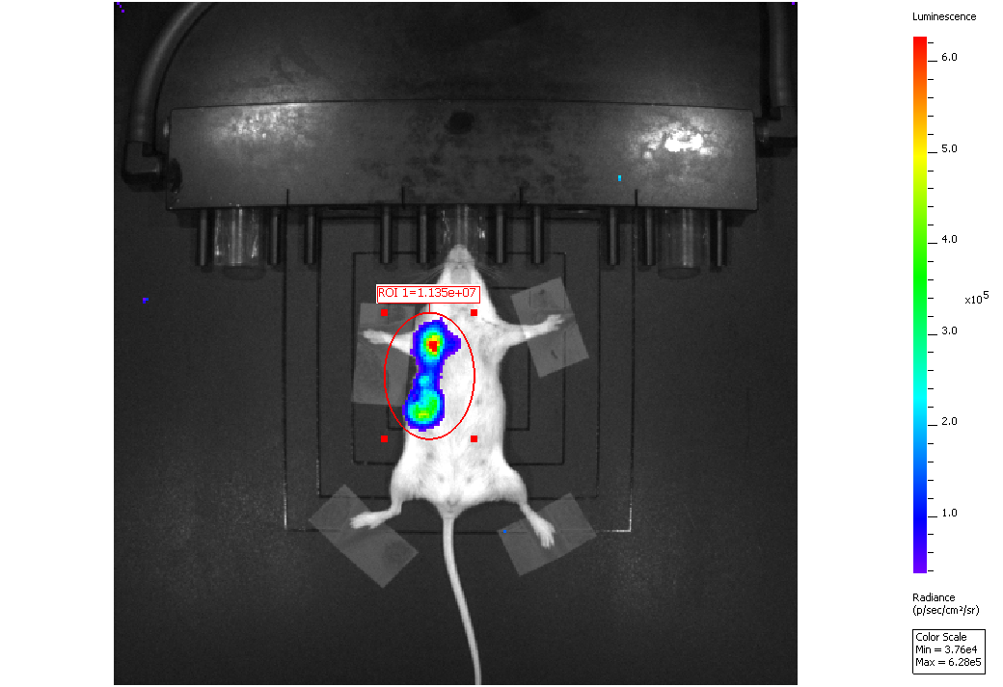
Supplemental Figures
a
b
Rechallenged 4T1 Tumors
800µCi [⁶⁷Cu]-FAP2287+IMT
2.5 Months post
1600µCi [⁶⁷Cu]-FAP2287+IMT
5.58e⁴
Tumor Volume (mm ³)
BLI (p/s)
1600µCi
800µCi
1.60e⁴
Time (Days)
Notes:
Supplementary Fig 3: Long-term immune surveillance: (a) Bioluminescence imaging of Balb/c mice treated with 1600µCi [⁶⁷Cu]-FAP2287+IMT (left) 800µCi [⁶⁷Cu]-FAP2287+IMT with one mouse showing recurrence of the primary tumor (right) 2.5 months post tumor injection indicates complete response to treatment with no residual primary tumor or any metastasis. (b) Tumor growth curve from exploratory study of the balb/c mice previously treated with 800/1600µCi [⁶⁷Cu]-FAP2287+IMT rechallenged with 4T1 tumors indicates that the mouse that received the higher dose of [⁶⁷Cu]-FAP2287 had increased immune surveillance and decreased tumor growth compared to the mouse that received lower dose of [⁶⁷Cu]-FAP2287+IMT.

Slide 5
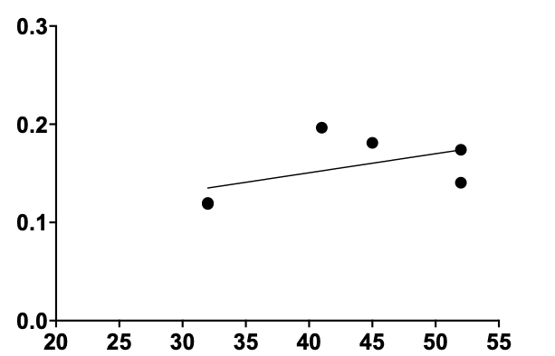
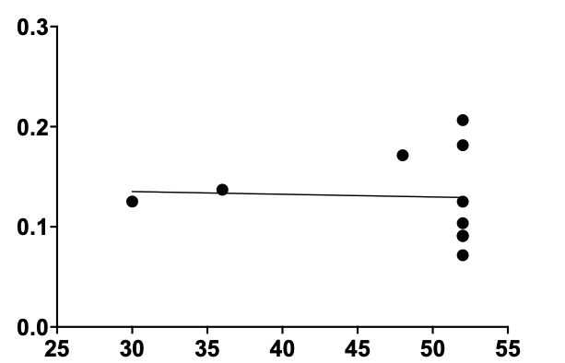
Supplemental Figures
a
b
800µCi [⁶⁷Cu]-FAP2287+IMT ​
1600µCi [⁶⁷Cu]-FAP2287+IMT ​
[⁶⁴Cu]-FAP2287 ​ SUV_{Mean}
[⁶⁴Cu]-FAP2287 ​ SUV_{Mean}
R² = 0.2792
p = 0.2812
R² = 0.0024
p = 0.8929
Probability of Survival (Days)
Probability of Survival (Days)
Notes:
Supplementary Fig 4: [⁶⁴Cu]-FAP2287 PET imaging as a reliable predictor for response to [⁶⁷Cu]-FAP2287 TRT+IMT: No correlation trend between probability of survival and [⁶⁴Cu]-FAP2287 PET SUV_{Mean} in mice treated with (a) 800uCi of [⁶⁷Cu]-FAP2287+IMT (R² = 0.2792, p = 0.2812) and (b) 1600uCi of [⁶⁷Cu]-FAP2287+IMT (R² = 0.002, p = 0.8929) due to censored survival data in both cohorts.

