Slide 1
Supplemental Data
Supplemental Table 1. The technical methods of immunohistochemical staining using kidney biopsy sections
Supplemental Figure 1. The statistical analysis between the positive area of AGT staining in the kidney tubules and each valuable
Sex (a), gestational week (b), birth weight (c), age at the timing of kidney biopsy (d), and systolic blood pressure at the timing of kidney biopsy (e) had no significant association with the mean AGT‑positive area per high‑power field in the proximal tubules. AGT; angiotensinogen
Supplemental Figure 2. The statistical analysis between the positive area of AT2 staining in the kidney tubules and each valuable
Sex (a), gestational week (b), term versus preterm birth (c), birth weight (d), normal BW versus LBW (e), urinary protein/creatinine ratio at the timing of kidney biopsy (f), Cr-eGFR at the timing of kidney biopsy (g), systolic blood pressure at the timing of kidney biopsy (h), and the average area of a single glomerulus (i) had no significant association with the mean AT2‑positive area per high‑power field in the proximal tubules. AT2; Angiotensin II, Cr-eGFR; creatinine-based estimated glomerular filtration rate, LBW; low birth weight

Slide 2
Supplemental Table1
The technical methods of immunohistochemical staining using kidney biopsy sections
Paraffin sections were deparaffinized and rehydrated.
Antigen retrieval was performed by Bond ER solution 2, pH 9.0 for 100 ℃, 20 min.
The following primary antibody were applied with anti-Human Angiotensinogen, anti-Human Angiotensin II, and anti‑TGF‑β for 15 min.
The post primary was applied with anti-mouse Ig antibody for 8 min.
The polymer was applied with peroxidase‑labeled polymer‑conjugated anti‑rabbit/anti‑mouse IgG antibody for 8 min.
The peroxidase blocking was applied with 3% hydrogen peroxide for 5 min.
Color development was performed using diaminobenzidine, followed by nuclear counterstaining with hematoxylin.

Slide 3
Supplemental Figure1
(a)
(×10³ μm²)
p=0.93
300
200
The positive area of AGT staining
in the kidney tubules
100
0
Female
Male
Sex

Slide 4
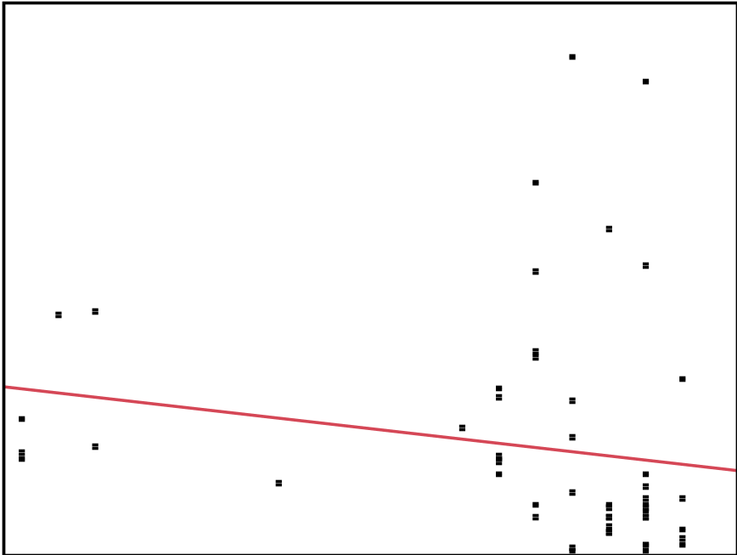
Supplemental Figure1
(b)
(×10³ μm²)
300
p=0.18
200
The positive area of AGT staining
in the kidney tubules
100
0
25
30
35
40
(week)
Gestational week

Slide 5
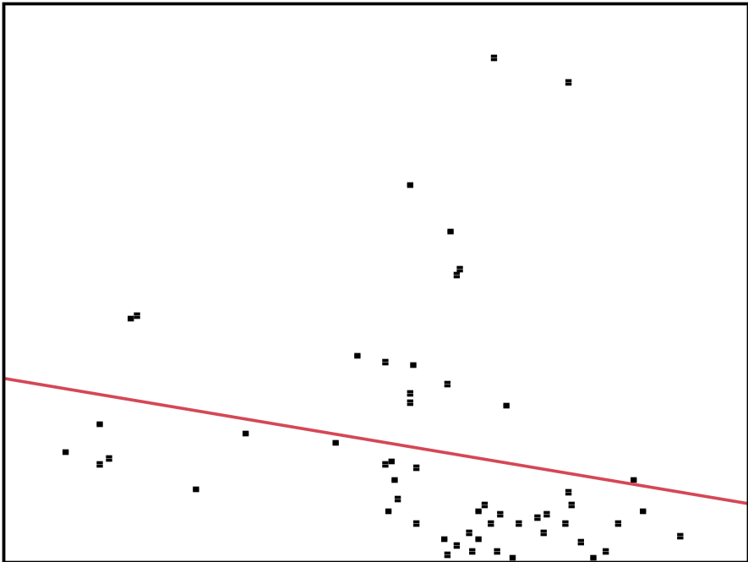
Supplemental Figure1
(c)
(×10³ μm²)
300
p=0.12
200
The positive area of AGT staining
in the kidney tubules
100
0
500
1500
2500
3500
4500
(g)
Birth weight

Slide 6
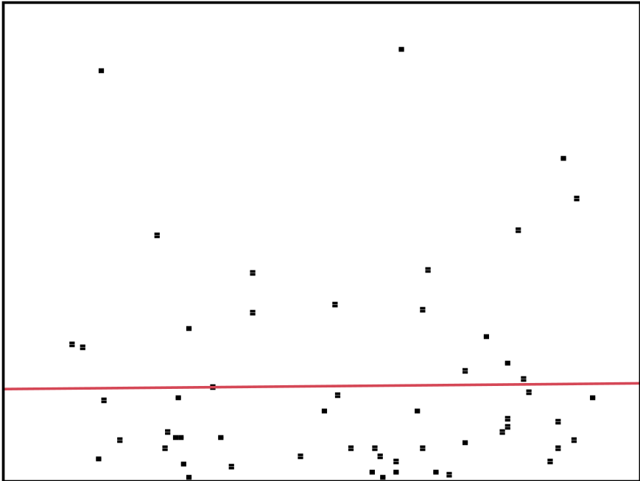
Supplemental Figure1
(d)
(×10³ μm²)
300
p=0.91
200
The positive area of AGT staining
in the kidney tubules
100
0
5
10
15
20
(years)
Age at the timing of biopsy

Slide 7
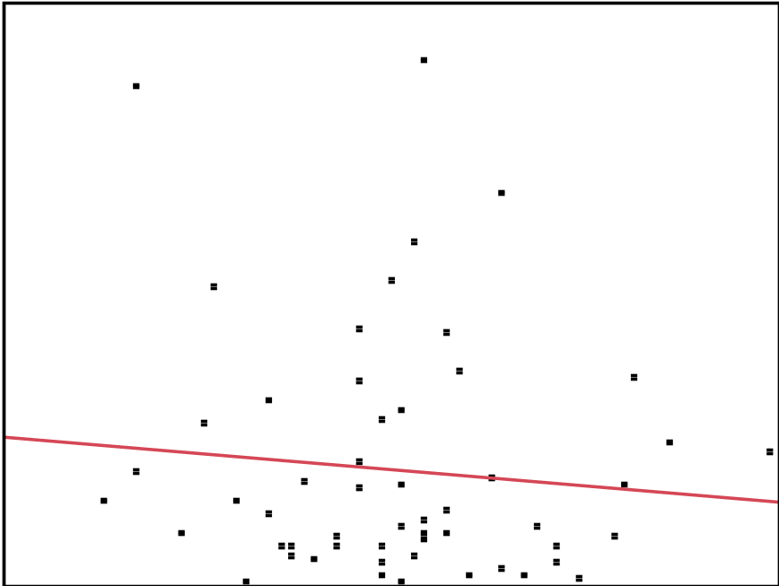
Supplemental Figure1
(e)
(×10³ μm²)
300
p=0.49
200
The positive area of AGT staining in the kidney tubules
100
0
70
90
110
130
(mmHg)
Systolic blood pressure at the timing of biopsy

Slide 8
Supplemental Figure2
(a)
(×10³ μm²)
p=0.37
50
40
30
The positive area of AT2 staining in the kidney tubules
20
10
0
Female
Male

Slide 9
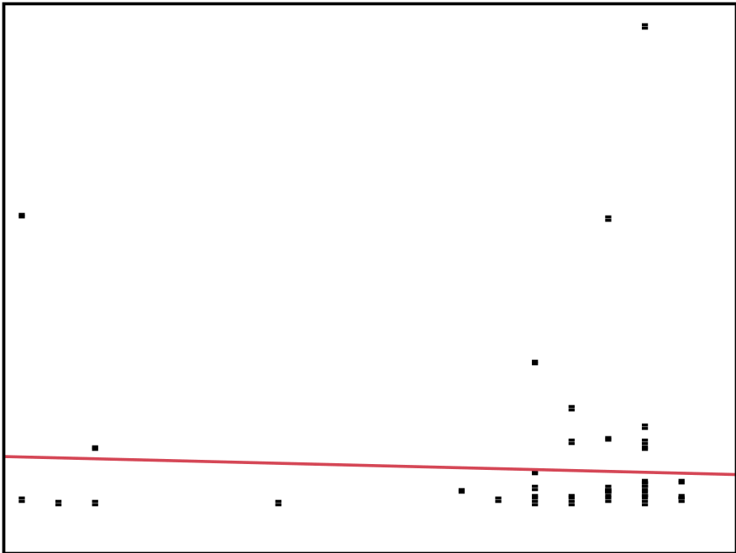
Supplemental Figure2
(b)
(×10³ μm²)
50
p=0.70
40
30
The positive area of AT2 staining in the kidney tubules
20
10
0
25
30
35
40
(week)
Gestational week

Slide 10
Supplemental Figure2
(c)
(×10³ μm²)
p=0.42
50
40
30
The positive area of AT2 staining in the kidney tubules
20
10
0
Term
Preterm

Slide 11
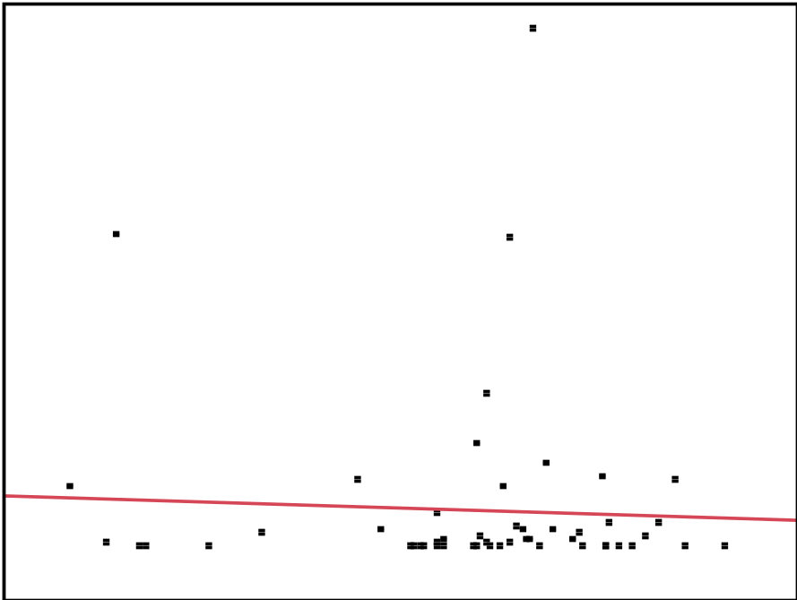
Supplemental Figure2
(d)
(×10³ μm²)
50
p=0.70
40
30
The positive area of AT2 staining
in the kidney tubules
20
10
0
500
1500
2500
3500
4500
(g)
Birth weight

Slide 12
Supplemental Figure2
(e)
(×10³ μm²)
p=0.68
50
40
30
The positive area of AT2 staining in the kidney tubules
20
10
0
Normal BW
LBW

Slide 13
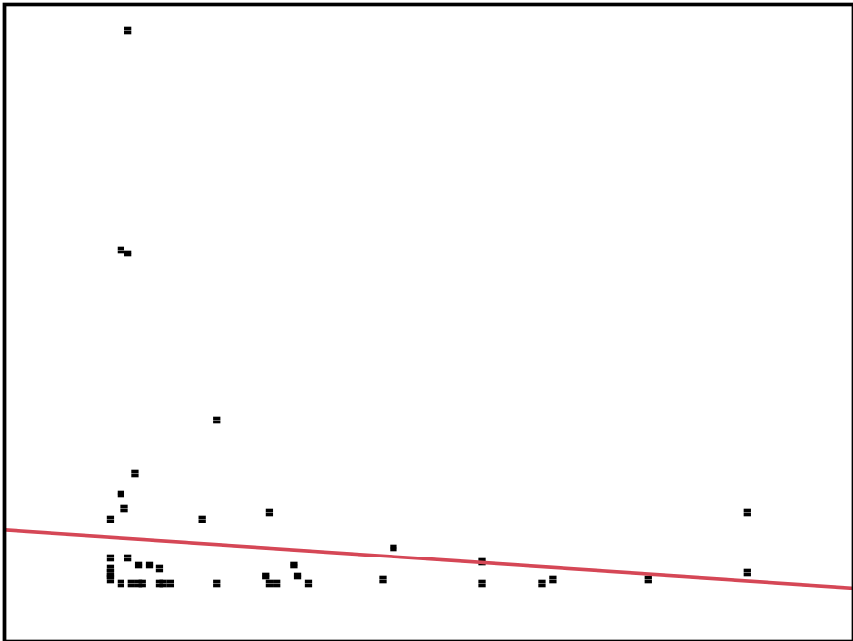
Supplemental Figure2
(f)
(×10³ μm²)
50
p=0.40
40
30
The positive area of AT2 staining in the kidney tubules
20
10
0
0.4
0.8
1.2
(g/g･Cr)
Urine protein/creatinine ratio

Slide 14
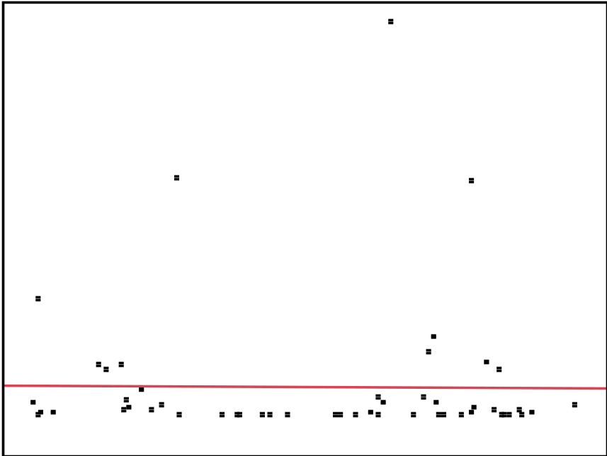
Supplemental Figure2
(g)
(×10³ μm²)
50
p=0.94
40
30
The positive area of AT2 staining in the kidney tubules
20
10
0
40
80
120
160
(×10³ μm²)
Cr-eGFR at the timing of biopsy

Slide 15
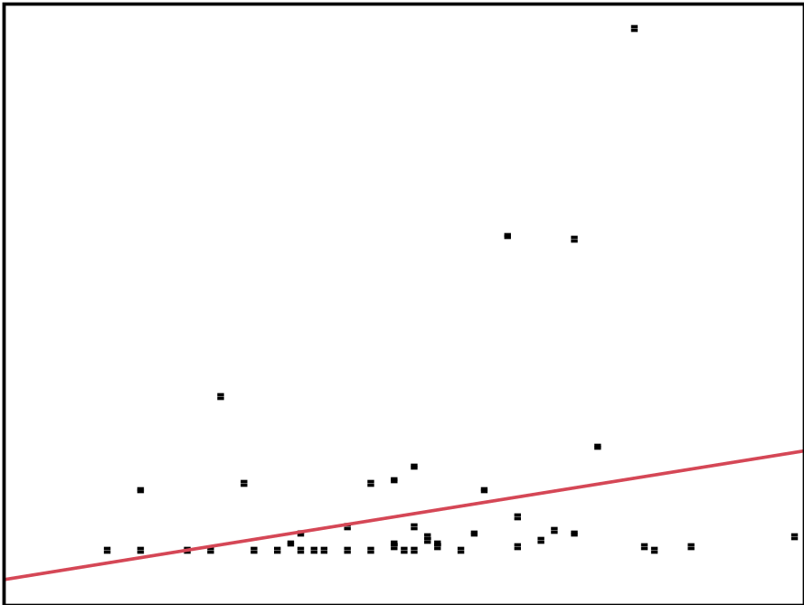
Supplemental Figure2
(h)
(×10³ μm²)
50
p=0.07
40
30
The positive area of AT2 staining
in the kidney tubules
20
10
0
70
90
110
130
(mmHg)
Systolic blood pressure at the timing of biopsy

