Slide 1
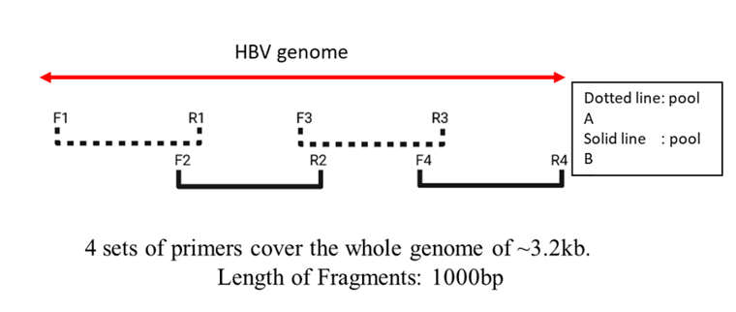
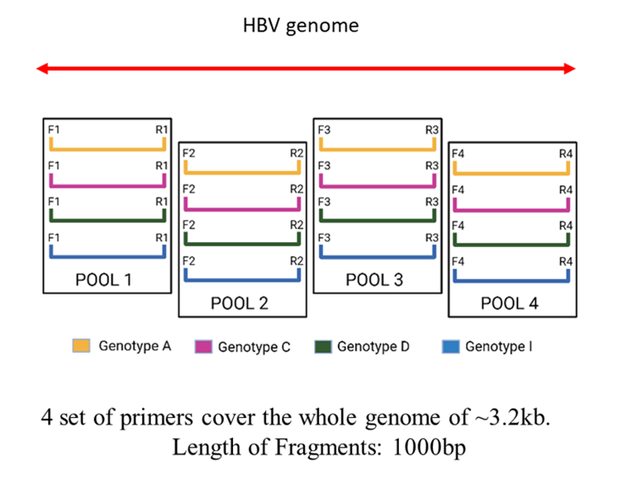
Supplementary Figure 1: Schematic representation of the primer design strategy for multiplex tiling PCR for amplification of HBV genotypes. (a.) The primer sets covering the entire 3.2 KB genome, in 4 overlapping fragments. (b.) Four different primers for each genotype (A, C, D and I) were pooled for amplification of the four overlapping fragments.

Slide 2
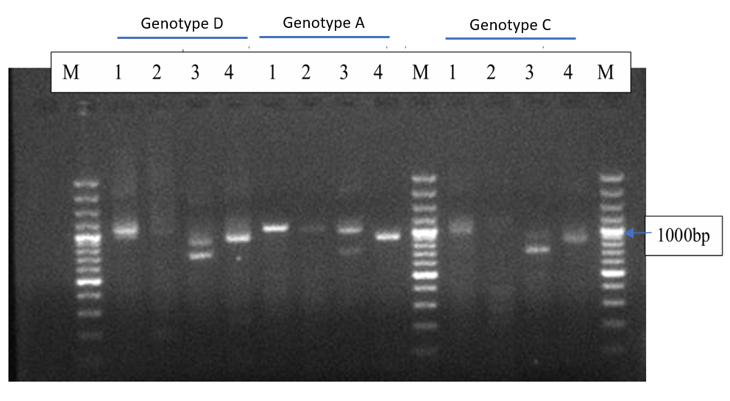
Supplementary Figure 2: Multiplex tiling PCR by using pooled genotype primers. M represents a 100bp DNA ladder. Four lanes each of indicated genotype show 1kb amplicons for respective serum samples of known genotypes.

