Slide 1
Raw images_Figures_CMI 2026
Title of manuscript: Glycolytic enzymes play important roles in innate immune memory of neuroimmune responses triggered by systemic inflammation

Slide 2
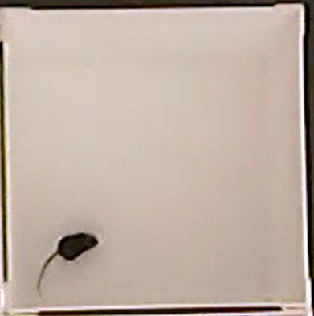
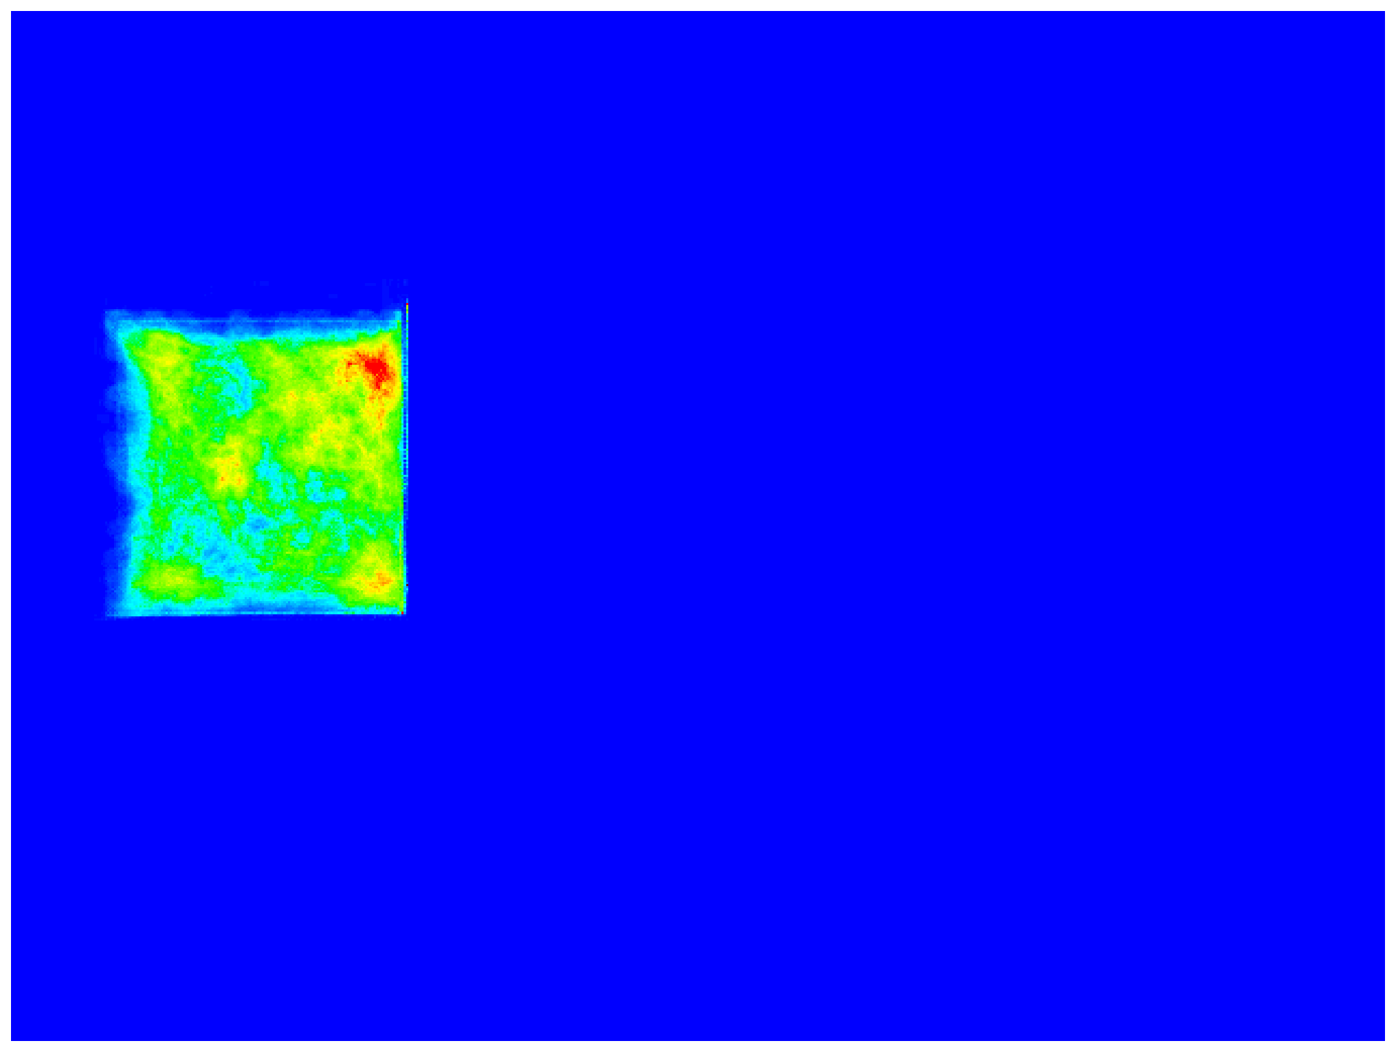
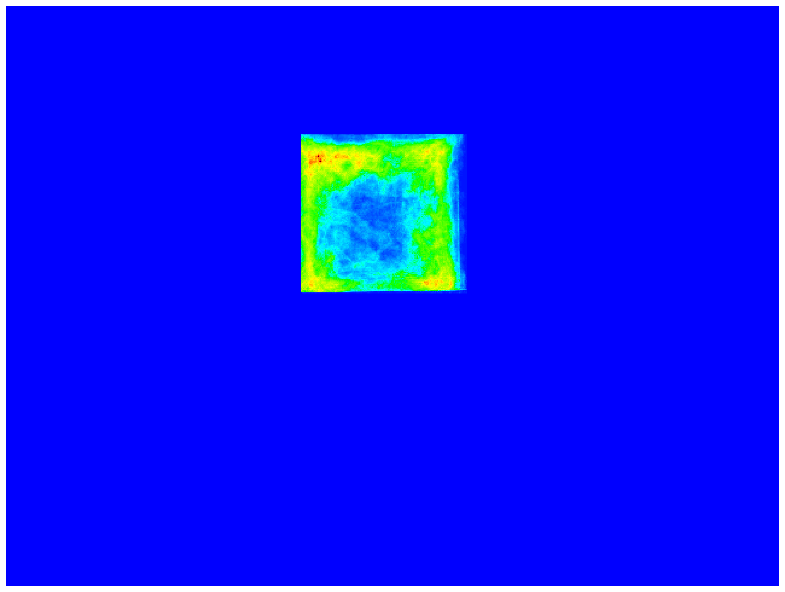
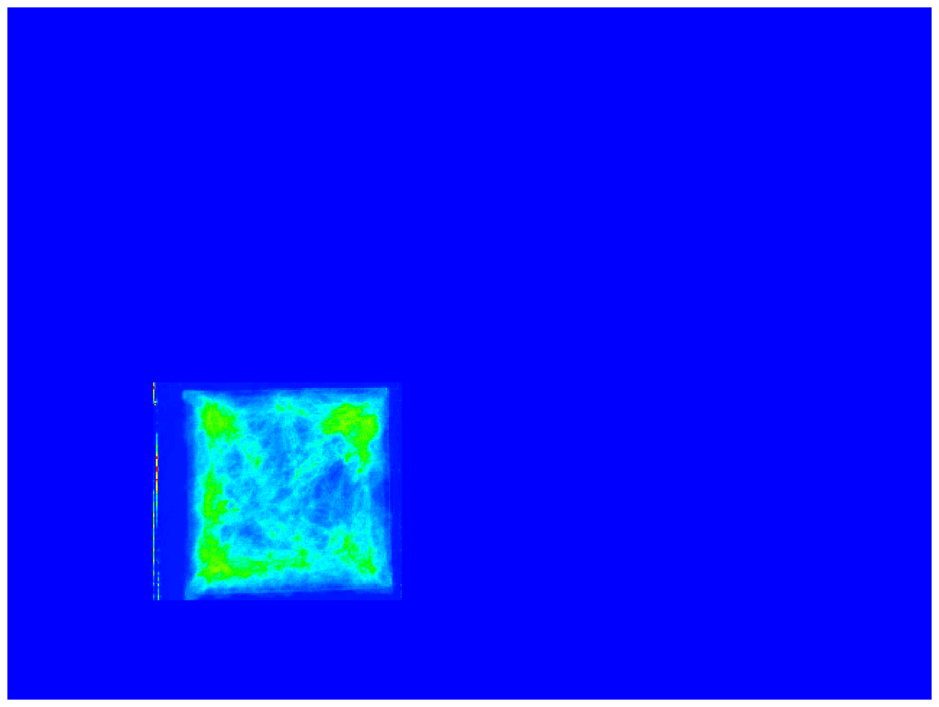
Fig 2.B.i
 |  | 1x NS | 1x LPS | 2x LPS
Day 1, Habituation (open field) 10 min
NIR (near-infrared) count
Higher activity/movement
Lower activity/movement

Slide 3
Fig 2.B.i
Day 1, Habituation (open field)
10 min
1x NS

Slide 4
Fig 2.B.i
Day 1, Habituation (open field)
10 min
1x LPS

Slide 5
Fig 2.B.i
Day 1, Habituation (open field)
10 min
2x LPS

