Slide 1
Raw images_Supplementary Figures_CMI 2026
Title of manuscript: Glycolytic enzymes play important roles in innate immune memory of neuroimmune responses triggered by systemic inflammation

Slide 2
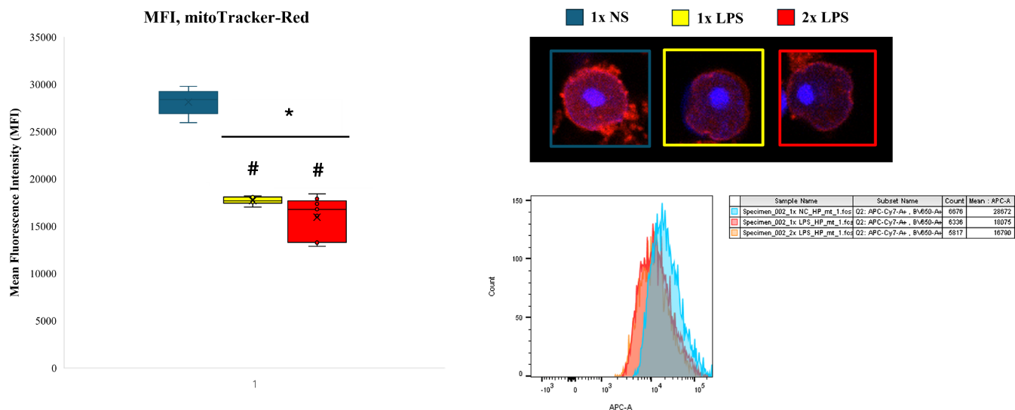
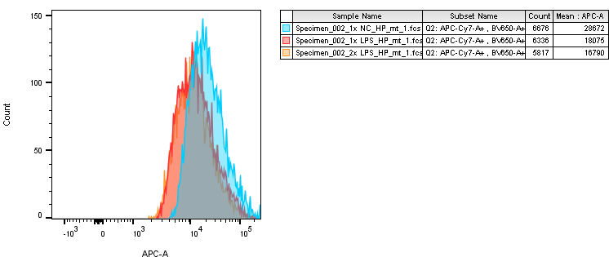
Fig S2.G

Slide 3
1x NS

Slide 4
1x LPS

Slide 5
2x LPS

