Slide 1
Raw images_Figures_CMI 2026
Title of manuscript: Glycolytic enzymes play important roles in innate immune memory of neuroimmune responses triggered by systemic inflammation

Slide 2
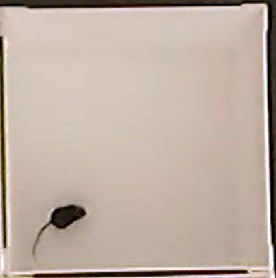
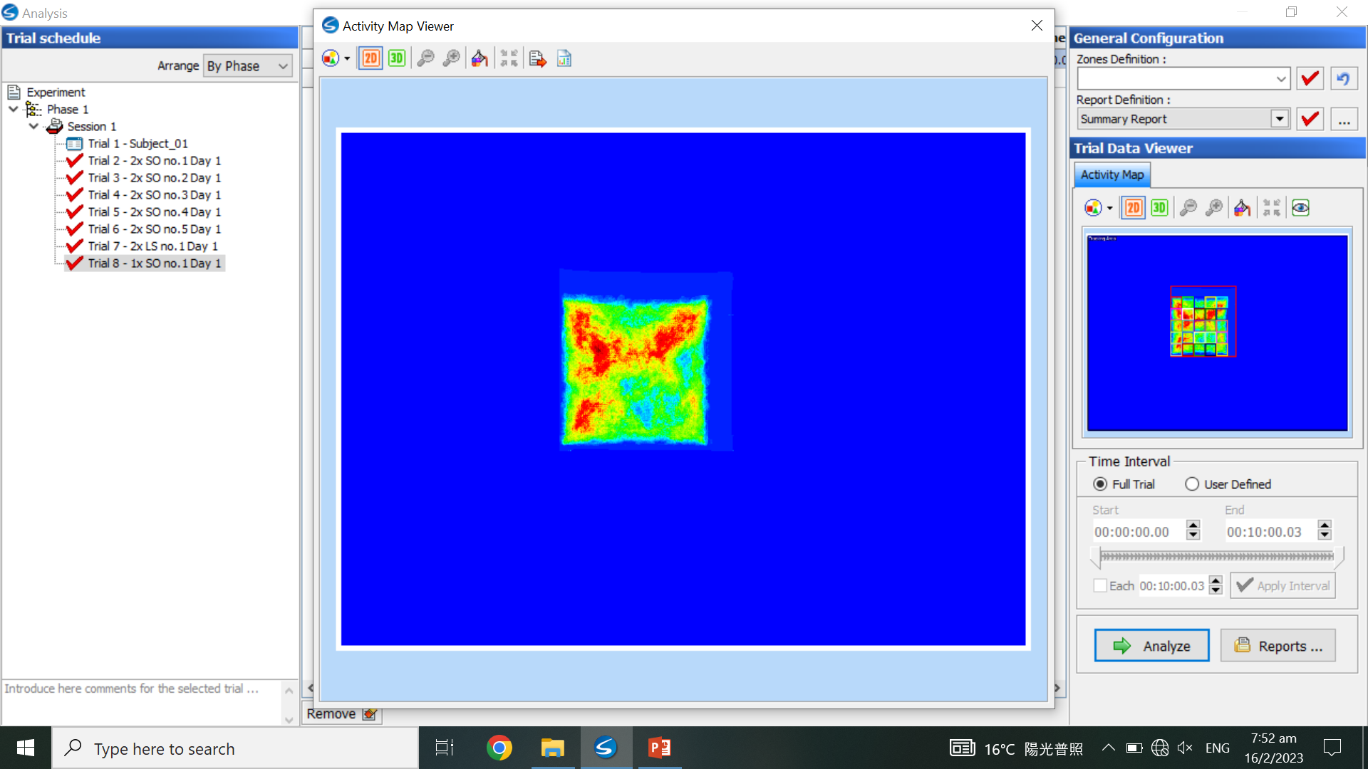
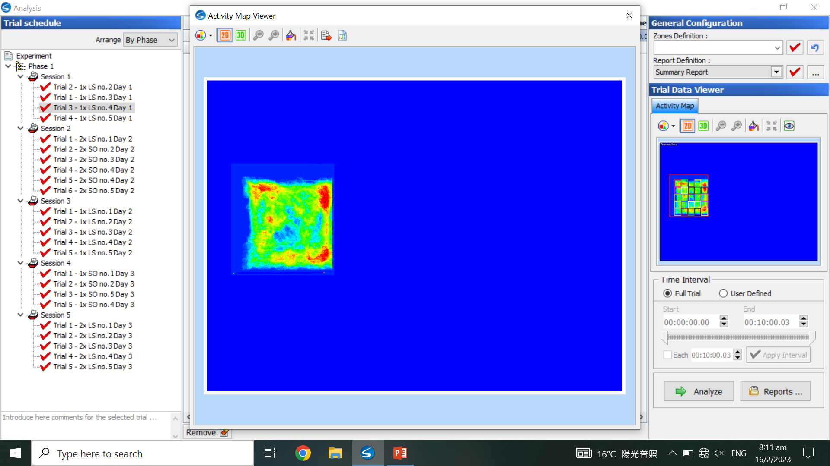
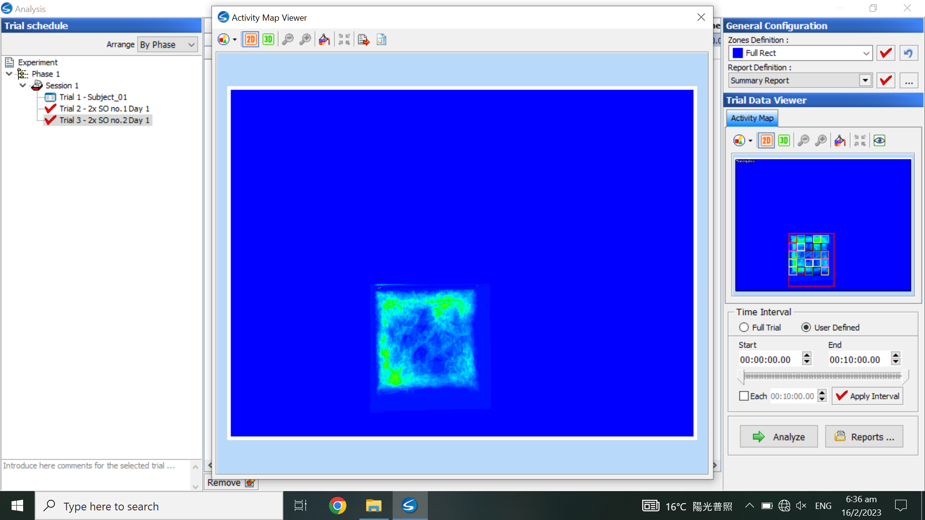
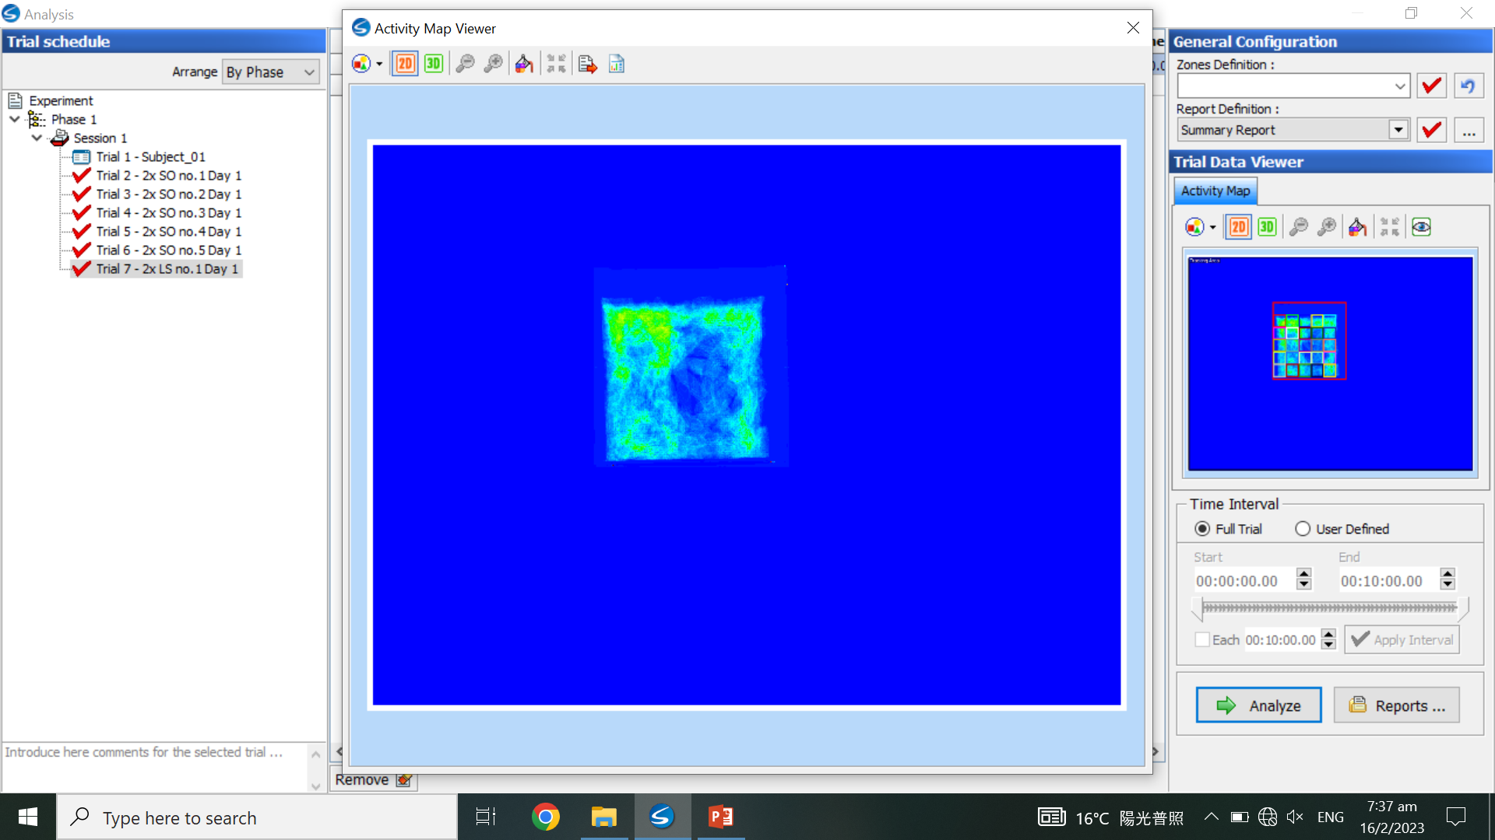
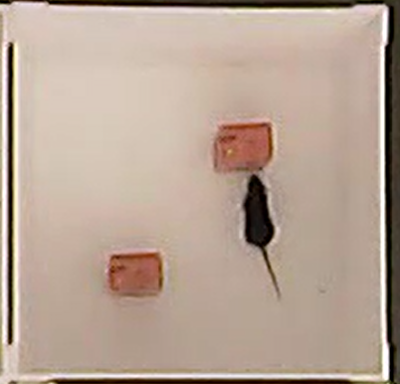
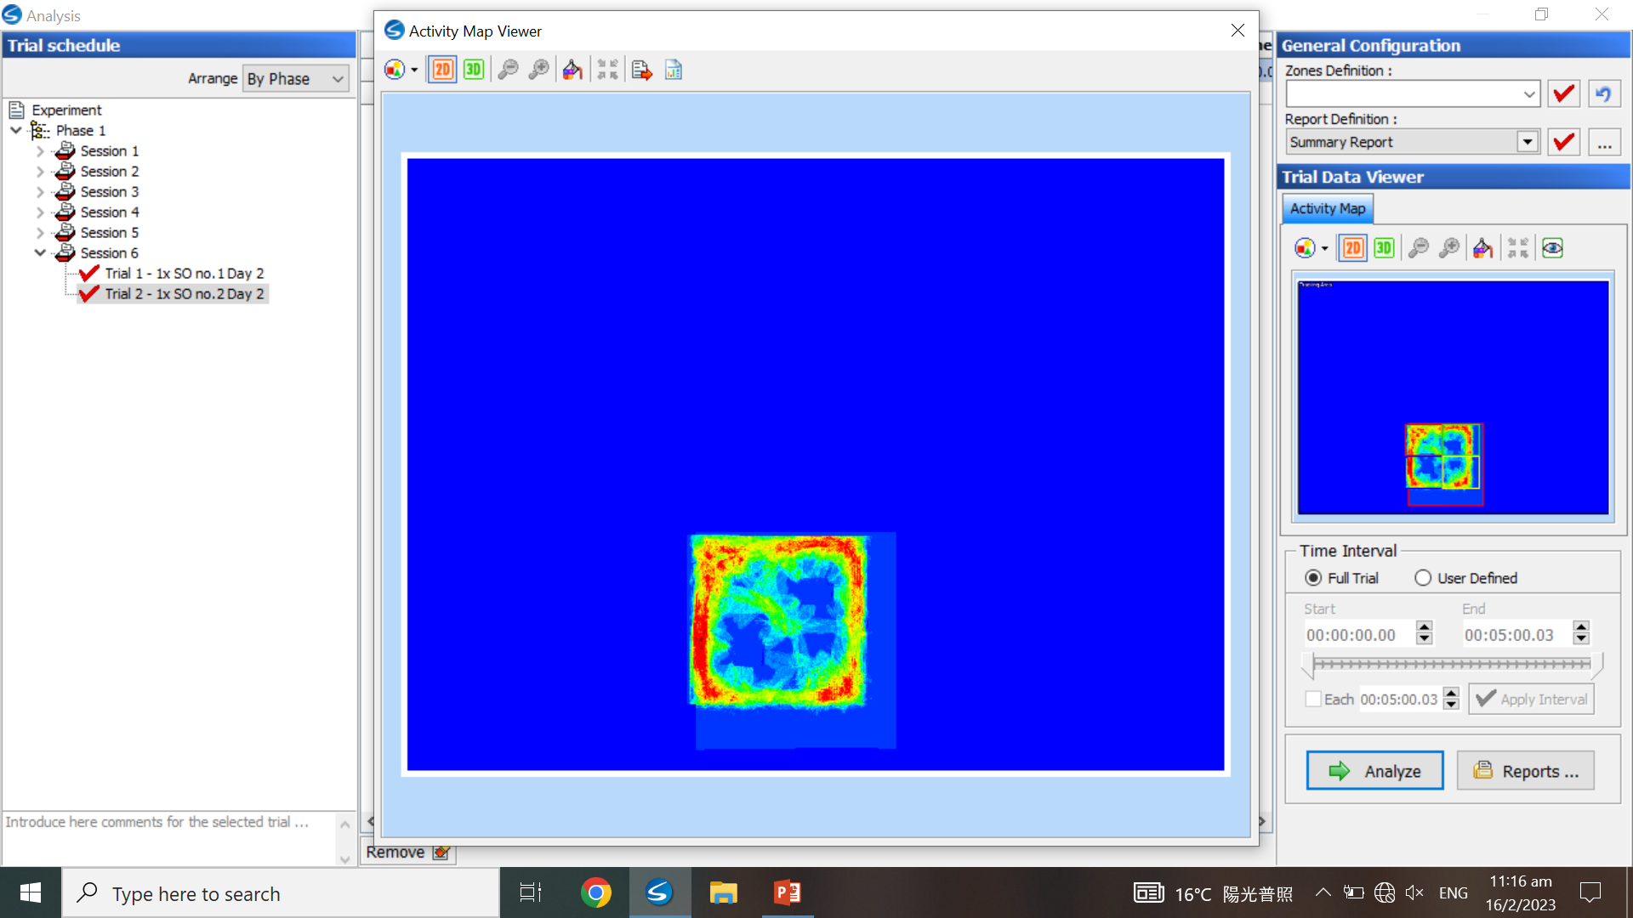
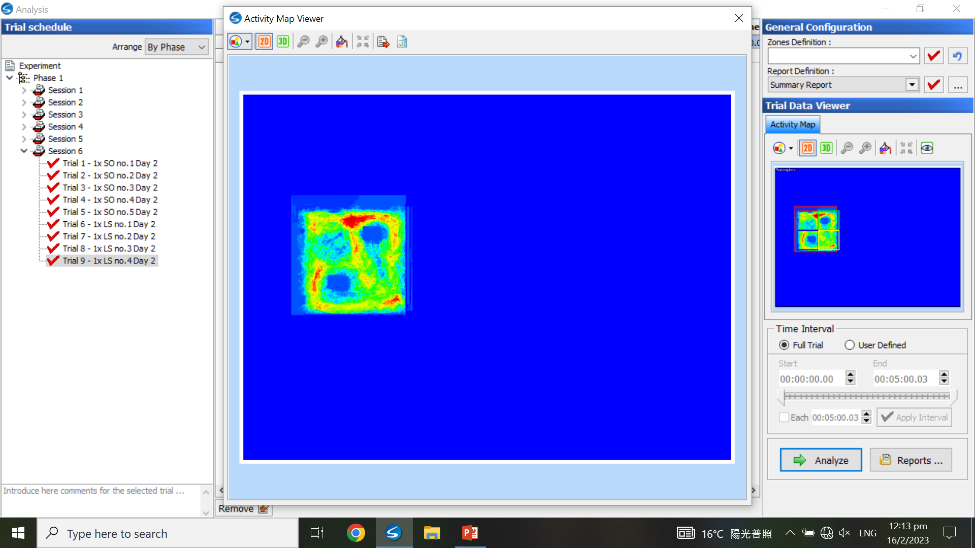
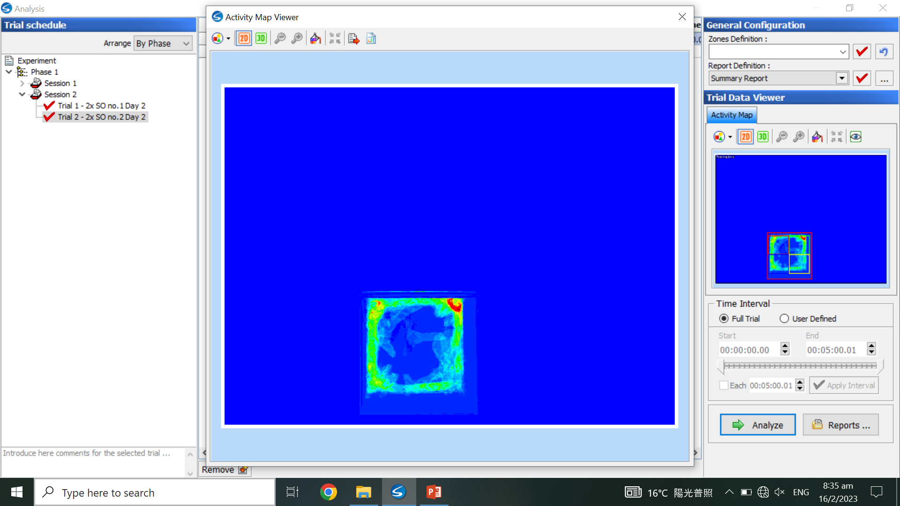
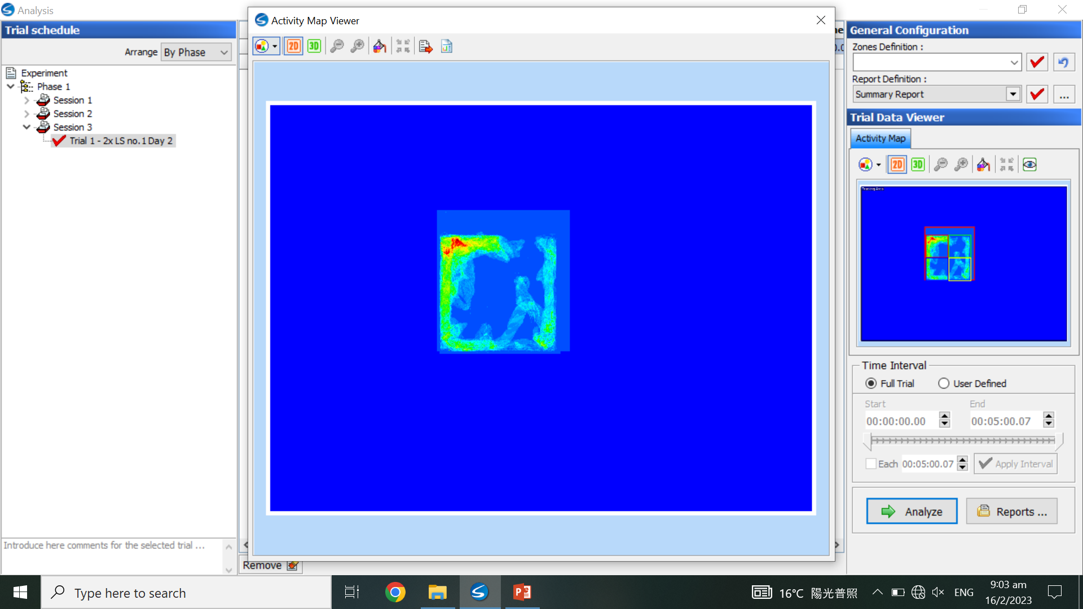
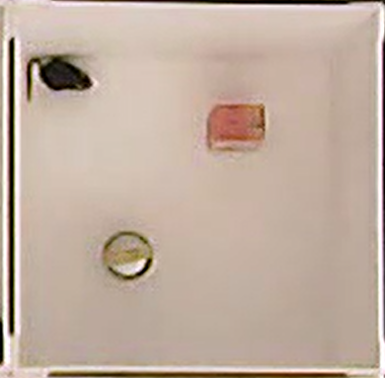

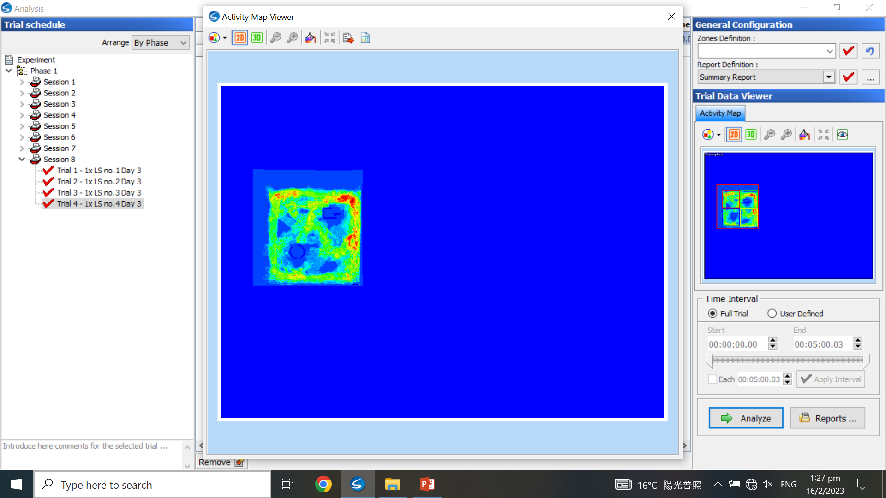
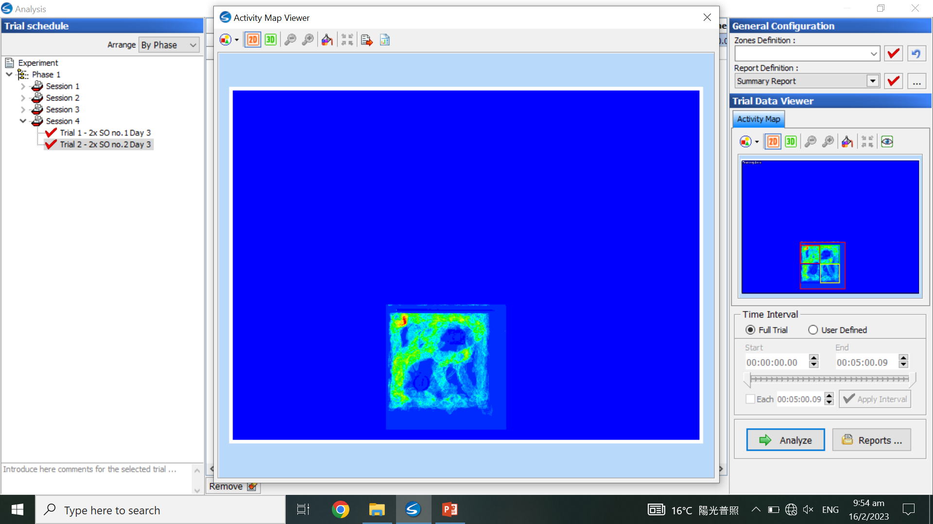

Fig 1.B.i
 |  | 1x SEVO | 1x LAP | 2x SEVO | 2x LAP
Day 1, Habituation (open field) 10 min
Day 2, Training 5 min
Day 3, Test 5 min
NIR (near-infrared) count
Higher activity/movement
Lower activity/movement

Slide 3
Fig 1.B.i
Day 1, Habituation (open field)
10 min
1x SEVO

Slide 4
Fig 1.B.i
Day 1, Habituation (open field)
10 min
1x LAP

Slide 5
Fig 1.B.i
Day 1, Habituation (open field)
10 min
2x SEVO

Slide 6
Fig 1.B.i
Day 1, Habituation (open field)
10 min
2x LAP

Slide 7
Fig 1.B.i
Day 2, Training
5 min
1x SEVO

Slide 8
Fig 1.B.i
Day 2, Training
5 min
1x LAP

Slide 9
Fig 1.B.i
Day 2, Training
5 min
2x SEVO

Slide 10
Fig 1.B.i
Day 2, Training
5 min
2x LAP

Slide 11
Fig 1.B.i
Day 3,
Test 5 min
1x SEVO

Slide 12
Fig 1.B.i
Day 3,
Test 5 min
1x LAP

Slide 13
Fig 1.B.i
Day 3,
Test 5 min
2x SEVO

Slide 14
Fig 1.B.i
Day 3,
Test 5 min
2x LAP

