Slide 1
Raw images_Figures_CMI 2026
Title of manuscript: Glycolytic enzymes play important roles in innate immune memory of neuroimmune responses triggered by systemic inflammation

Slide 2
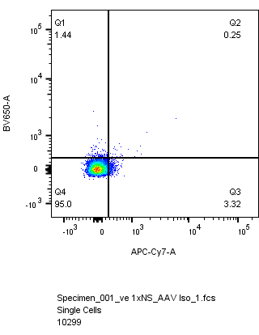
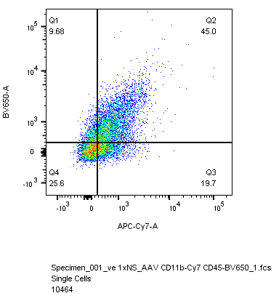
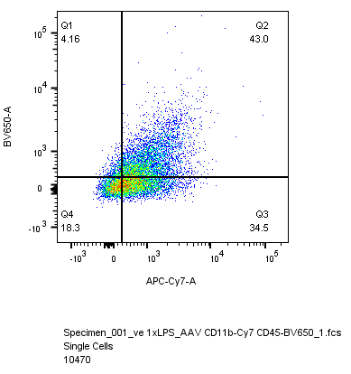
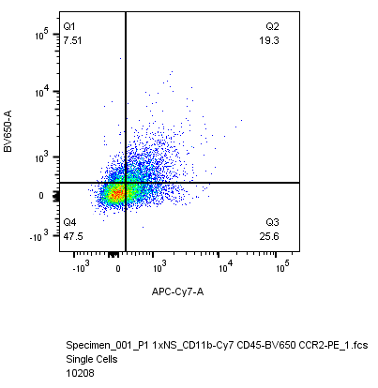
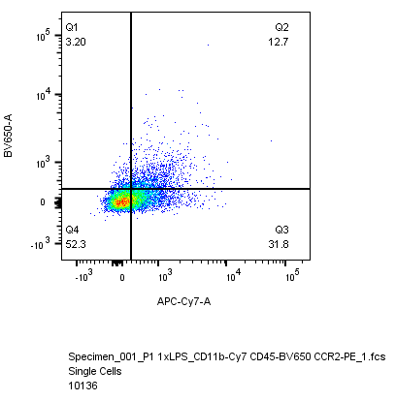
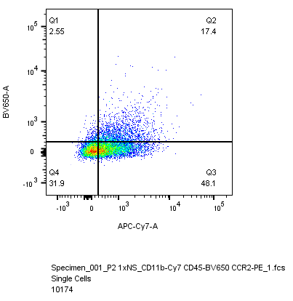
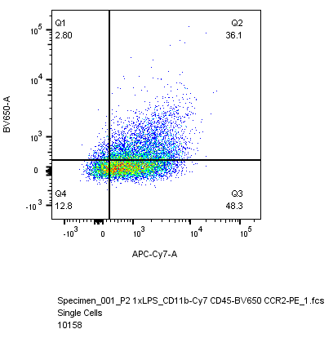
Fig 7.G
Isotype control, IgG
1x NS
1x LPS
CD45-BV650
vehicle
CD11b-APC/Cy7
Iba1-shPfk1
Iba1-shPfk2

