Slide 1
Raw images_Figures_CMI 2026
Title of manuscript: Glycolytic enzymes play important roles in innate immune memory of neuroimmune responses triggered by systemic inflammation

Slide 2
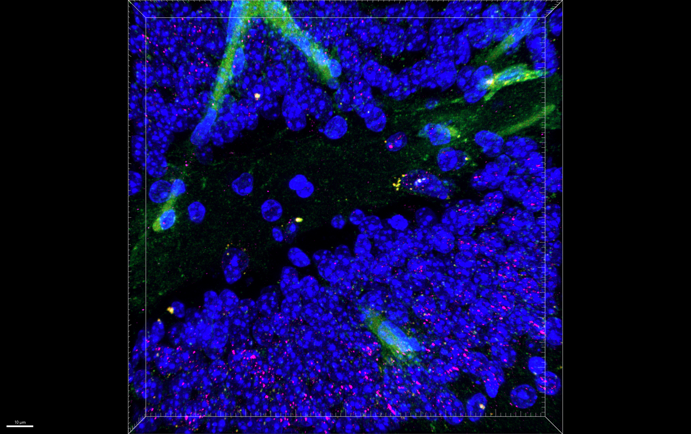
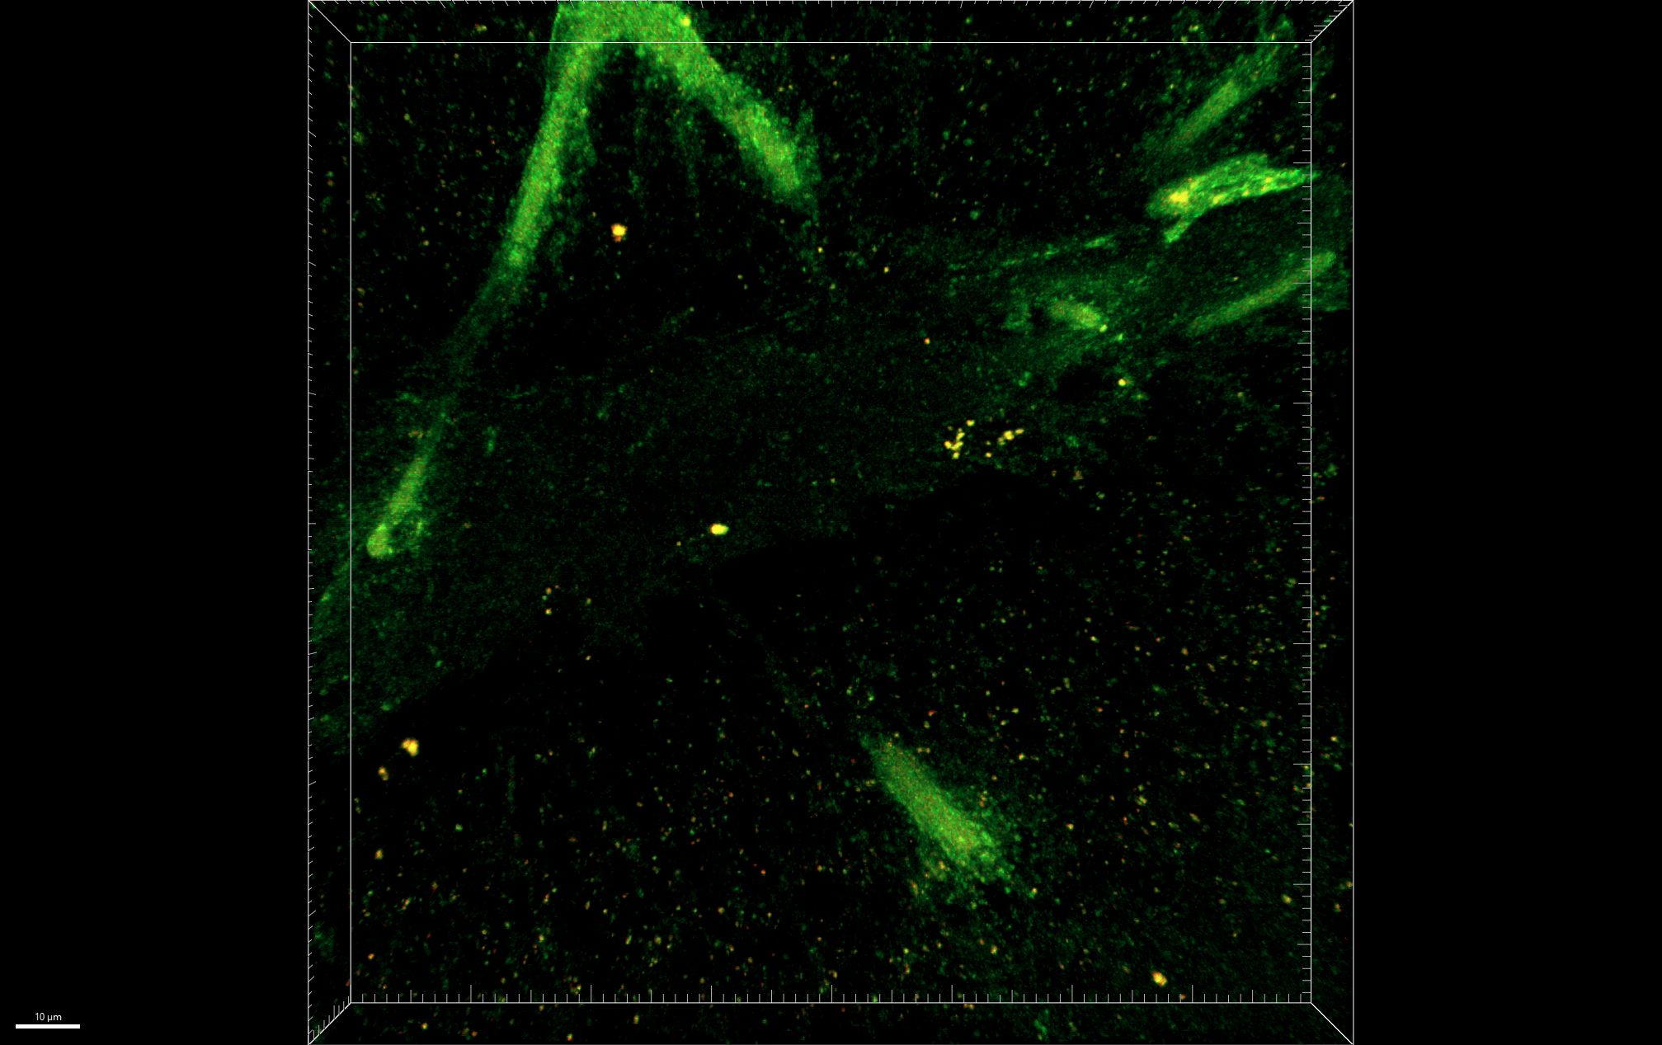
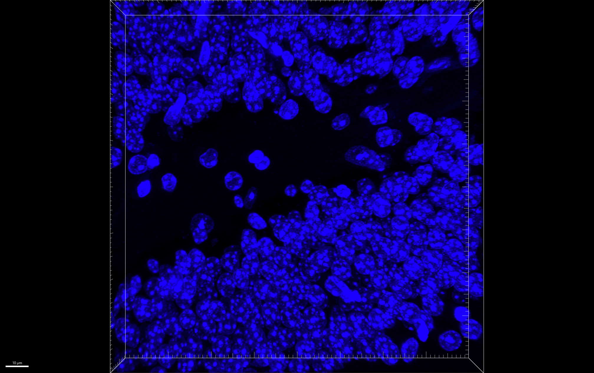
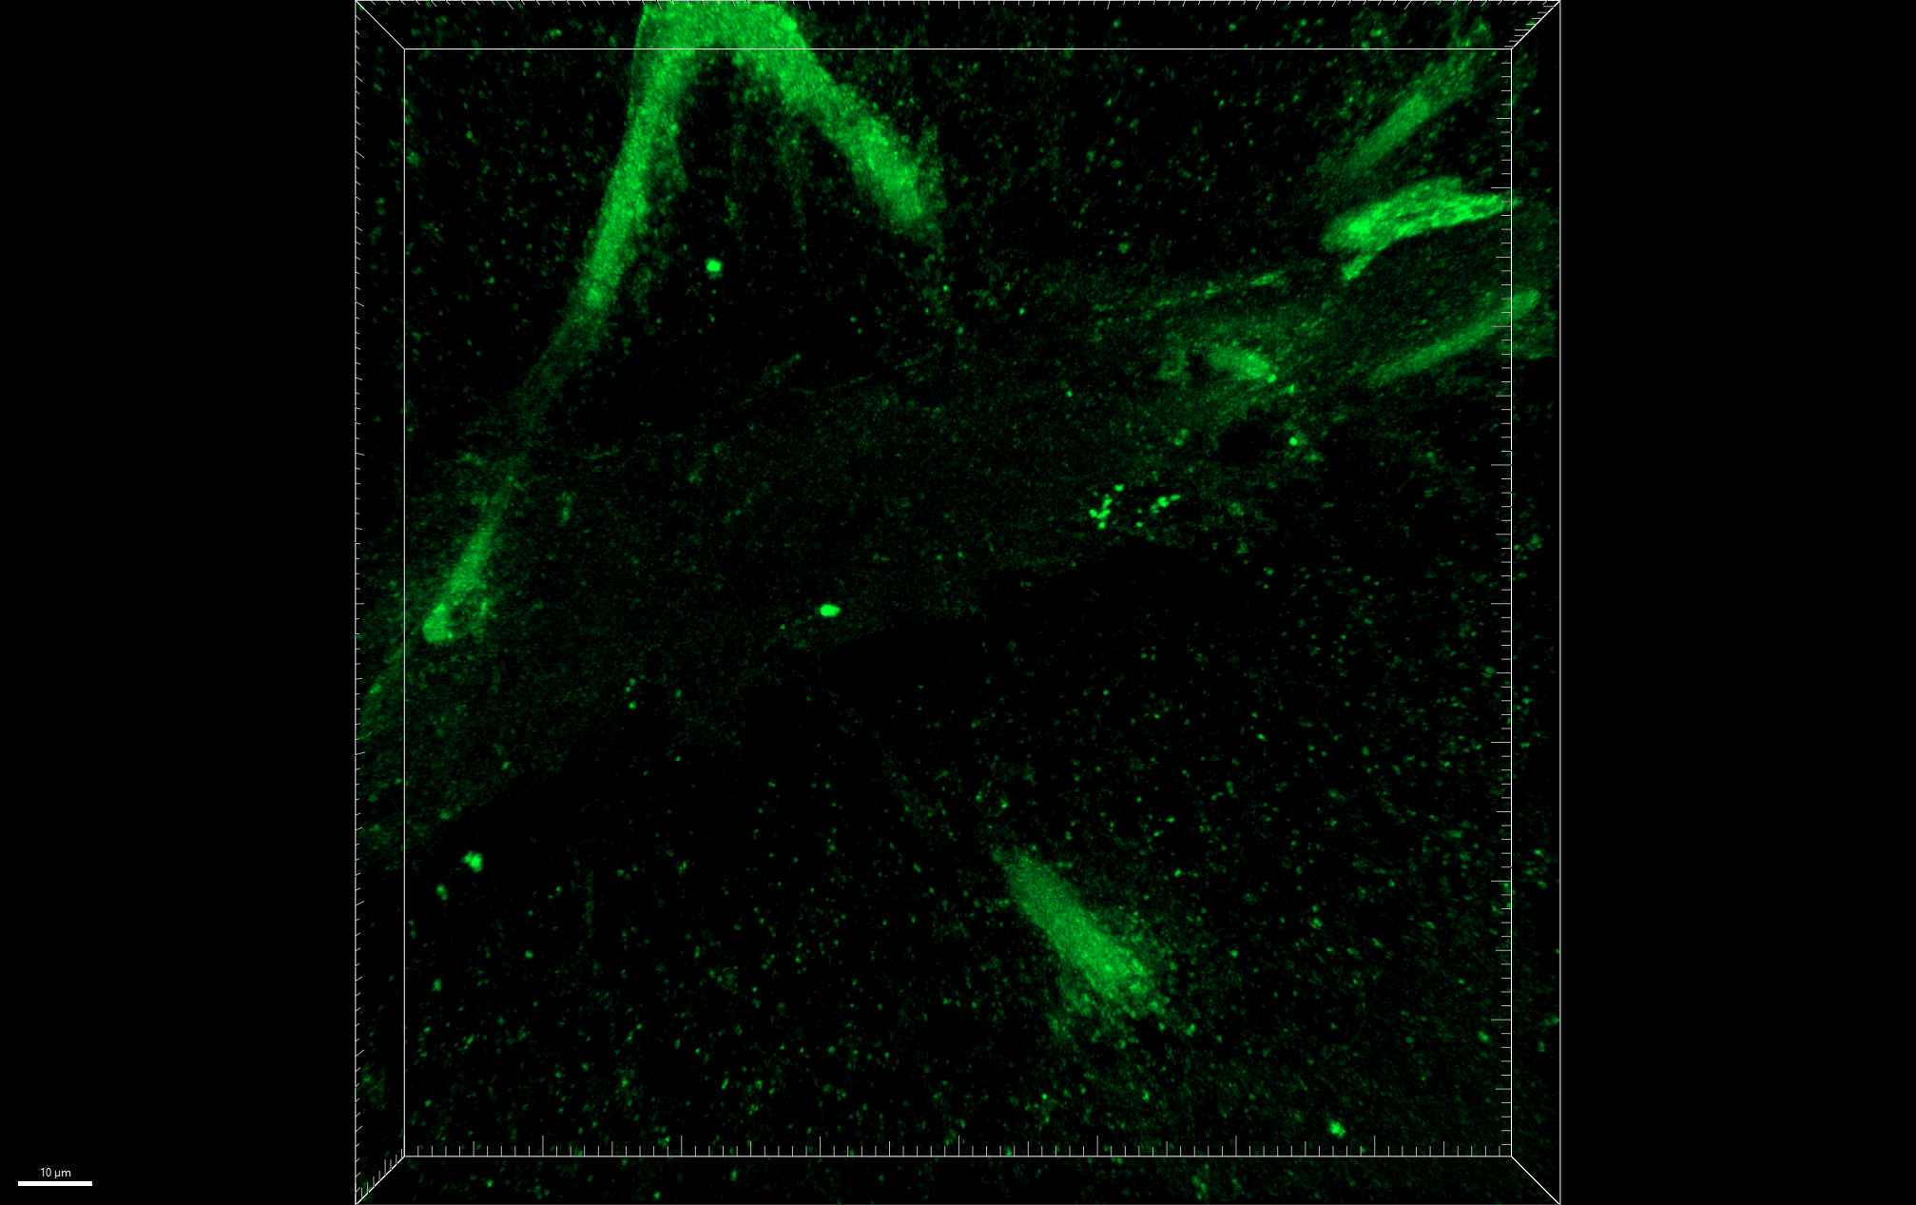
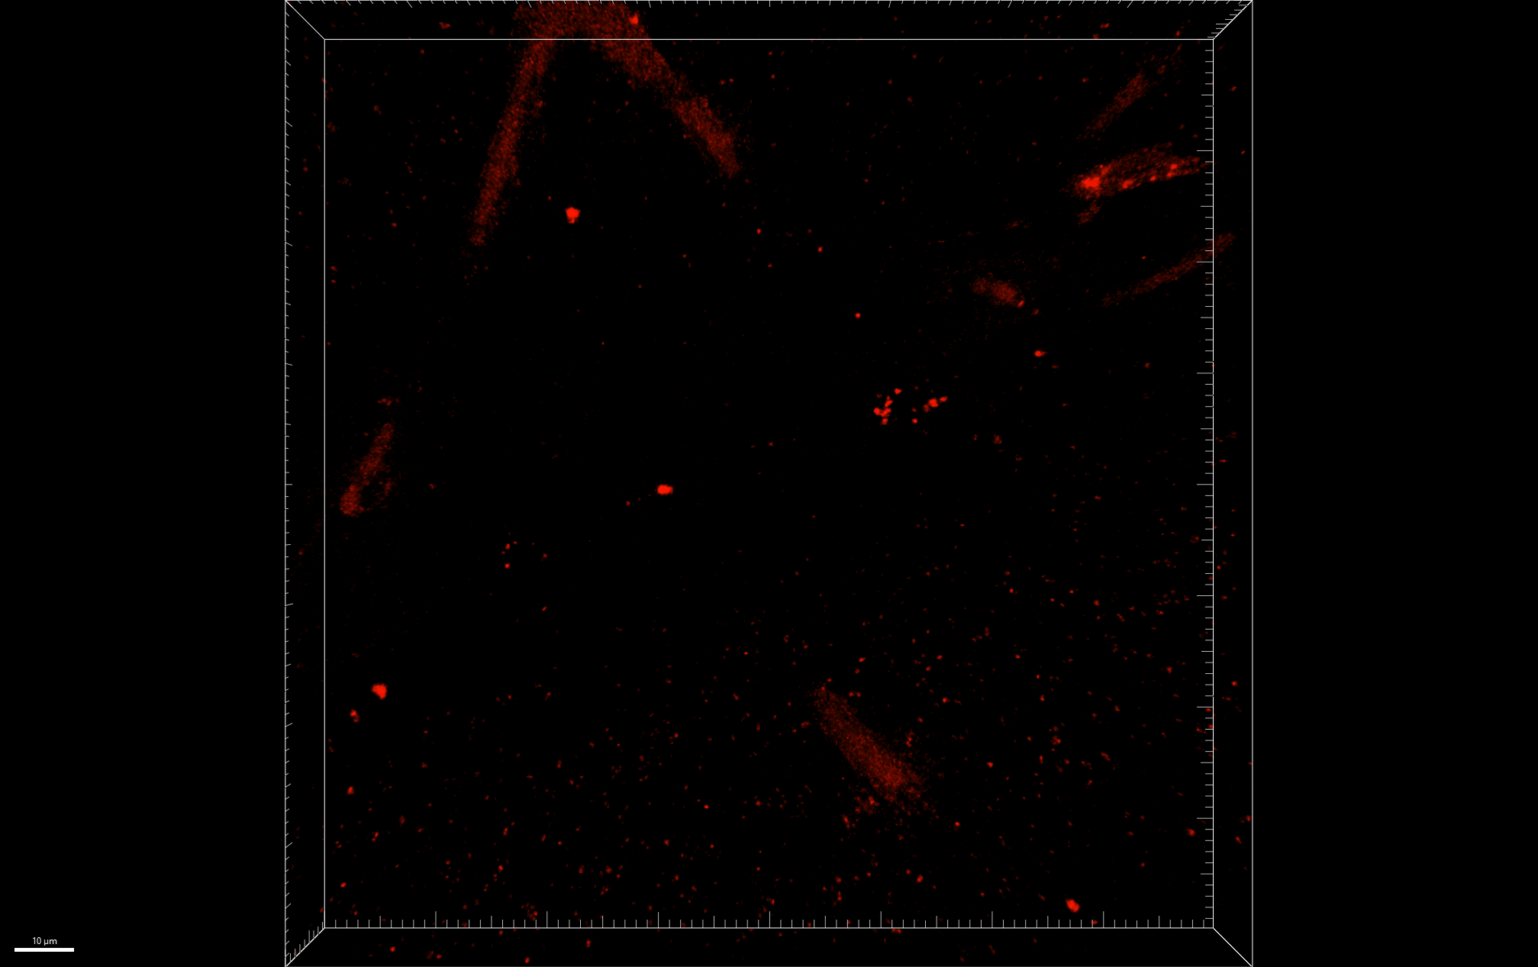
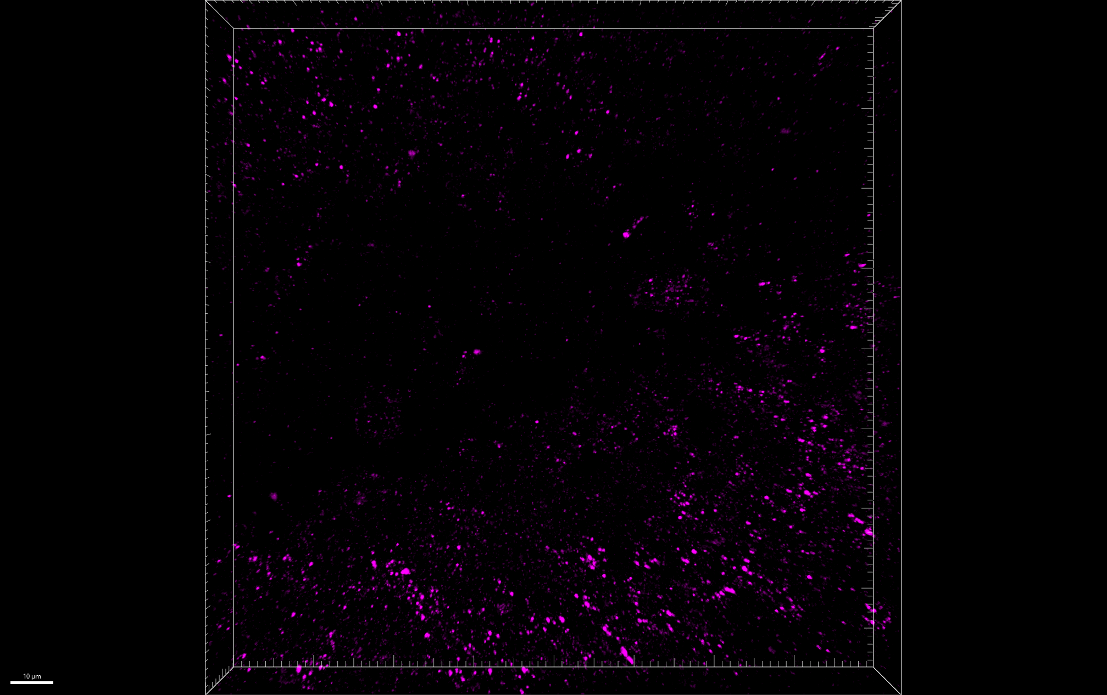
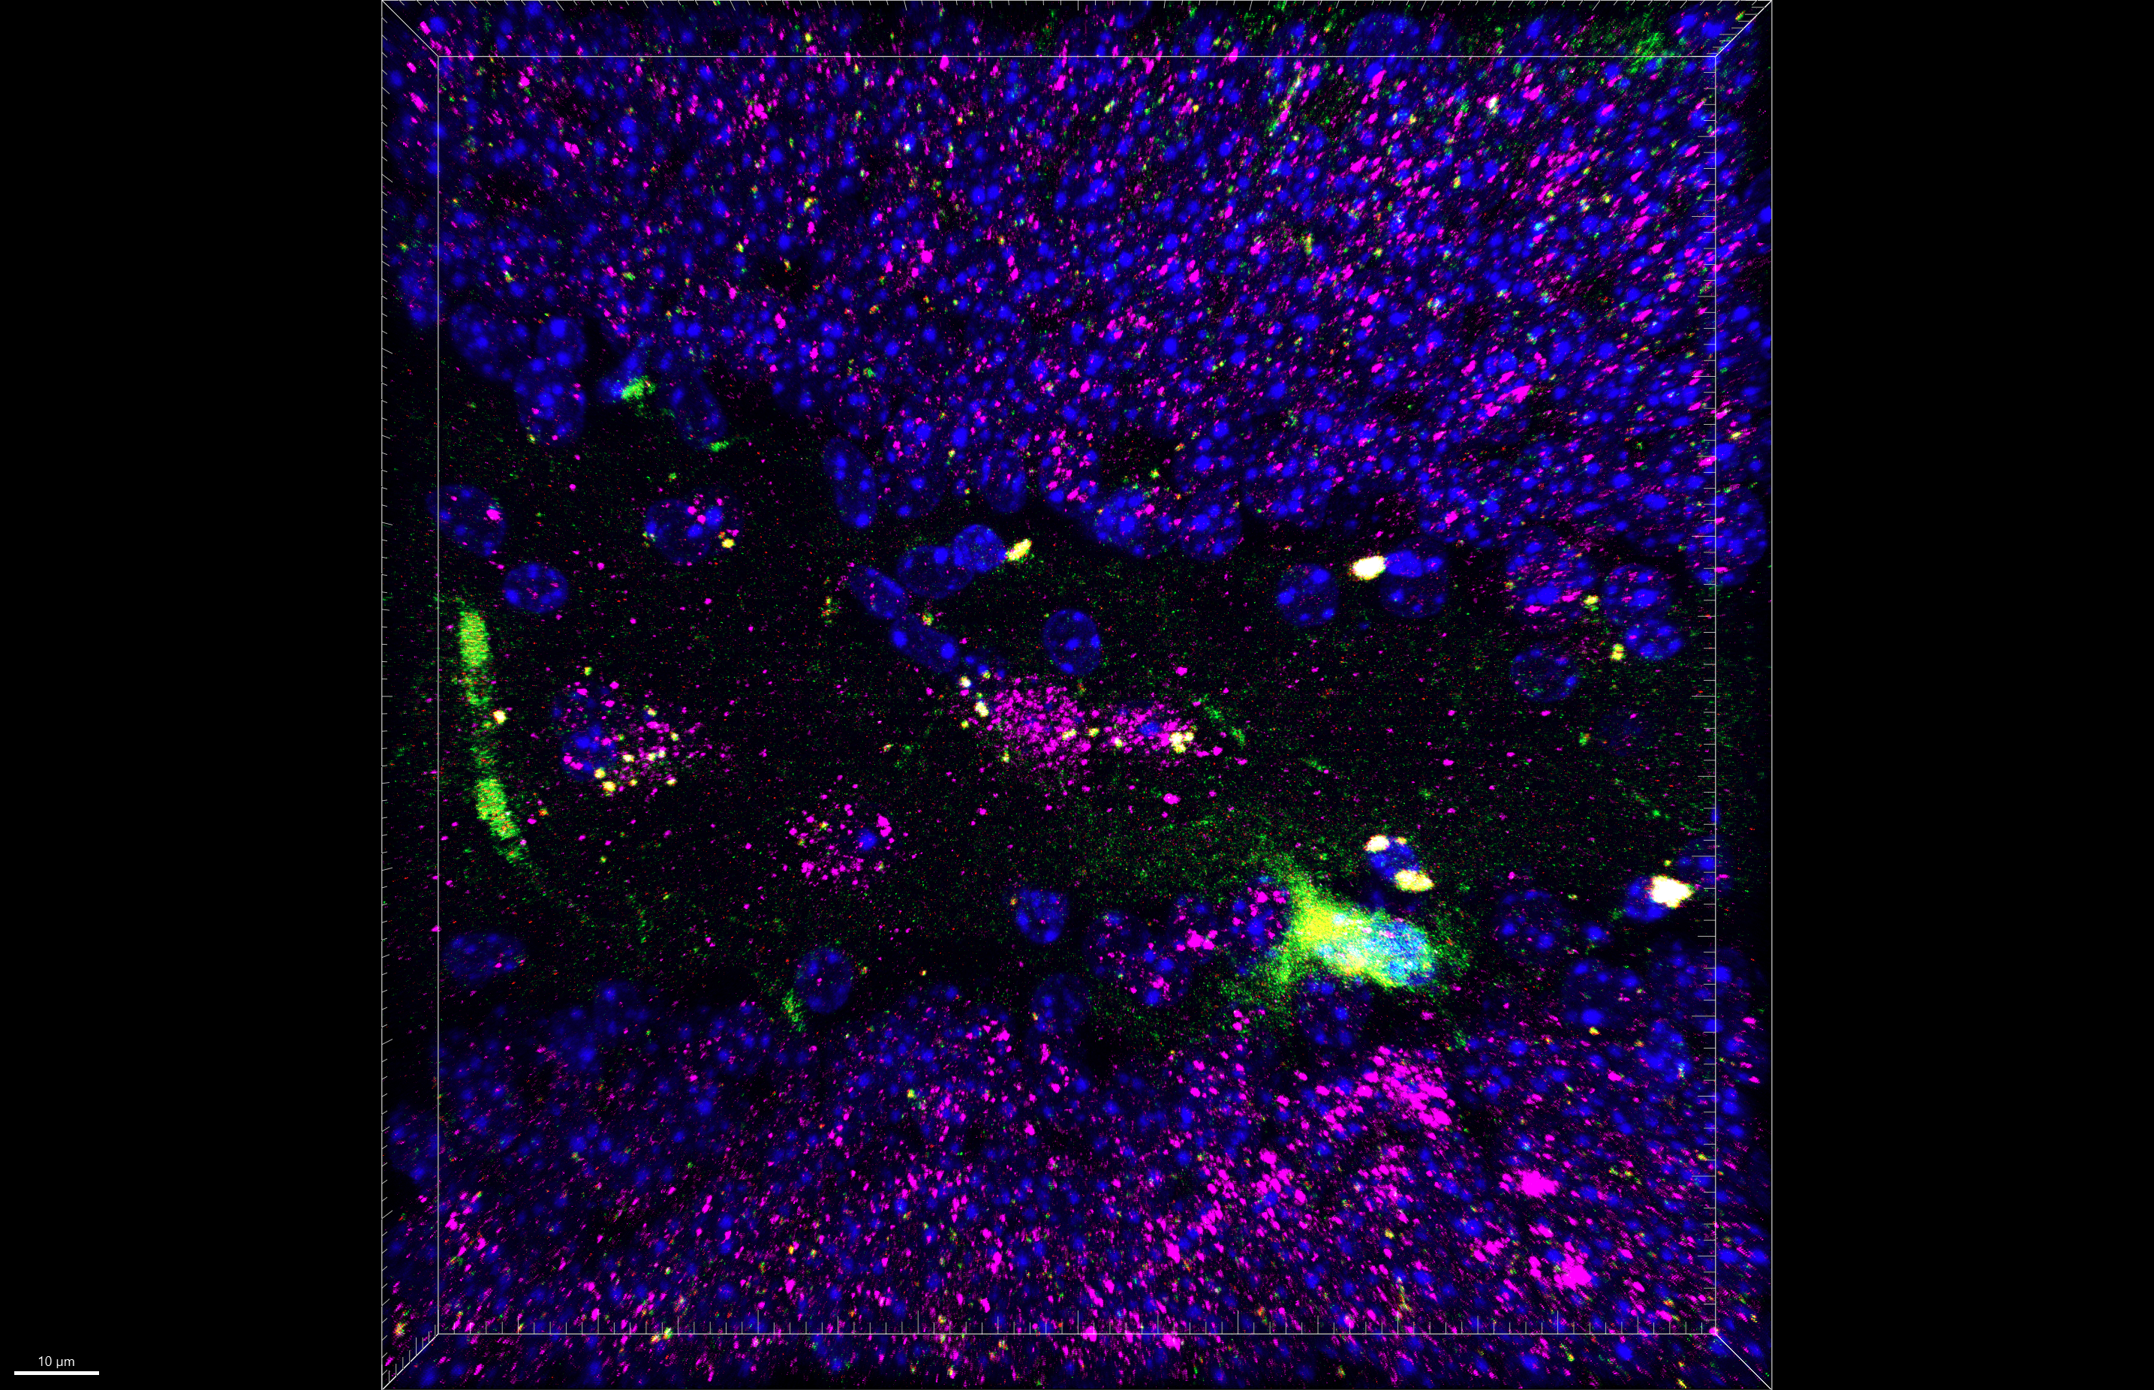
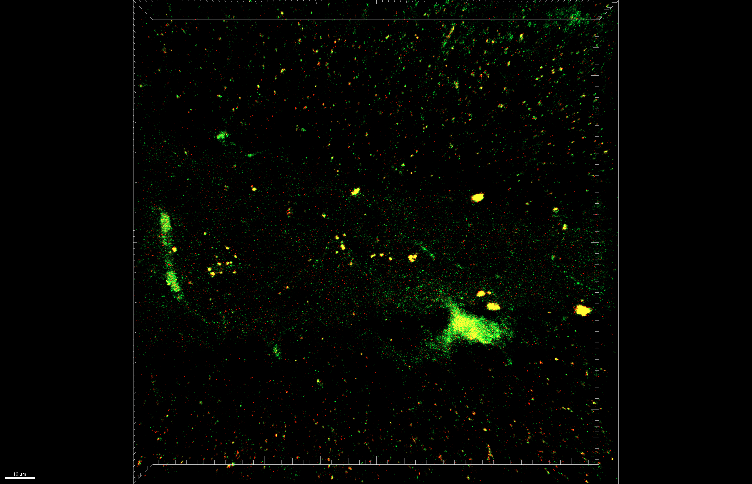
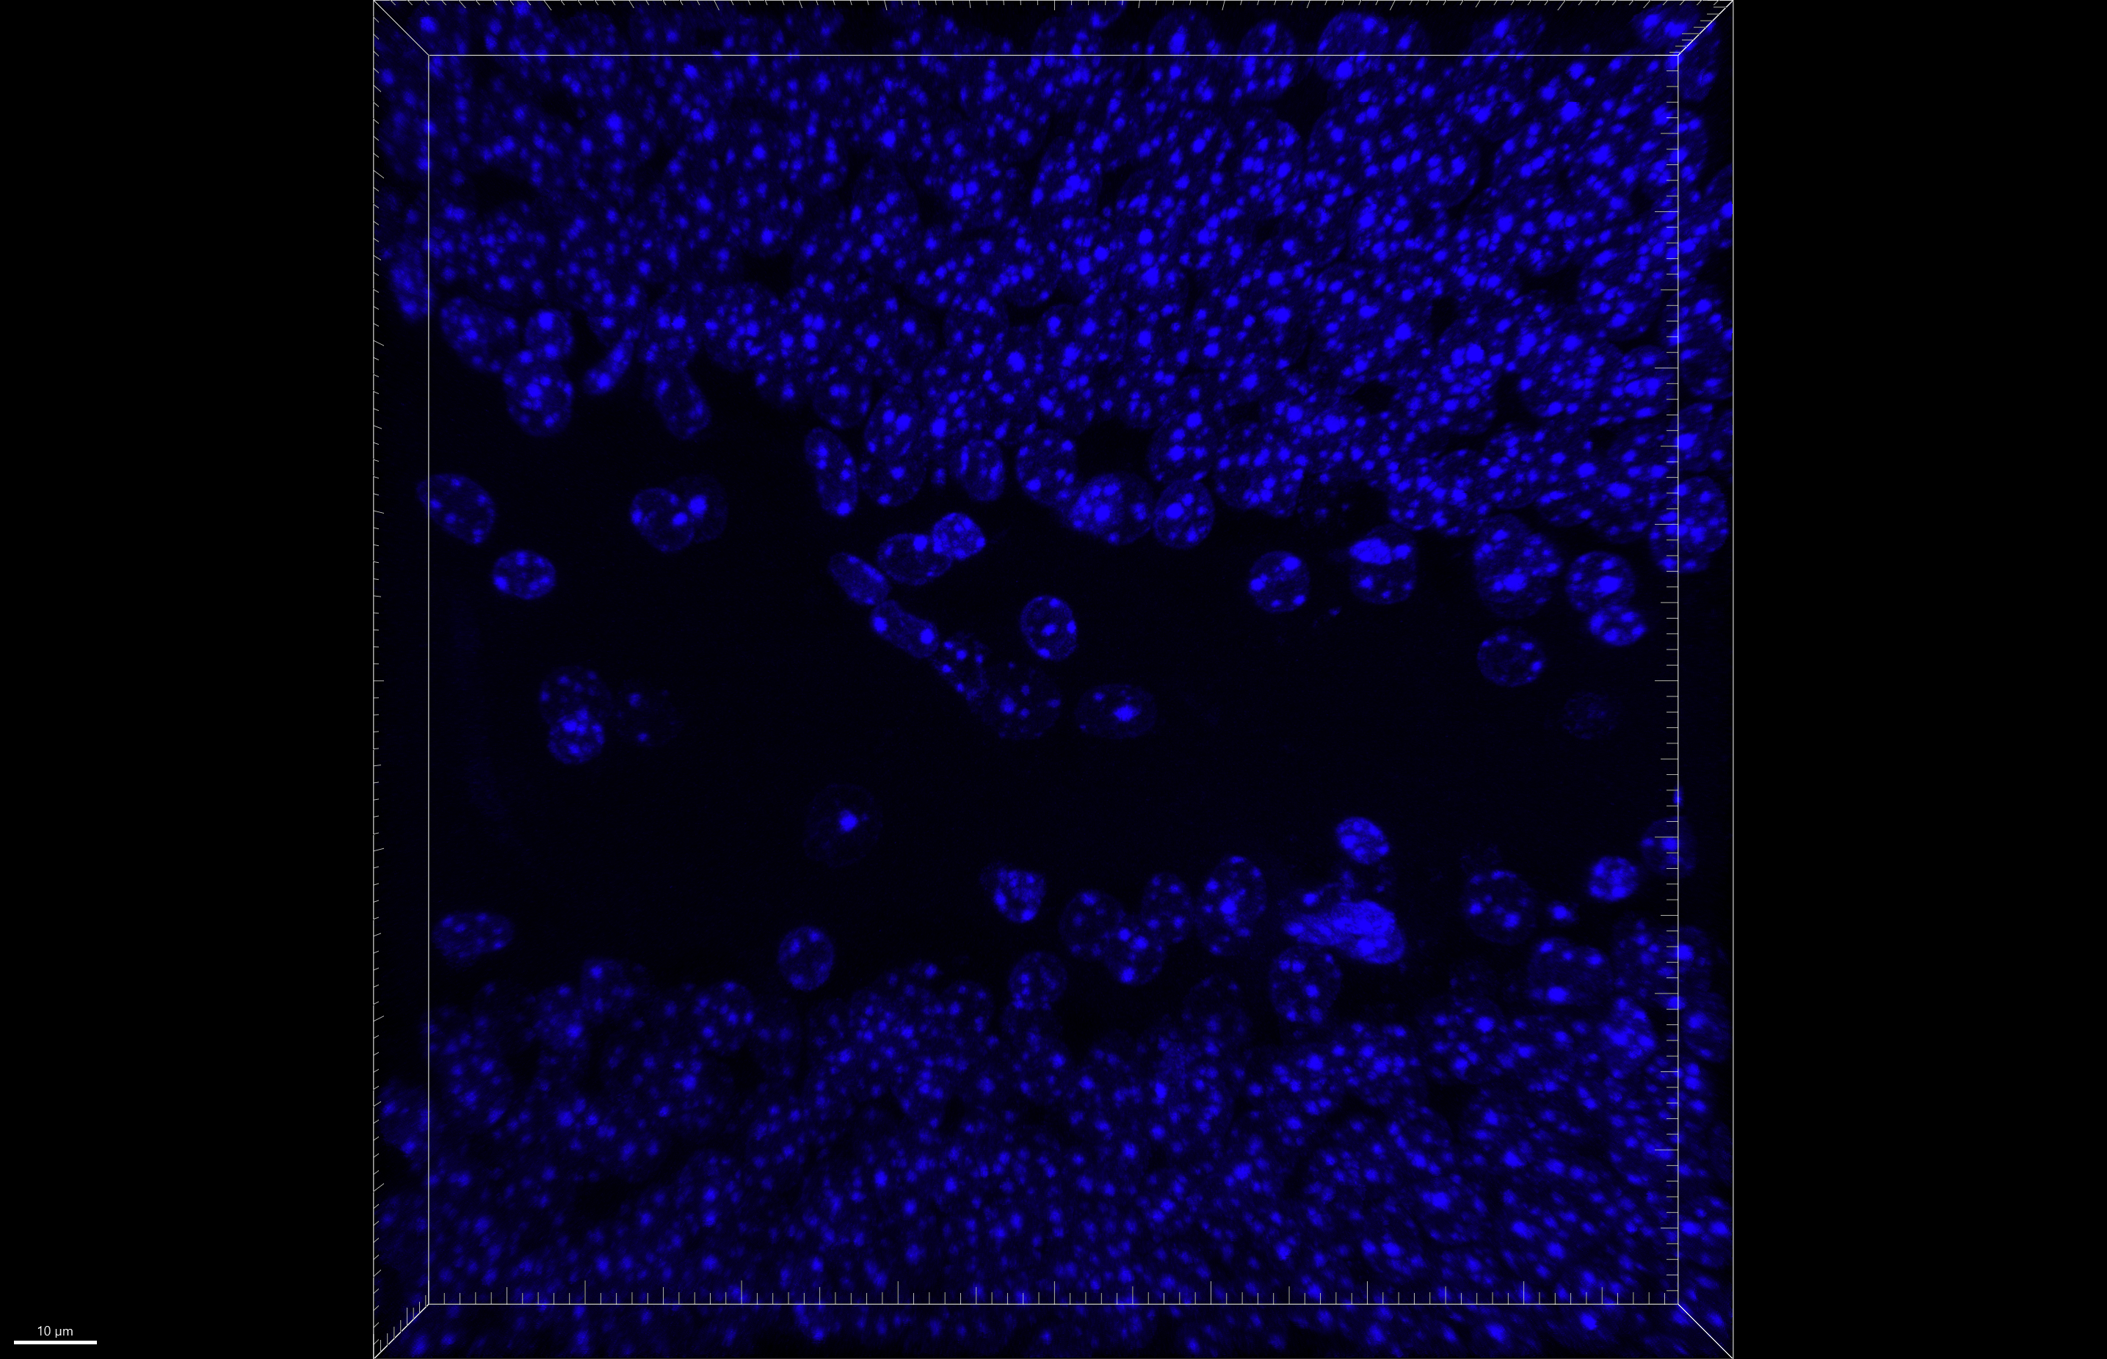
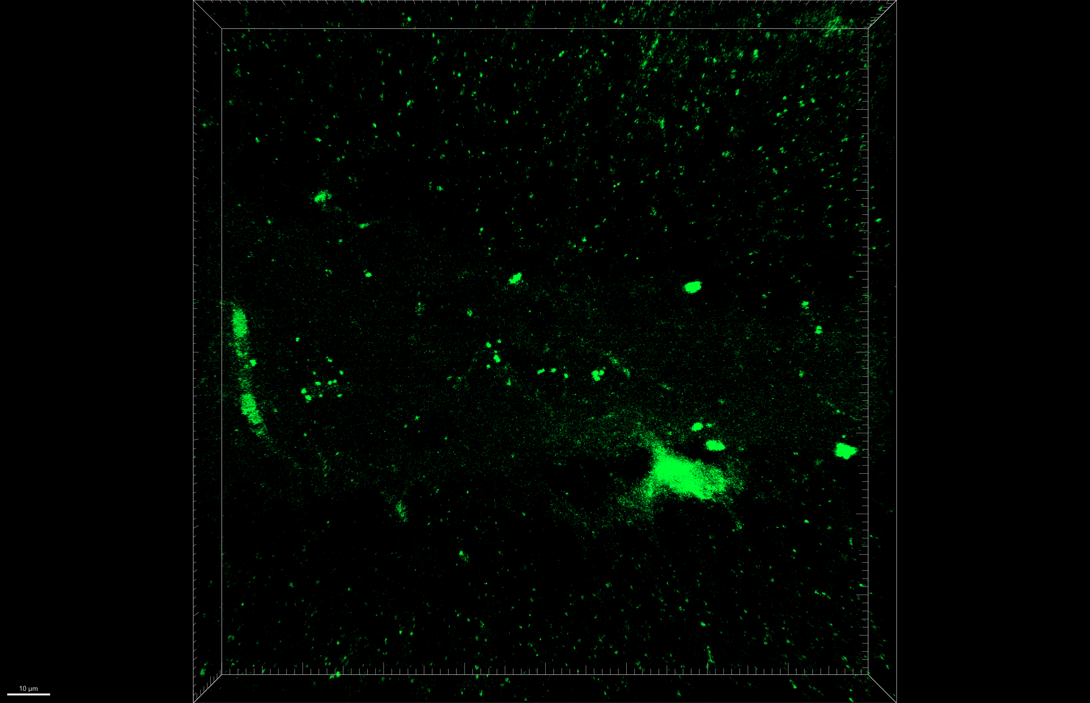
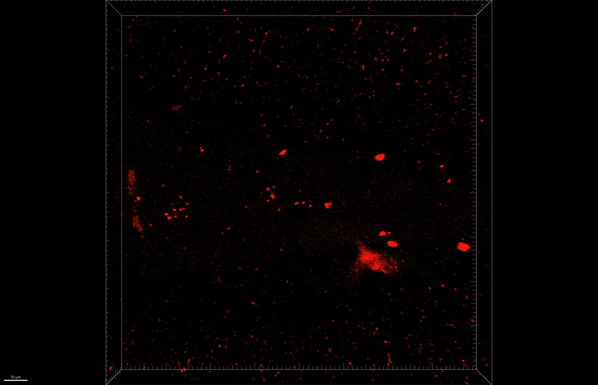
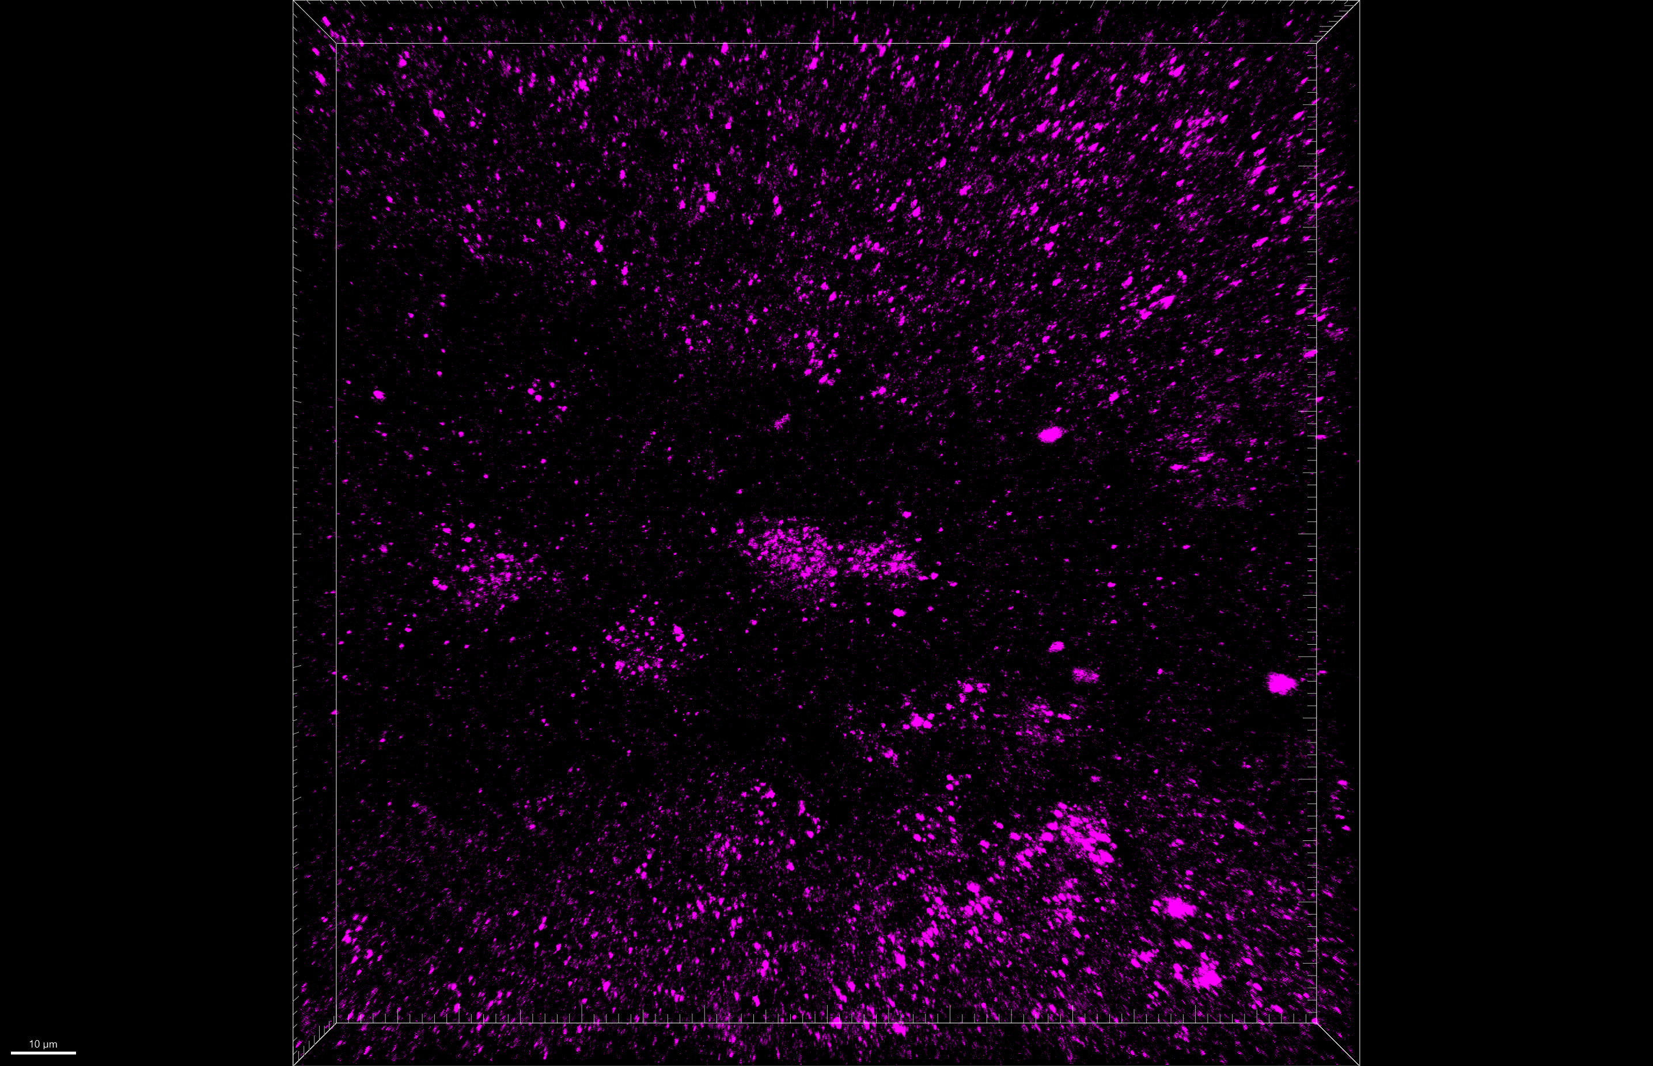
Fig 4.E
[Iba1-shPfk + mt-mKeima] + LAP POD 14, DG
LSM 800, 40x, z stacks
merge
enlarged
merged
green + red
Hoechst
mt-mKeima
mt-mKeima
γH2AX
mKeima
+
LAP
shPfk1
+
mKeima
+
LAP
shPfk2
+
mKeima
+
LAP

Slide 3
Fig 4.E
mKeima + LAP
merge

Slide 4
Fig 4.E
merged
green + red
mKeima + LAP

Slide 5
Fig 4.E
mKeima + LAP
Hoechst

Slide 6
Fig 4.E
mt-mKeima
mKeima + LAP

Slide 7
Fig 4.E
mKeima + LAP
mt-mKeima

Slide 8
Fig 4.E
γH2AX
mKeima + LAP

Slide 9
Fig 4.E
shPfk1 + mKeima + LAP
merge

Slide 10
Fig 4.E
merged
green + red
shPfk1 + mKeima + LAP

Slide 11
Fig 4.E
shPfk1 + mKeima + LAP
Hoechst

Slide 12
Fig 4.E
shPfk1 + mKeima + LAP
mt-mKeima

Slide 13
Fig 4.E
shPfk1 + mKeima + LAP
mt-mKeima

Slide 14
Fig 4.E
shPfk1 + mKeima + LAP
γH2AX

Slide 15
Fig 4.E
shPfk2 + mKeima + LAP
merge

Slide 16
Fig 4.E
merged
green + red
shPfk2 + mKeima + LAP

Slide 17
Fig 4.E
shPfk2 + mKeima + LAP
Hoechst

Slide 18
Fig 4.E
shPfk2 + mKeima + LAP
mt-mKeima

Slide 19
Fig 4.E
shPfk2 + mKeima + LAP
mt-mKeima

Slide 20
Fig 4.E
shPfk2 + mKeima + LAP
γH2AX

