Slide 1
Raw images_Supplementary Figures_CMI 2026
Title of manuscript: Glycolytic enzymes play important roles in innate immune memory of neuroimmune responses triggered by systemic inflammation

Slide 2
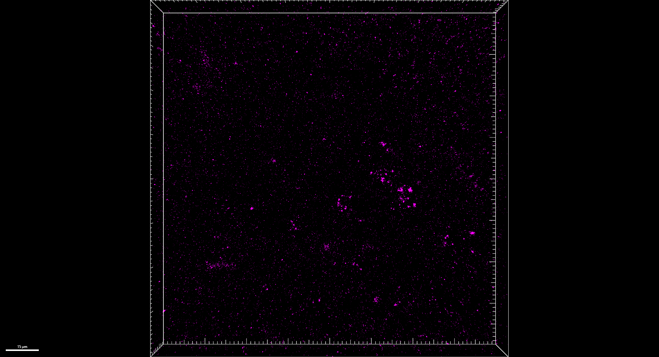
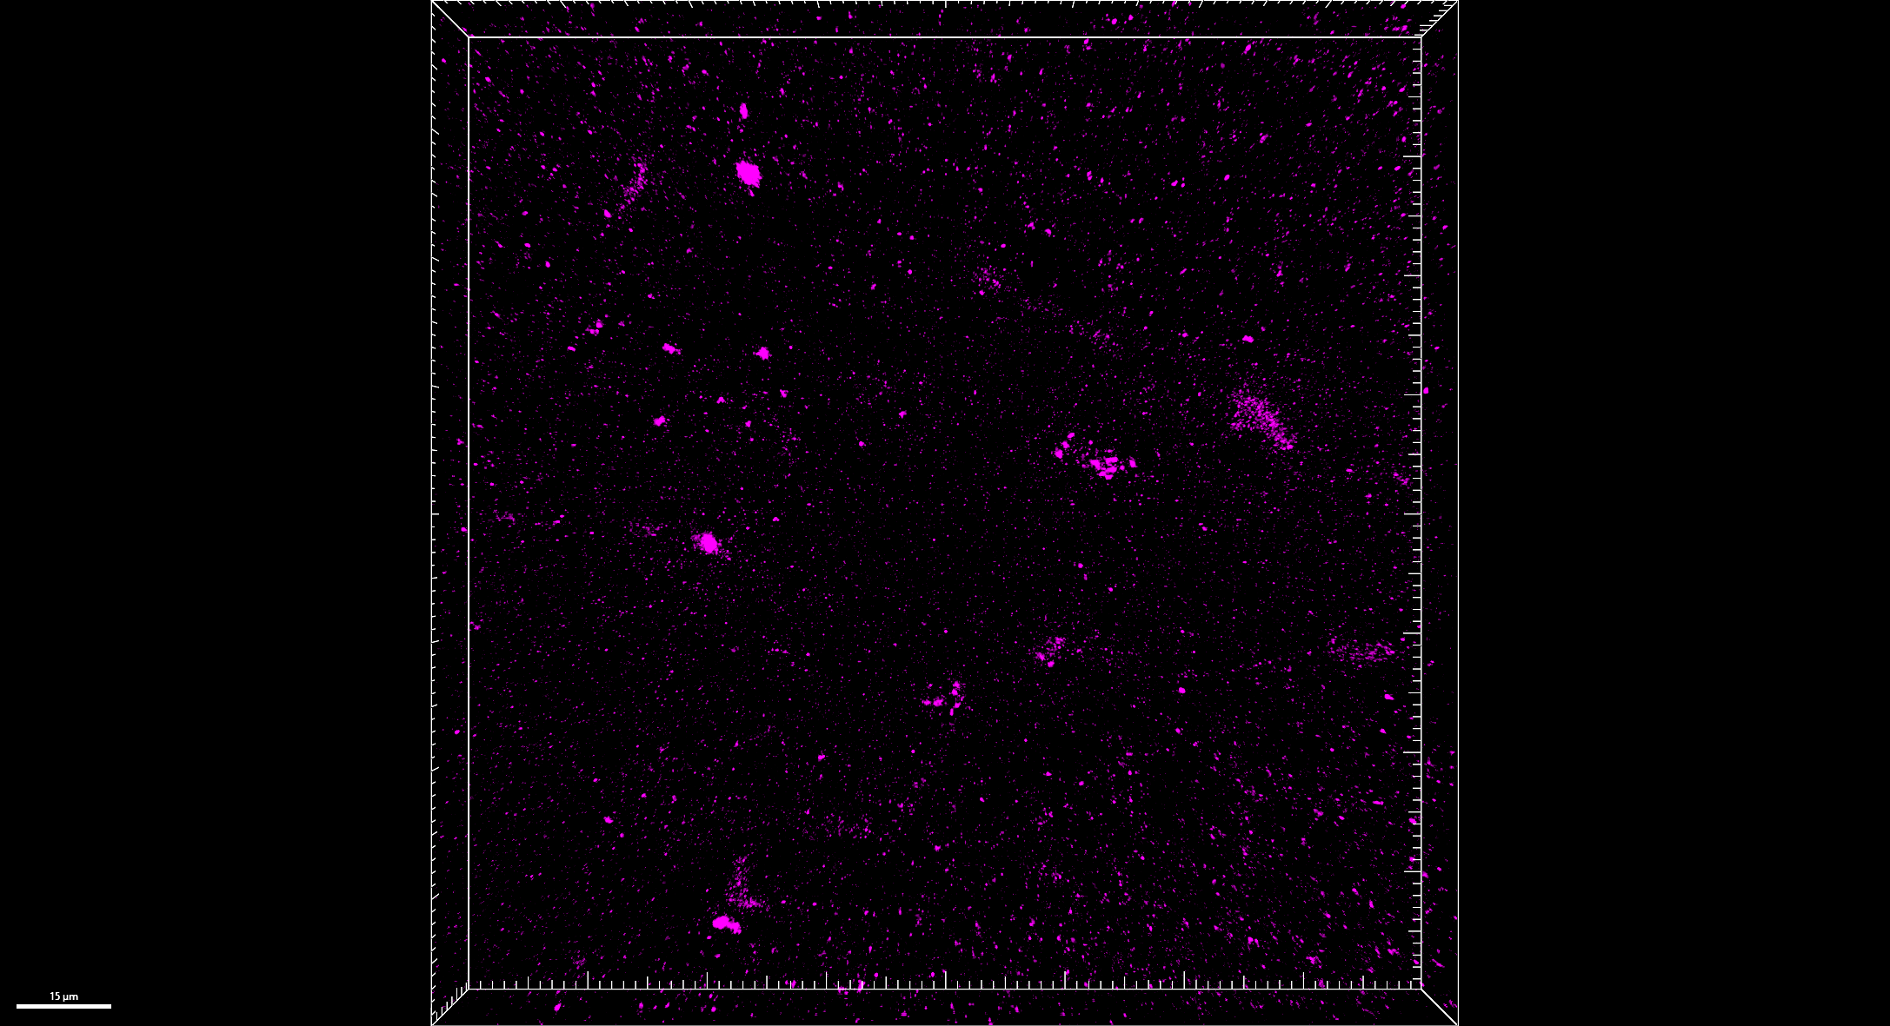
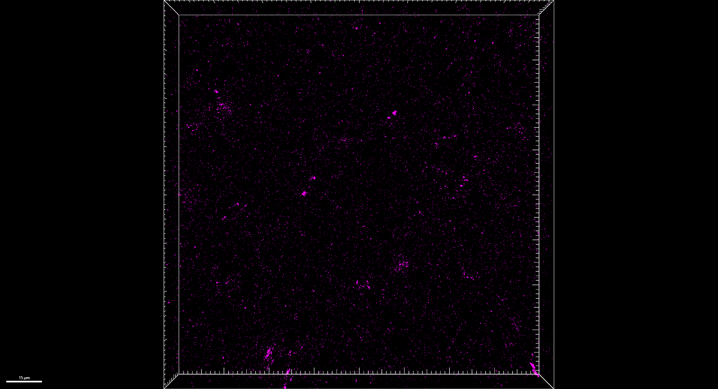
Fig S1.A
SEVO POD 2/3/14, DG
LSM 800, 40x, z stacks
merged
enlarged
Hoechst
Iba1
GFAP
STING
POD 2
POD 3
POD 14

Slide 3
Fig S1.A
merged
SEVO, POD 2

Slide 4
Fig S1.A
Hoechst
SEVO, POD 2

Slide 5
Fig S1.A
Iba1
SEVO, POD 2

Slide 6
Fig S1.A
GFAP
SEVO, POD 2

Slide 7
Fig S1.A
STING
SEVO, POD 2

Slide 8
Fig S1.A
merged
SEVO, POD 3

Slide 9
Fig S1.A
Hoechst
SEVO, POD 3

Slide 10
Fig S1.A
Iba1
SEVO, POD 3

Slide 11
Fig S1.A
GFAP
SEVO, POD 3

Slide 12
Fig S1.A
STING
SEVO, POD 3

Slide 13
Fig S1.A
merged
SEVO, POD 14

Slide 14
Fig S1.A
Hoechst
SEVO, POD 14

Slide 15
Fig S1.A
Iba1
SEVO, POD 14

Slide 16
Fig S1.A
GFAP
SEVO, POD 14

Slide 17
Fig S1.A
STING
SEVO, POD 14

