Slide 1
Raw images_Figures_CMI 2026
Title of manuscript: Glycolytic enzymes play important roles in innate immune memory of neuroimmune responses triggered by systemic inflammation

Slide 2
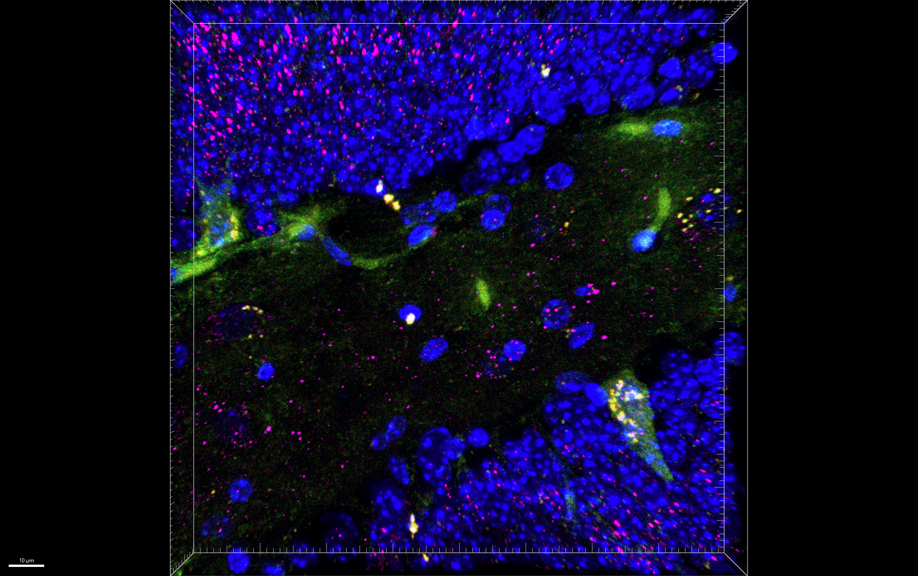
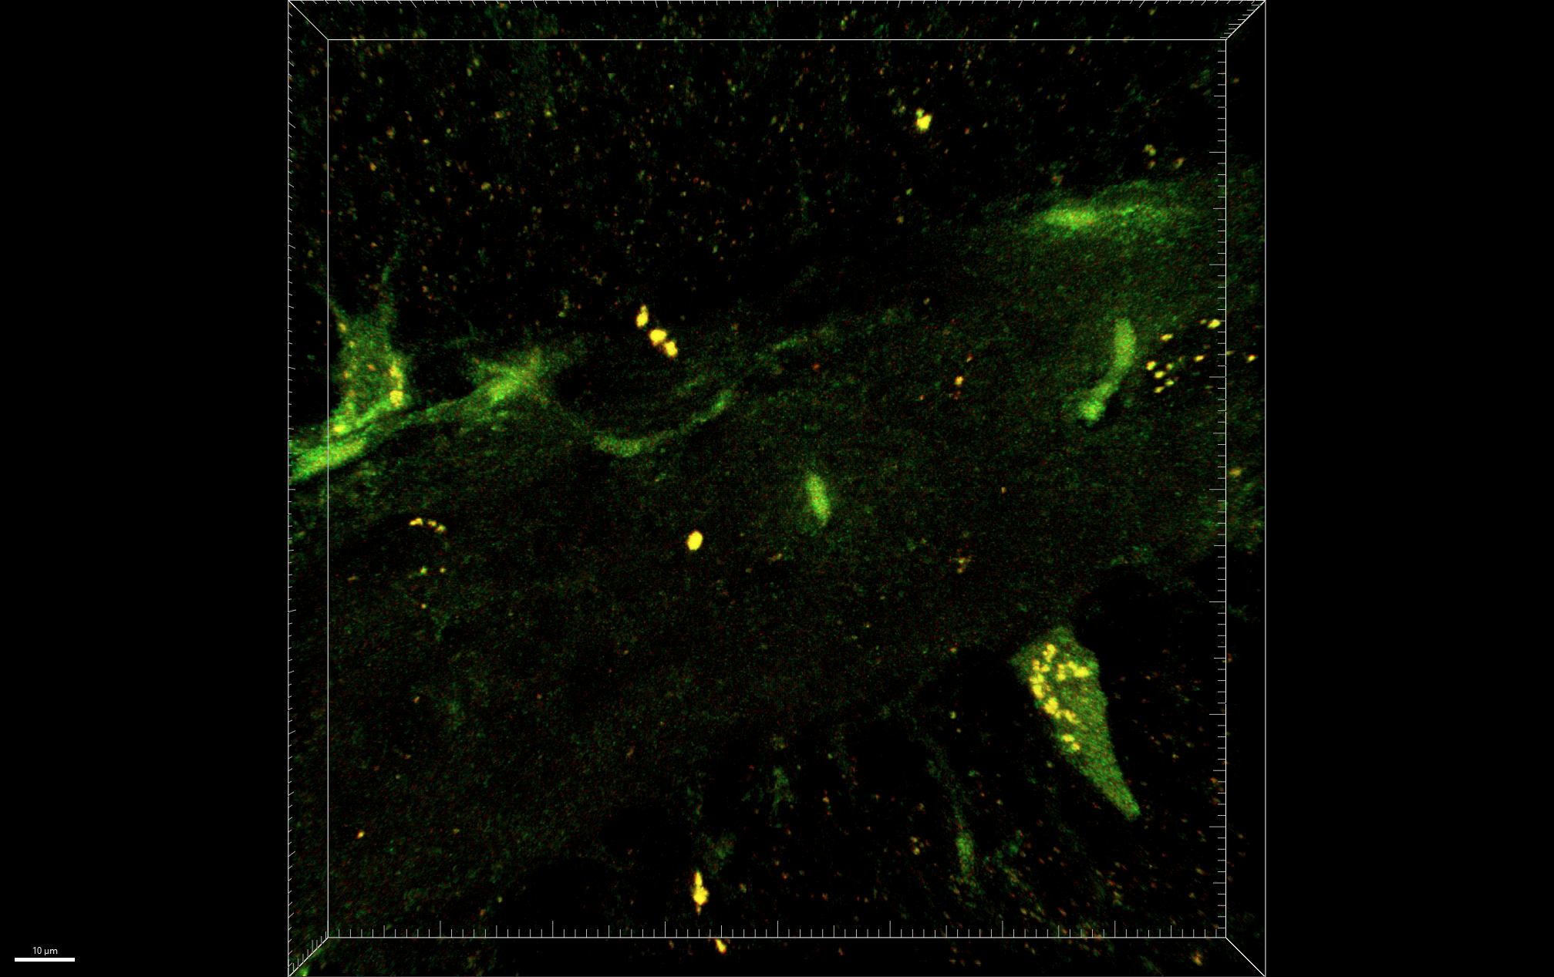
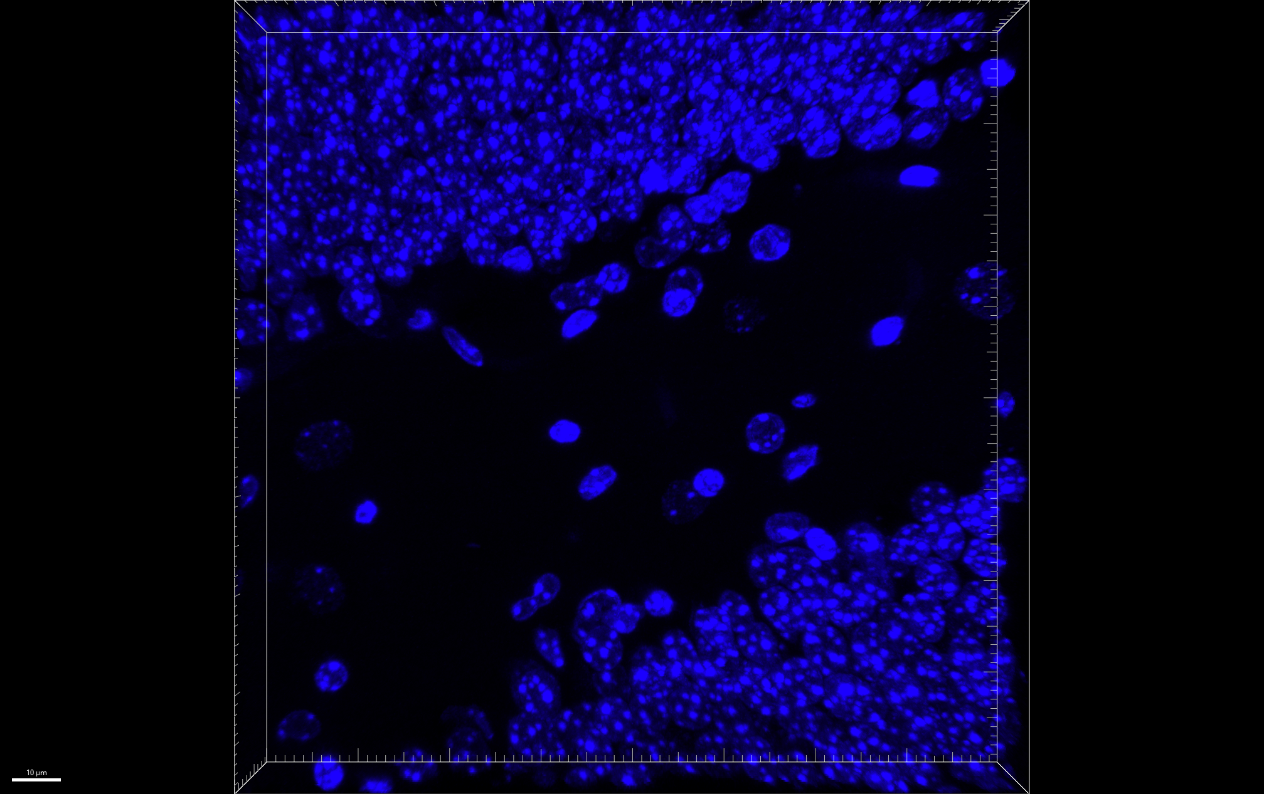
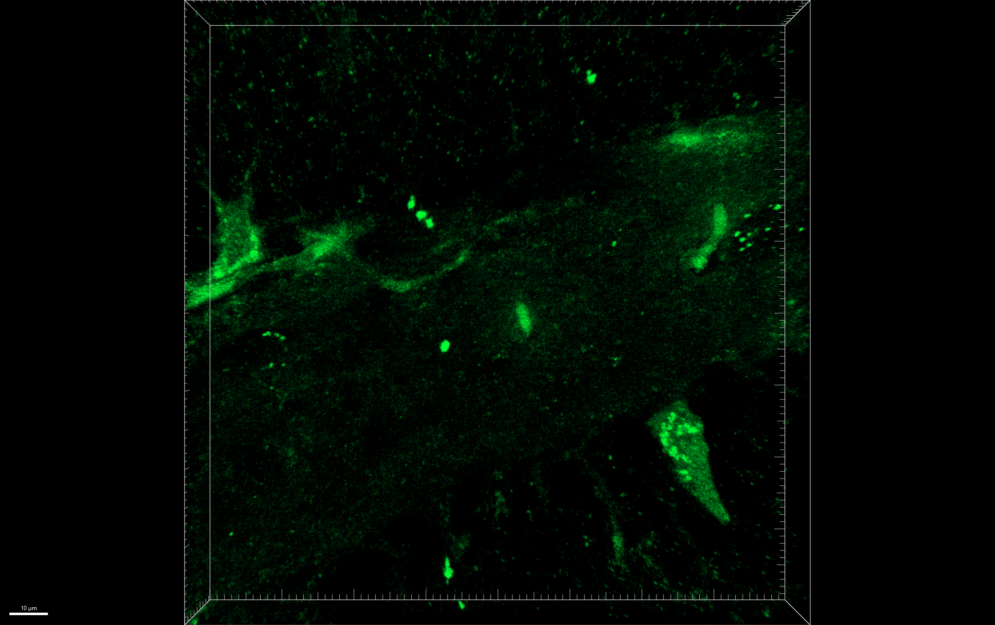
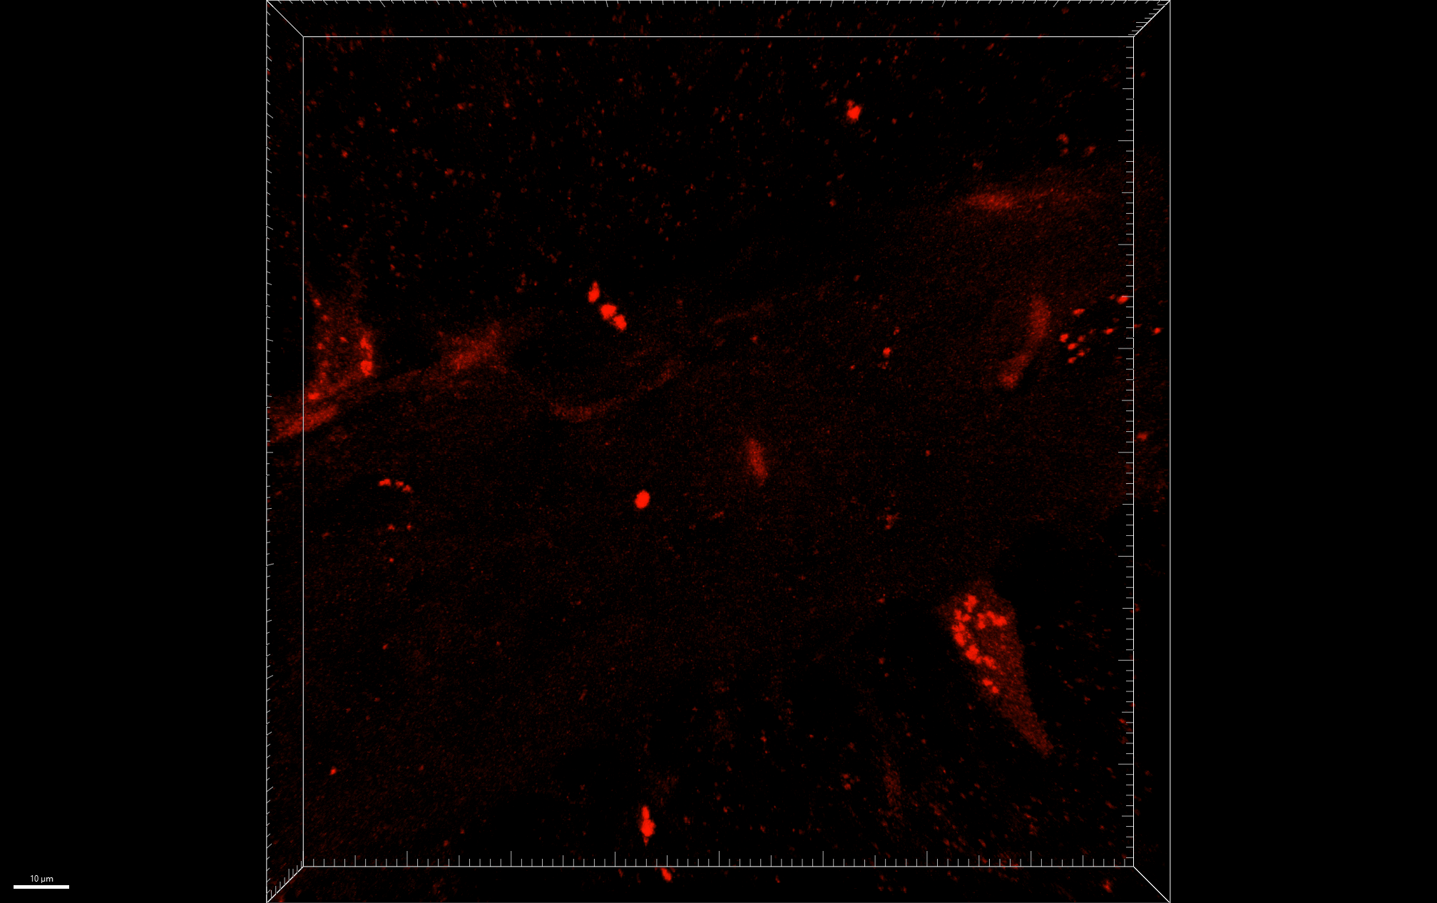
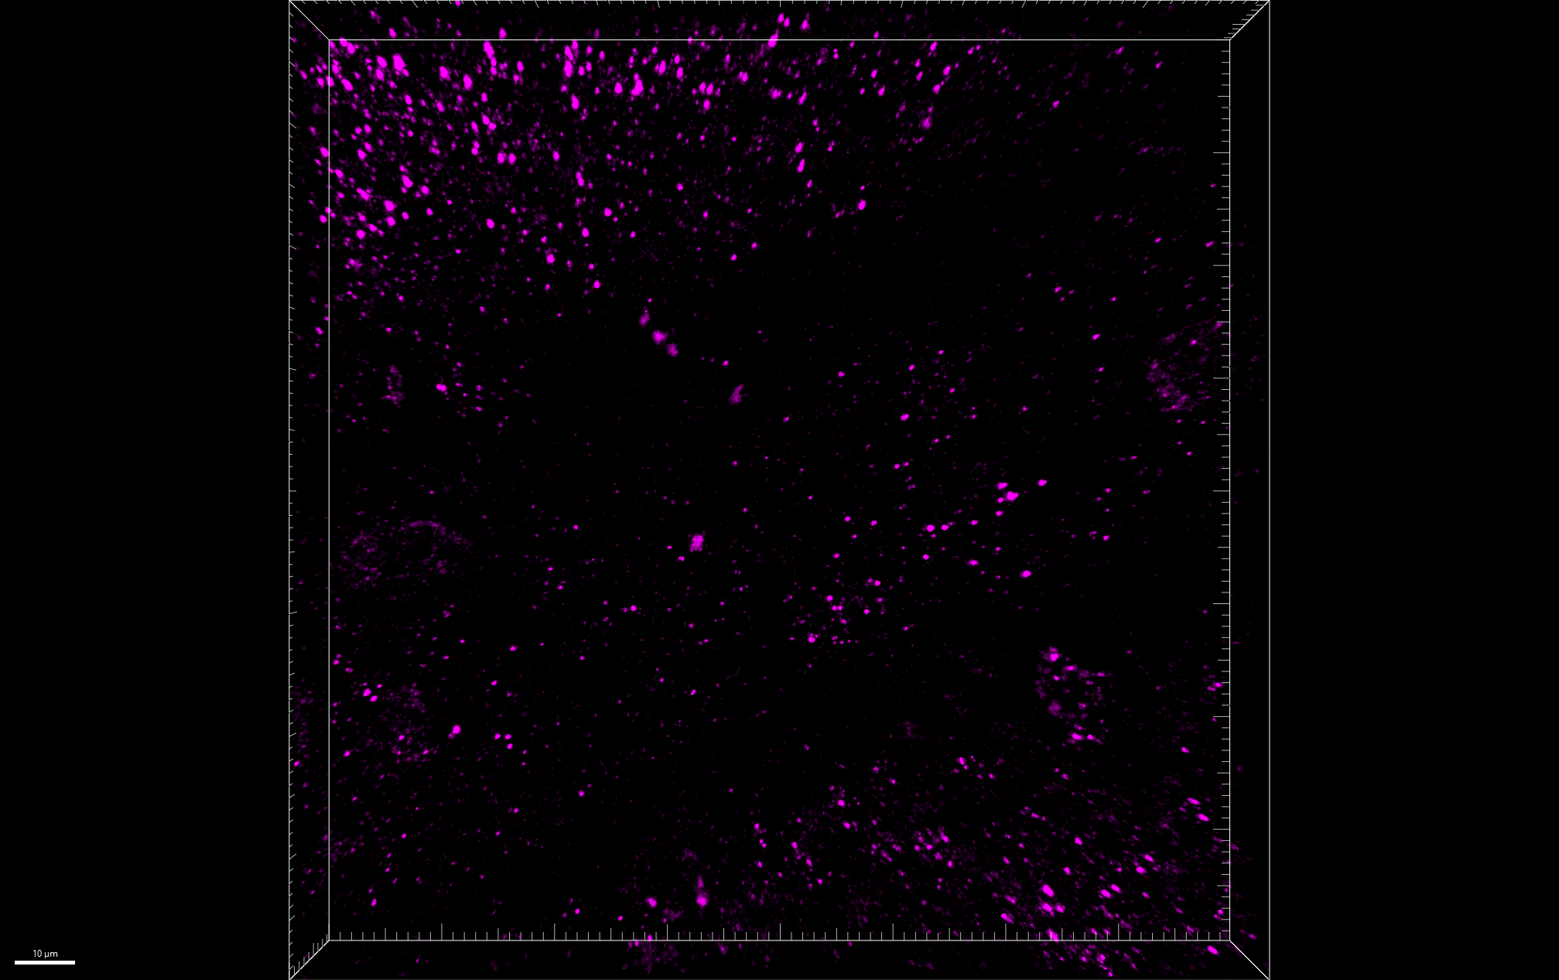
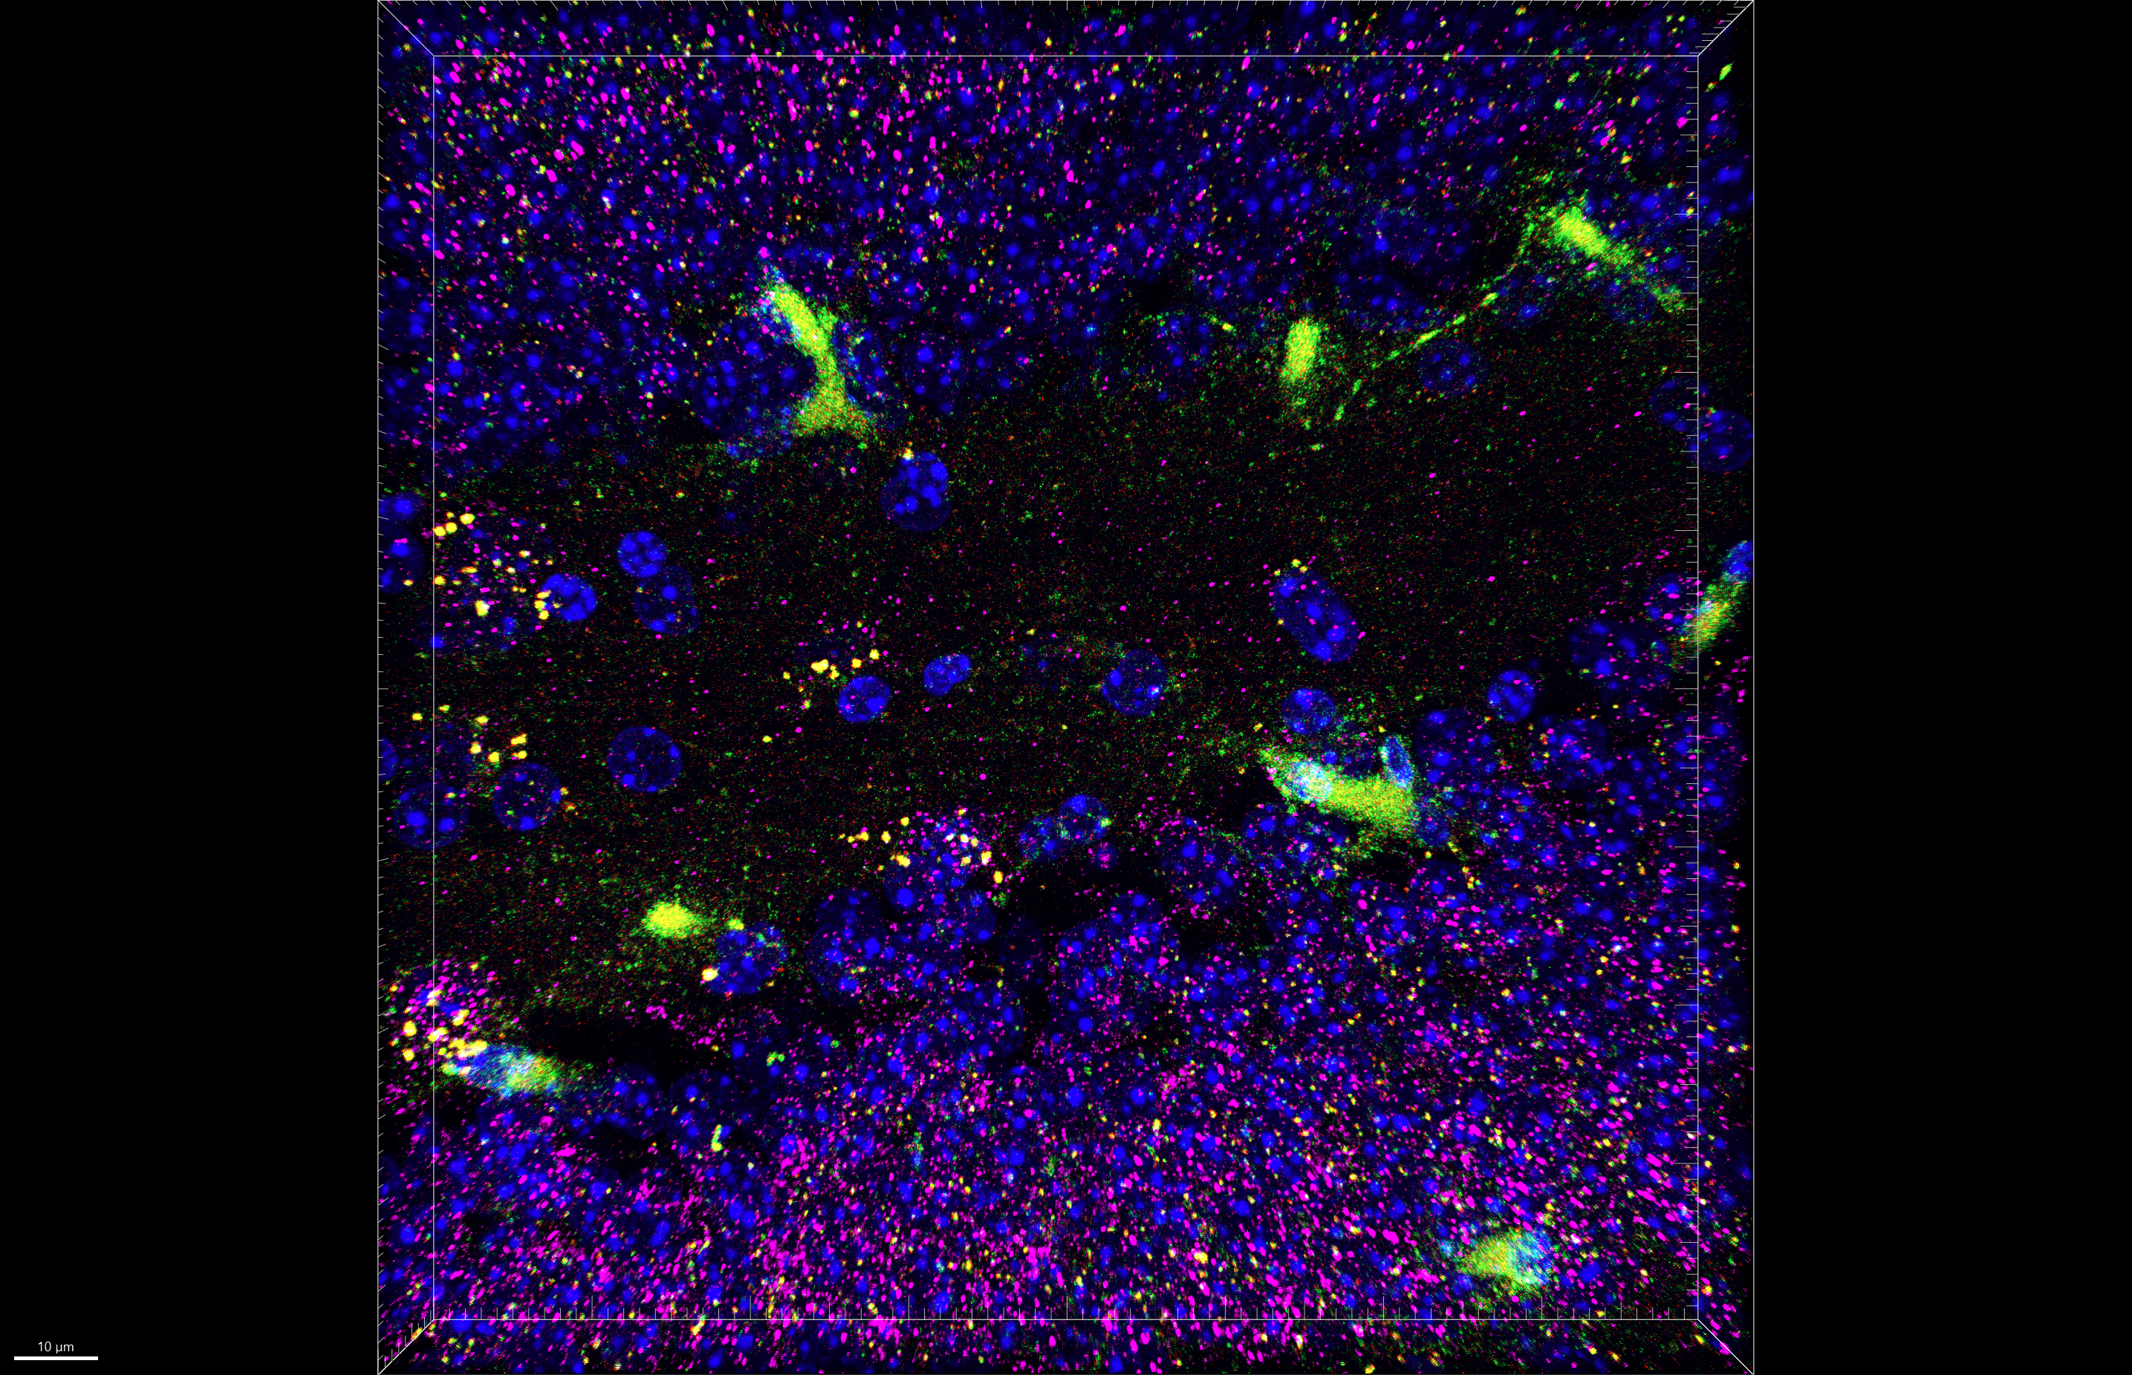
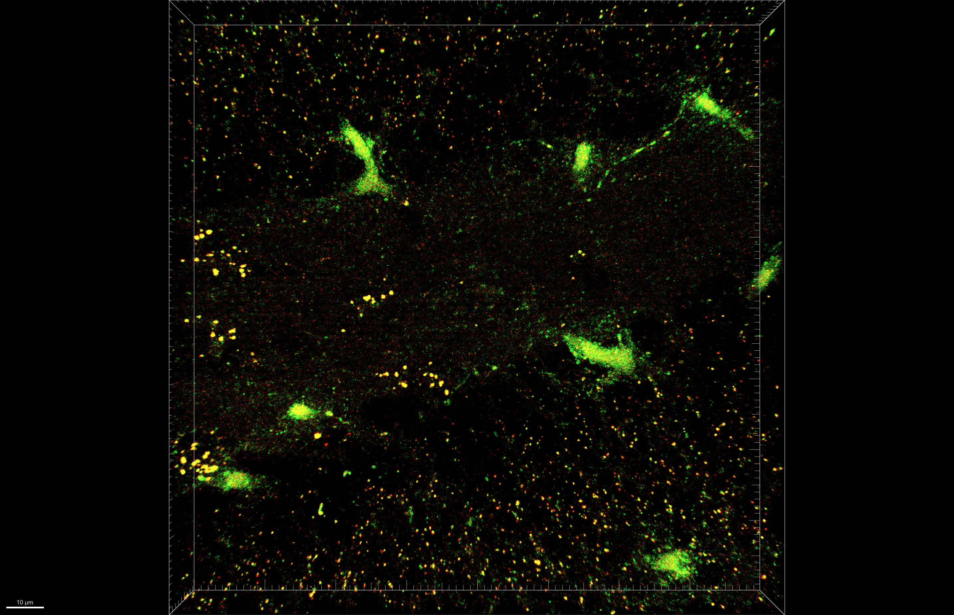
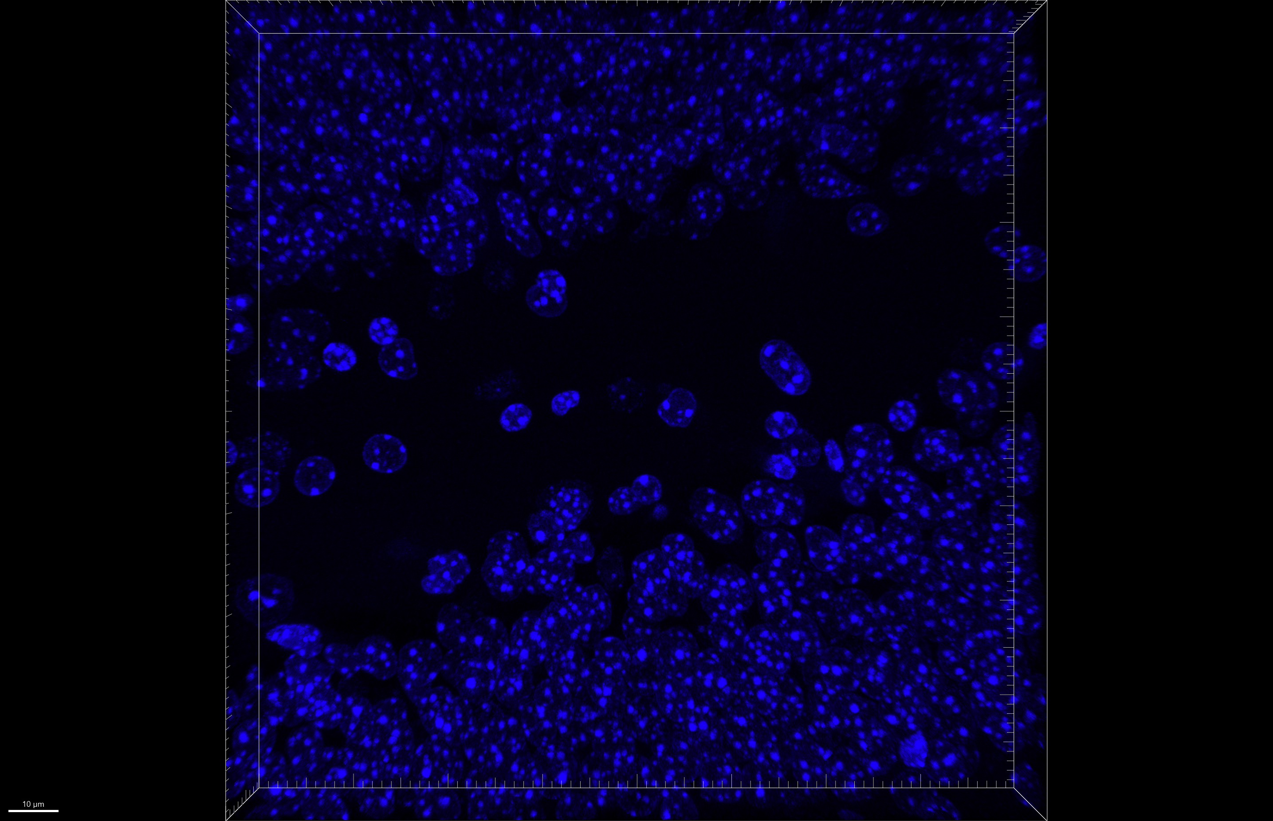
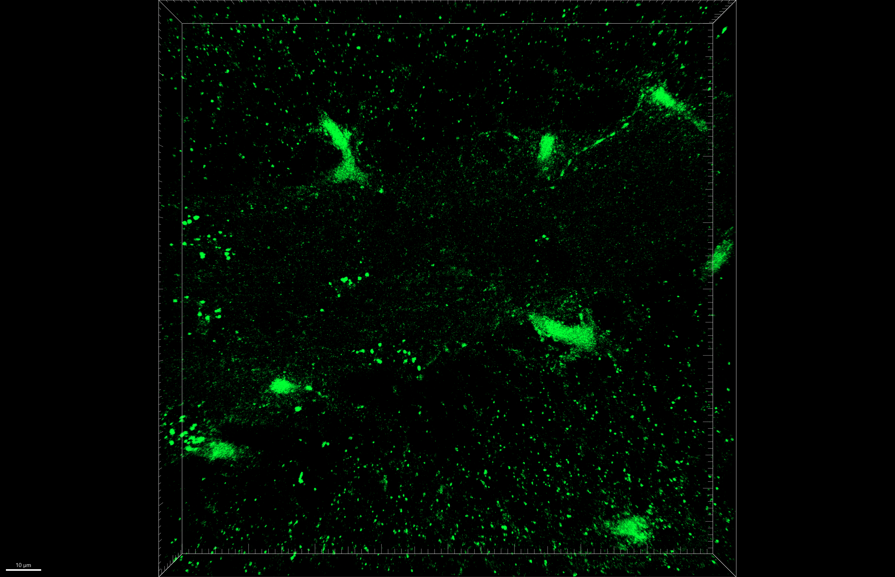
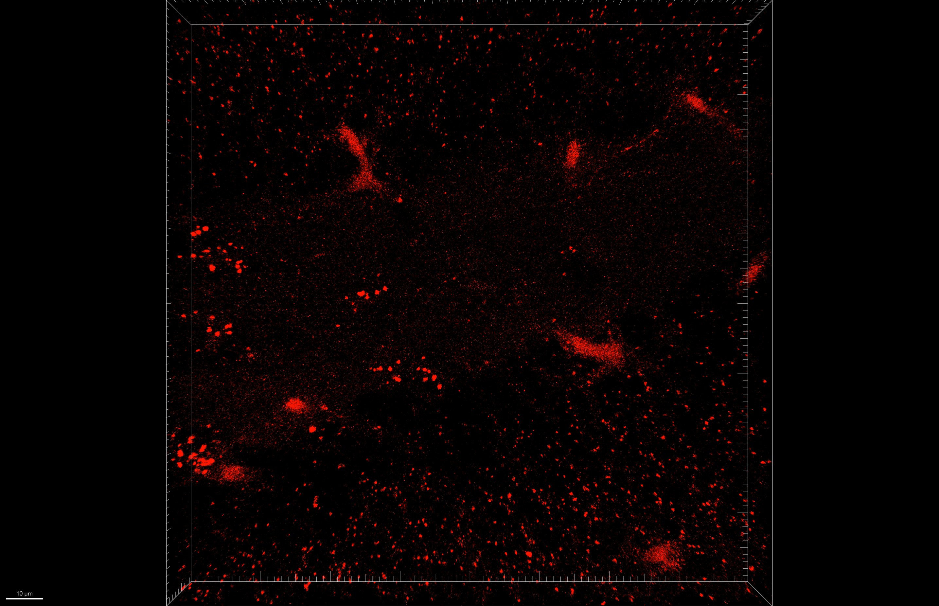
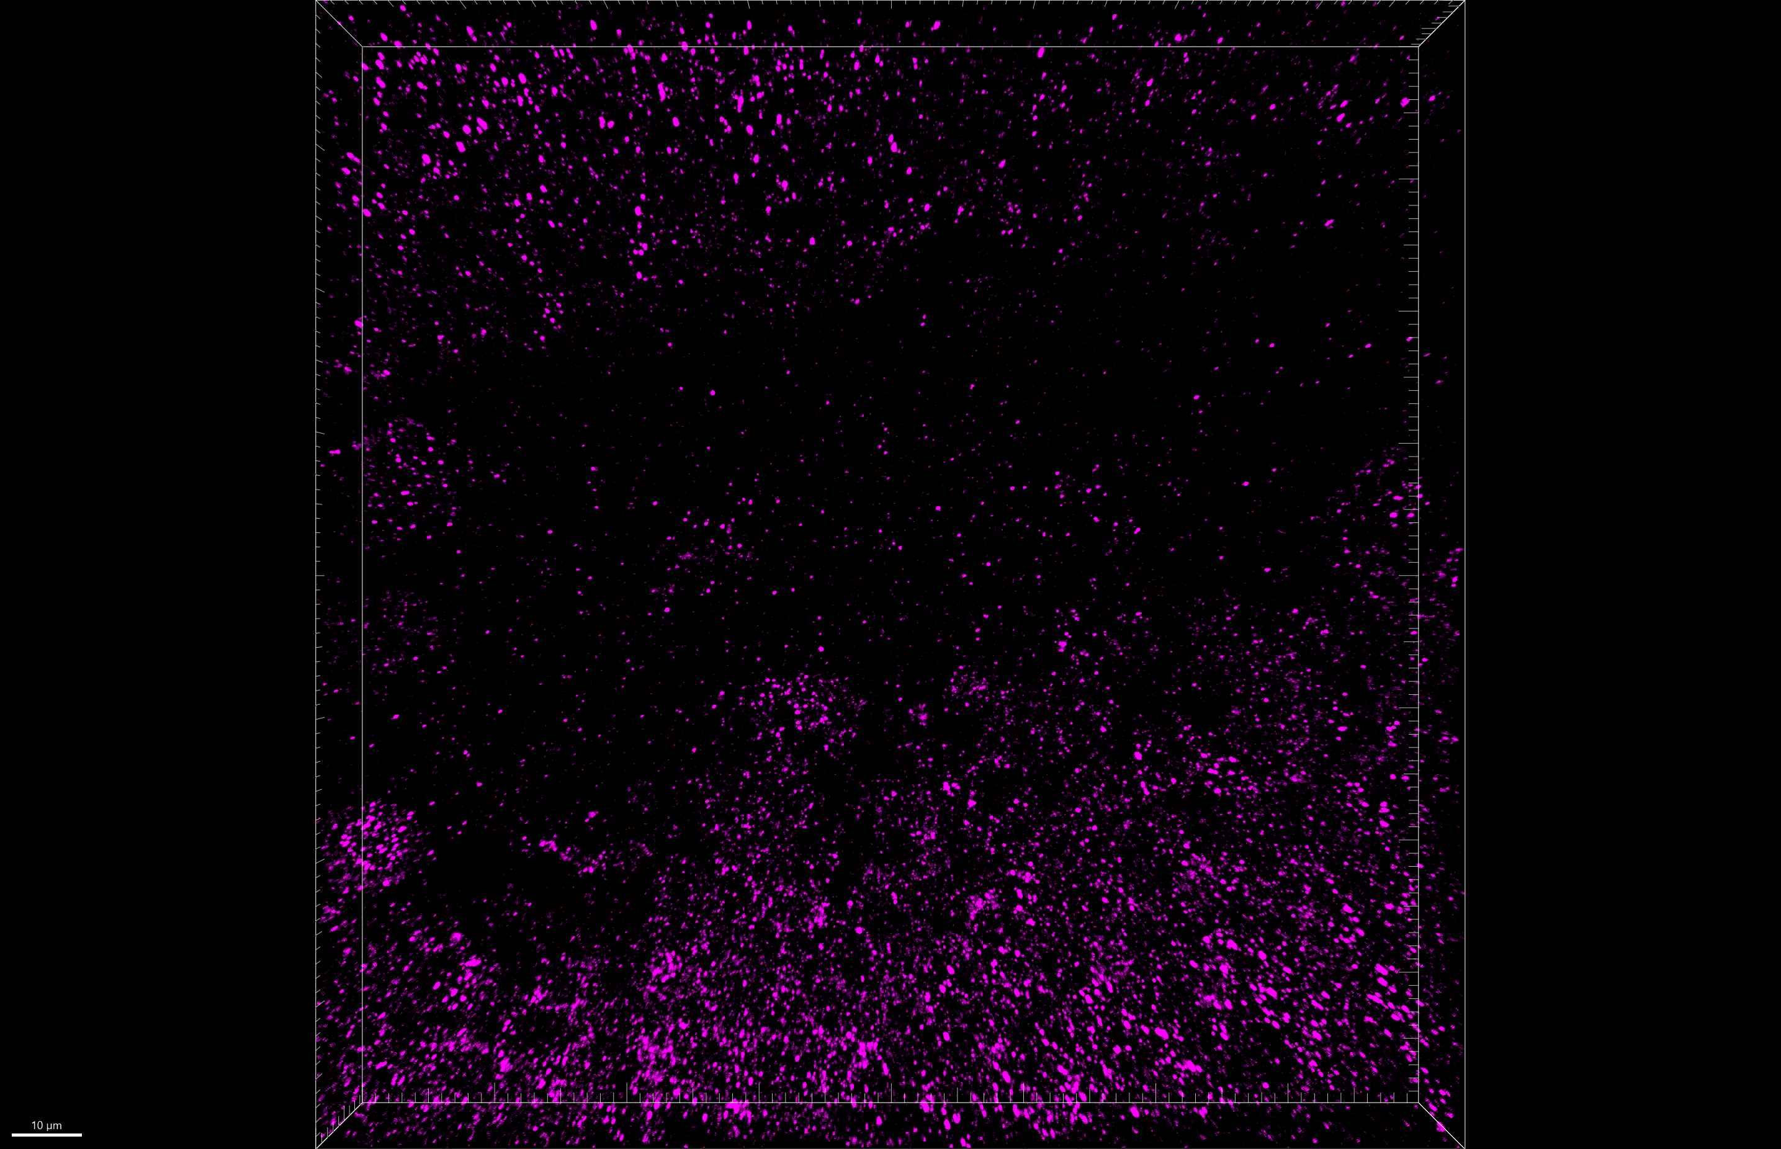
Fig 6.D
[Iba1-mKeima / Iba1-shPfk2 + Iba1-mKeima] + LPS, day 14, DG
LSM 800, 40x, z stacks
merged
green + red
Hoechst
mt-mKeima
merged
enlarged
mt-mKeima
γH2AX
mKeima
+
LPS
shPfk1
+
mKeima
+
LPS
shPfk2
+
mKeima
+
LPS

Slide 3
Fig 6.D
mKeima + LPS
merged

Slide 4
Fig 6.D
merged
green + red
mKeima + LPS

Slide 5
Fig 6.D
mKeima + LPS
Hoechst

Slide 6
Fig 6.D
mKeima + LPS
mt-mKeima

Slide 7
Fig 6.D
mKeima + LPS
mt-mKeima

Slide 8
Fig 6.D
mKeima + LPS
γH2AX

Slide 9
Fig 6.D
shPfk1 + mKeima + LPS
merged

Slide 10
Fig 6.D
merged
green + red
shPfk1 + mKeima + LPS

Slide 11
Fig 6.D
shPfk1 + mKeima + LPS
Hoechst

Slide 12
Fig 6.D
shPfk1 + mKeima + LPS
mt-mKeima

Slide 13
Fig 6.D
shPfk1 + mKeima + LPS
mt-mKeima

Slide 14
Fig 6.D
shPfk1 + mKeima + LPS
γH2AX

Slide 15
Fig 6.D
shPfk2 + mKeima + LPS
merged

Slide 16
Fig 6.D
merged
green + red
shPfk2 + mKeima + LPS

Slide 17
Fig 6.D
shPfk2 + mKeima + LPS
Hoechst

Slide 18
Fig 6.D
shPfk2 + mKeima + LPS
mt-mKeima

Slide 19
Fig 6.D
shPfk2 + mKeima + LPS
mt-mKeima

Slide 20
Fig 6.D
shPfk2 + mKeima + LPS
γH2AX

