Slide 1
Raw images_Figures_CMI 2026
Title of manuscript: Glycolytic enzymes play important roles in innate immune memory of neuroimmune responses triggered by systemic inflammation

Slide 2
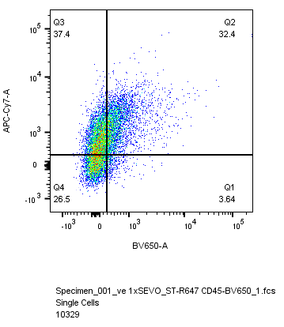
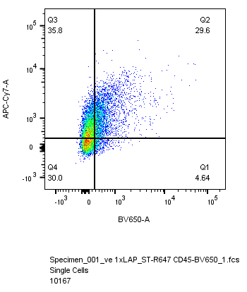
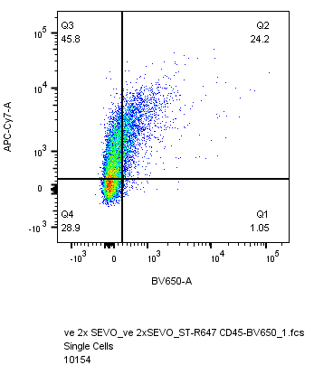
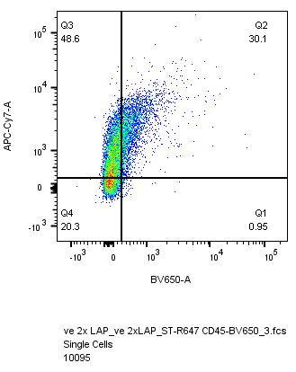
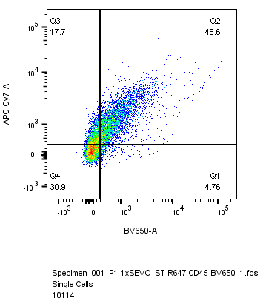
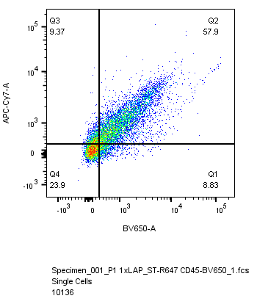
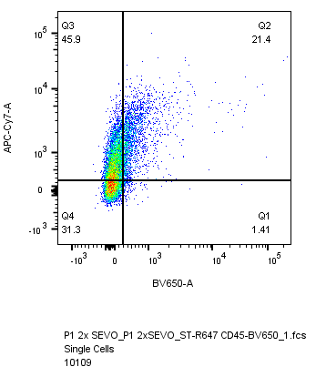

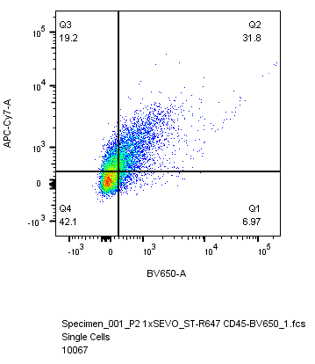
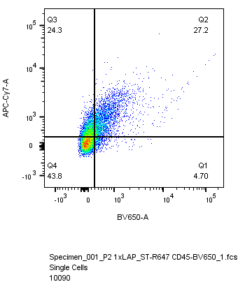


Fig 5.I
1x SEVO
1x LAP
2x SEVO
2x LAP
vehicle
STING-647
CD45-BV650
Iba1-shPfk1
Iba1-shPfk2

