Slide 1
Raw images_Supplementary Figures_CMI 2026
Title of manuscript: Glycolytic enzymes play important roles in innate immune memory of neuroimmune responses triggered by systemic inflammation

Slide 2
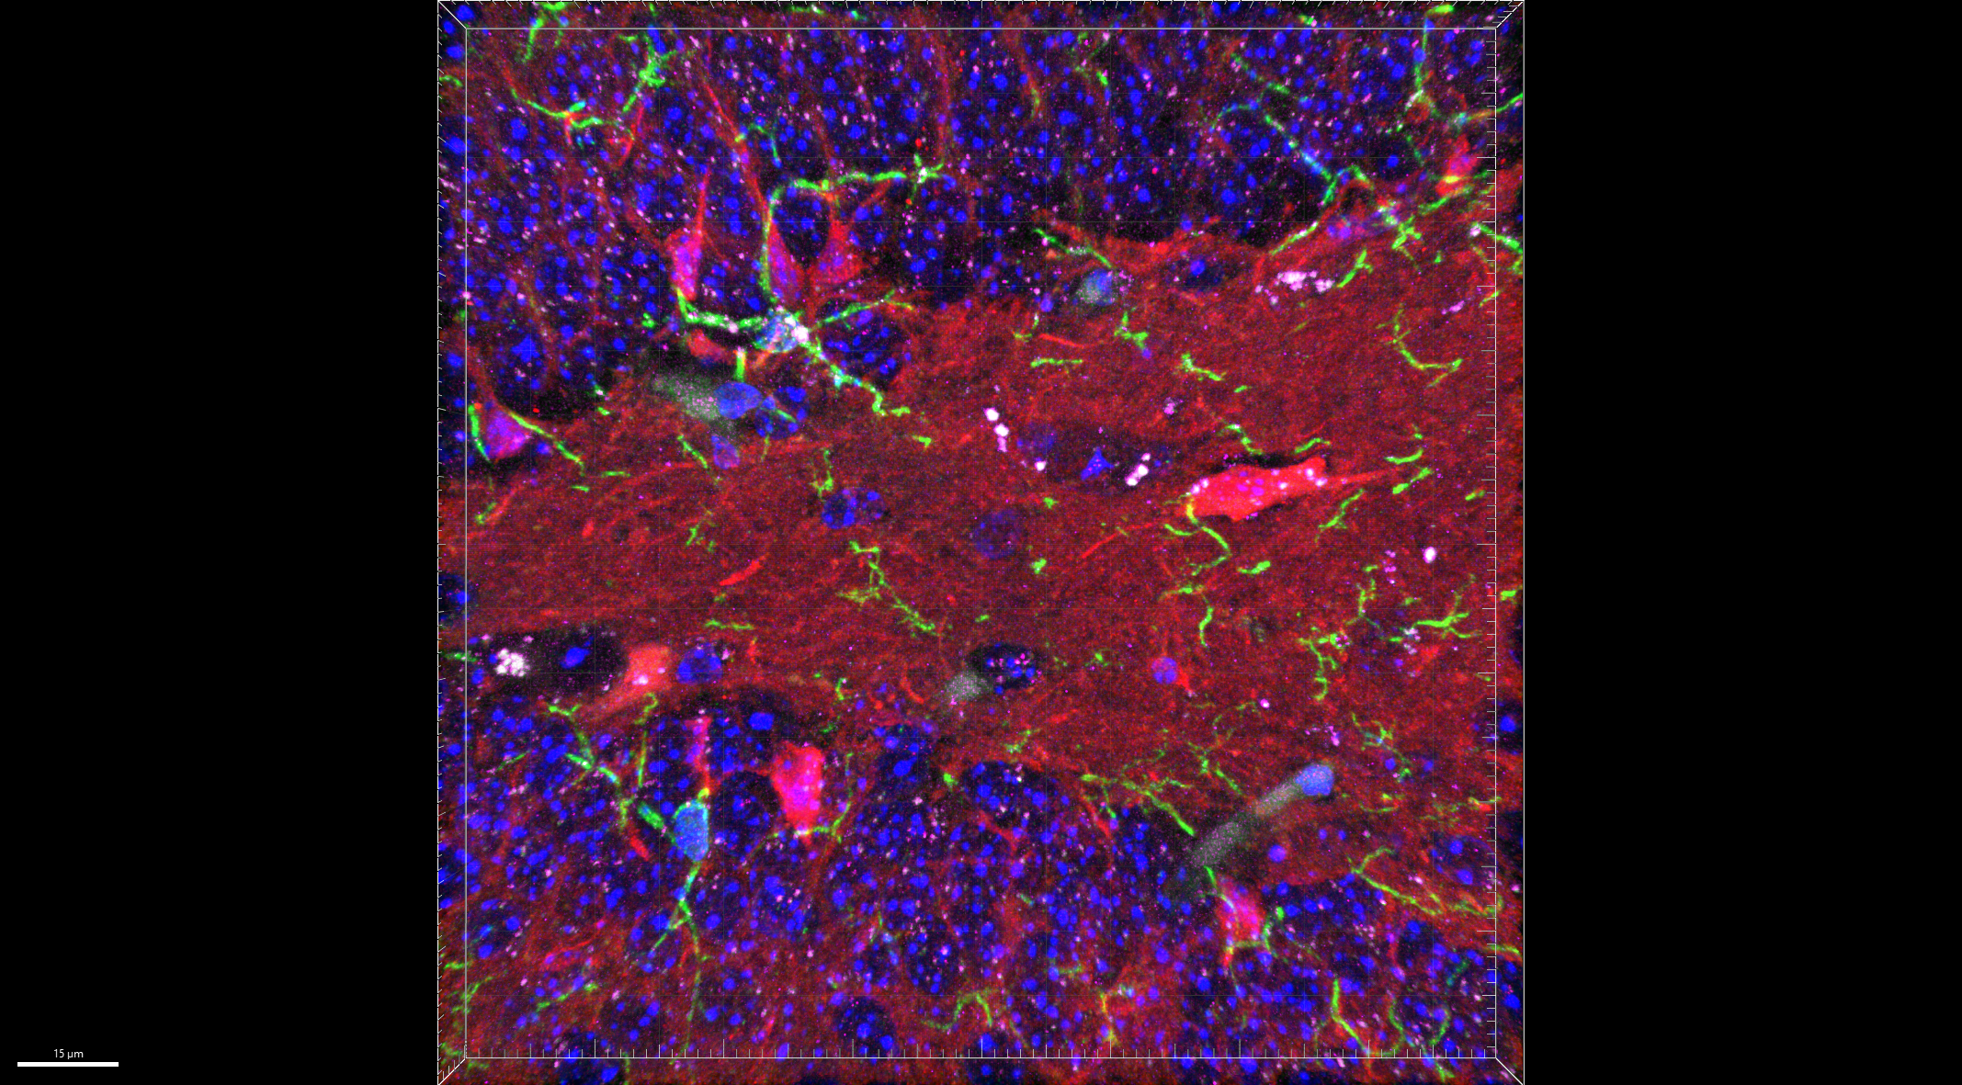
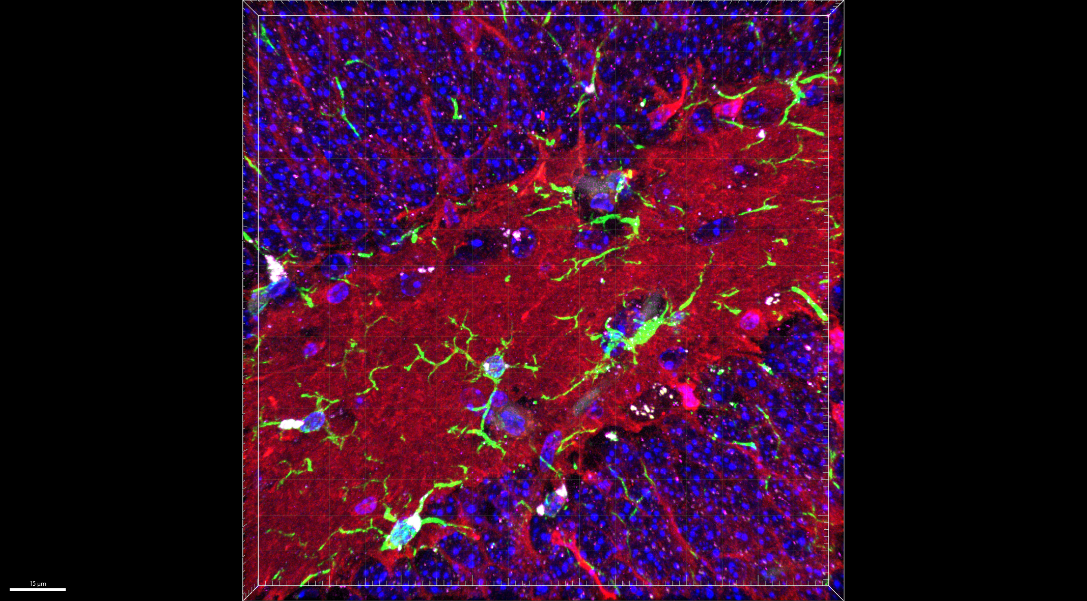
1x NS
Fig S2.A
Hoechst / Iba1 / mitoTracker / STING
1x LPS, 48 hr
1x LPS, 72 hr
LSM 780, 20x
LSM 800, 40x

Slide 3
1x NS
Fig S2.A
Hoechst / Iba1 / mitoTracker / STING

Slide 4
1x LPS
Fig S2.A
Hoechst / Iba1 / mitoTracker / STING

Slide 5
2x LPS
Fig S2.A
Hoechst / Iba1 / mitoTracker / STING

