Slide 1
Raw images_Figures_CMI 2026
Title of manuscript: Glycolytic enzymes play important roles in innate immune memory of neuroimmune responses triggered by systemic inflammation

Slide 2
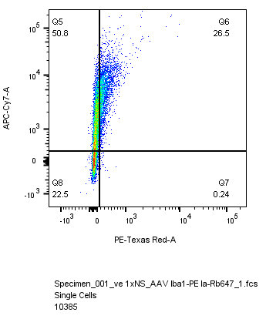
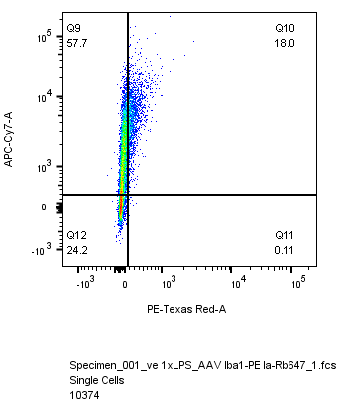
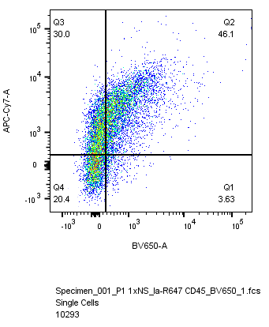
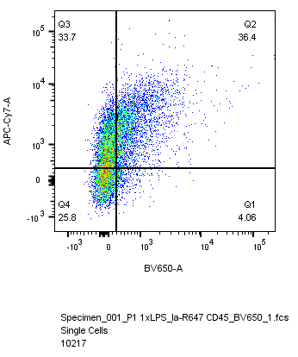
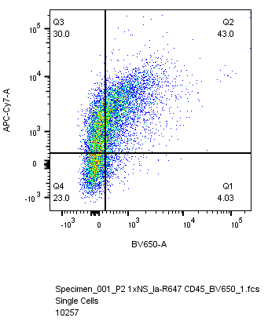
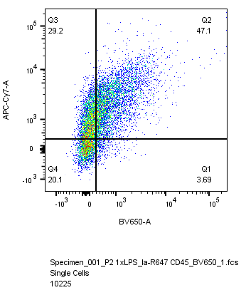
Fig 6.L
1x NS
1x LPS
H4K12la-647
vehicle
Iba1-PE
H4K12la-647
Iba1-shPfk1
CD45-BV650
Iba1-shPfk2

