Slide 1
Raw images_Supplementary Figures_CMI 2026
Title of manuscript: Glycolytic enzymes play important roles in innate immune memory of neuroimmune responses triggered by systemic inflammation

Slide 2
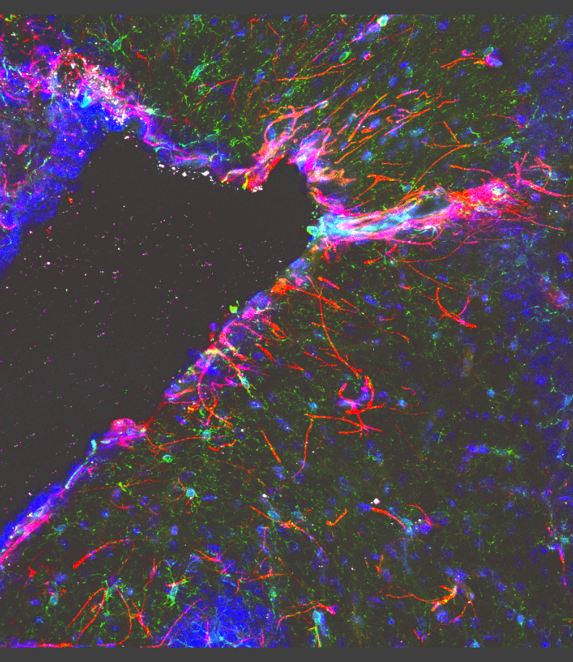
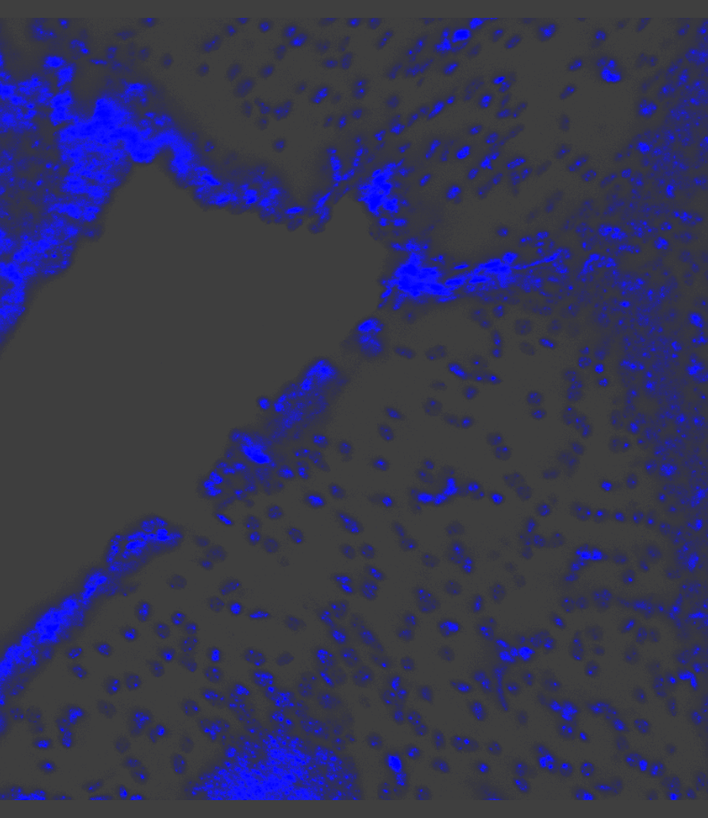
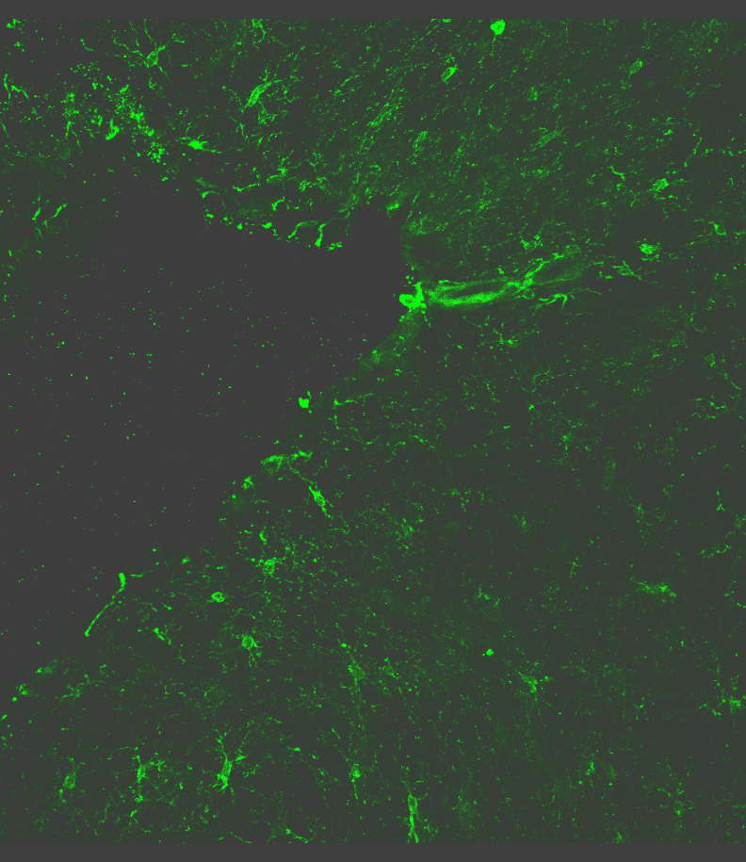
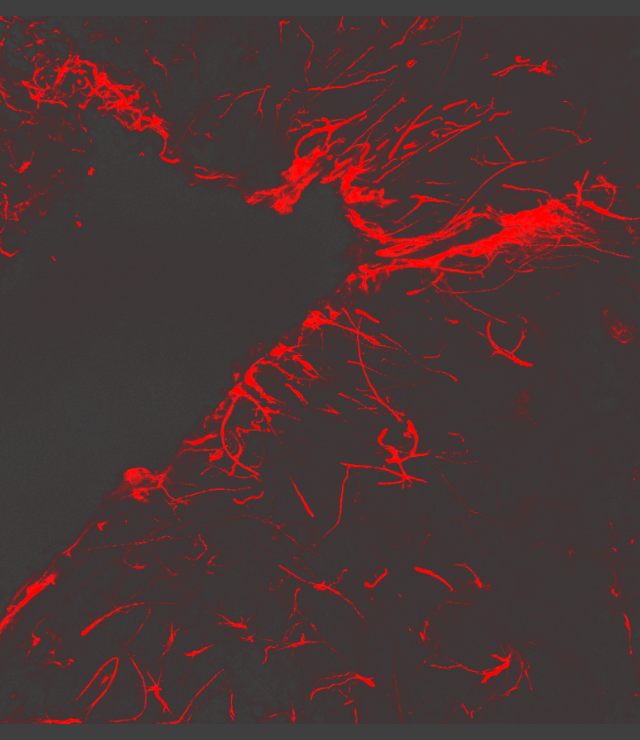

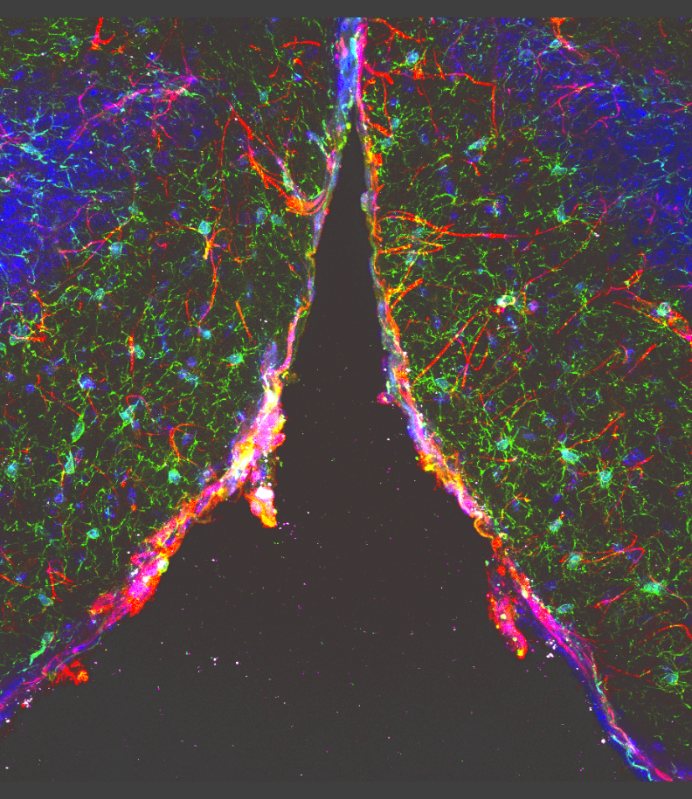
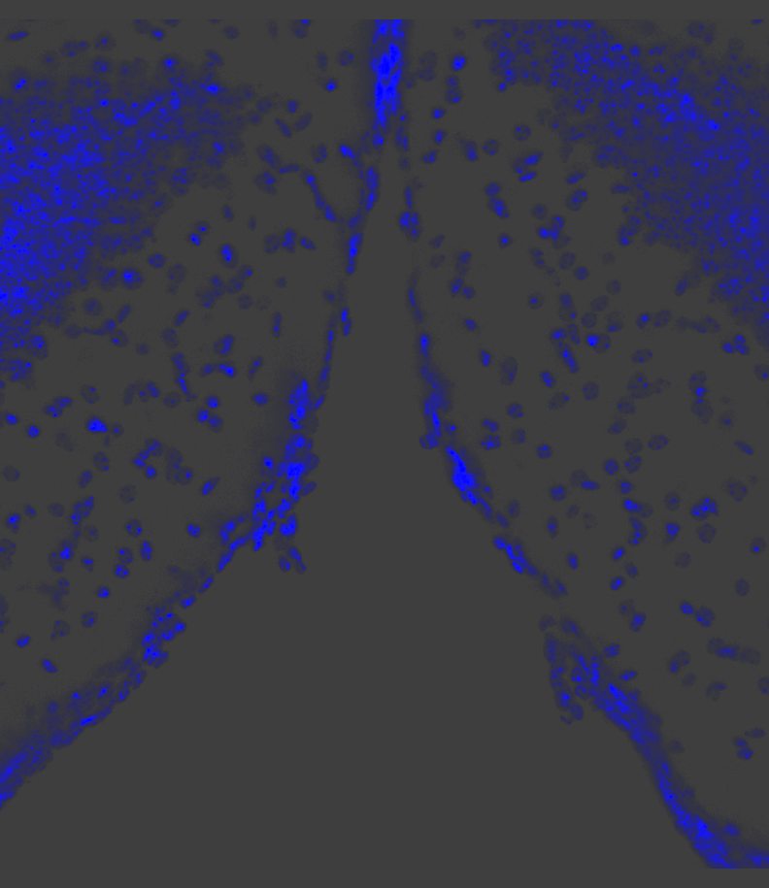
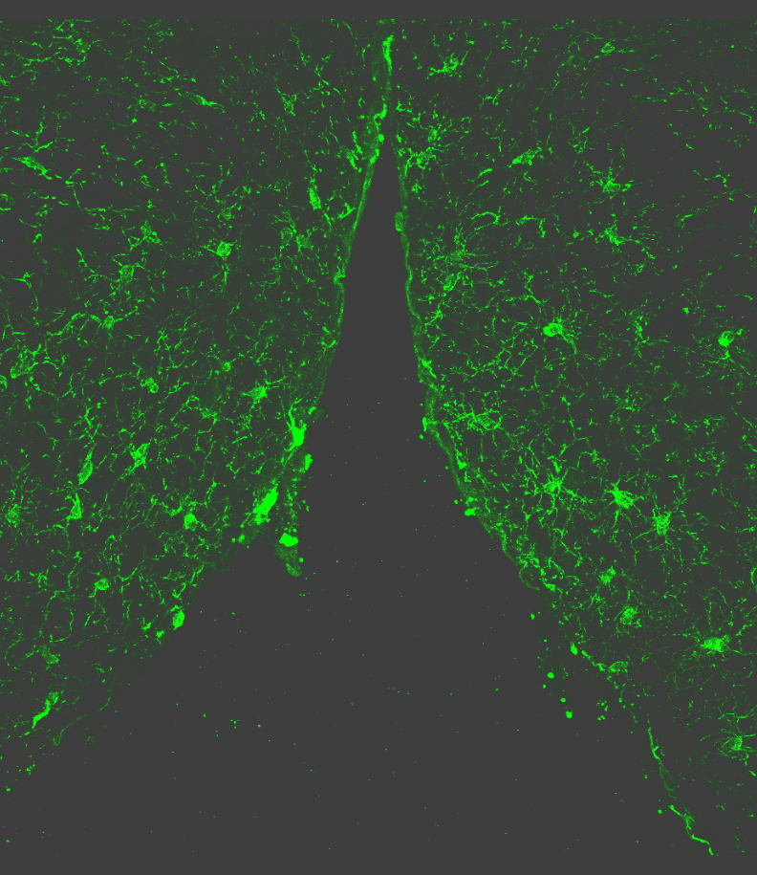
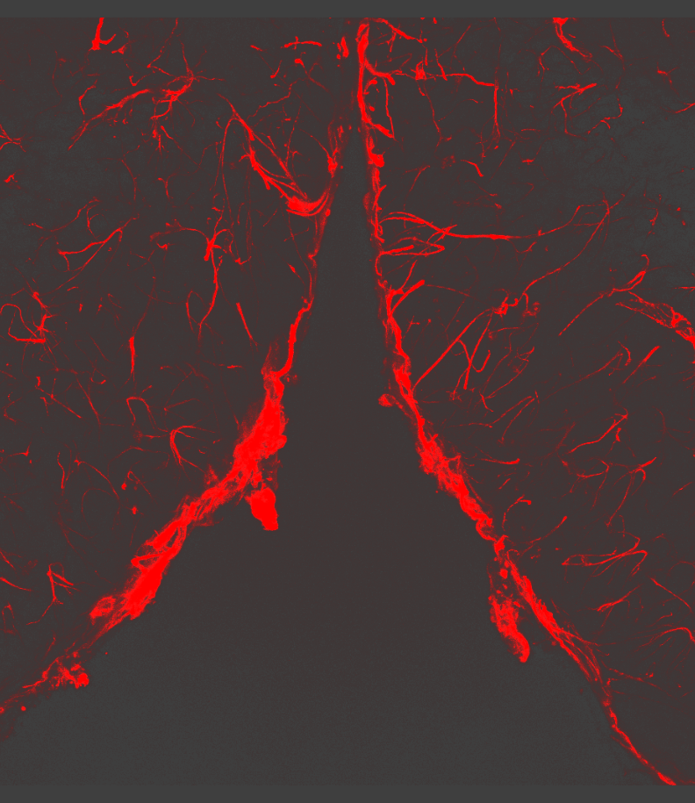

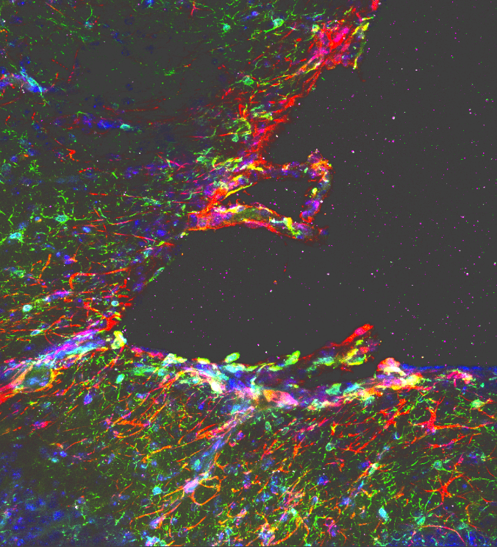
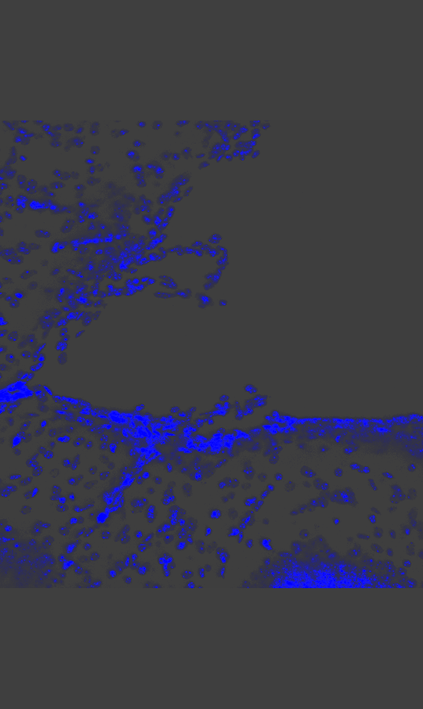
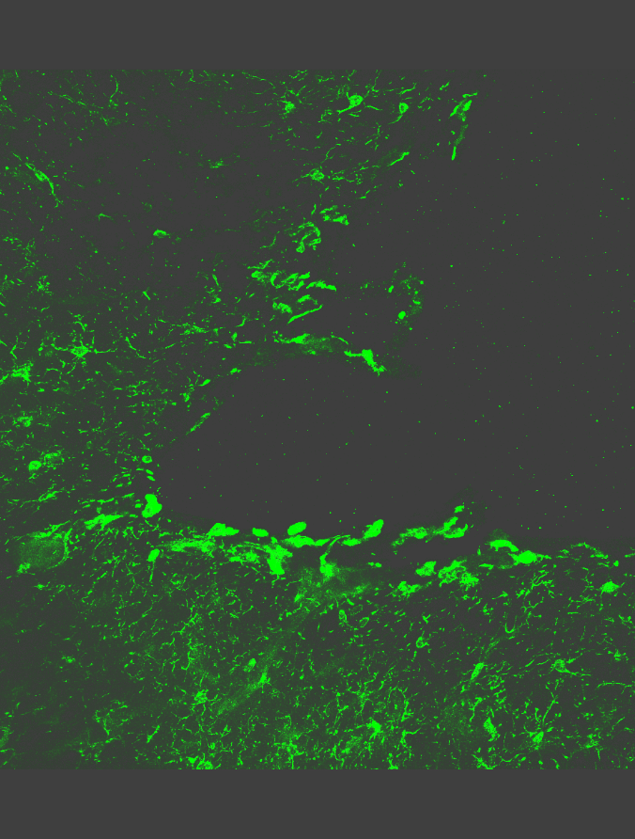
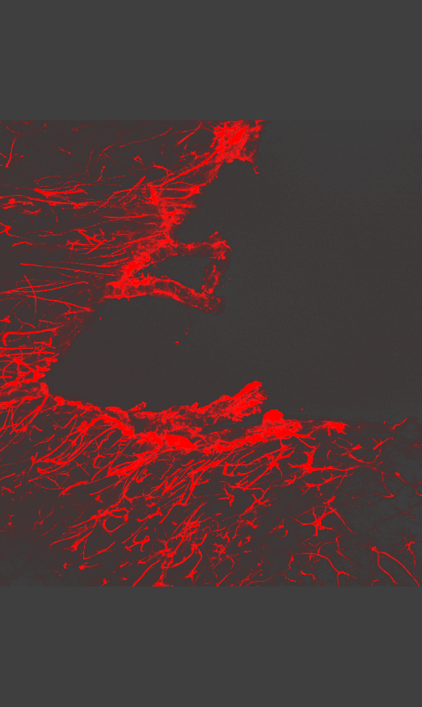

Fig S2.D
Dorsal ventricle to hippocampus
Hoechst / Iba1-488 / GFAP-568 / STING-648
LSM 780, 20x
1x NS
1x LPS
2x LPS
NS / 1x LPS / 2x LPS, DG
LSM 780, 20x, z stacks
merged
Hoechst
Iba1
GFAP
STING
NS
1x
LPS
Choroid plexus
Hoechst / Iba1-488 / GFAP-568 / STING-648
LSM 780, 20x
1x NS
1x LPS
2x LPS
2x
LPS

Slide 3
Fig S2.D
merged
1x NS

Slide 4
Fig S2.D
Hoechst
1x NS

Slide 5
Fig S2.D
Iba1
1x NS

Slide 6
Fig S2.D
GFAP
1x NS

Slide 7
Fig S2.D
STING
1x NS

Slide 8
Fig S2.D
merged
1x LPS

Slide 9
Fig S2.D
Hoechst
1x LPS

Slide 10
Fig S2.D
Iba1
1x LPS

Slide 11
Fig S2.D
GFAP
1x LPS

Slide 12
Fig S2.D
STING
1x LPS

Slide 13
Fig S2.D
merged
2x LPS

Slide 14
Fig S2.D
Hoechst
2x LPS

Slide 15
Fig S2.D
Iba1
2x LPS

Slide 16
Fig S2.D
GFAP
2x LPS

Slide 17
Fig S2.D
STING
2x LPS

