Slide 1
Raw images_Figures_CMI 2026
Title of manuscript: Glycolytic enzymes play important roles in innate immune memory of neuroimmune responses triggered by systemic inflammation

Slide 2
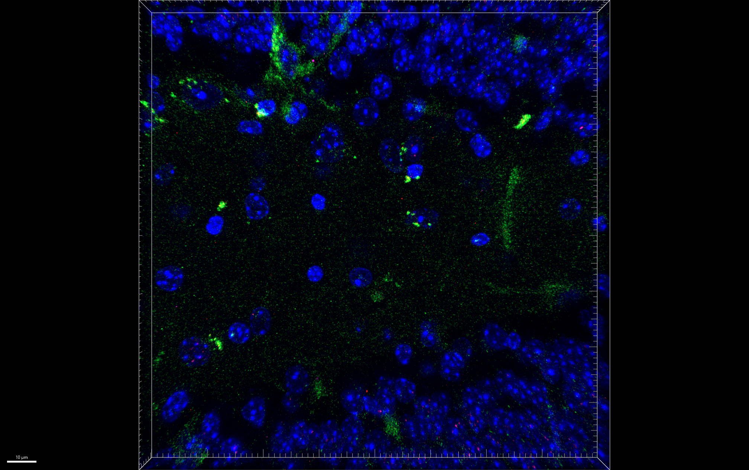
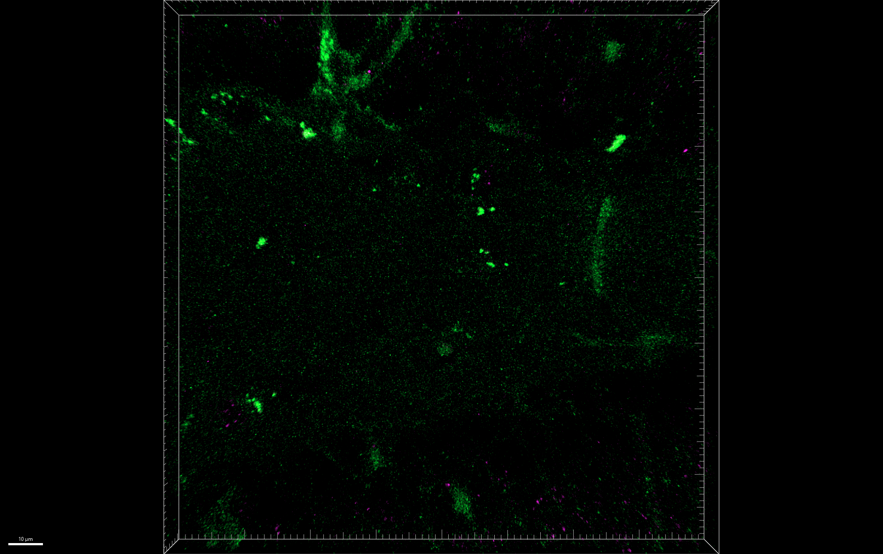
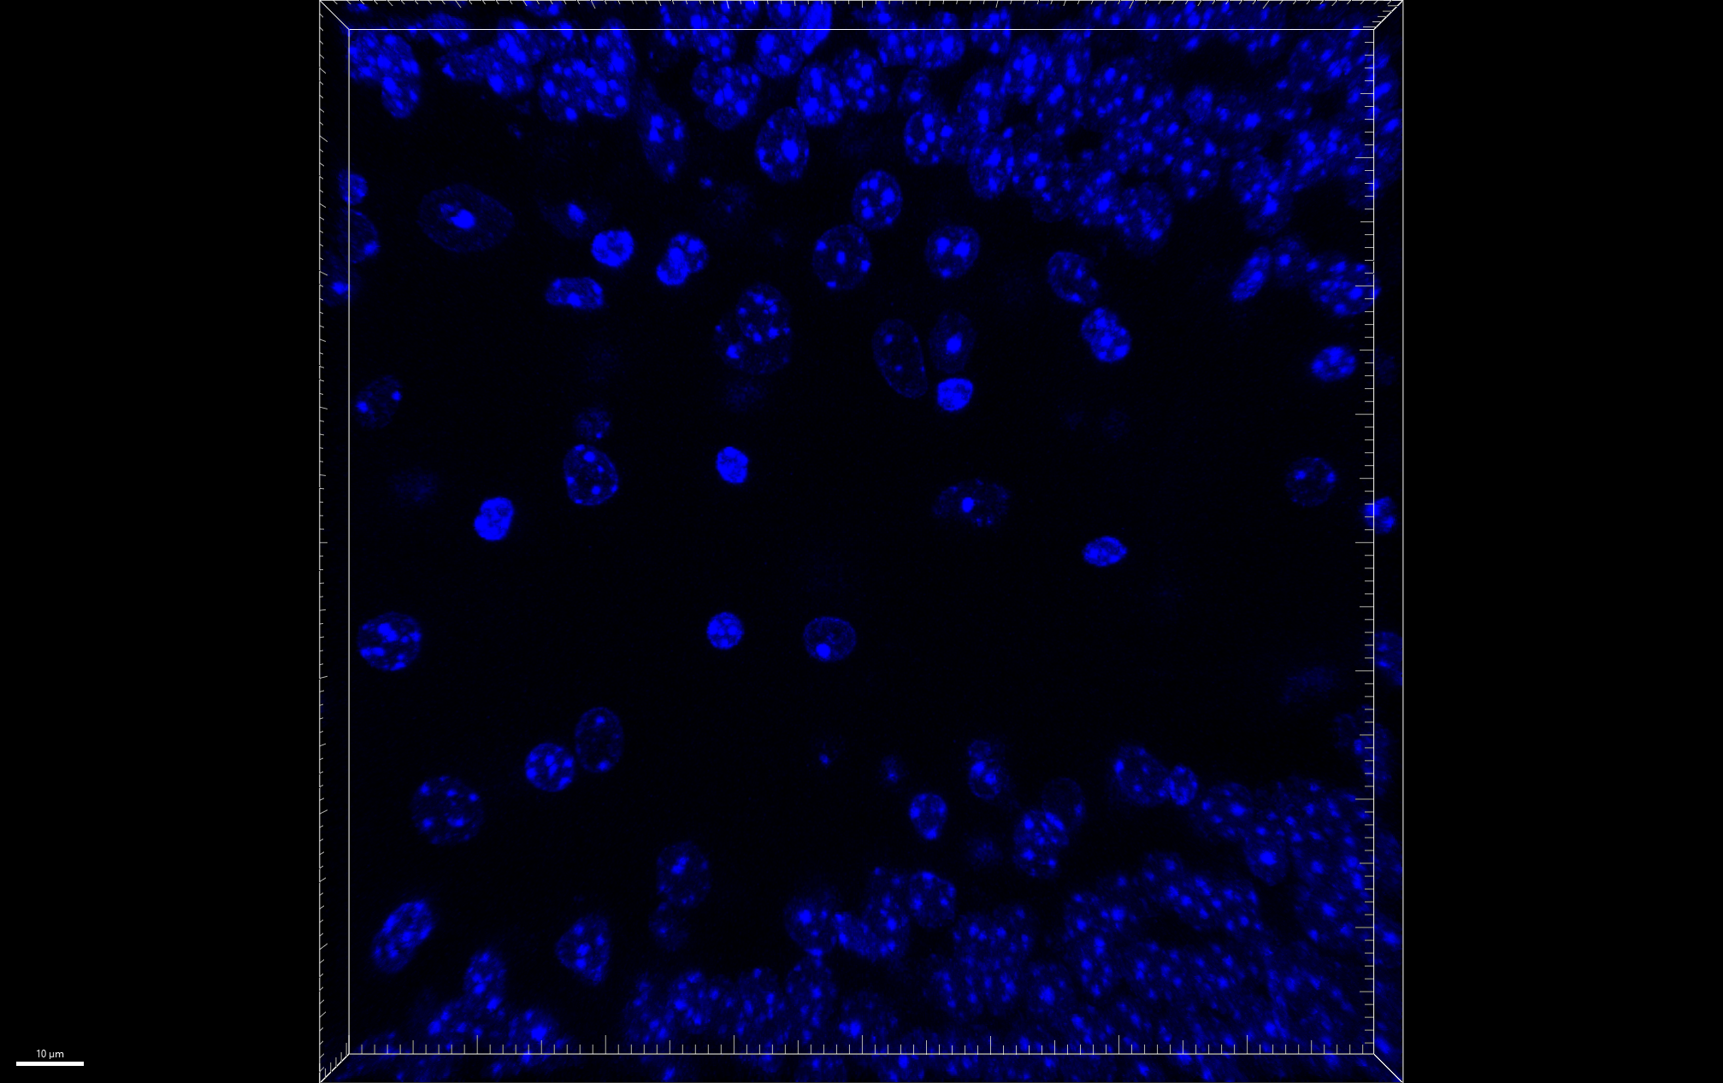
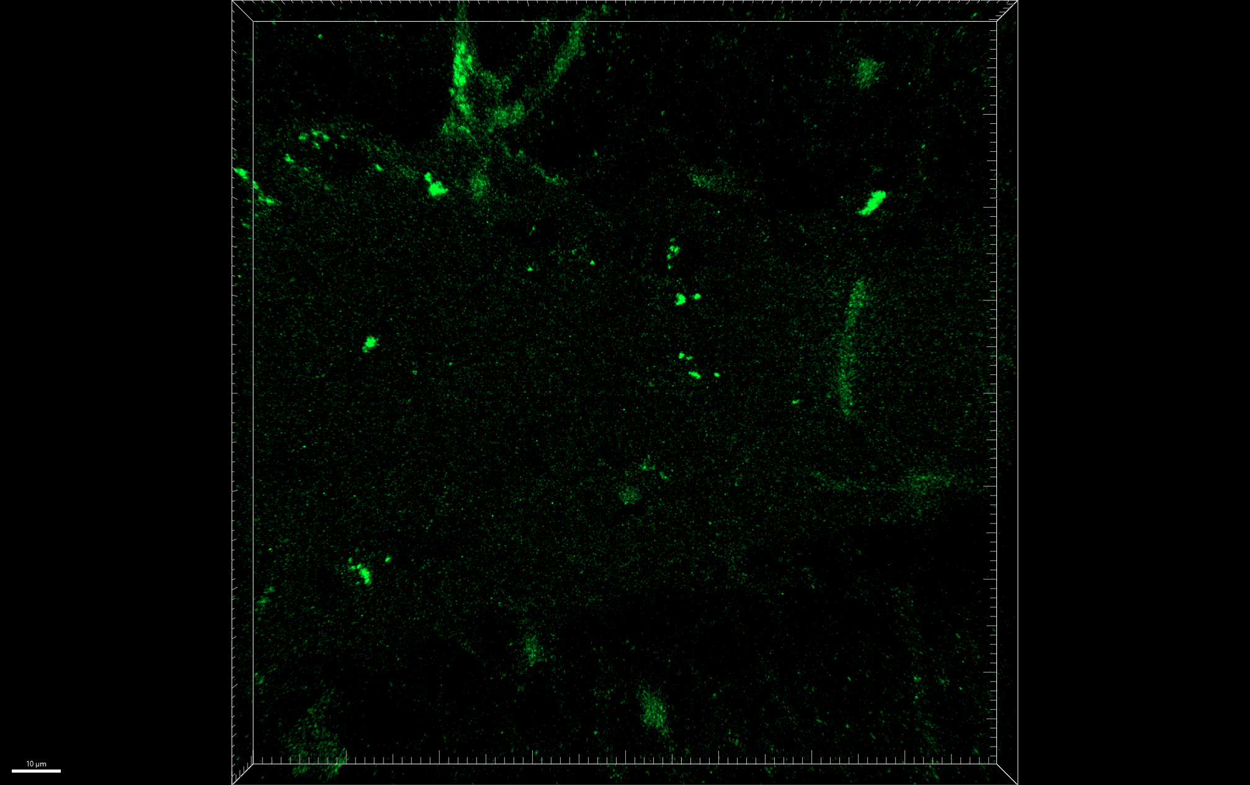
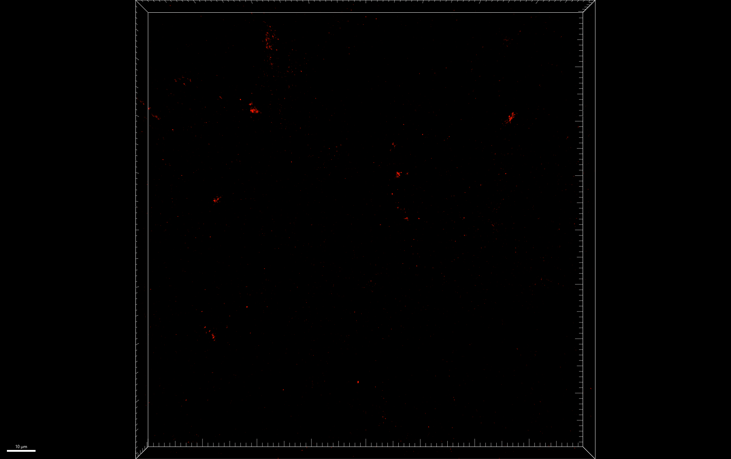
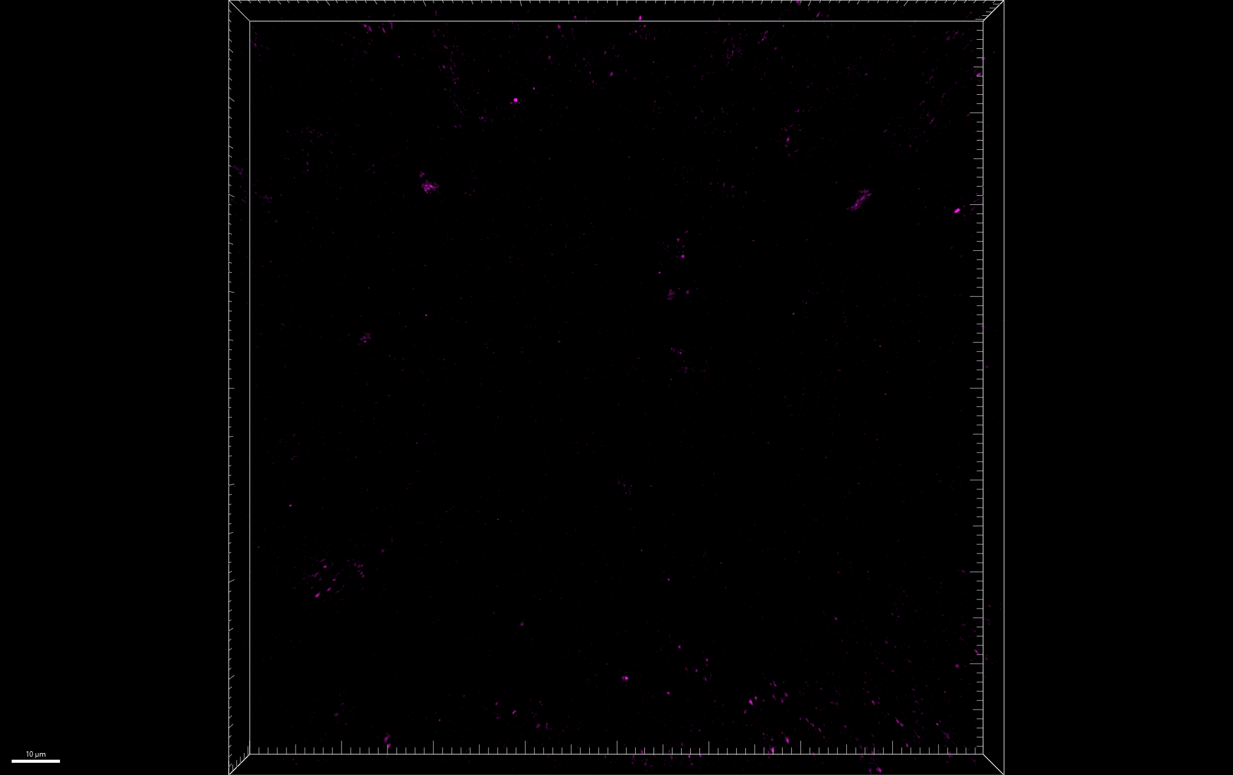
Fig 3.C
[Iba1-mKeima / Iba1-shPfk2 + Iba1-mKeima] + NS, day 14, DG
LSM 800, 40x, z stacks
merged
merged
green + red
Hoechst
mt-mKeima
mt-mKeima
γH2AX
enlarged
NS
LPS

Slide 3
Fig 3.C
NS
merged

Slide 4
Fig 3.C
NS
merged
green + red

Slide 5
Fig 3.C
NS
Hoechst

Slide 6
Fig 3.C
mt-mKeima
NS

Slide 7
Fig 3.C
NS
mt-mKeima

Slide 8
Fig 3.C
γH2AX
NS

Slide 9
Fig 3.C
LPS
merged

Slide 10
Fig 3.C
LPS
merged
green + red

Slide 11
Fig 3.C
LPS
Hoechst

Slide 12
Fig 3.C
LPS
mt-mKeima

Slide 13
Fig 3.C
LPS
mt-mKeima

Slide 14
Fig 3.C
γH2AX
LPS

