Slide 1
Raw images_Figures_CMI 2026
Title of manuscript: Glycolytic enzymes play important roles in innate immune memory of neuroimmune responses triggered by systemic inflammation

Slide 2
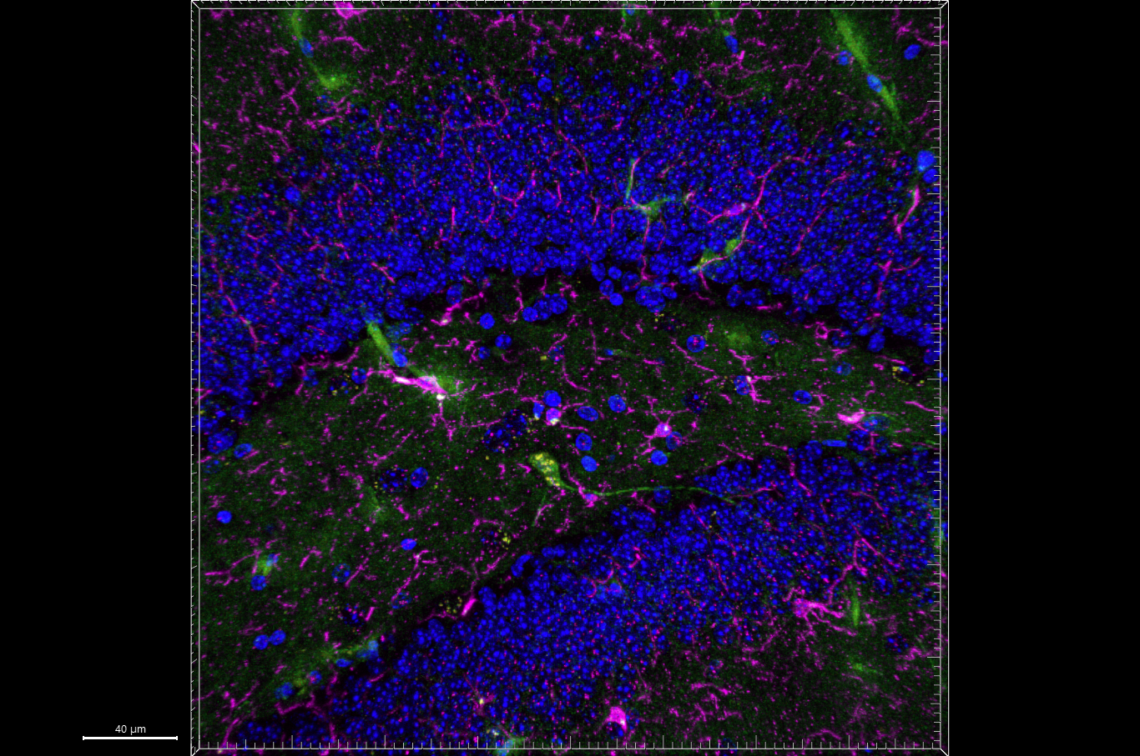
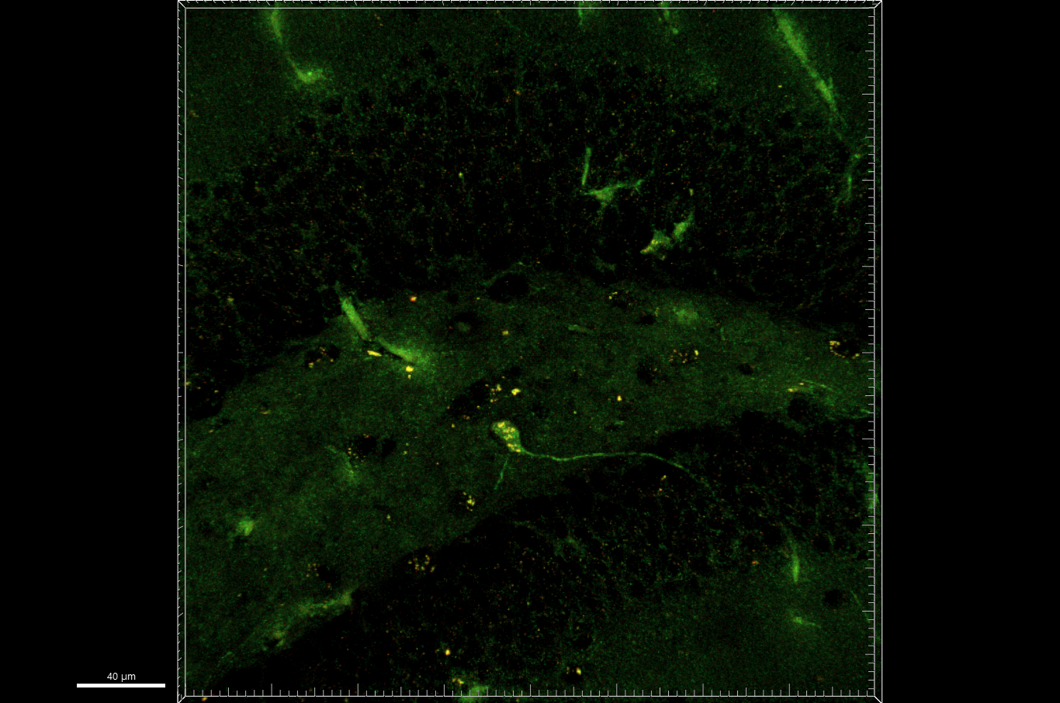
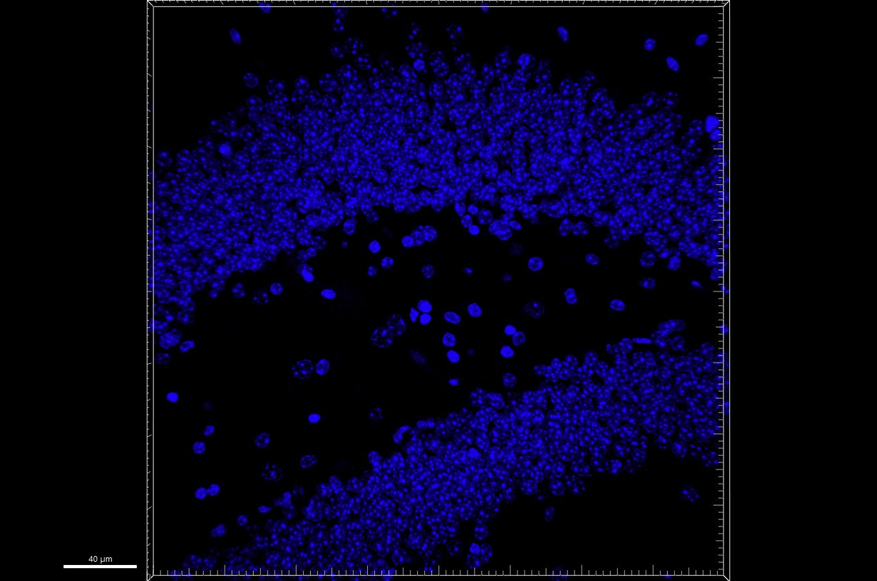
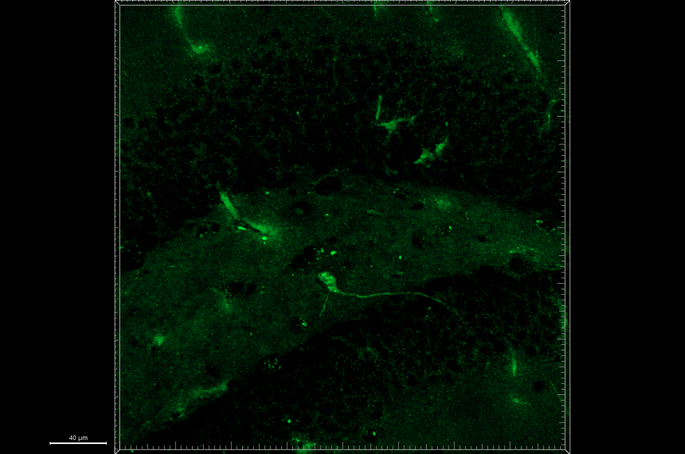
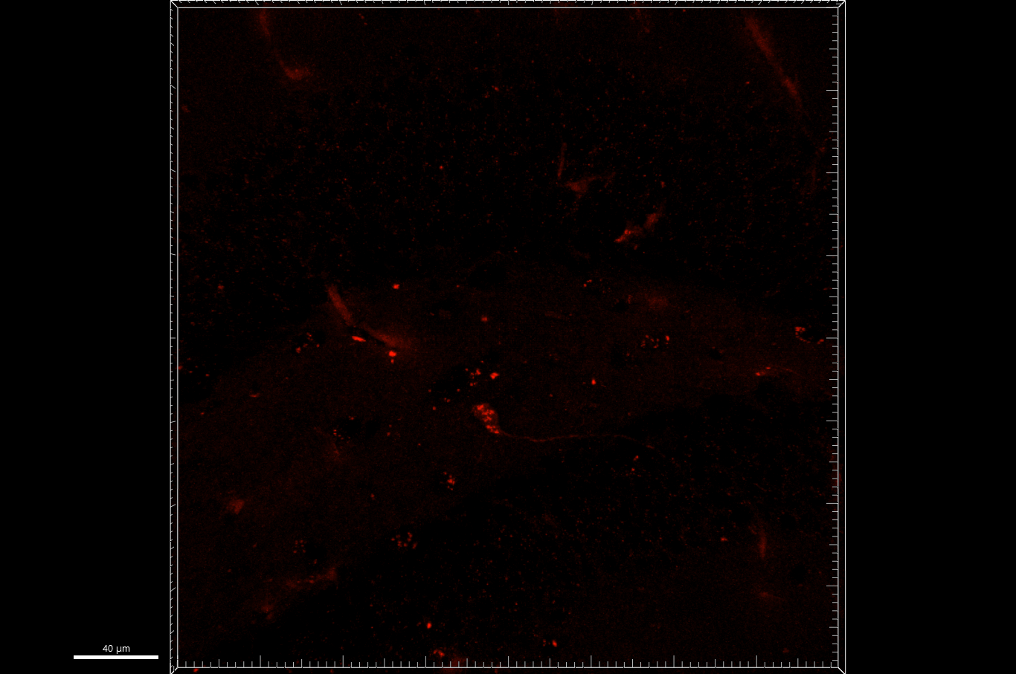
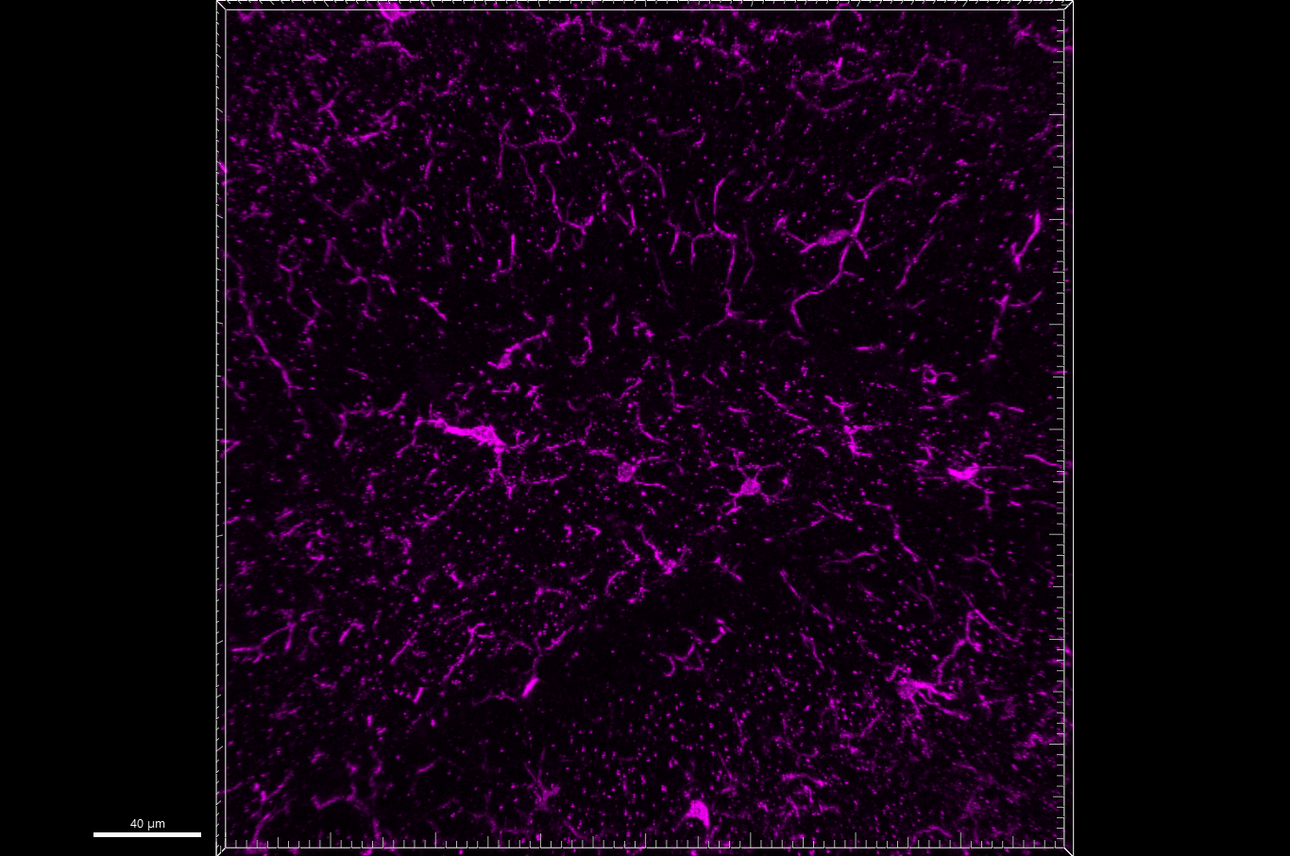
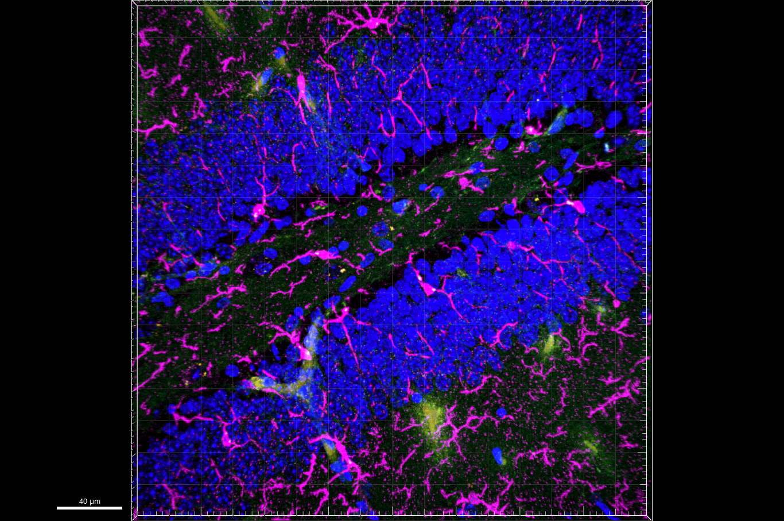
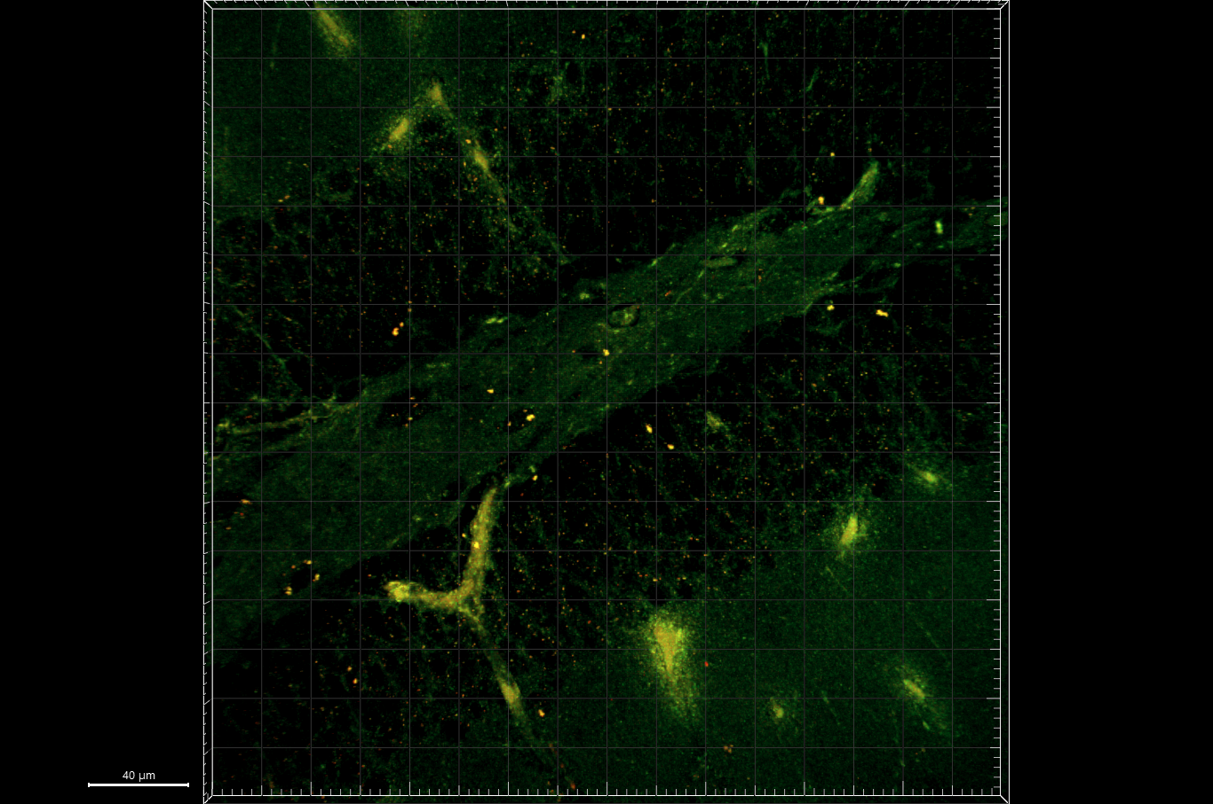
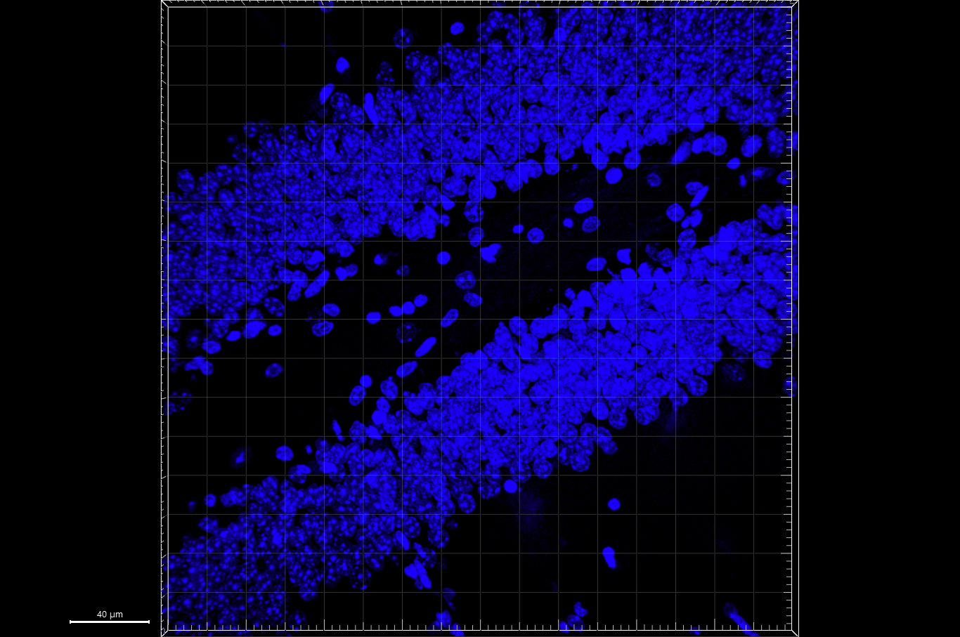
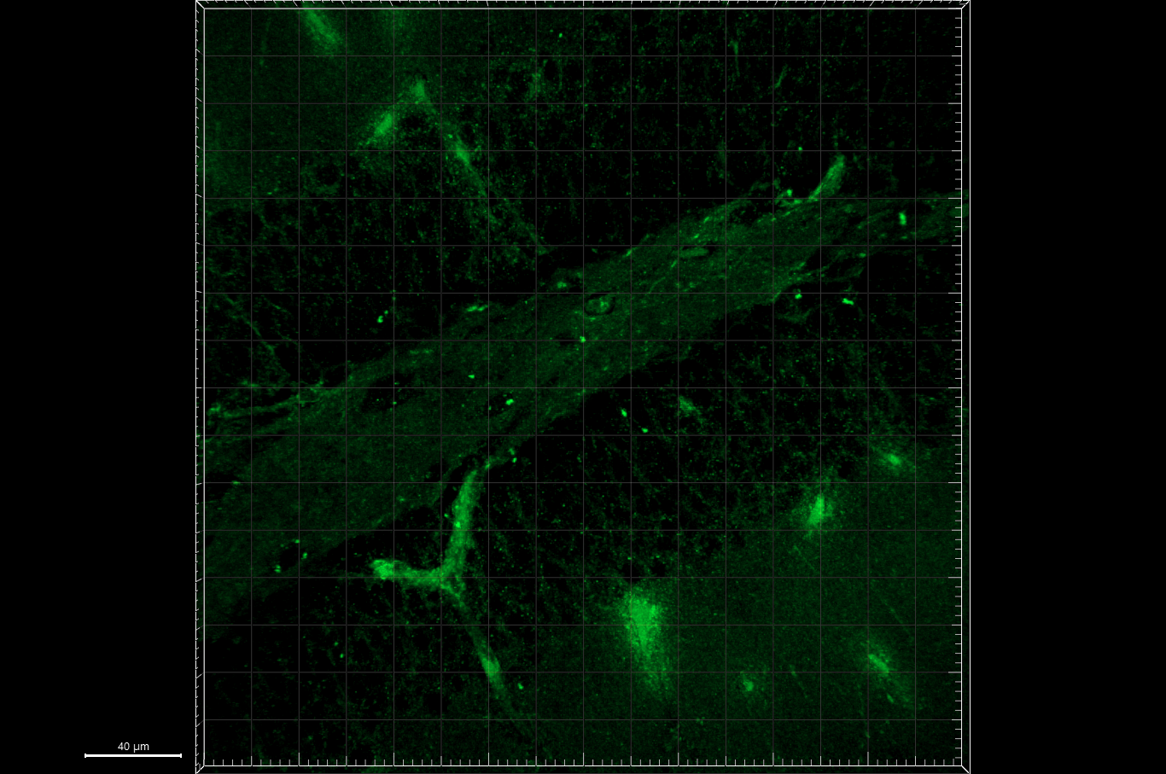
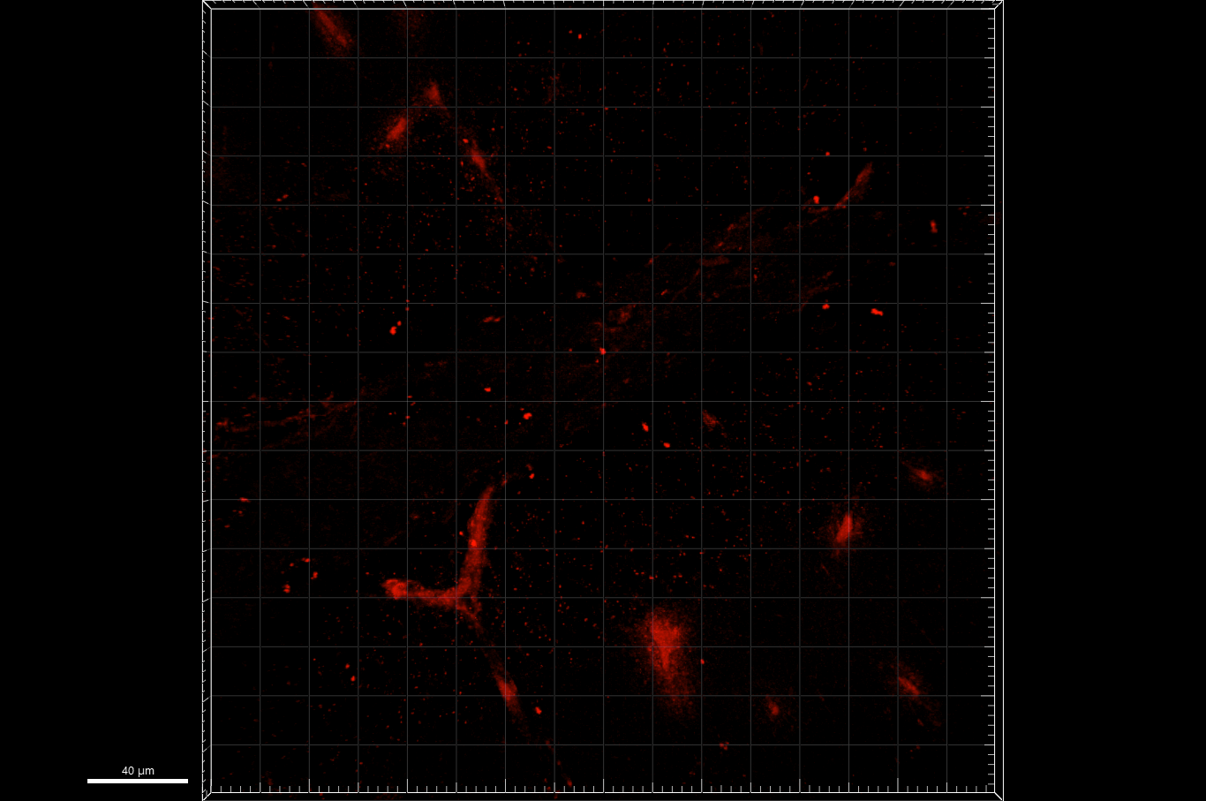
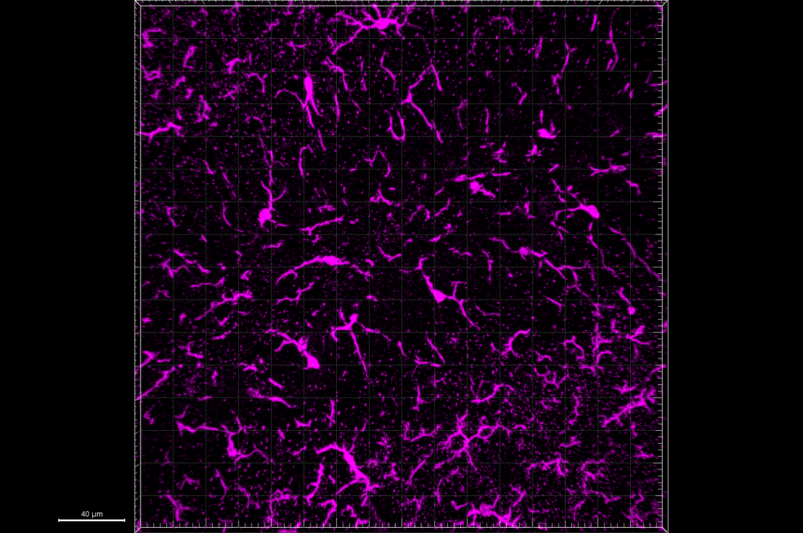
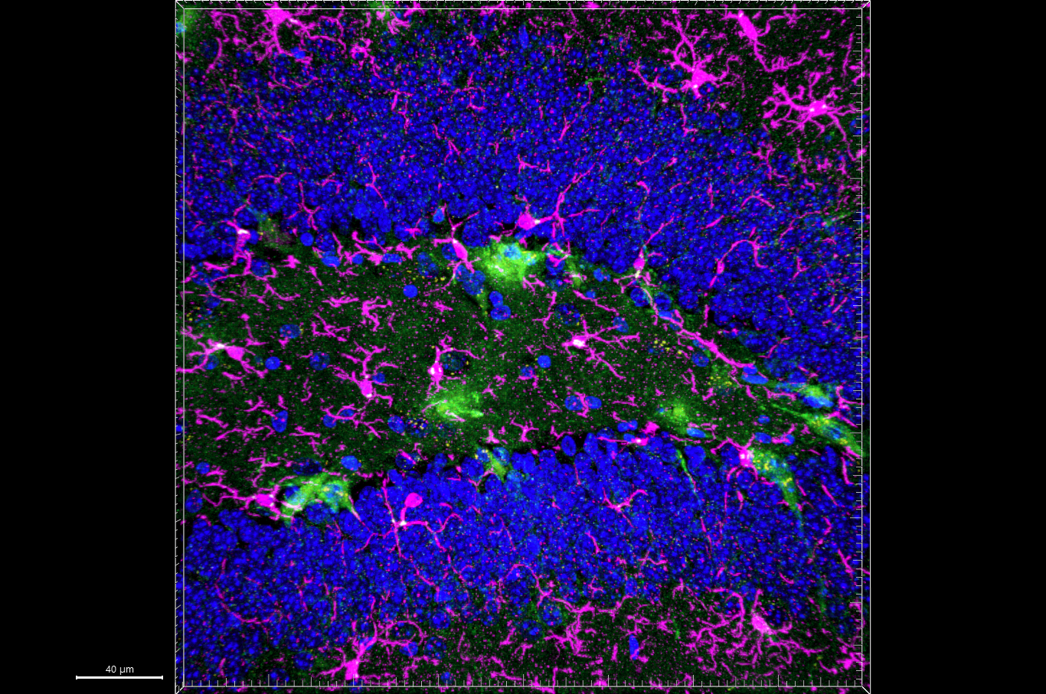
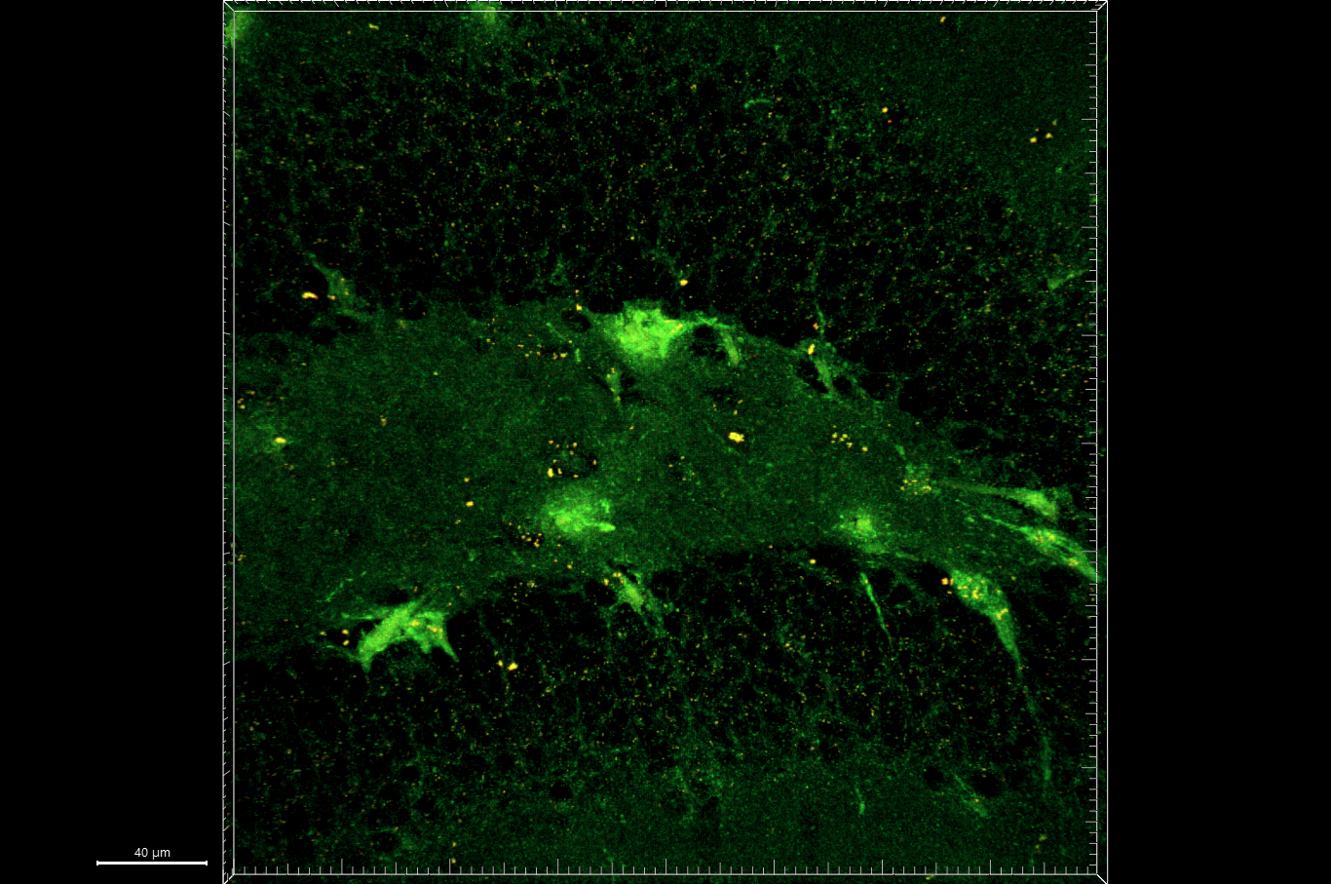
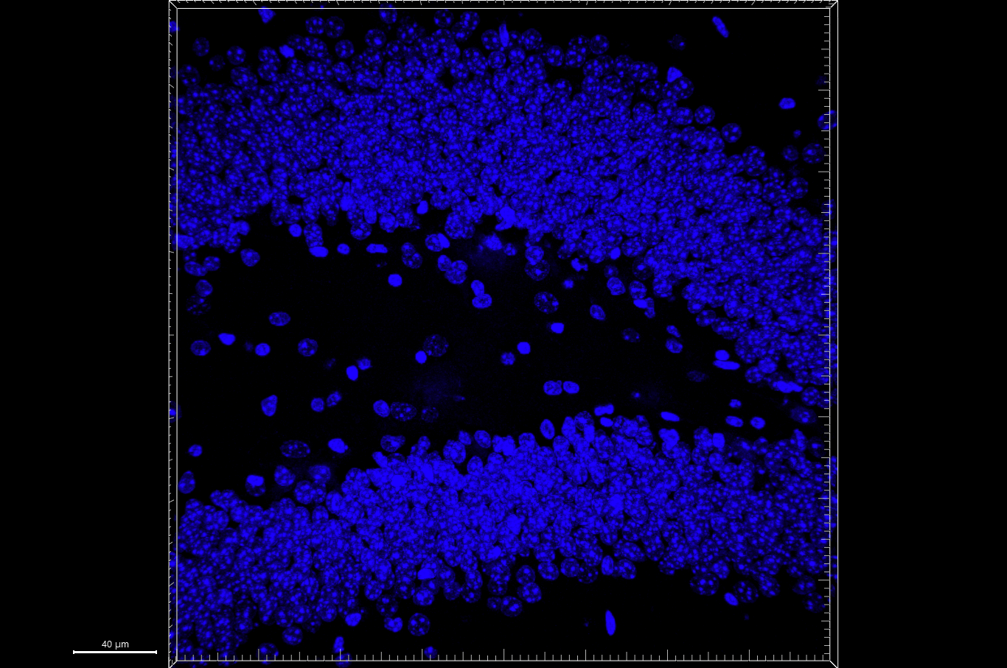
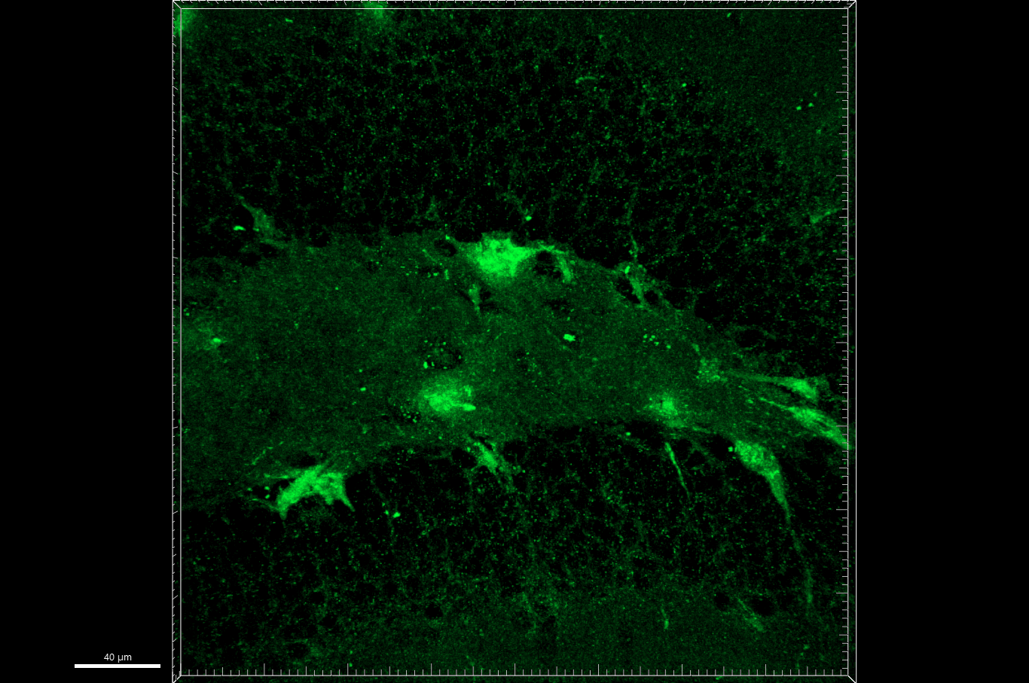
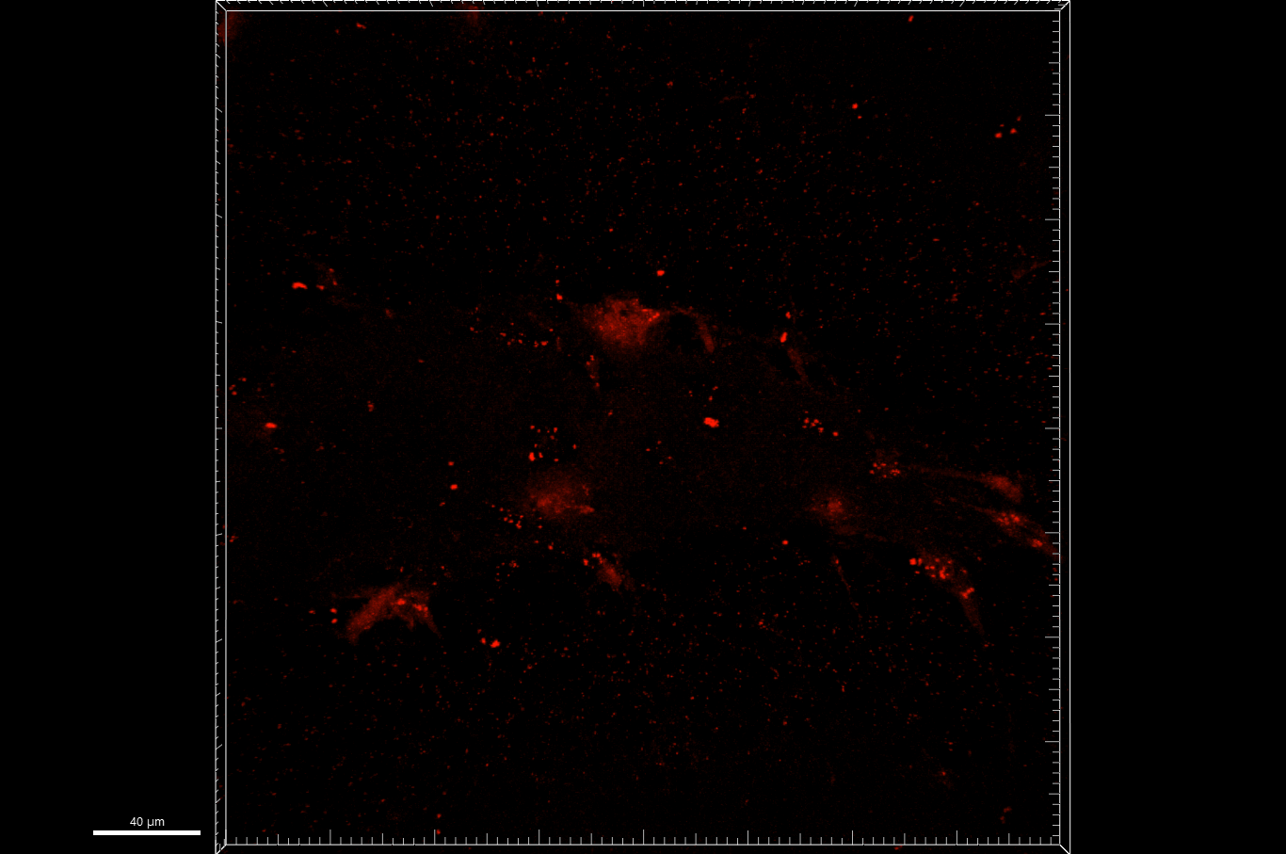
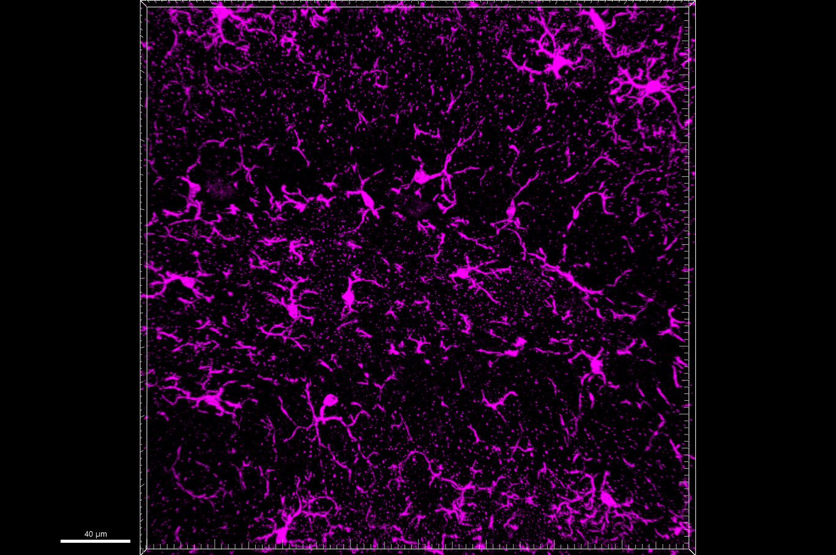
Fig 7.B
[Iba1-shPfk + mt-mKeima] + 2xLPS [PID (28 + 14)], DG
LSM 900, 40x, z stacks
merged
enlarged
merged
green + red
Hoechst
mt-mKeima
mt-mKeima
Iba1
mKeima
+
2xLPS
shPfk1
+
mKeima
+
2xLPS
shPfk2
+
mKeima
+
2xLPS

Slide 3
Fig 7.B
mKeima + 2xLPS
merged

Slide 4
Fig 7.B
merged
green + red
mKeima + 2xLPS

Slide 5
Fig 7.B
mKeima + 2xLPS
Hoechst

Slide 6
Fig 7.B
mKeima + 2xLPS
mt-mKeima

Slide 7
Fig 7.B
mKeima + 2xLPS
mt-mKeima

Slide 8
Fig 7.B
mKeima + 2xLPS
Iba1

Slide 9
Fig 7.B
shPfk1 + mKeima + 2xLPS
merged

Slide 10
Fig 7.B
merged
green + red
shPfk1 + mKeima + 2xLPS

Slide 11
Fig 7.B
shPfk1 + mKeima + 2xLPS
Hoechst

Slide 12
Fig 7.B
shPfk1 + mKeima + 2xLPS
mt-mKeima

Slide 13
Fig 7.B
shPfk1 + mKeima + 2xLPS
mt-mKeima

Slide 14
Fig 7.B
shPfk1 + mKeima + 2xLPS
Iba1

Slide 15
Fig 7.B
shPfk2 + mKeima + 2xLPS
merged

Slide 16
Fig 7.B
merged
green + red
shPfk2 + mKeima + 2xLPS

Slide 17
Fig 7.B
shPfk2 + mKeima + 2xLPS
Hoechst

Slide 18
Fig 7.B
shPfk2 + mKeima + 2xLPS
mt-mKeima

Slide 19
Fig 7.B
shPfk2 + mKeima + 2xLPS
mt-mKeima

Slide 20
Fig 7.B
shPfk2 + mKeima + 2xLPS
Iba1

