Slide 1
Raw images_Figures_CMI 2026
Title of manuscript: Glycolytic enzymes play important roles in innate immune memory of neuroimmune responses triggered by systemic inflammation

Slide 2
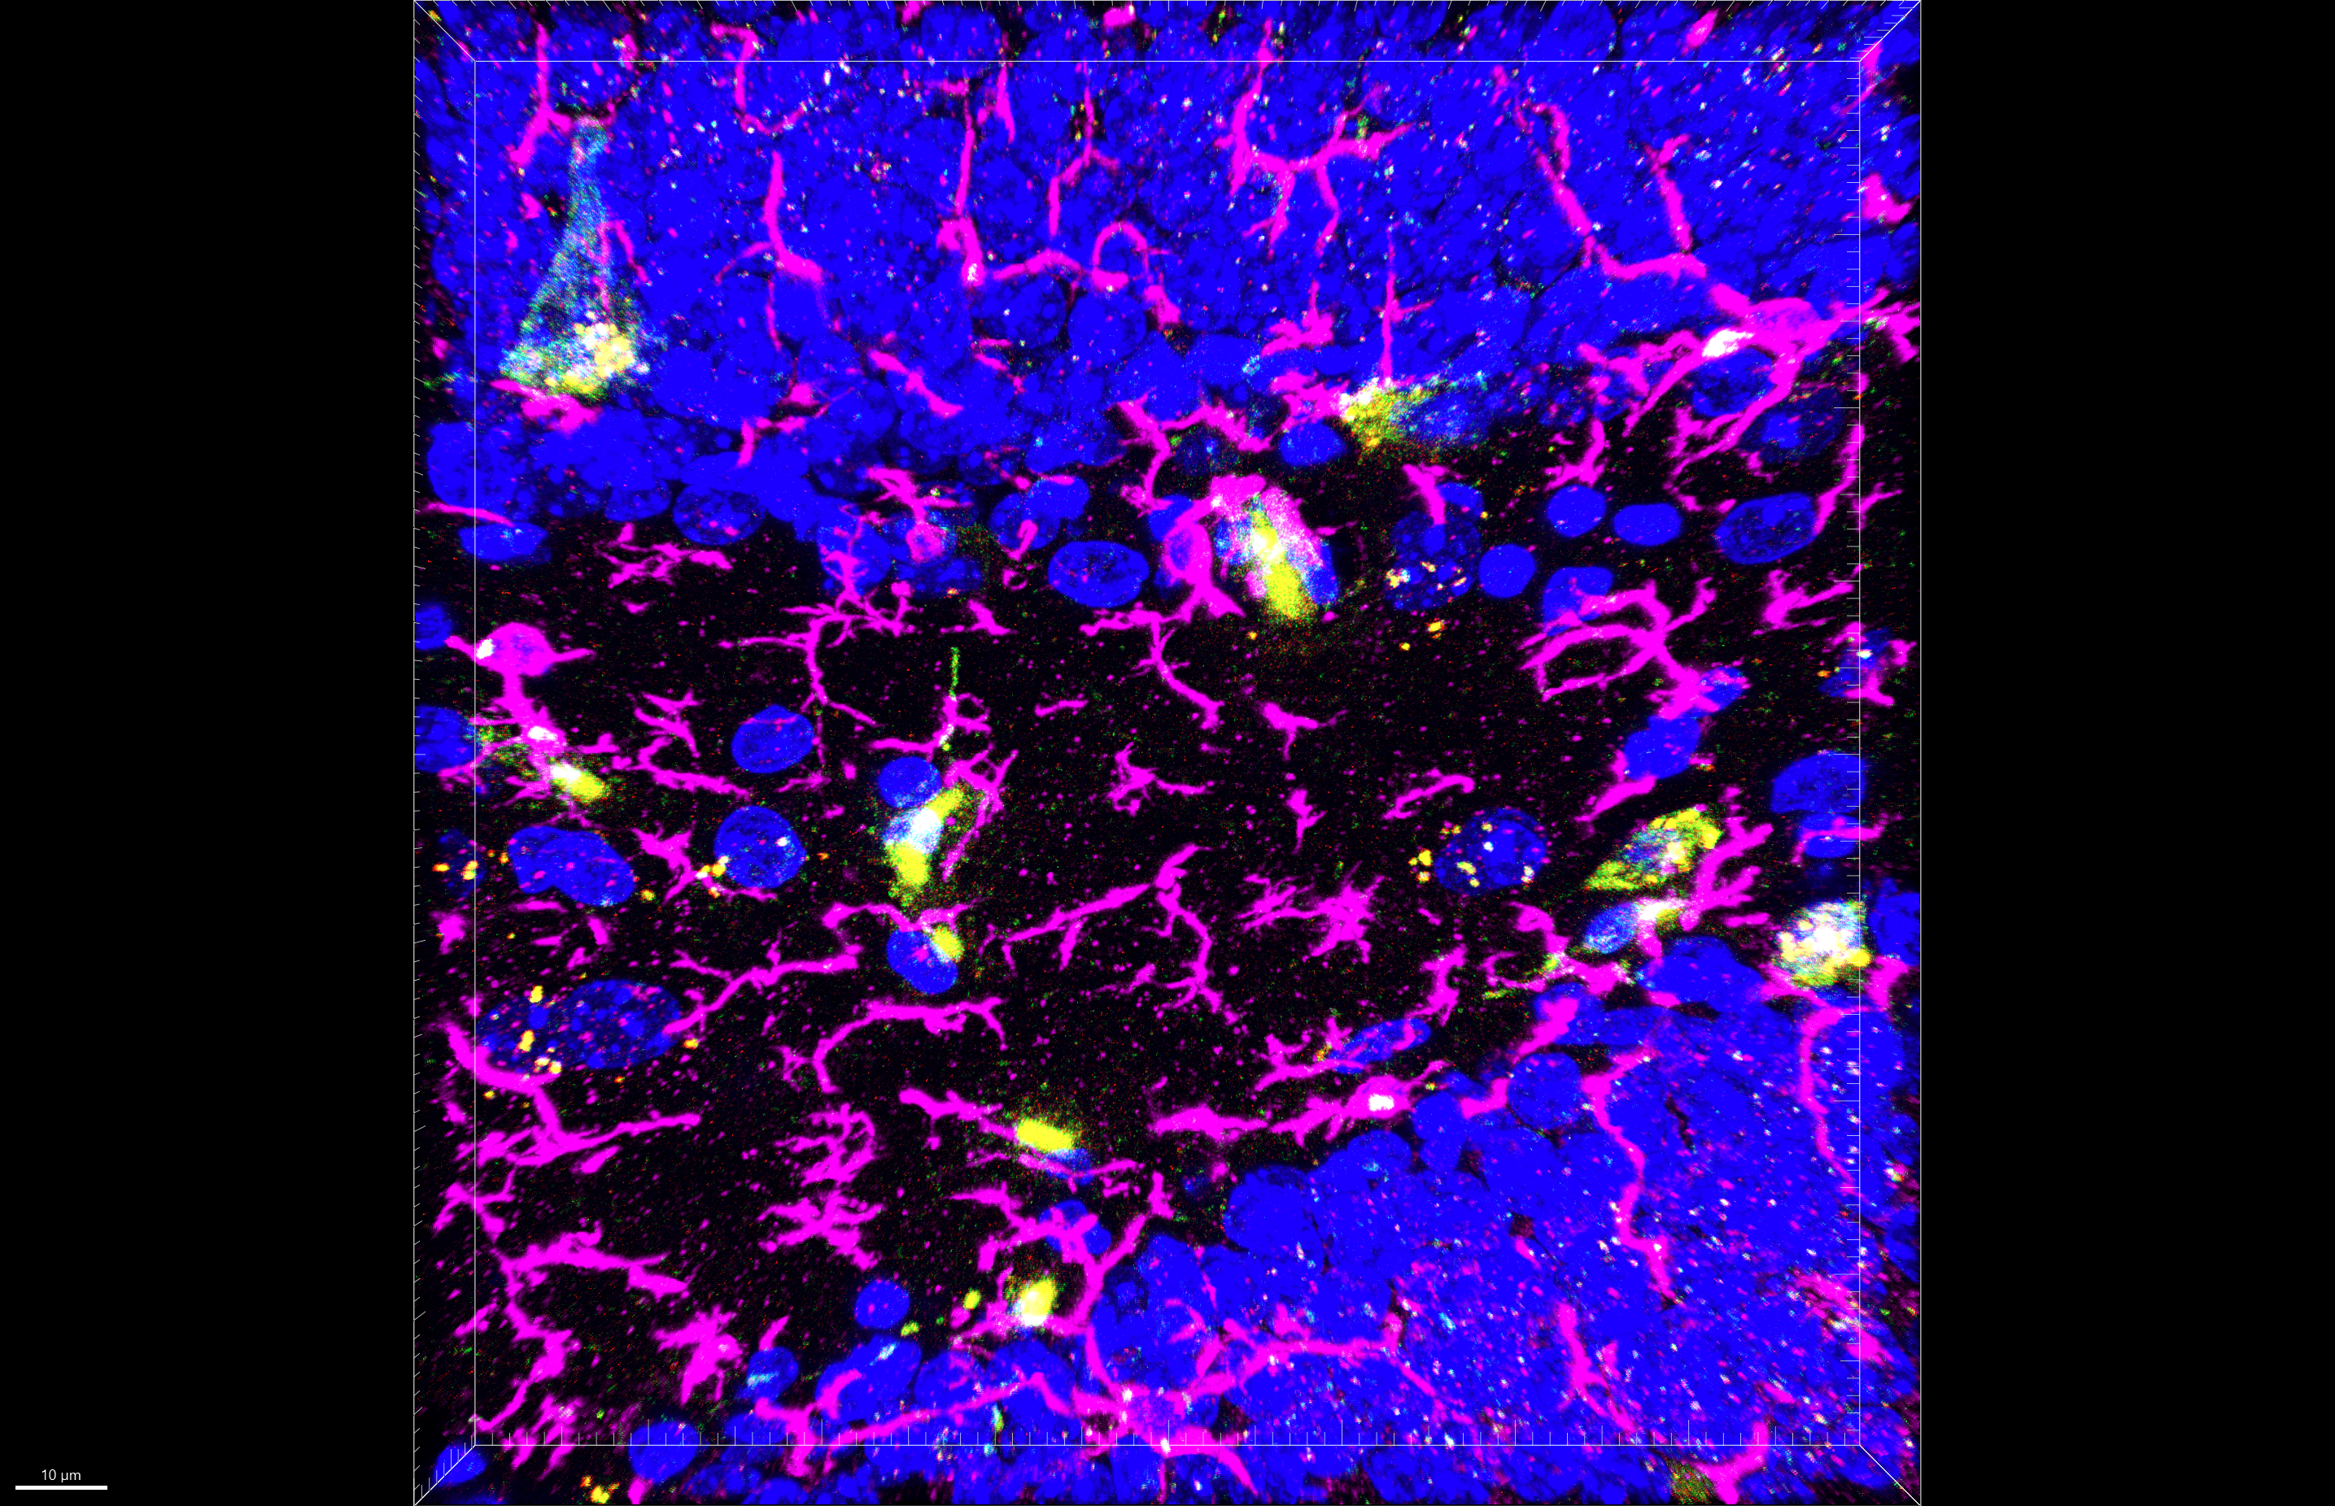
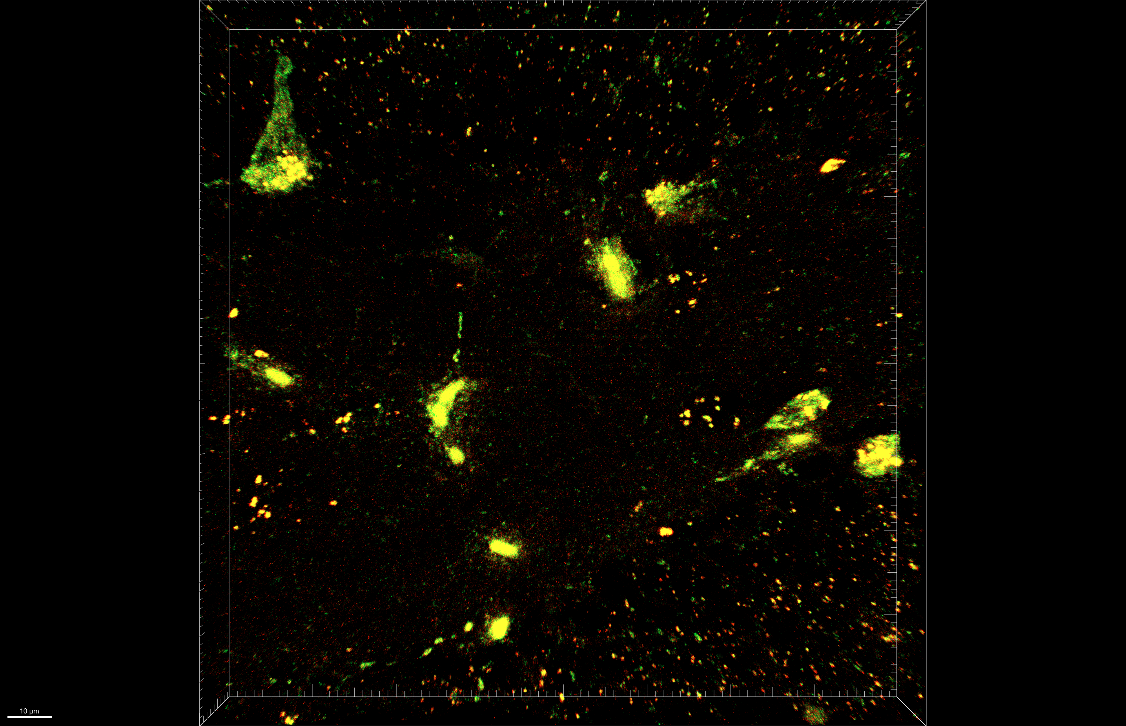
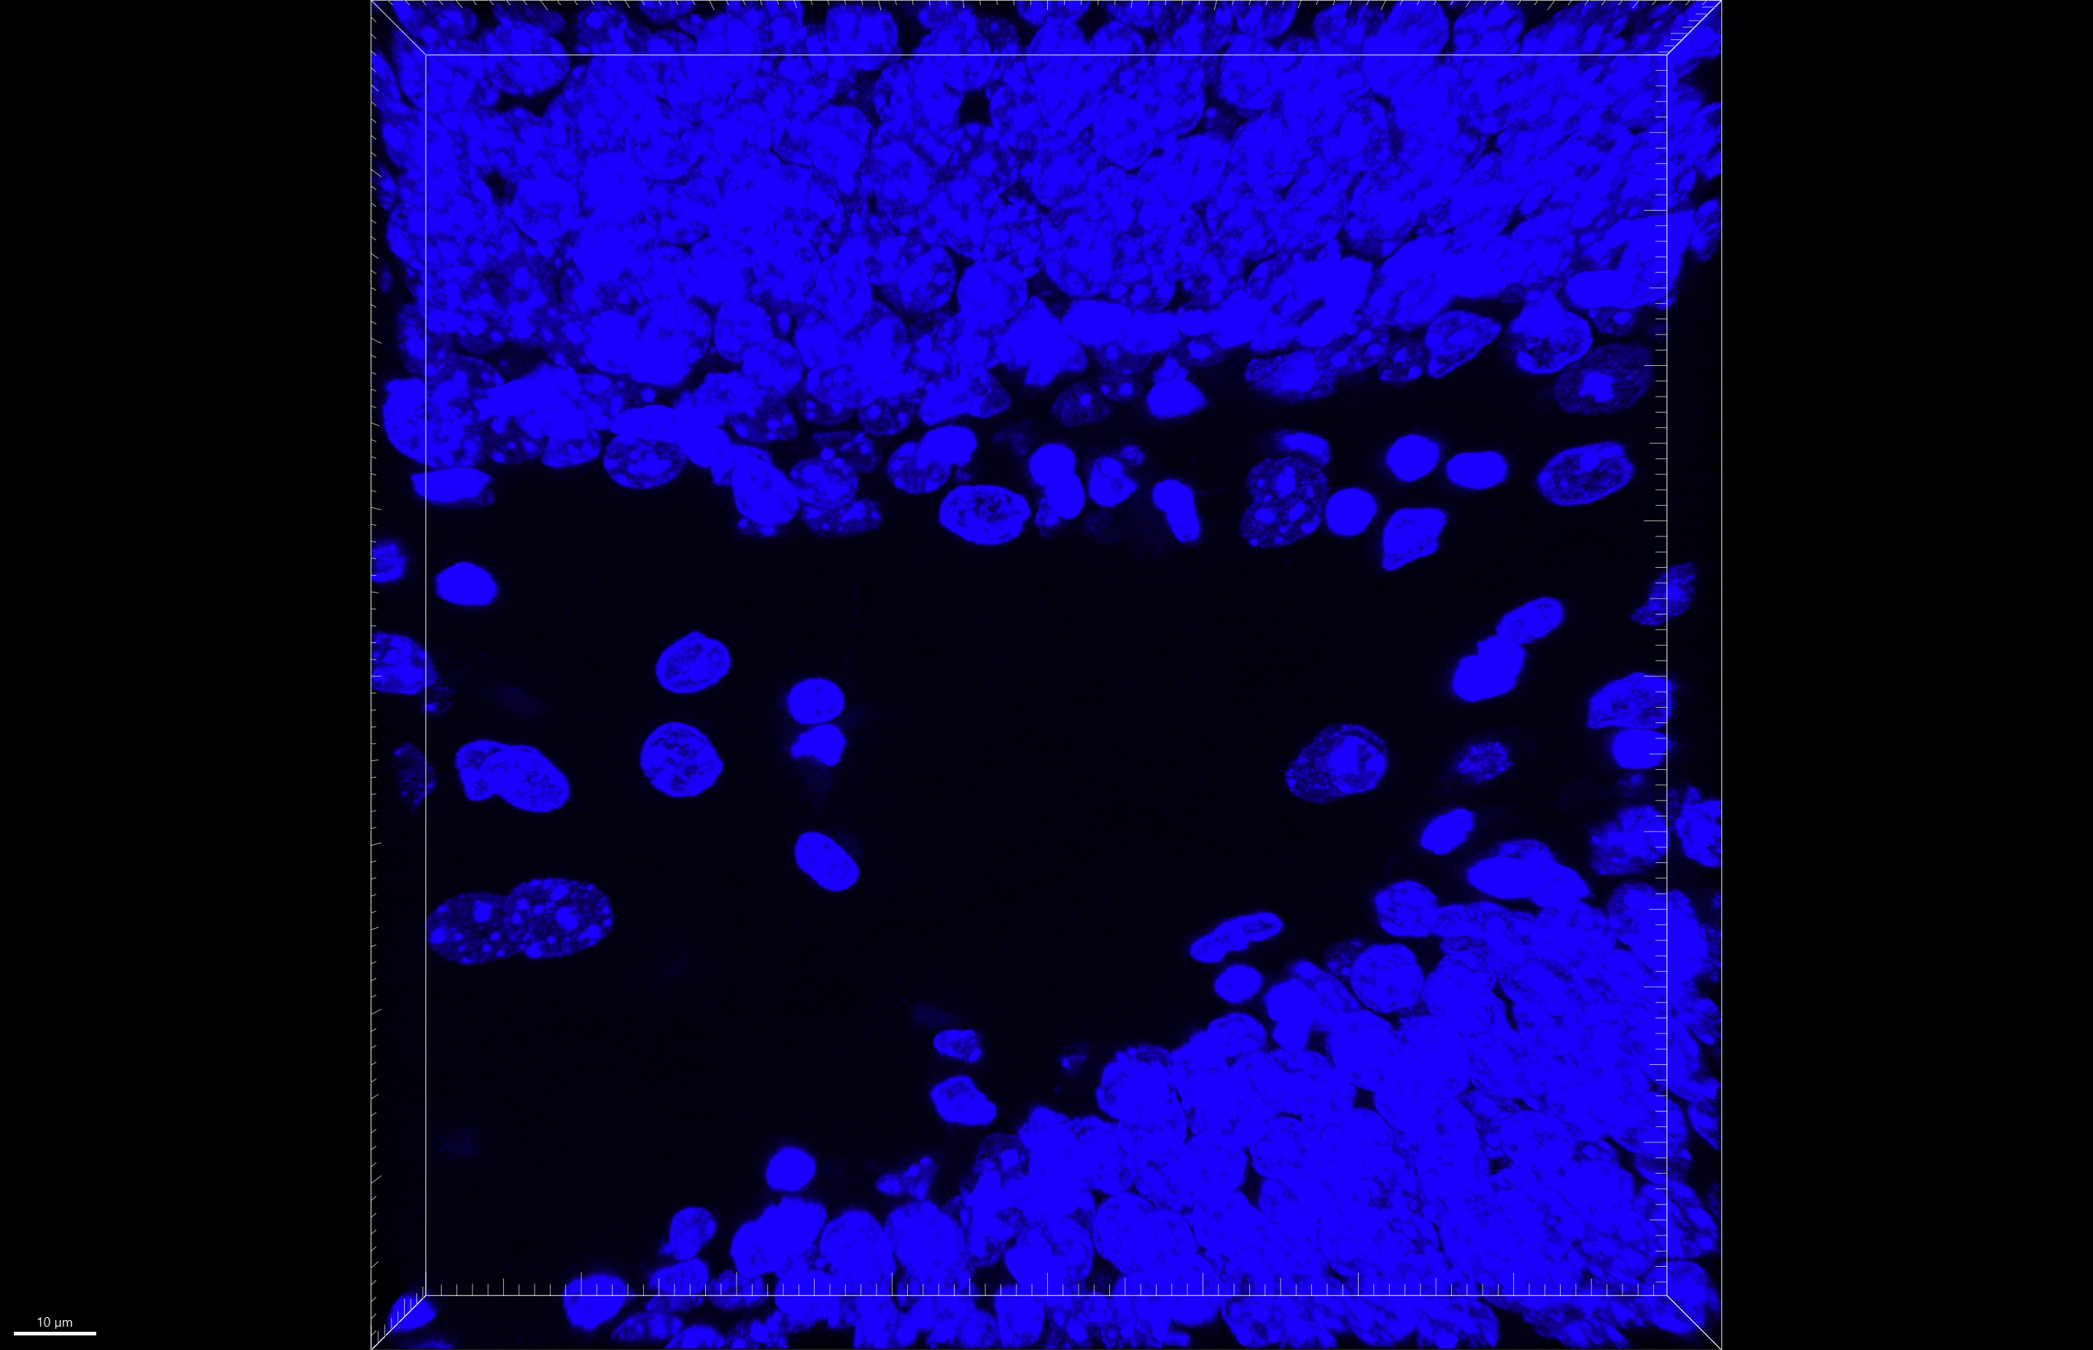
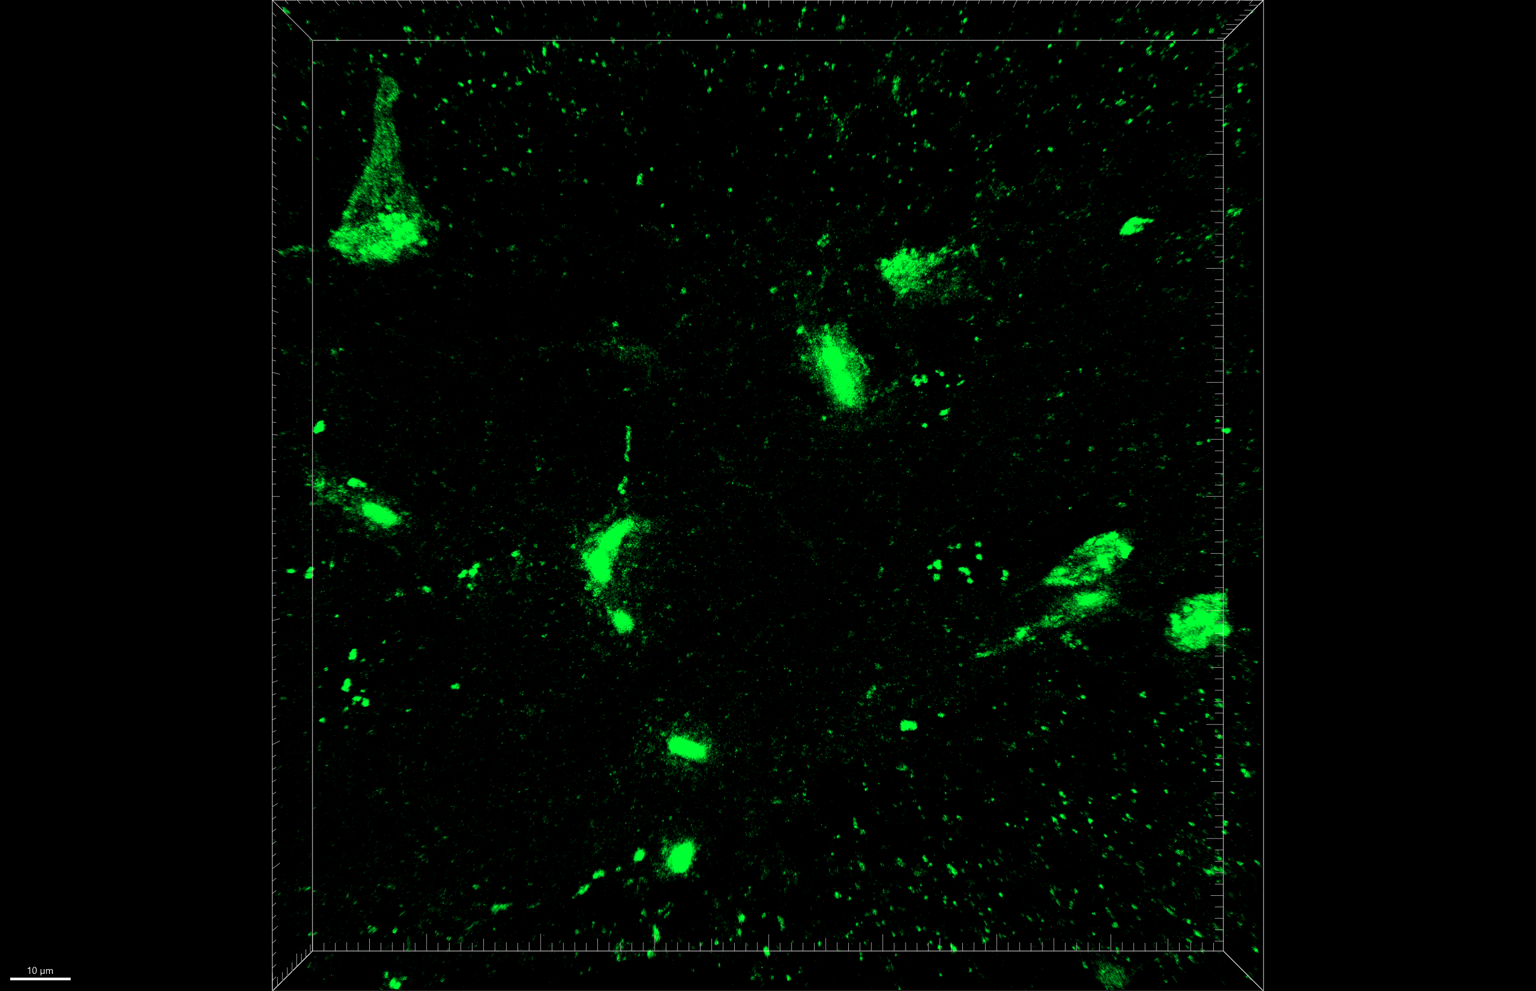
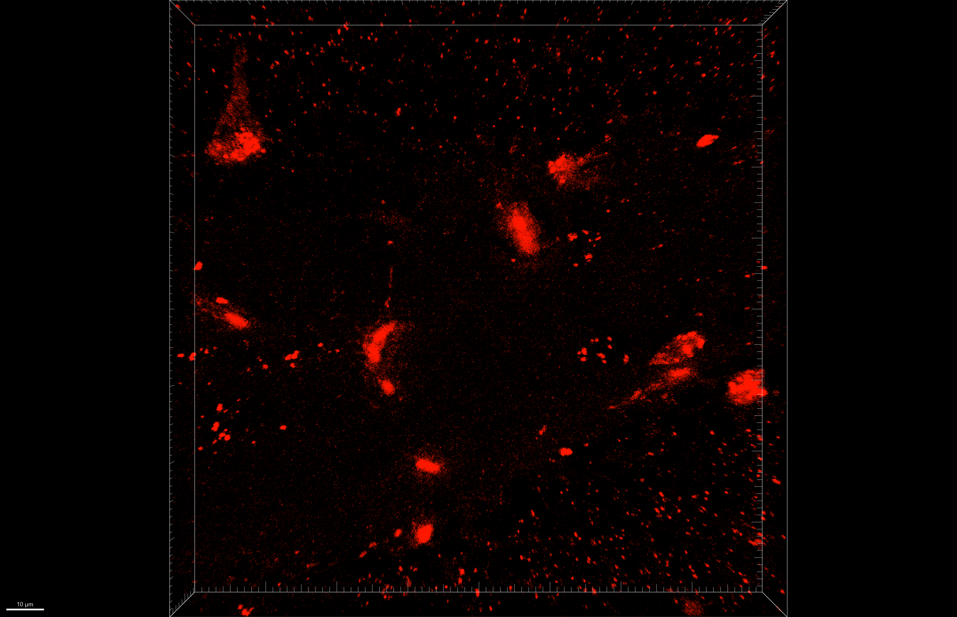
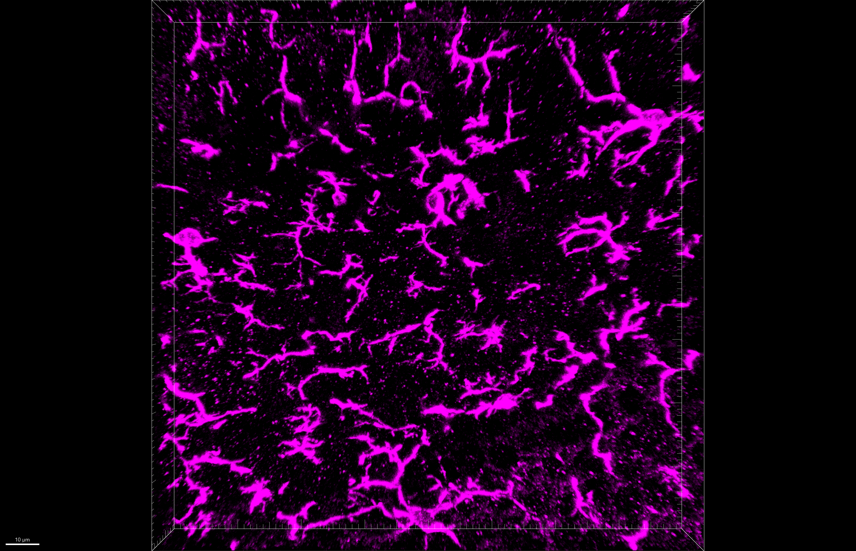
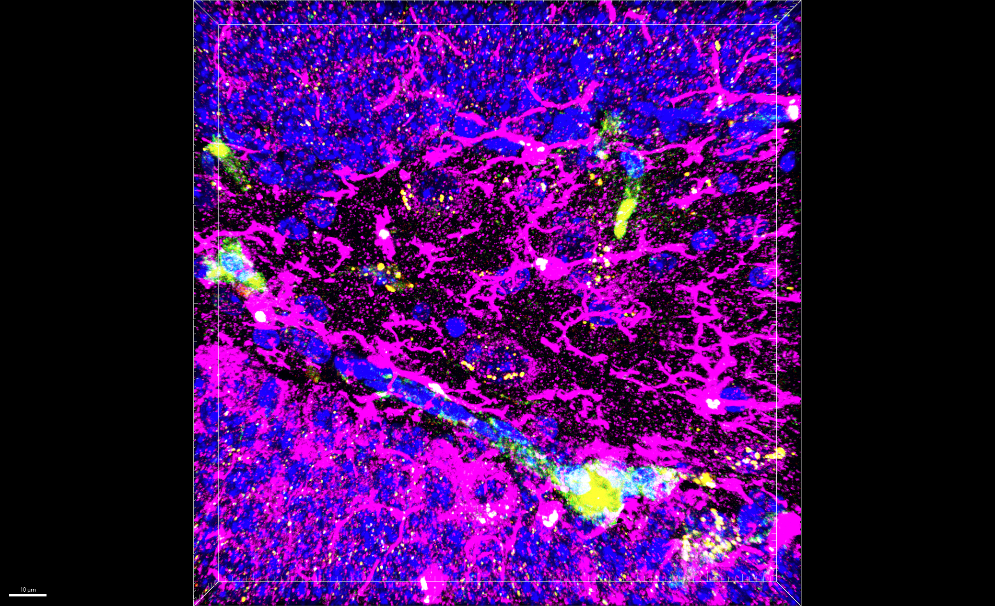
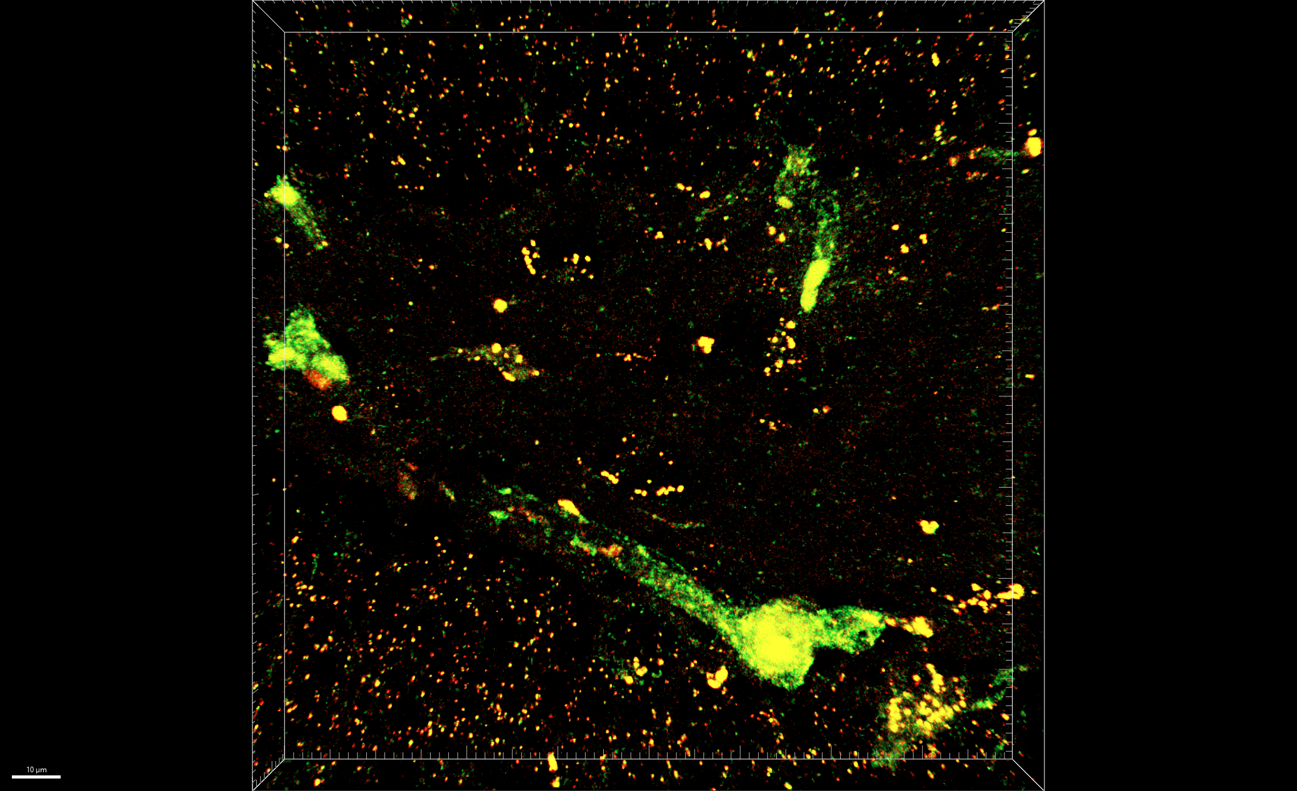
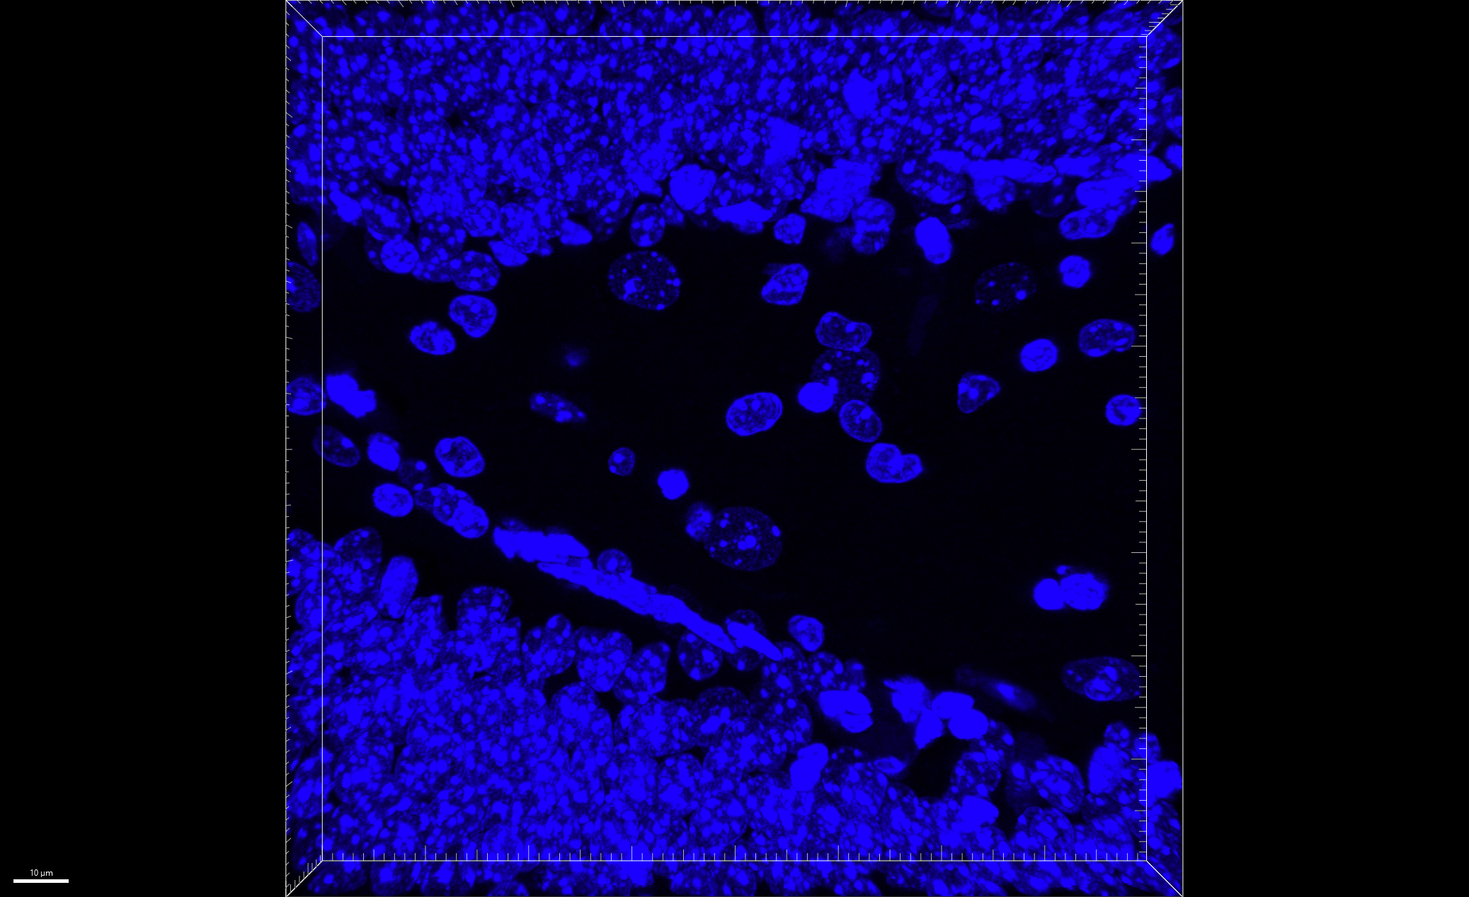
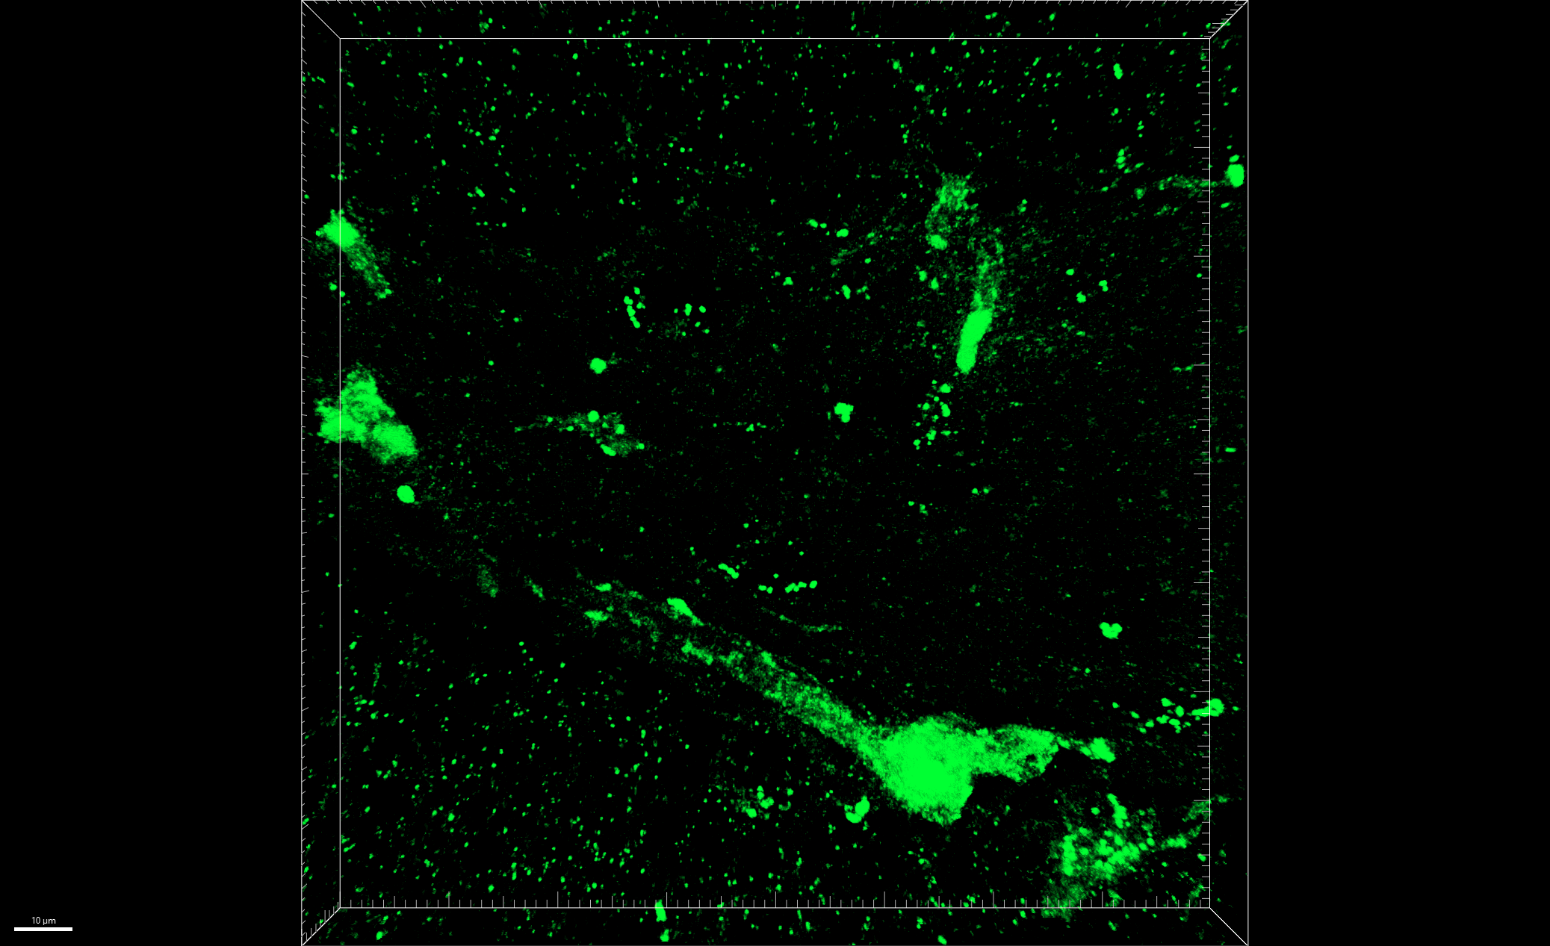
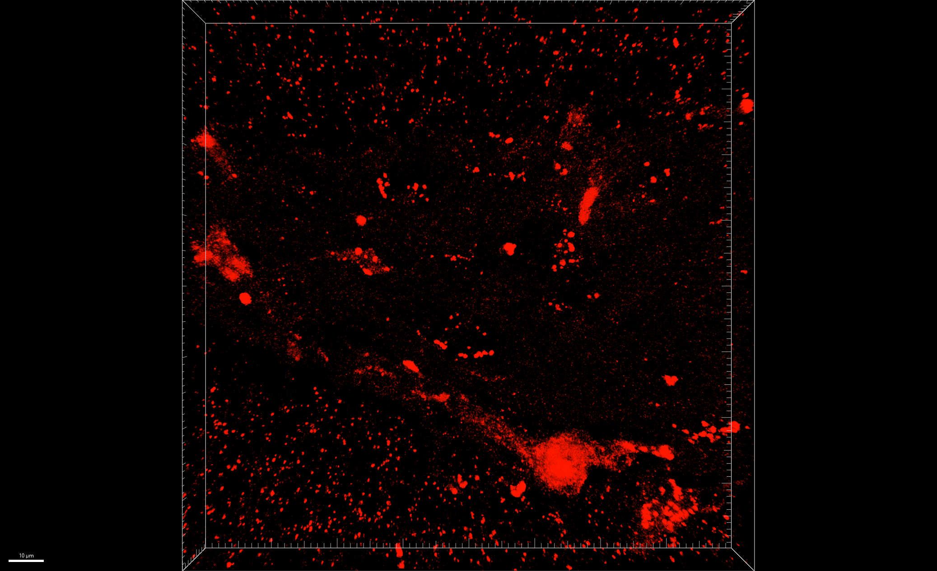
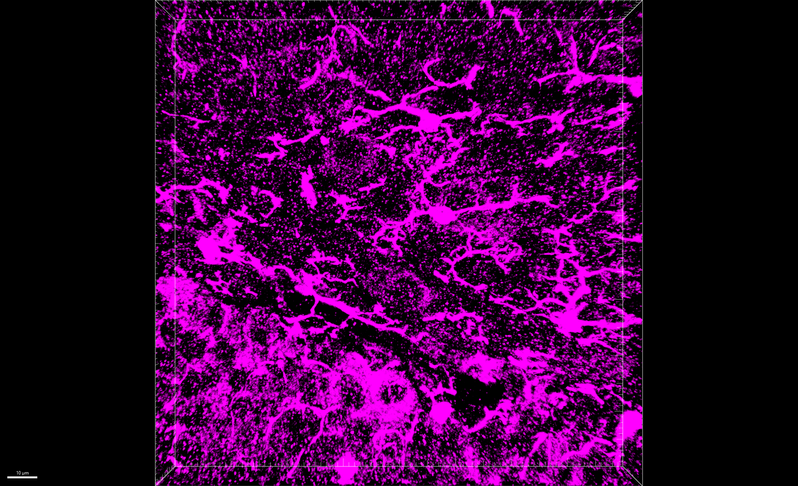
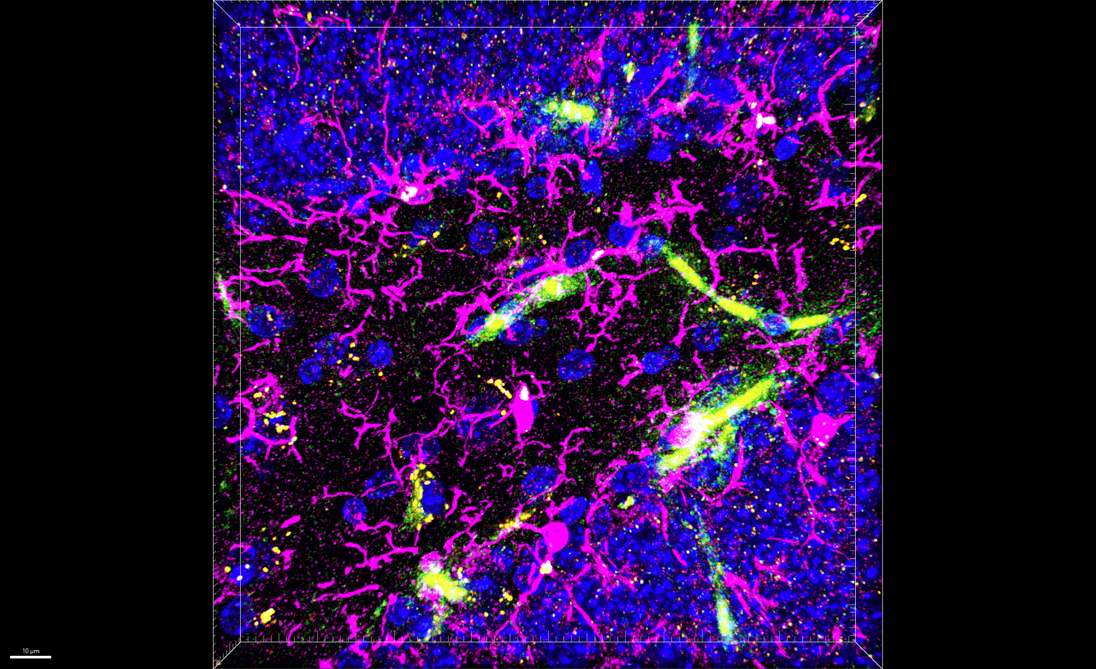
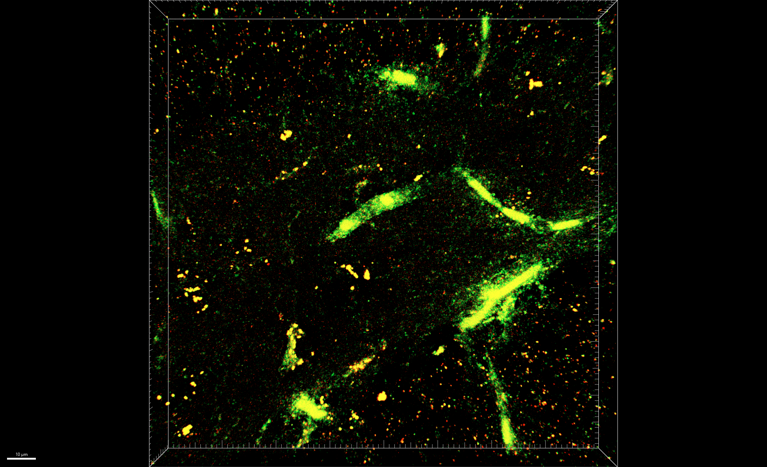
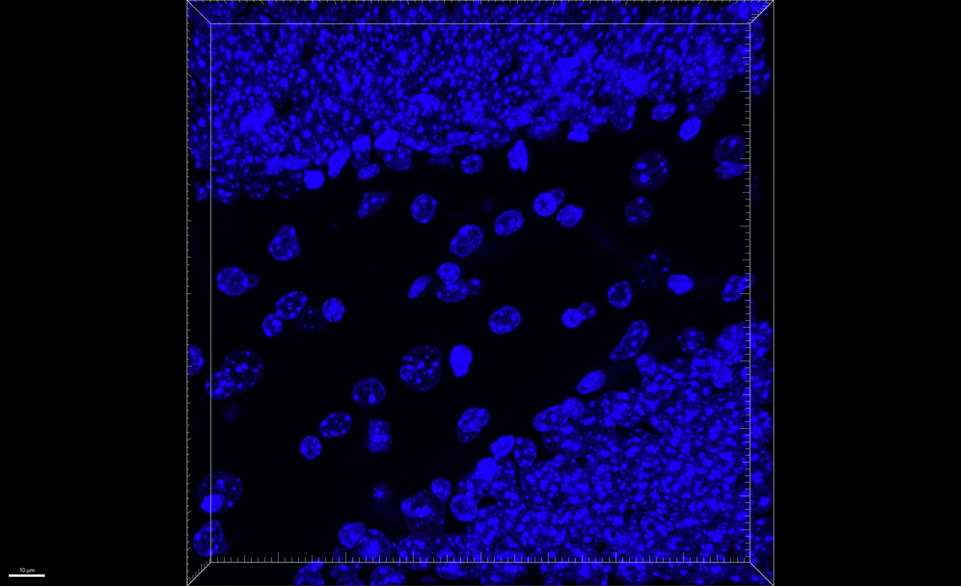
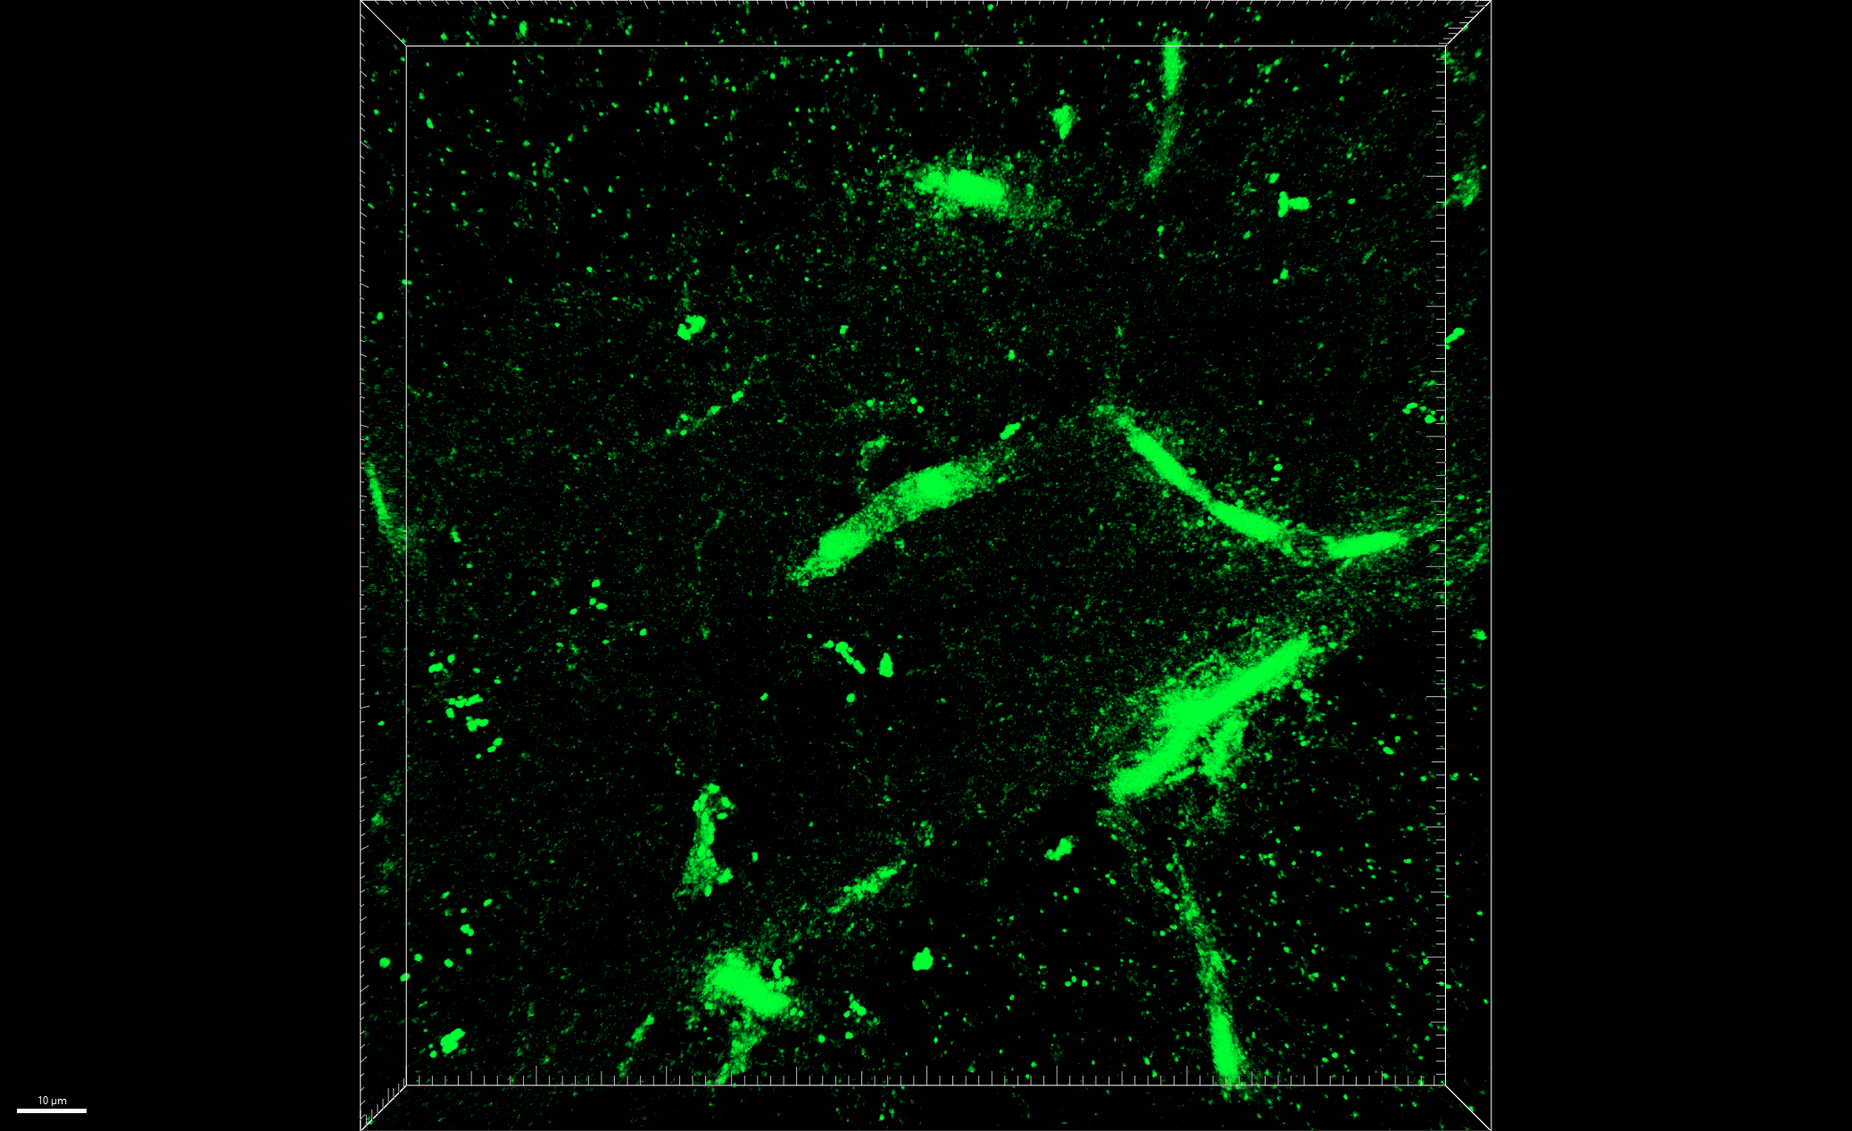
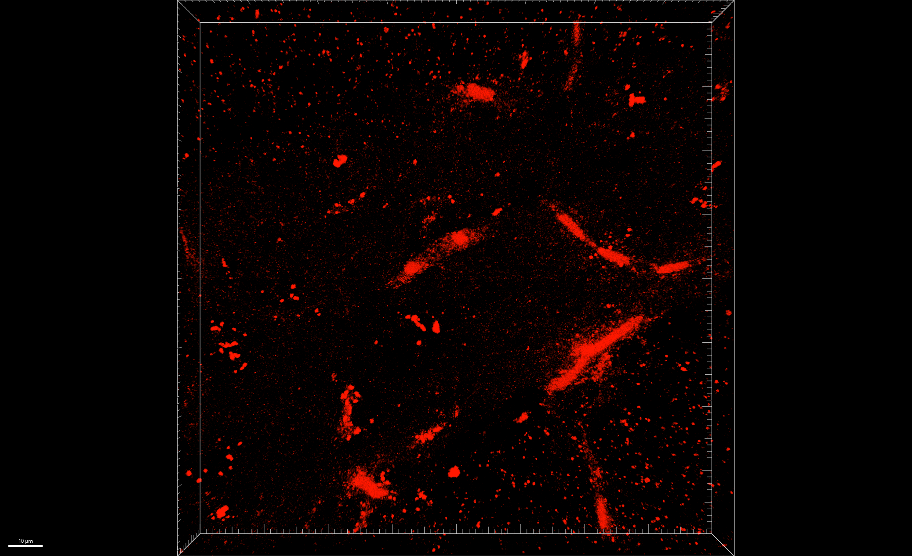
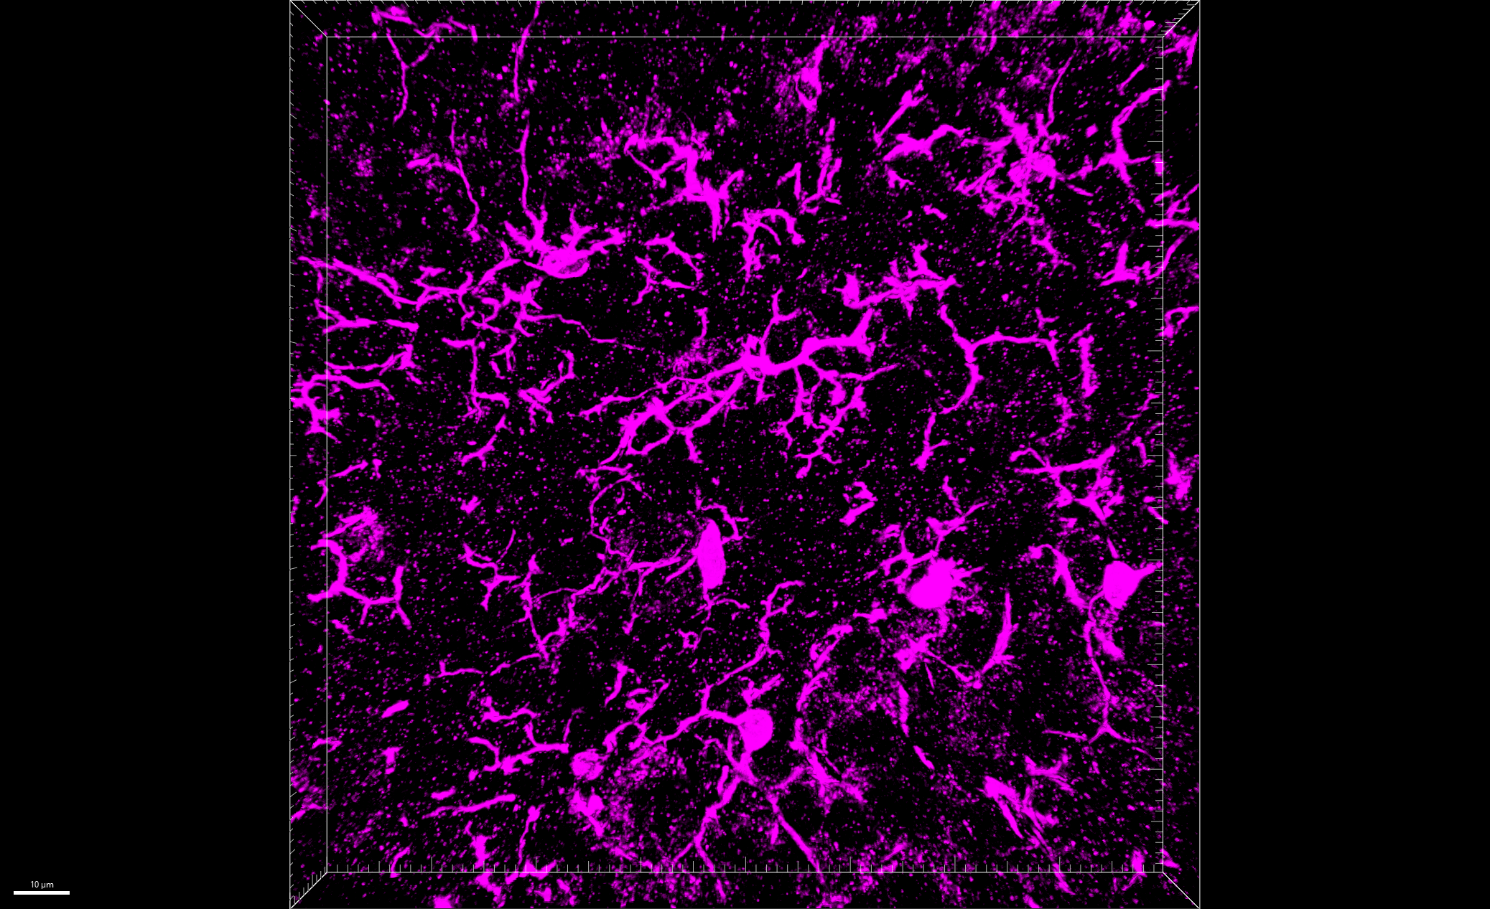
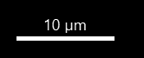
Fig 7.A
[Iba1-shPfk + mt-mKeima] + LPS, PID 14, DG
LSM 900, 40x, z stacks
merged
green + red
Hoechst
mt-mKeima
mt-mKeima
merged
enlarged
Iba1
mt-mKeima
+
LPS
Iba1-shPfk1
+
mt-mKeima
+
LPS
Iba1-shPfk2
+
mt-mKeima
+
LPS

Slide 3
Fig 7.A
mKeima + LPS
merged

Slide 4
Fig 7.A
merged
green + red
mKeima + LPS

Slide 5
Fig 7.A
mKeima + LPS
Hoechst

Slide 6
Fig 7.A
mKeima + LPS
mt-mKeima

Slide 7
Fig 7.A
mKeima + LPS
mt-mKeima

Slide 8
Fig 7.A
mKeima + LPS
Iba1

Slide 9
Fig 7.A
Iba1-shPfk1 + mt-mKeima + LPS
merged

Slide 10
Fig 7.A
merged
green + red
Iba1-shPfk1 + mt-mKeima + LPS

Slide 11
Fig 7.A
Iba1-shPfk1 + mt-mKeima + LPS
Hoechst

Slide 12
Fig 7.A
Iba1-shPfk1 + mt-mKeima + LPS
mt-mKeima

Slide 13
Fig 7.A
Iba1-shPfk1 + mt-mKeima + LPS
mt-mKeima

Slide 14
Fig 7.A
Iba1-shPfk1 + mt-mKeima + LPS
Iba1

Slide 15
Fig 7.A
Iba1-shPfk2 + mt-mKeima + LPS
merged

Slide 16
Fig 7.A
merged
green + red
Iba1-shPfk2 + mt-mKeima + LPS

Slide 17
Fig 7.A
Iba1-shPfk2 + mt-mKeima + LPS
Hoechst

Slide 18
Fig 7.A
Iba1-shPfk2 + mt-mKeima + LPS
mt-mKeima

Slide 19
Fig 7.A
Iba1-shPfk2 + mt-mKeima + LPS
mt-mKeima

Slide 20
Fig 7.A
Iba1-shPfk2 + mt-mKeima + LPS
Iba1

