Slide 1
Raw images_Figures_CMI 2026
Title of manuscript: Glycolytic enzymes play important roles in innate immune memory of neuroimmune responses triggered by systemic inflammation

Slide 2
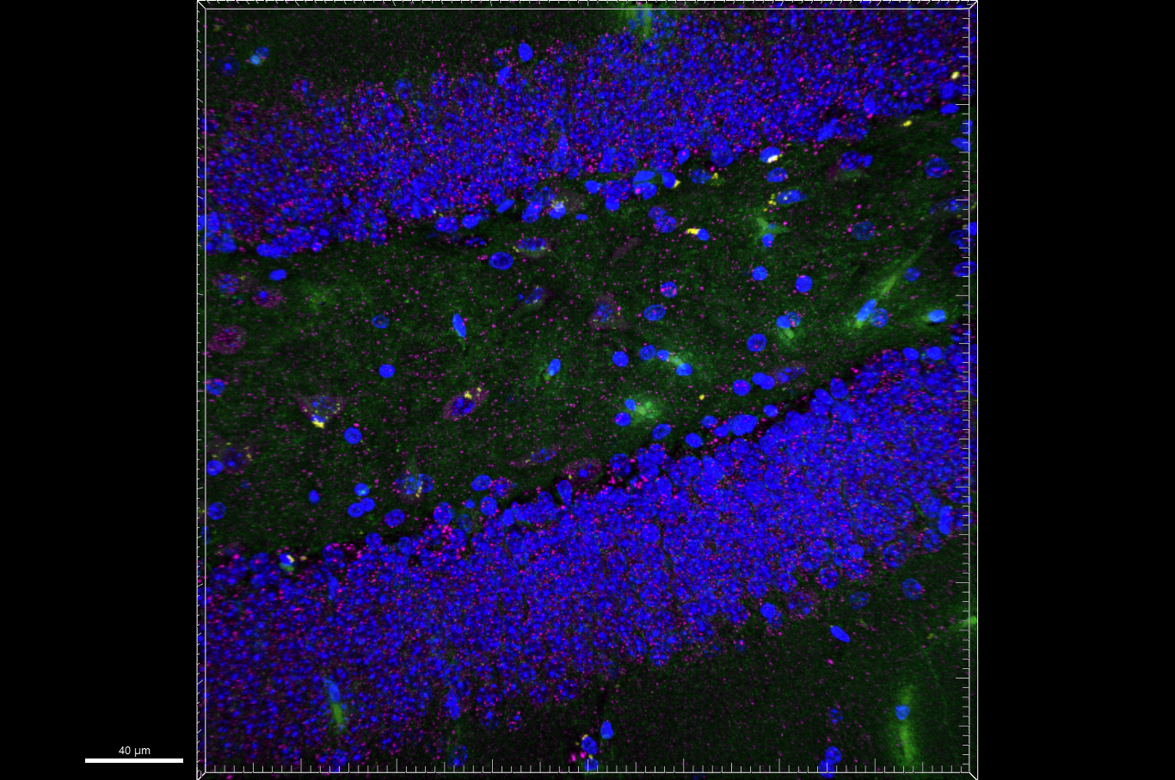
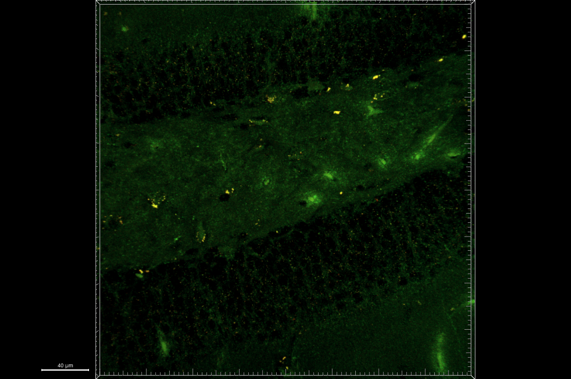
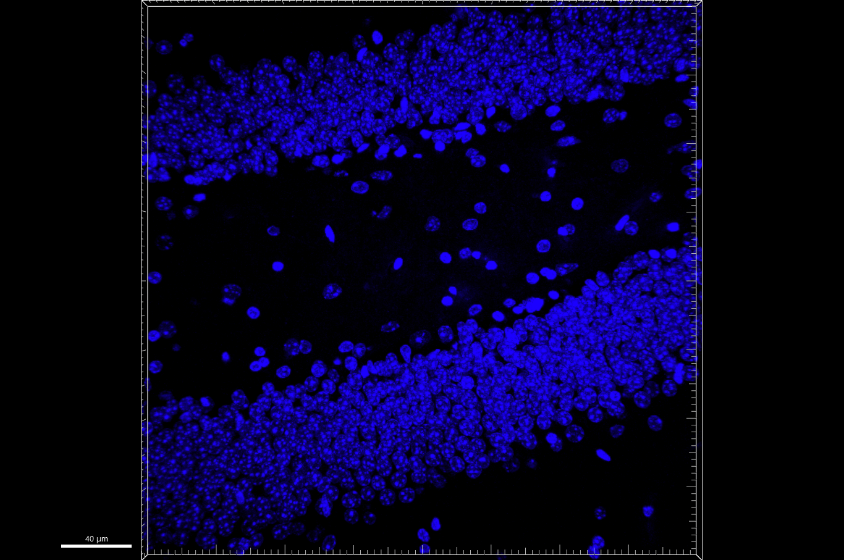
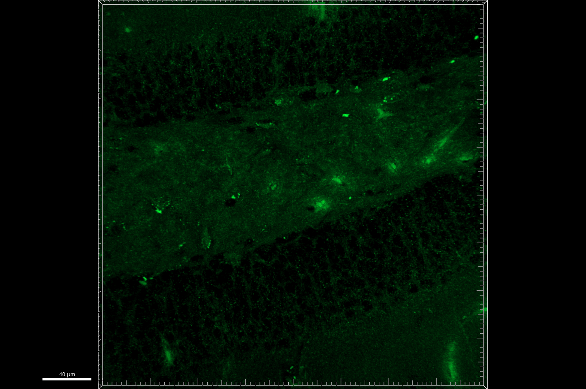
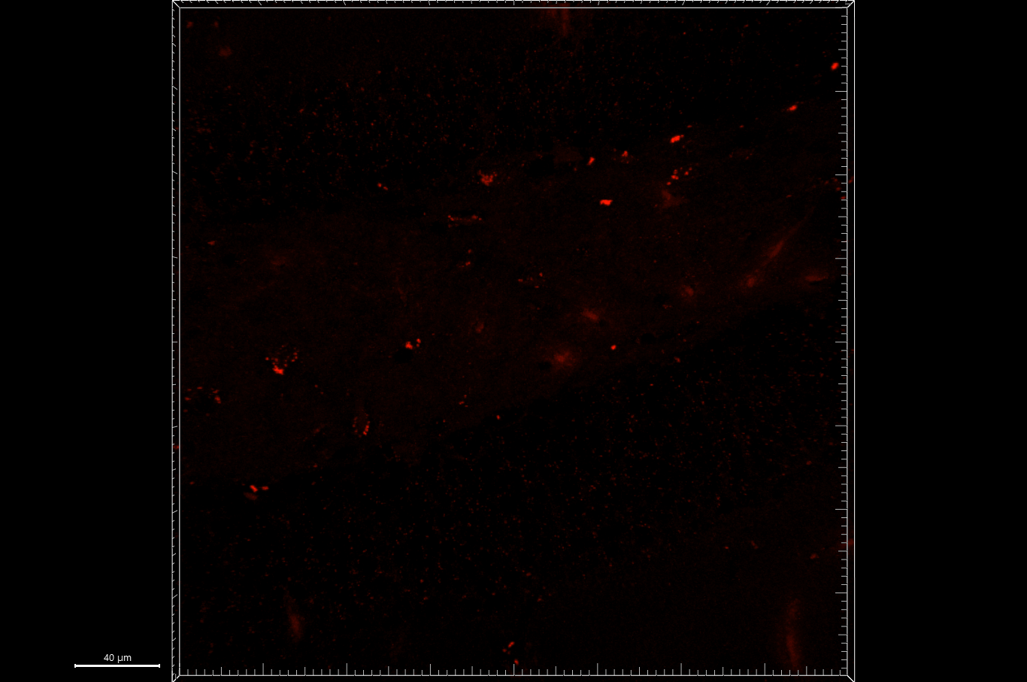
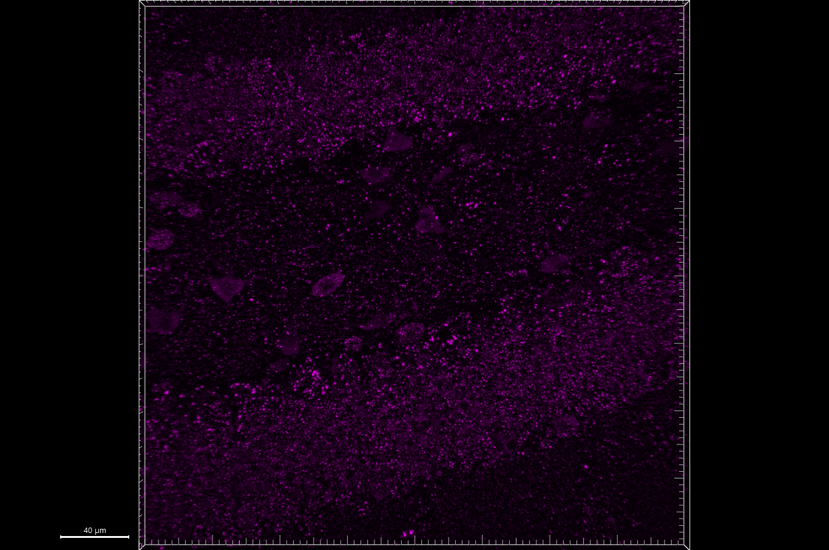
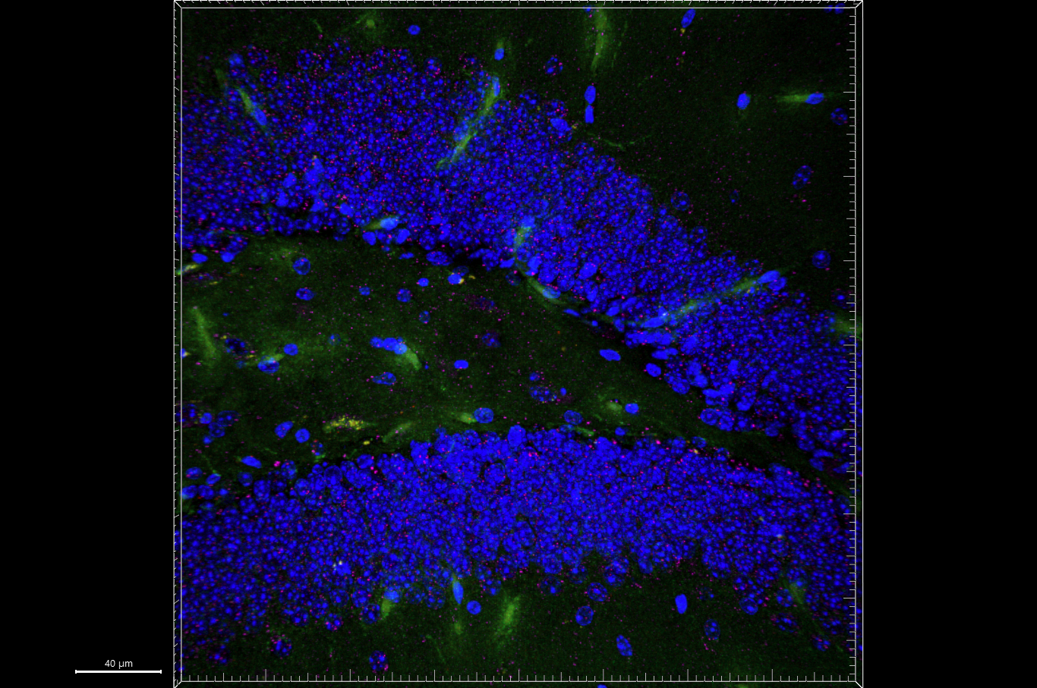
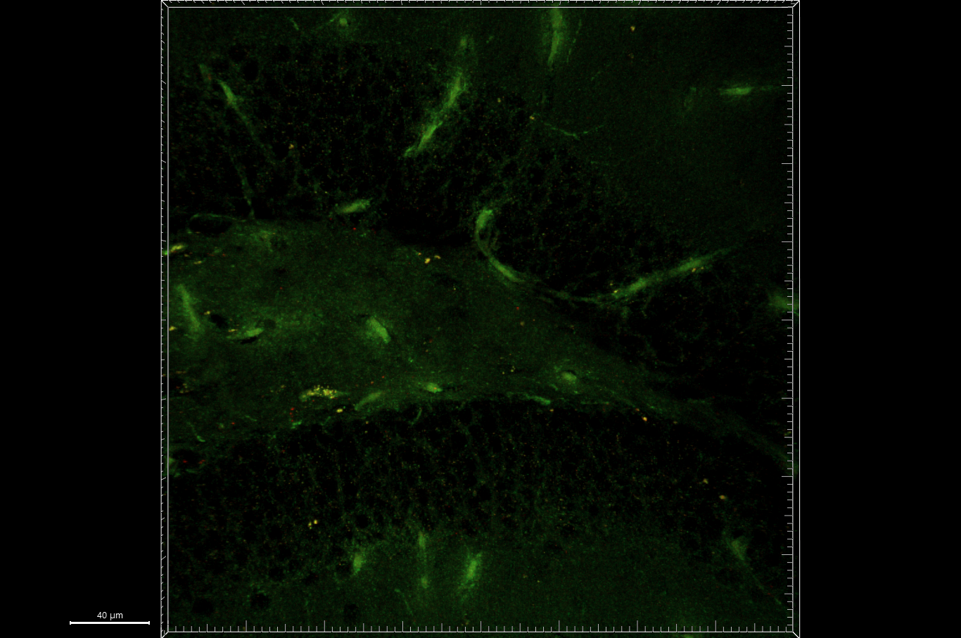
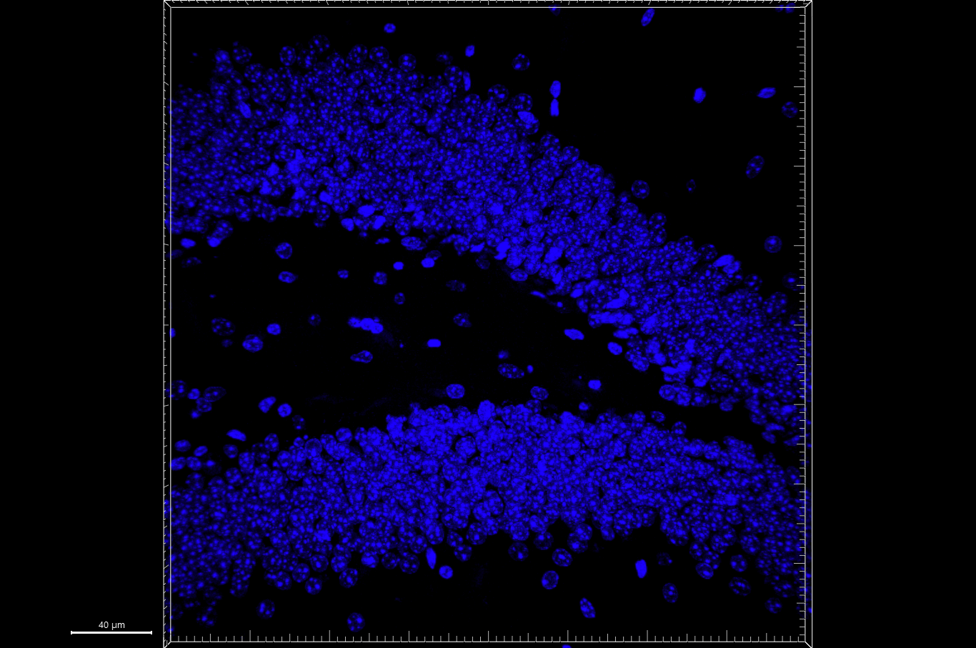
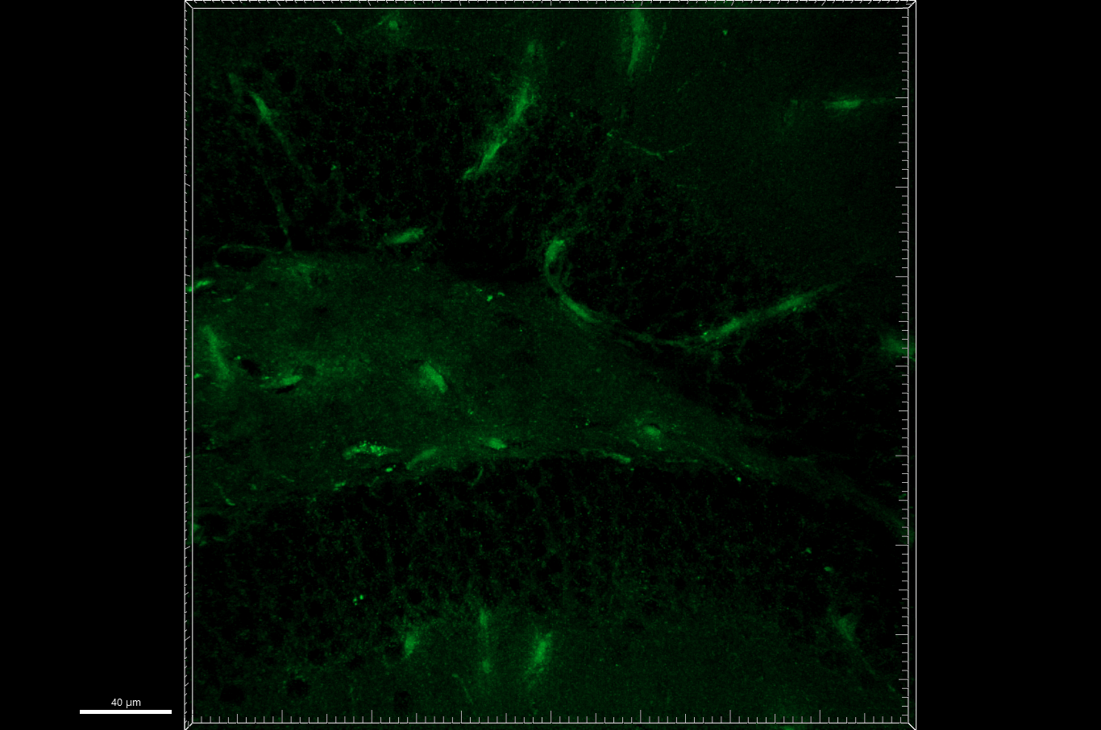
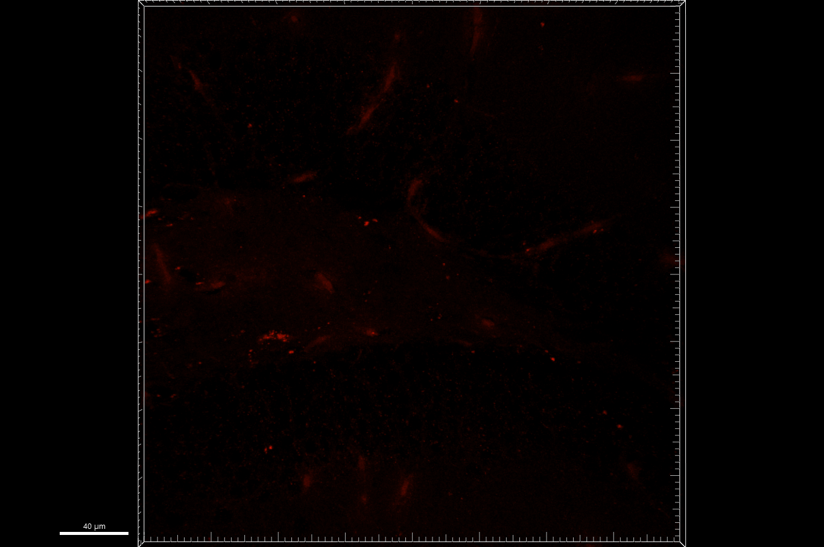
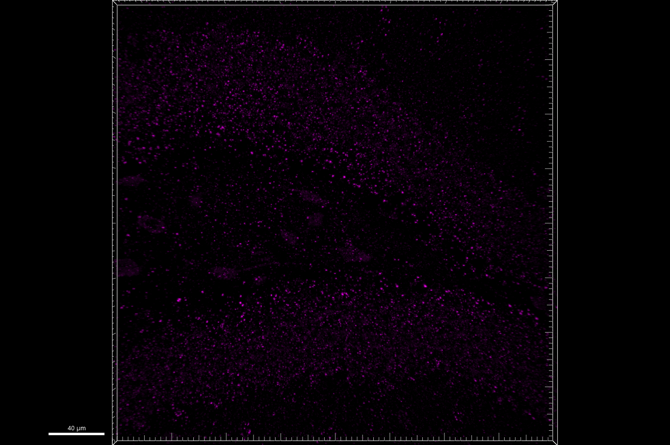
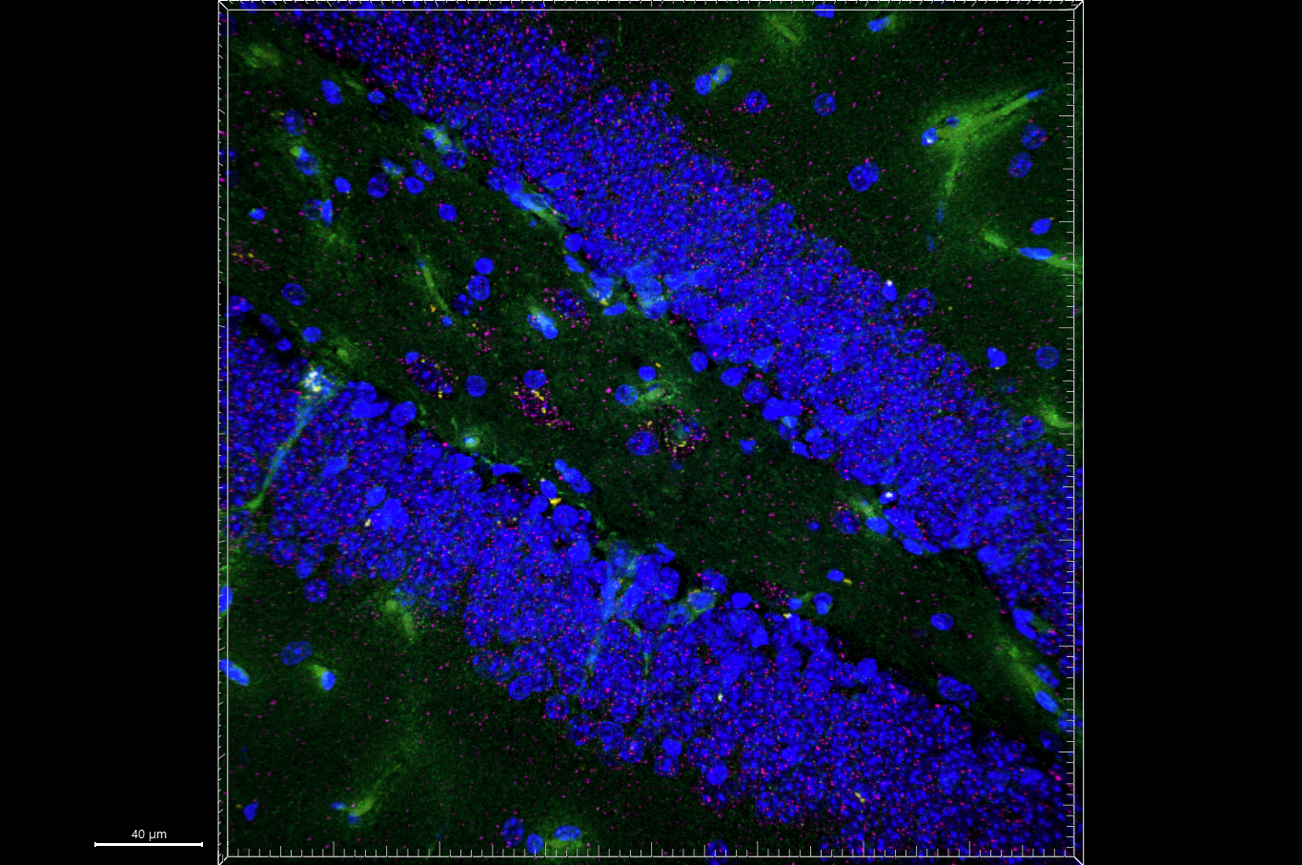
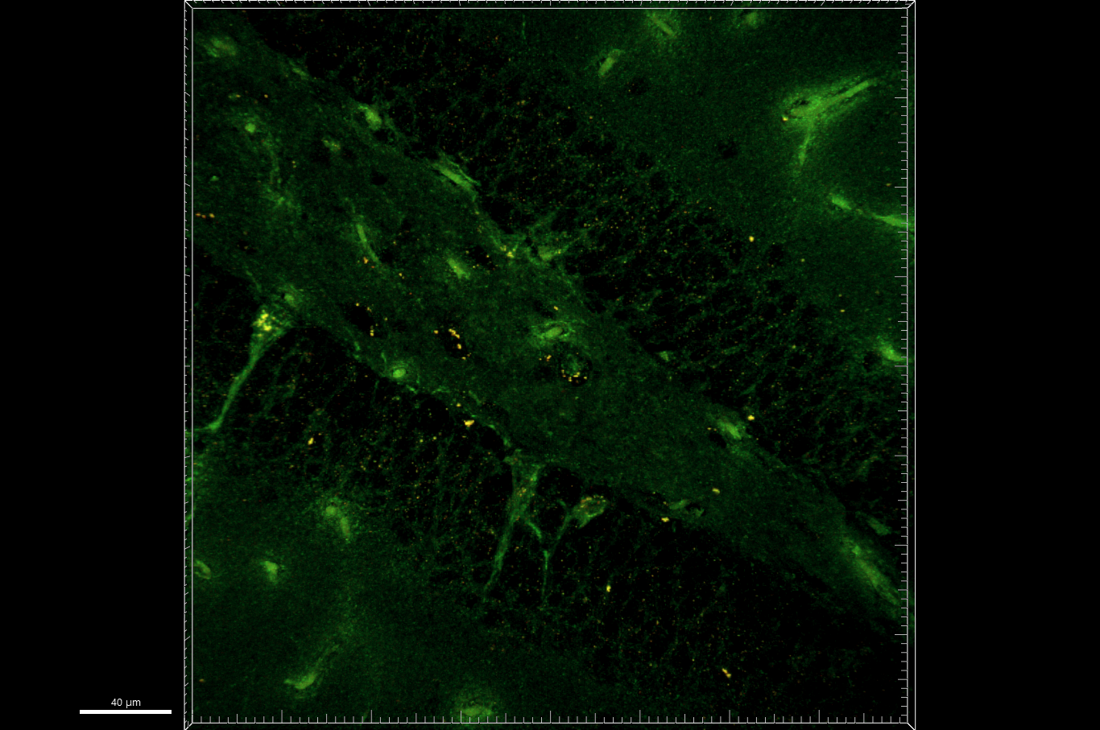
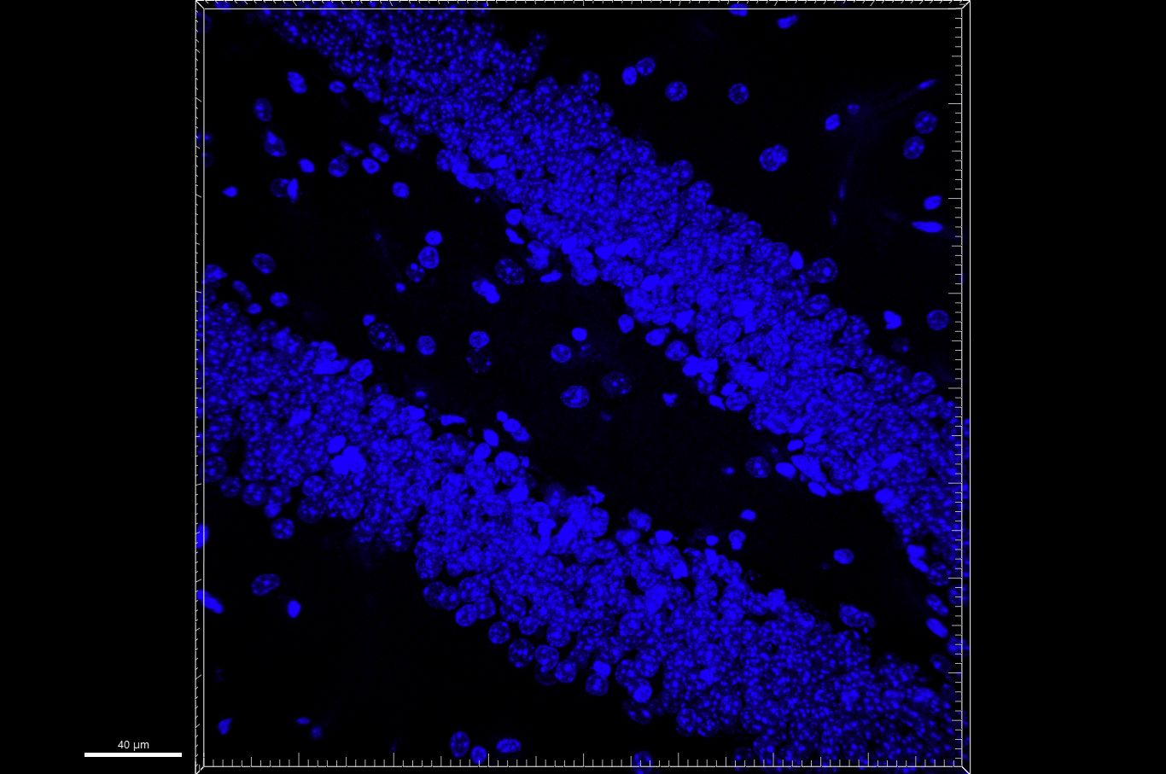
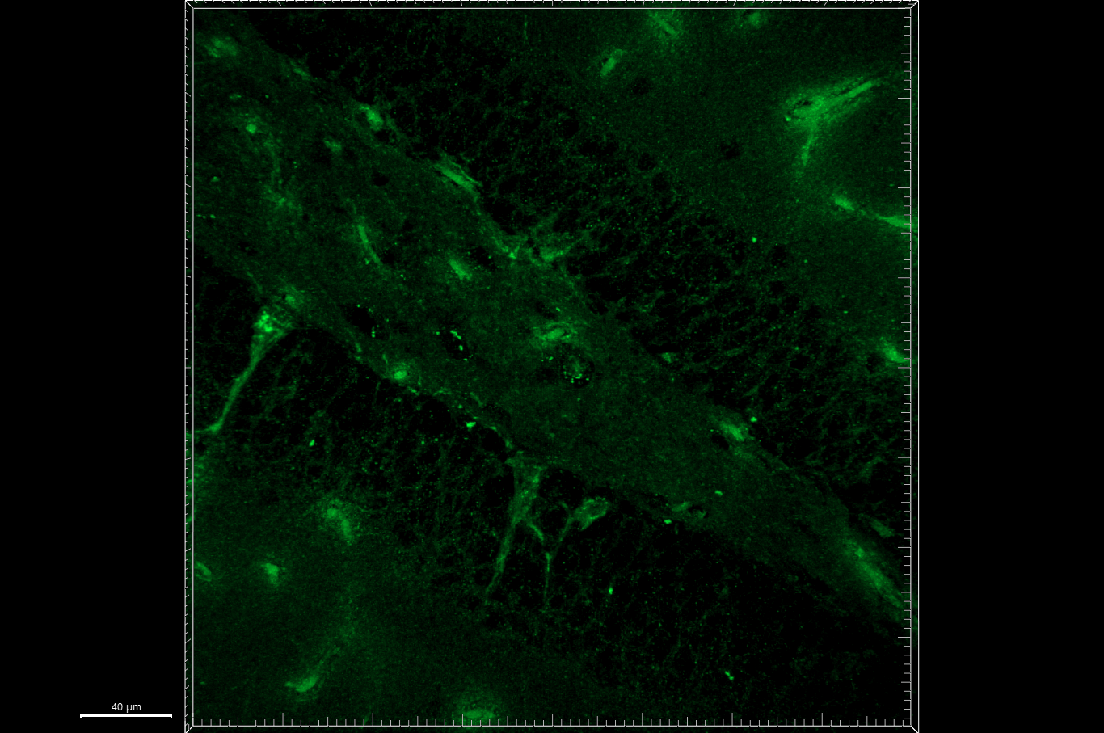
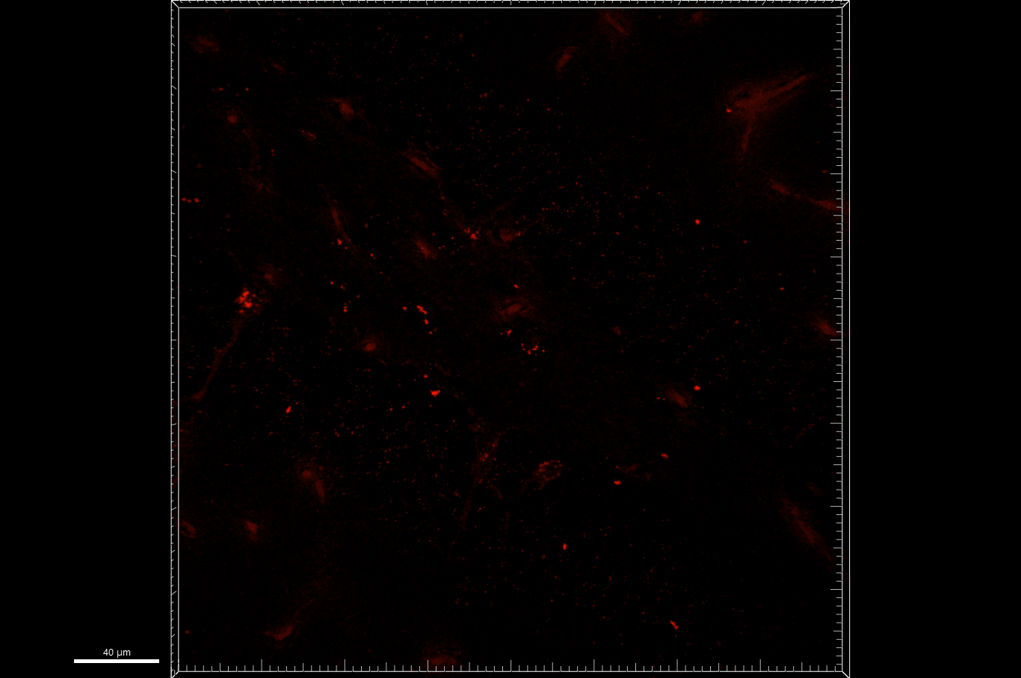
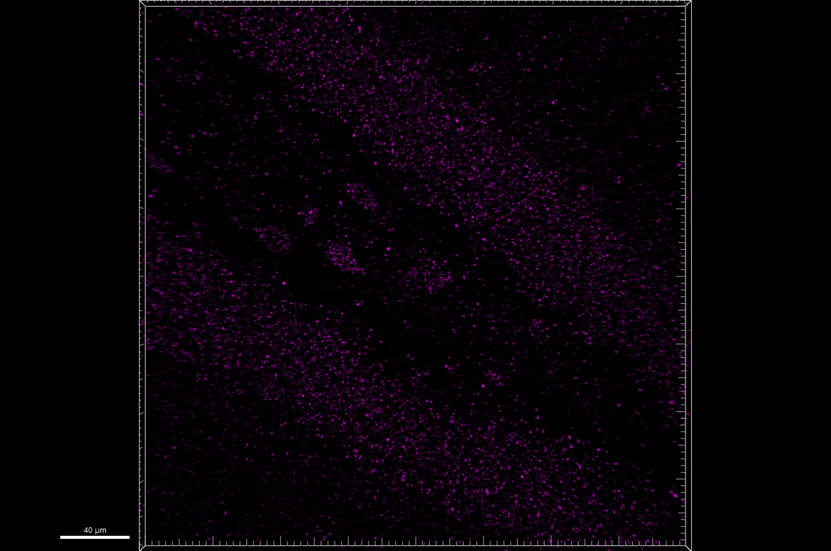
Fig 6.E
[Iba1-shPfk + mt-mKeima] + 2xLPS [PID (28 + 14)], DG
merge
green + red
LSM 900, 40x, z stacks
merged
enlarged
Hoechst
mt-mKeima
mt-mKeima
γH2AX
mKeima
+
2xLPS
shPfk1
+
mKeima
+
2xLPS
shPfk2
+
mKeima
+
2xLPS

Slide 3
Fig 6.E
mKeima + 2xLPS
merged

Slide 4
Fig 6.E
merged
green + red
mKeima + 2xLPS

Slide 5
Fig 6.E
mKeima + 2xLPS
Hoechst

Slide 6
Fig 6.E
mKeima + 2xLPS
mt-mKeima

Slide 7
Fig 6.E
mKeima + 2xLPS
mt-mKeima

Slide 8
Fig 6.E
mKeima + 2xLPS
γH2AX

Slide 9
Fig 6.E
shPfk1 + mKeima + 2xLPS
merged

Slide 10
Fig 6.E
merged
green + red
shPfk1 + mKeima + 2xLPS

Slide 11
Fig 6.E
shPfk1 + mKeima + 2xLPS
Hoechst

Slide 12
Fig 6.E
shPfk1 + mKeima + 2xLPS
mt-mKeima

Slide 13
Fig 6.E
shPfk1 + mKeima + 2xLPS
mt-mKeima

Slide 14
Fig 6.E
shPfk1 + mKeima + 2xLPS
γH2AX

Slide 15
Fig 6.E
shPfk2 + mKeima + 2xLPS
merged

Slide 16
Fig 6.E
merged
green + red
shPfk2 + mKeima + 2xLPS

Slide 17
Fig 6.E
shPfk2 + mKeima + 2xLPS
Hoechst

Slide 18
Fig 6.E
shPfk2 + mKeima + 2xLPS
mt-mKeima

Slide 19
Fig 6.E
shPfk2 + mKeima + 2xLPS
mt-mKeima

Slide 20
Fig 6.E
shPfk2 + mKeima + 2xLPS
γH2AX

