Slide 1
Raw images_Figures_CMI 2026
Title of manuscript: Glycolytic enzymes play important roles in innate immune memory of neuroimmune responses triggered by systemic inflammation

Slide 2
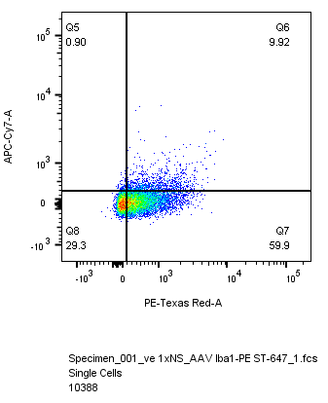
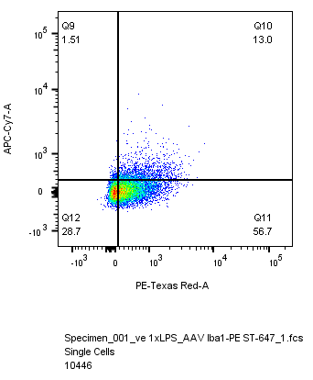
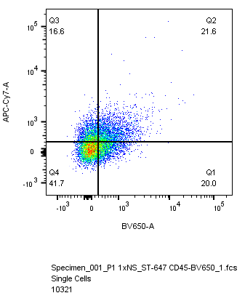
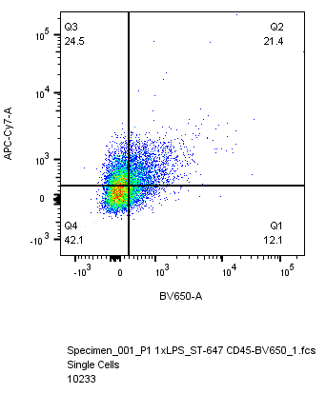
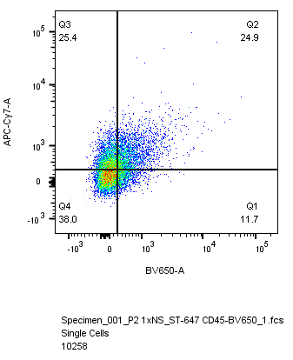
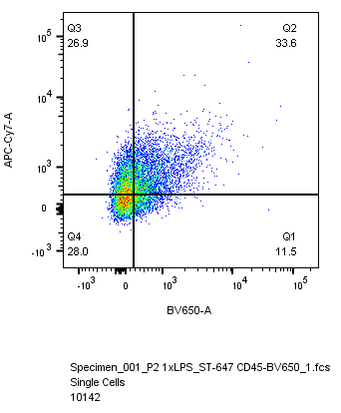
Fig 7.I
1x NS
1x LPS
STING-647
vehicle
CD45-BV650
Iba1-shPfk1
Iba1-shPfk2

