Slide 1
Raw images_Supplementary Figures_CMI 2026
Title of manuscript: Glycolytic enzymes play important roles in innate immune memory of neuroimmune responses triggered by systemic inflammation

Slide 2
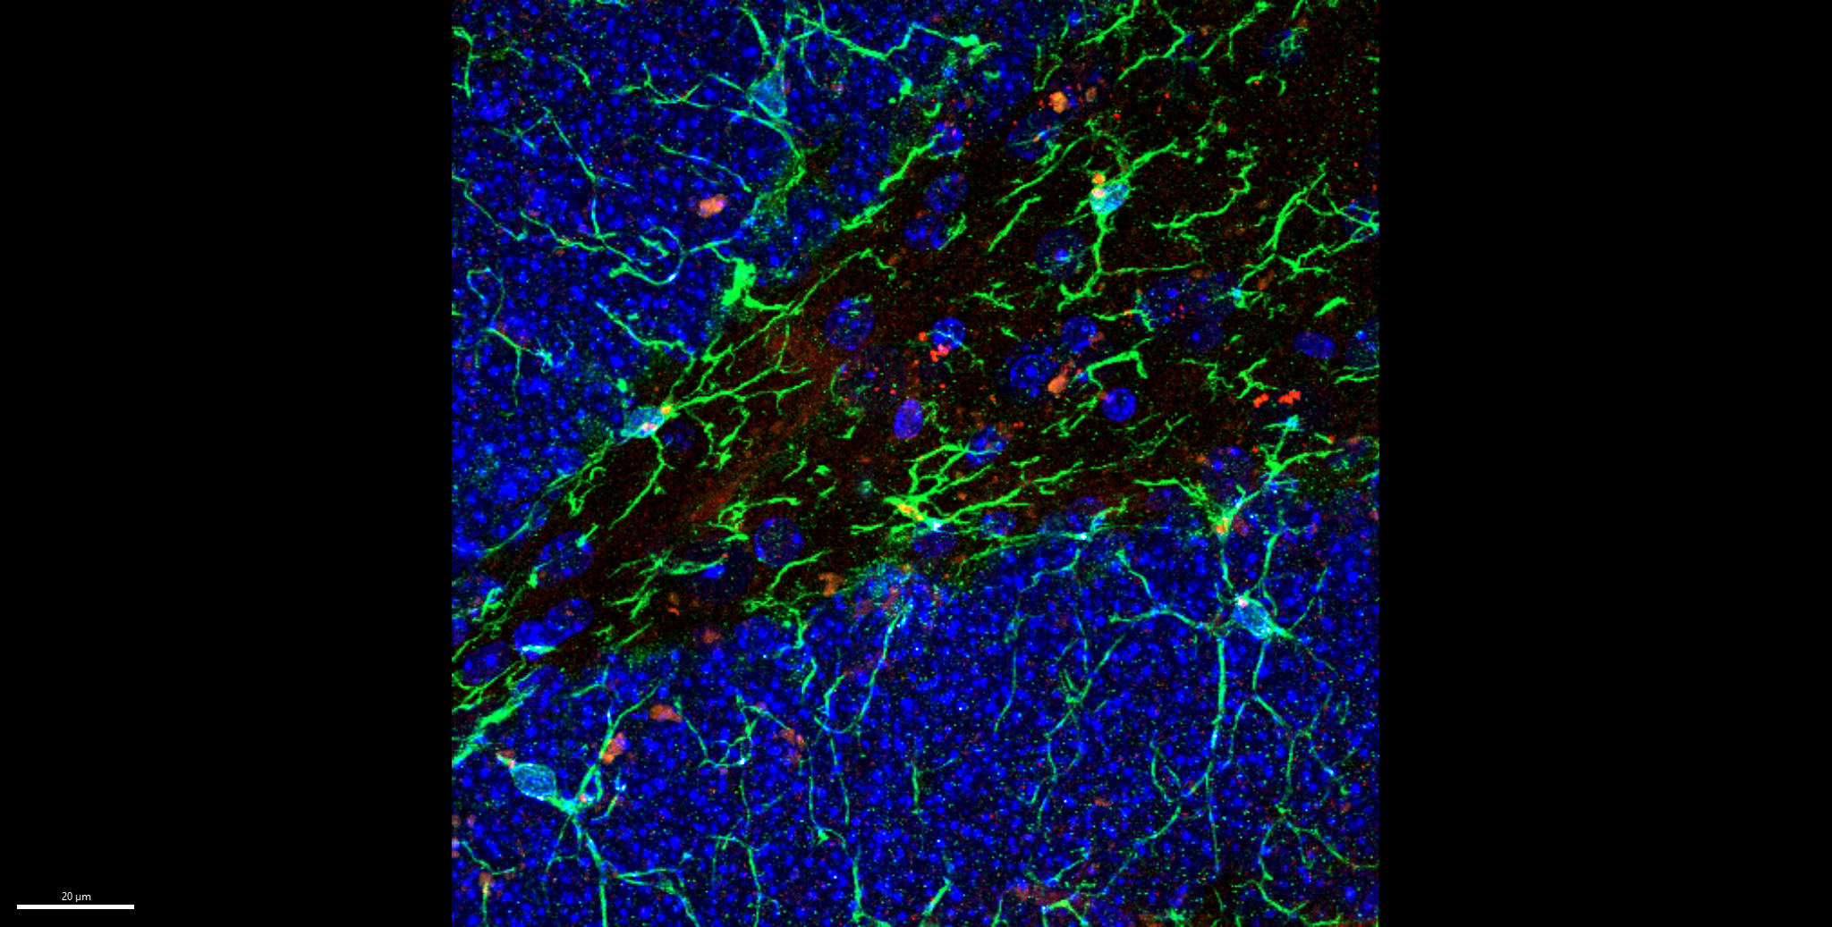
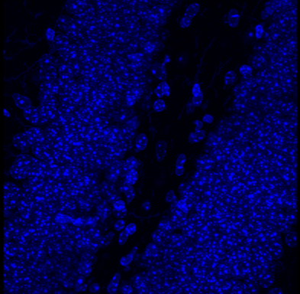
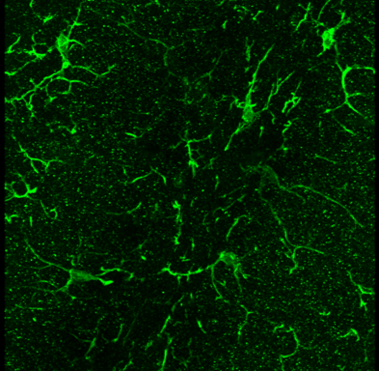
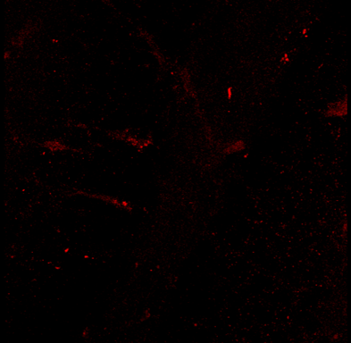
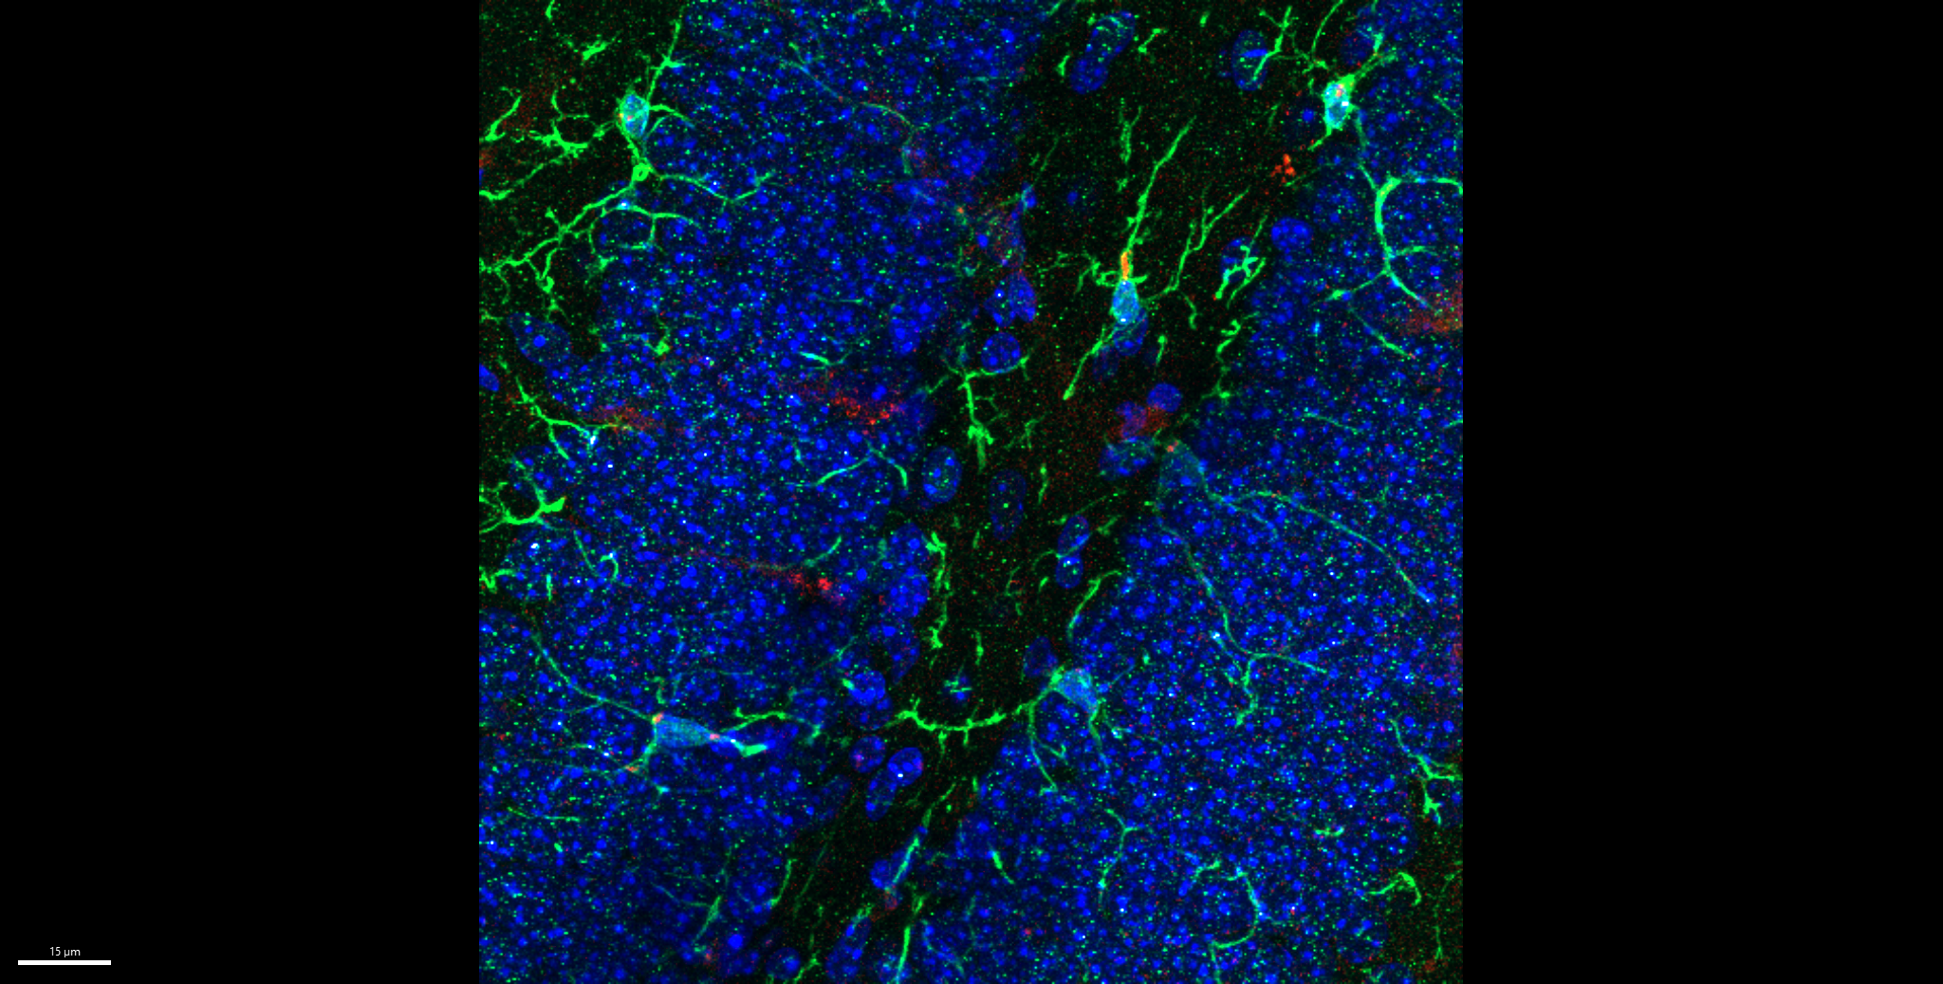
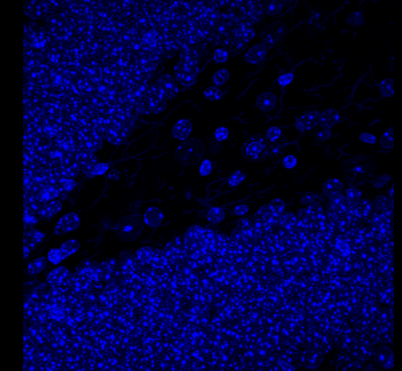
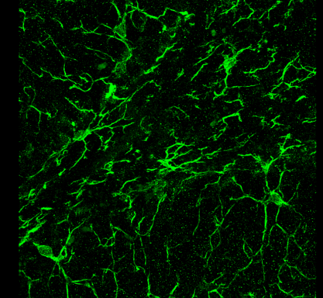
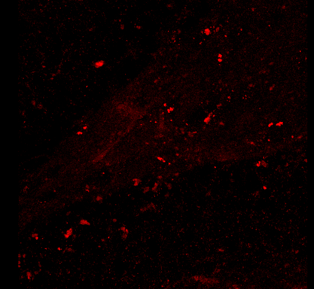
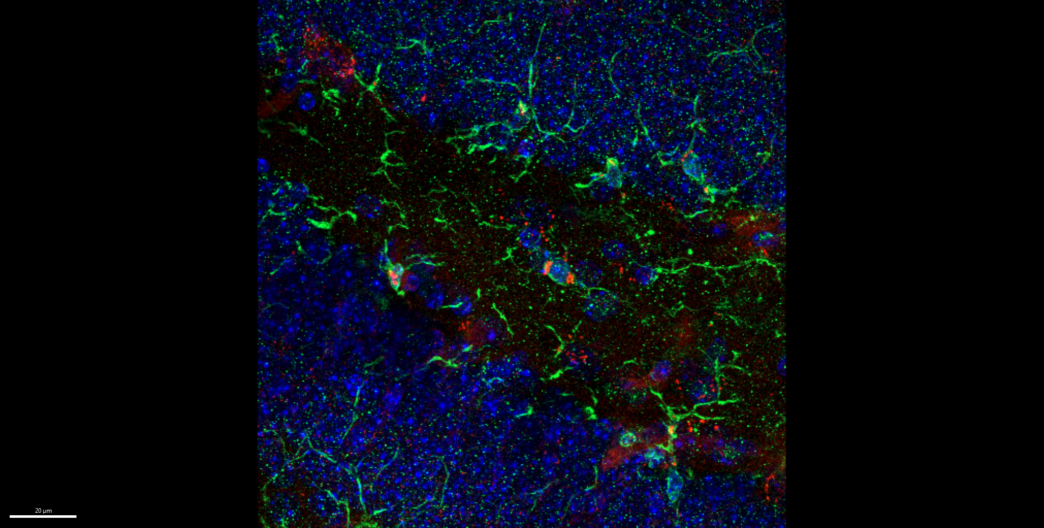
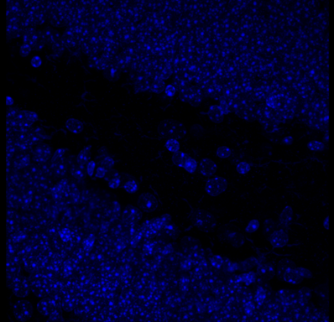
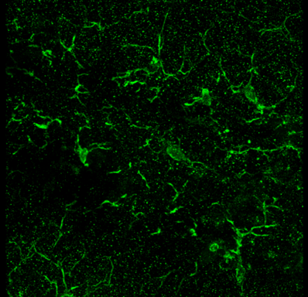
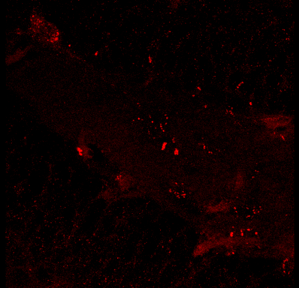
Fig S2.B
LSM 780, 40x, z stack (0.5), 3D
merged
enlarged
Hoechst
Iba1
CD121a
1x NS
1x LPS
2x LPS

Slide 3
Fig S2.B
1x NS
merged

Slide 4
Fig S2.B
1x NS
Hoechst

Slide 5
Fig S2.B
1x NS
Iba1

Slide 6
Fig S2.B
CD121a
1x NS

Slide 7
Fig S2.B
1x LPS
merged

Slide 8
Fig S2.B
1x LPS
Hoechst

Slide 9
Fig S2.B
1x LPS
Iba1

Slide 10
Fig S2.B
CD121a
1x LPS

Slide 11
Fig S2.B
2x LPS
merged

Slide 12
Fig S2.B
2x LPS
Hoechst

Slide 13
Fig S2.B
2x LPS
Iba1

Slide 14
Fig S2.B
CD121a
2x LPS

