Slide 1
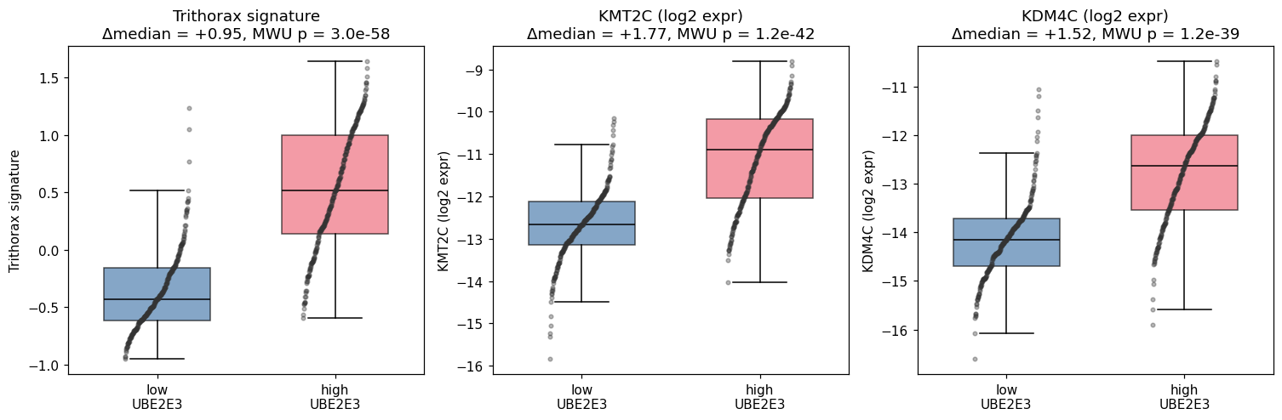
Supplementary Figure S1. UBE2E3 co-expresses with a Trithorax/COMPASS program
Trithorax signature, KMT2C and KDM4C in UBE2E3-high (top quartile) versus UBE2E3-low (bottom quartile) metacells (n = 250 each). Boxes show median and interquartile range with individual metacells overlaid; whiskers extend to 1.5× IQR and outliers are omitted. UBE2E3-high metacells carry a higher Trithorax signature (Δmedian = +0.95 z, Mann–Whitney P = 3.0 × 10⁻⁵⁸) and higher KMT2C (Δmedian = +1.77 log₂, P = 1.2 × 10⁻⁴²) and KDM4C (Δmedian = +1.52 log₂, P = 1.2 × 10⁻³⁹) expression.

Slide 2
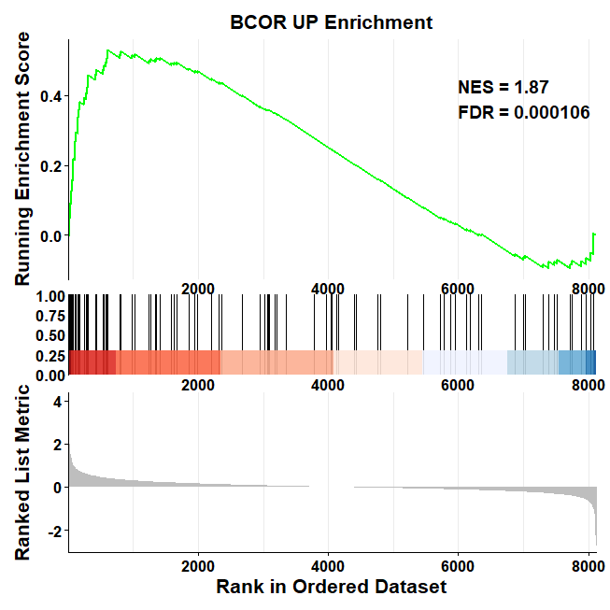
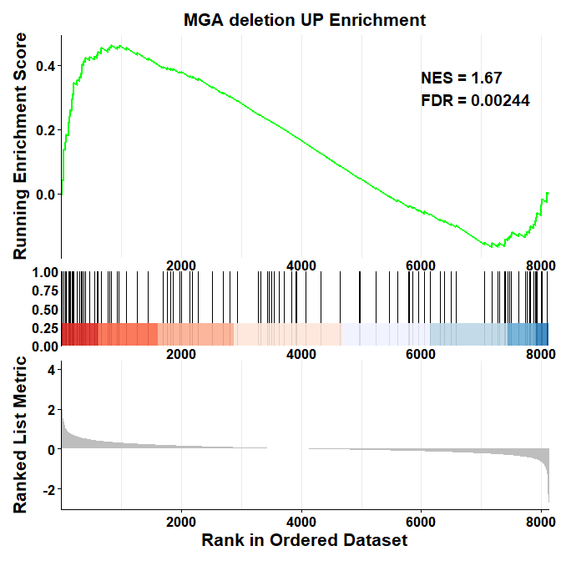
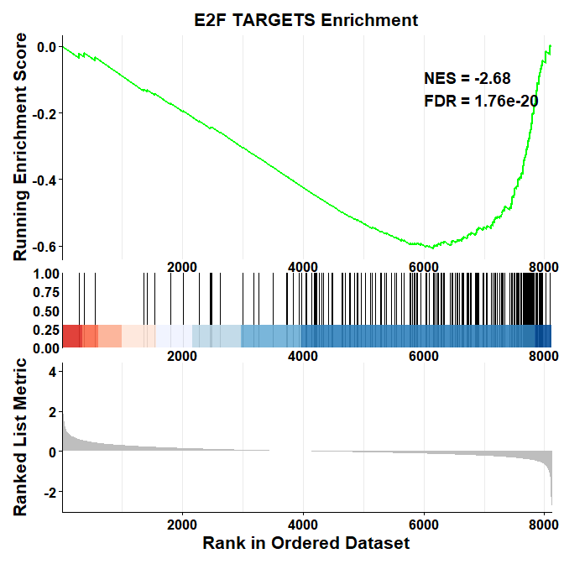
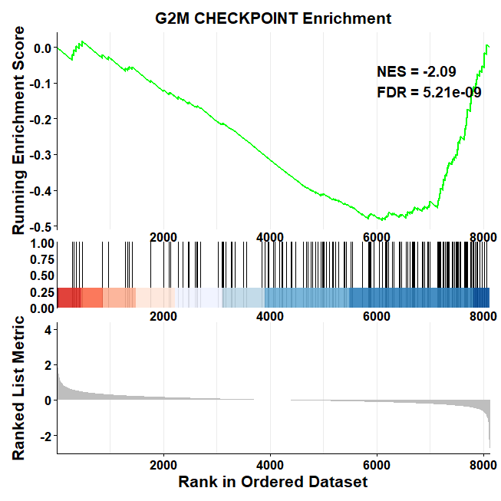
GSEA Enrichment plots of UBE2E3KD proteome
Supplementary Figure S2. GSEA plots of global proteomic analysis.
Quantitative proteomic data following UBE2E3 depletion in OCI-AML2. Proteins were ranked according to log2 fold-change. Differentially expressed proteins were plot against the BCORKD-UP, MGAKD-UP gene set and hallmark sets.

Slide 3
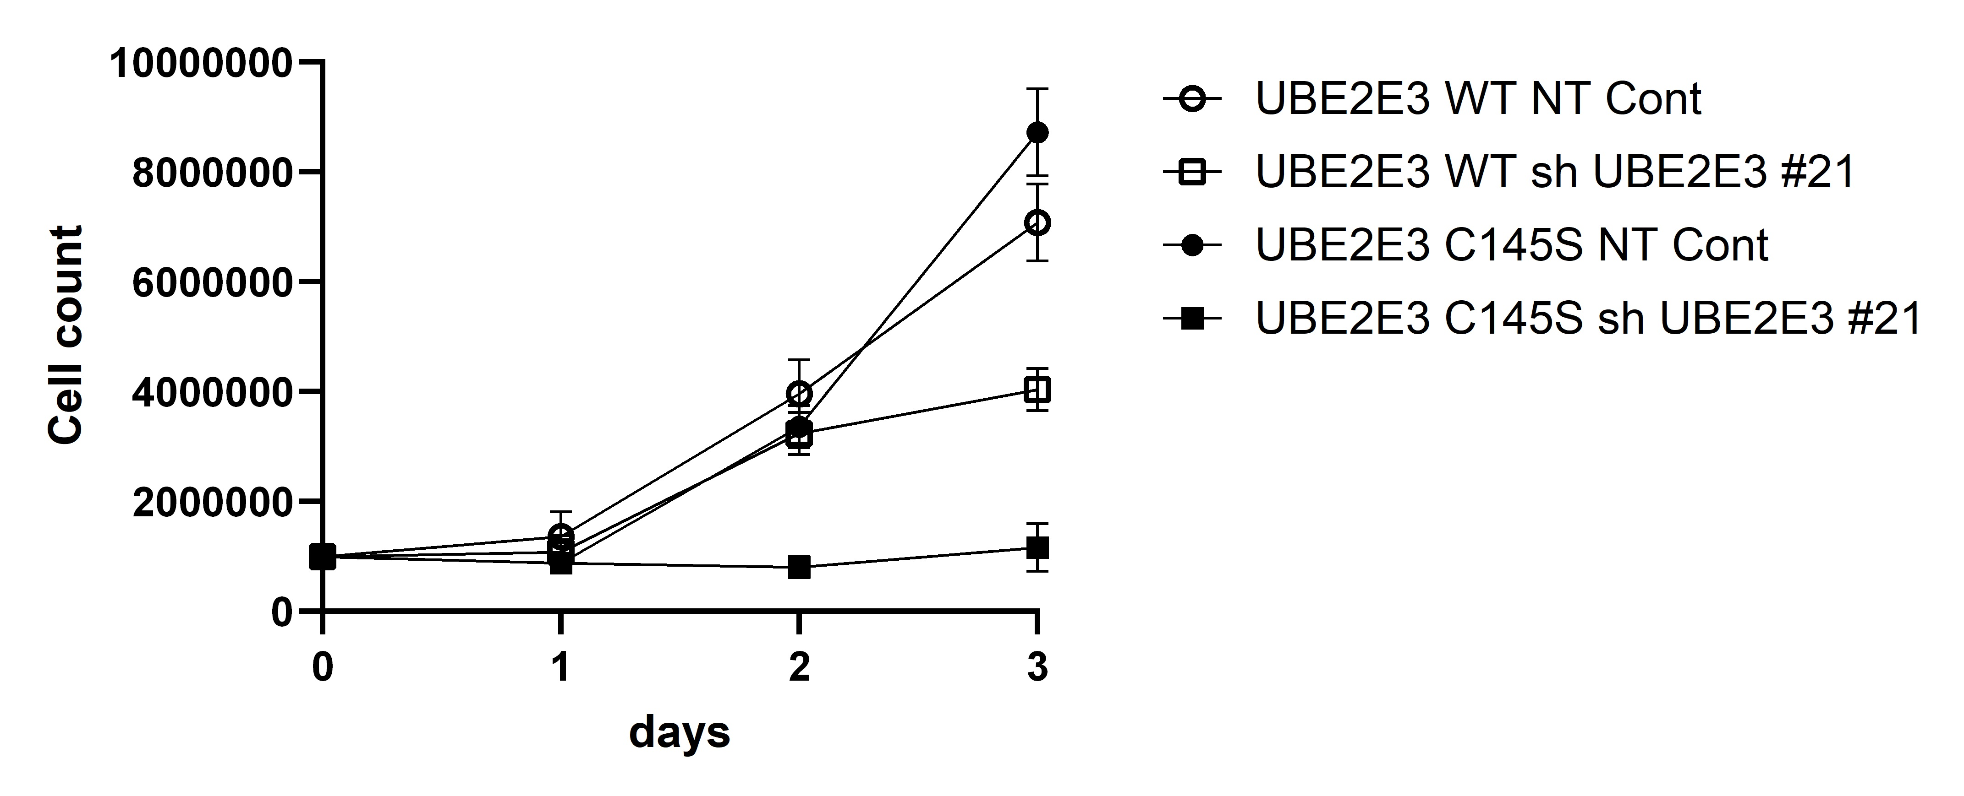
Supplementary Figure S3. Growth and viability assay following rescue with wt and E2 dead UBE2E3
OCI-AML2 cells were stably transduced with either an empty vector, wild-type UBE2E3 (UBE2E3-WT), or catalytically inactive UBE2E3 (UBE2E3-C145S). Cells were then transduced with an shRNA targeting the untranslated region (UTR) of UBE2E3, allowing specific depletion of endogenous UBE2E3 without affecting exogenous expression or with a non-targeting control (NT cont). Graph presents cell proliferation, measured across three independent experiments (mean ± SD of a representative experiment shown)

Slide 4
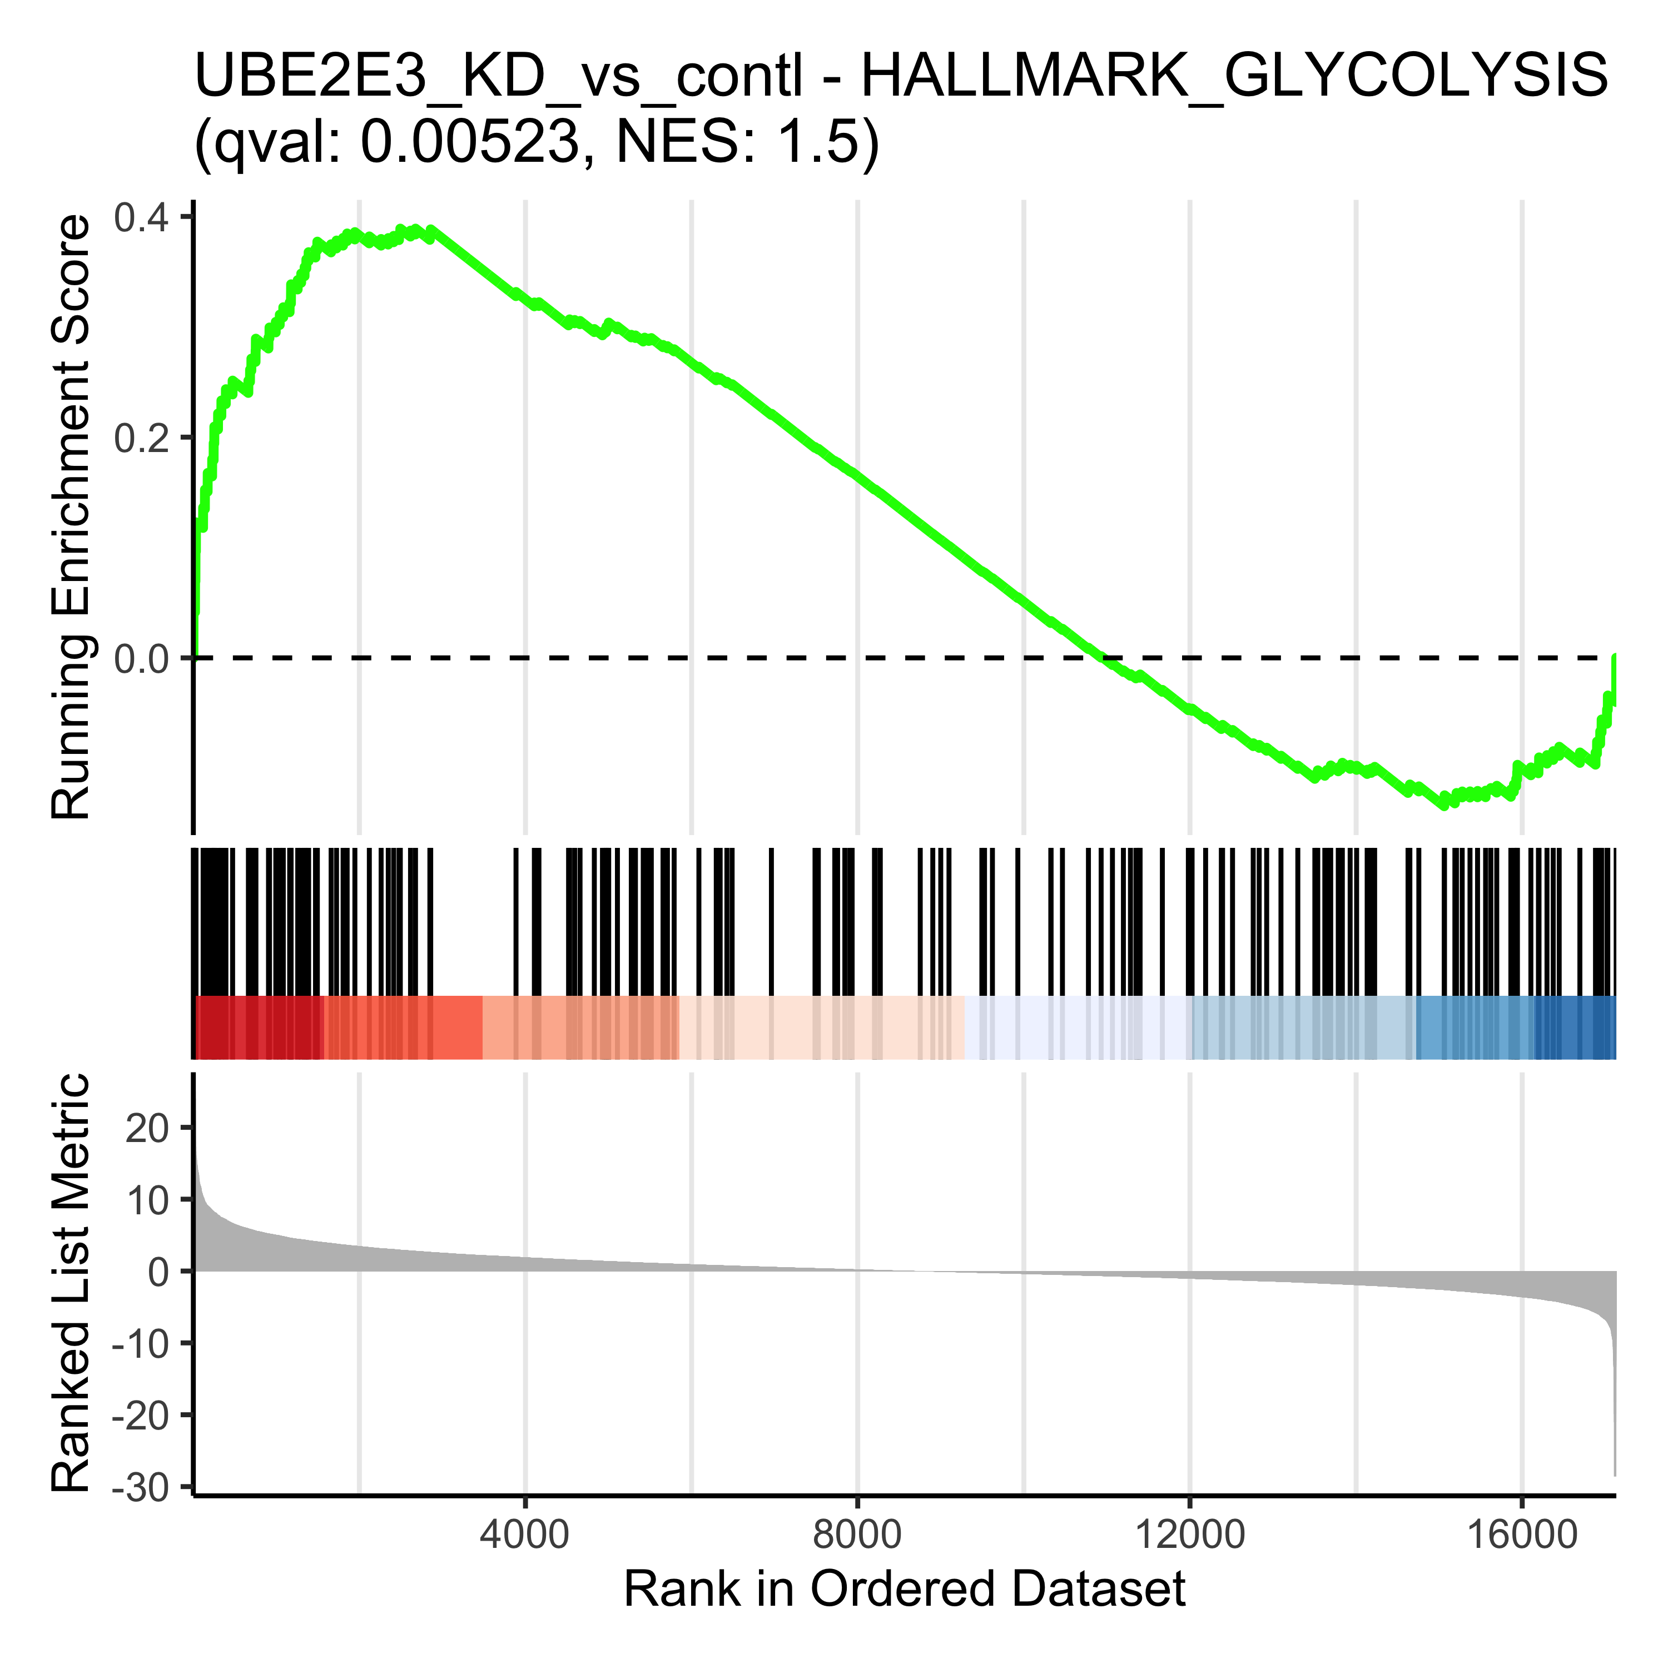
Supplementary Figure S4. GSEA enrichment plots supporting Figure 5E. Individual GSEA (clusterProfiler) running-enrichment-score plots for each gene set summarised in Figure 5E, from OCI-AML2 RNA-seq following UBE2E3 knockdown versus non-targeting control. Enriched (positive NES) in UBE2E3-KD: monocyte-like (top 250), LSC⁻ (non-stem; “LSCm”), Hallmark interferon-α response, genes down-regulated in leukemia stem cells (LSC104) and Hallmark glycolysis. Depleted (negative NES): GMP-like (top 100), a proliferative-gene signature, Hallmark MYC targets and Hallmark E2F targets. Normalized enrichment score (NES) and FDR-adjusted q value are indicated on each panel.

