Slide 1
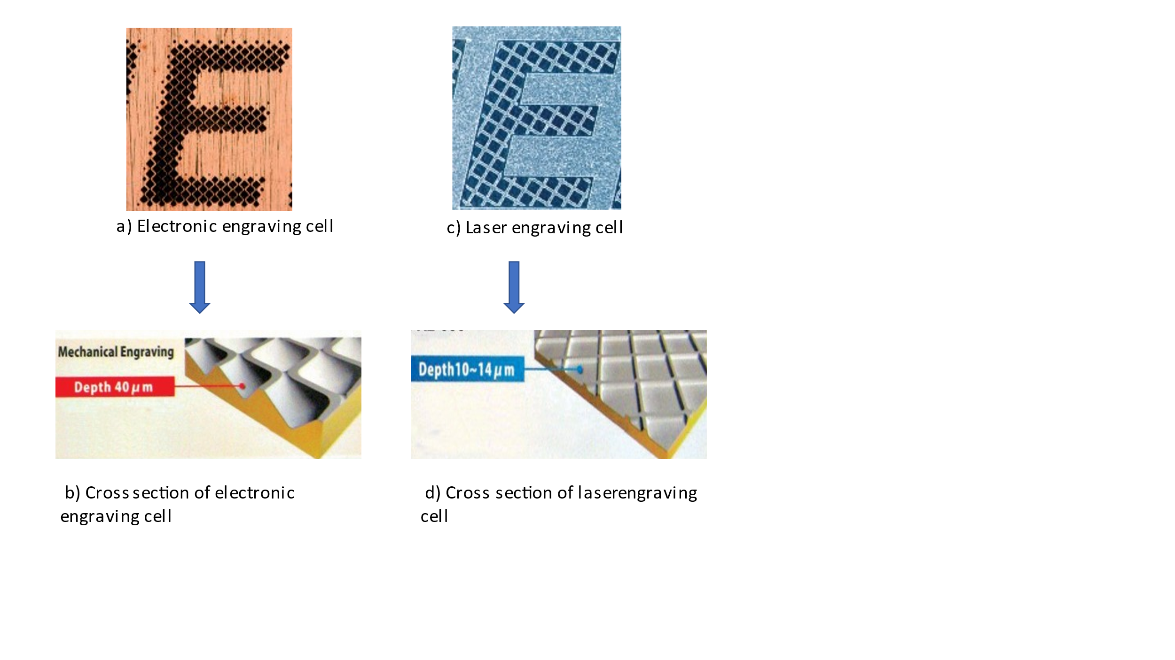
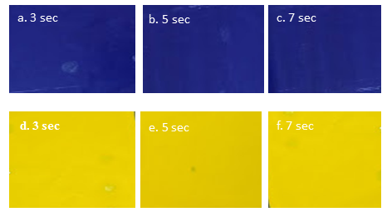
Graphical Abstract
Difference between electronic and laser engraving
Quality measurement with formulated ink
VOCs emissions in SB and WB inks during printing process.

