Slide 1
BOPPPS+AI
Teaching Model
Target Audience: Clinical Medicine Undergraduates (Junior Year and Above)
Department of Nephrology, Xiangya Hospital, Central South University

Slide 2

Part1
Concept Introduction

Slide 3
BOPPPS Teaching Model
The BOPPPS teaching model is a structured instructional design framework centered on goal orientation. It forms a six-stage cyclical teaching process by defining learning objectives, understanding students' prior knowledge, designing highly participatory teaching activities, conducting effect assessments, and organizing knowledge frameworks. Its prominent feature is student-centeredness, emphasizing active participation and practice, integrating learning content with practical applications, and effectively enhancing learning outcomes and student satisfaction.
Participatory Learning
Bridge-in
Objectives
Pre-test
Post-test
Summary

Slide 4
Comparison of Teaching Models
VS
BOPPPS + AI
LBL
A traditional teaching model centered on teacher lectures. Relying on the classroom, teachers systematically transmit knowledge, and students passively receive information, focusing on knowledge impartation and memory, emphasizing the completeness of theoretical teaching, but weak in practice and independent thinking guidance.
Based on the BOPPPS structured teaching closed-loop framework, it integrates AI technology into the entire teaching process. It covers pre-class virtual case collection (DoctorU), intelligent diagnosis of learning emotions (learning questionnaires), virtual simulation training (Shengyun Medical Education Platform), learning data quantitative analysis, and other links. It not only ensures the integrity of teaching logic but also uses digital tools to strengthen practical ability training, connecting knowledge impartation with clinical skill training.
PBL
A teaching model driven by clinical problems. By presenting case problems, students independently review literature and conduct group discussions, constructing knowledge by solving problems, emphasizing independent inquiry and teamwork. However, it is difficult to restore real scenarios, and hands-on training tends to be "theoretical".

Slide 5
Part2
Teaching Plan

Slide 6
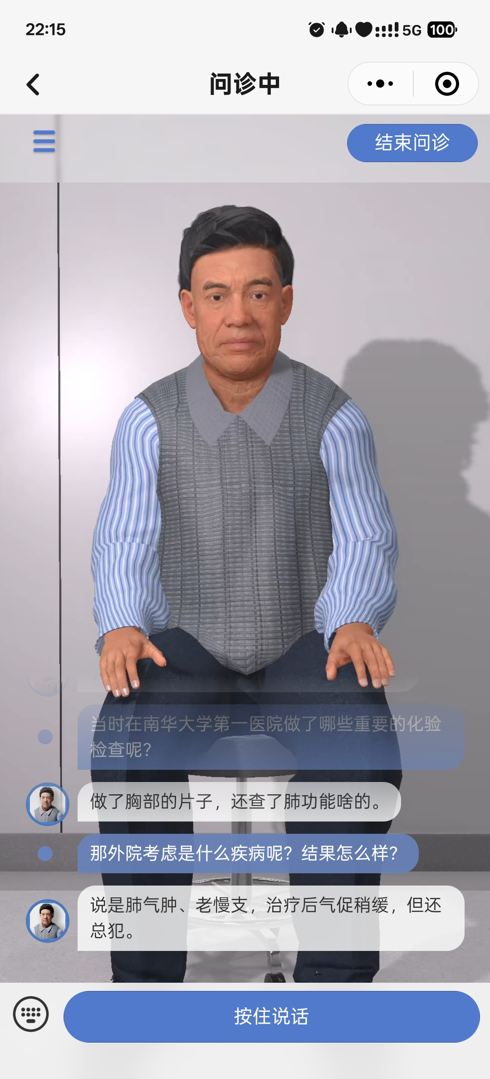
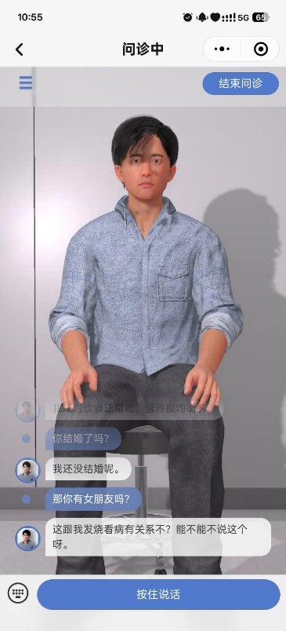
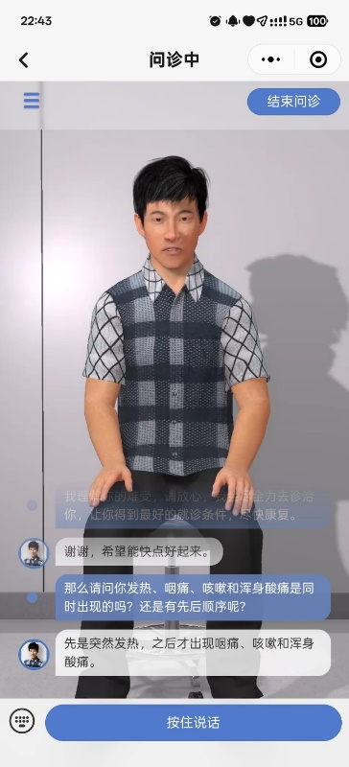
Teaching Plan
Pre-assessment
Participatory Learning
Post-assessment
Summary
Bridge-in
Objectives
Bridge-in: Select a case of "Uremia with Pleural Effusion" and release it to students one day before class through an online platform. Students can use the DoctorU mini-program to conduct online virtual case questioning to collect medical history and analyze the case.
Patient Chen XX, female, 80 years old, was admitted to the hospital due to the discovery of proteinuria and elevated blood creatinine for 10 years, and shortness of breath for half a month. The patient received regular hemodialysis treatment in another hospital 3 times a week for 3 years before admission. After admission, chest CT suggested a large amount of bilateral pleural effusion.
CASE

Slide 7
Teaching Plan
Pre-assessment
Participatory Learning
Post-assessment
桥入
目标
前评估
后评估
总结
Bridge-in
Objectives
参与式学习
Summary
Bridge-in: Select a case of "Uremia with Pleural Effusion" and release it to students one day before class through an online platform. Students can use the DoctorU mini-program to conduct online virtual case questioning to collect medical history and analyze the case.
Objectives: Clarify the knowledge and ability objectives related to the indications for thoracentesis, standard operating procedures, and risk control of complications.
Pre-assessment: Use the Xuexitong platform to release online questionnaires and conduct oral questioning to assess students' mastery of knowledge such as standardized thoracentesis procedures.

Slide 8

教学方案
Pre-assessment
Participatory Learning
Post-assessment
桥入
目标
前评估
后评估
总结
Bridge-in
Objectives
参与式学习
Summary
Participatory Learning: First, discuss the case in groups (to justify the necessity of thoracentesis, assess the patient's puncture risk, and develop a treatment plan). Then, use the Shengyun Medical Education Platform for thoracentesis simulation training.

Slide 9
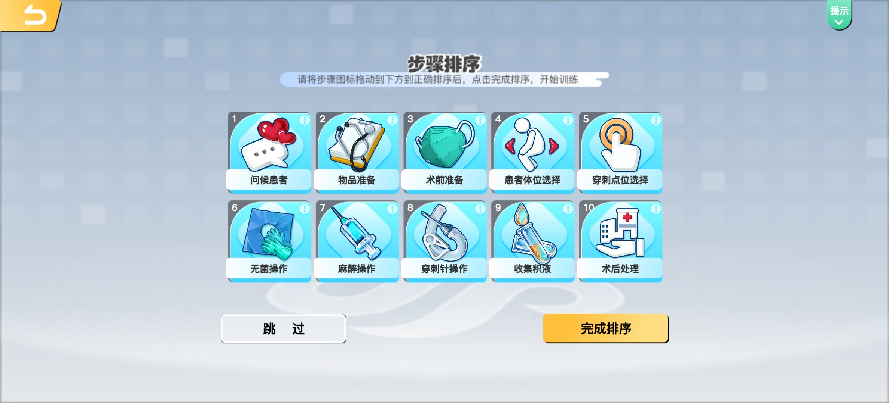
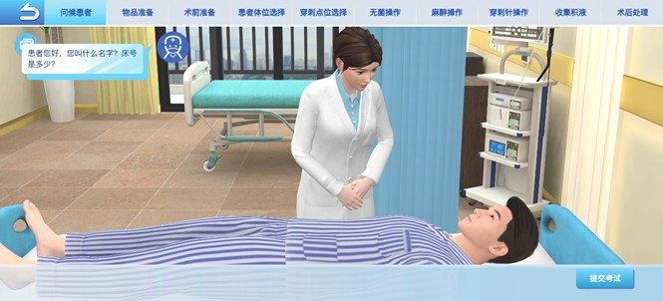
Teaching Plan
Core Steps of Simulation Training on Shengyun Medical Education Platform
Step Sequencing
01
Drag and drop the thoracentesis procedure cards (10 steps including consultation, preparation, body position, etc.) to sort them, organize the logical sequence of operations, and clarify the basic process of "what to do first, what to do next".
Greeting the Patient
02
Enter the virtual scene, students click "Greet the Patient", ask the virtual patient's name and bed number, complete the first step of clinical communication, and collect basic information.

Slide 10
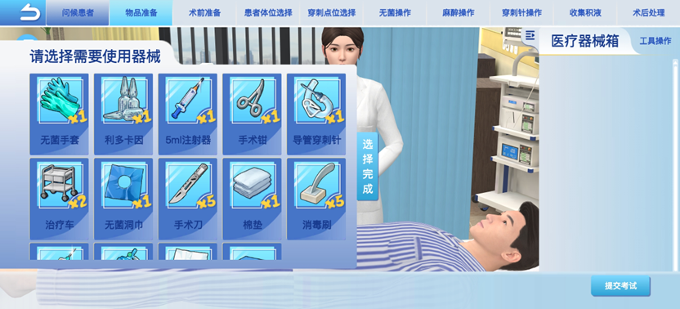
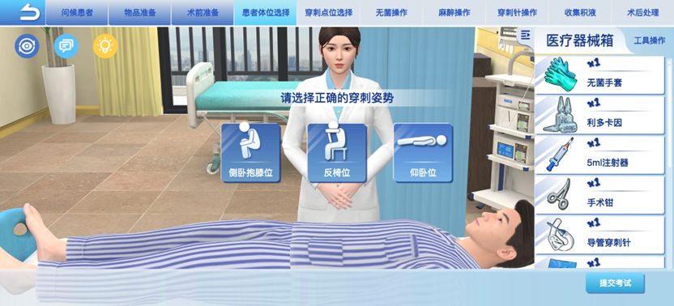
Teaching Plan
Preparing Items
03
Open the "Medical Instrument Box" and select all items required for thoracentesis from tools such as gloves, lidocaine, and syringes to complete preoperative instrument preparation.
Patient Position Selection
04
According to the puncture requirements, select an appropriate position from "lateral decubitus, prone position, supine position" to position the patient for subsequent puncture operations.

Slide 11
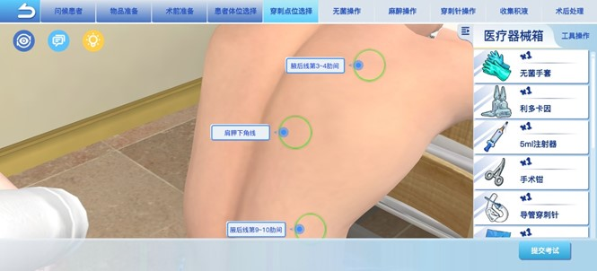
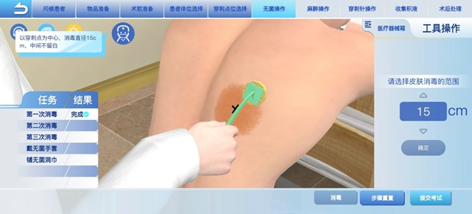
Teaching Plan
Puncture Site Selection
05
On the virtual patient's back, click to select the puncture entry point based on anatomical markers (midscapular line, posterior axillary line intercostal space).
Aseptic Technique
06
Hold the disinfection brush, select a 15cm range centered on the puncture point for skin disinfection, and complete the standardized operation of "disinfection diameter and sequence".

Slide 12
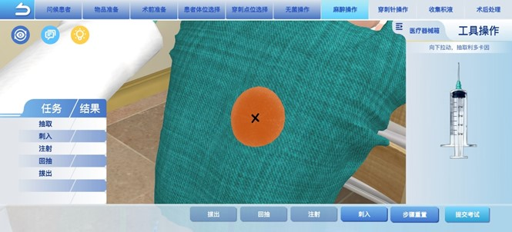
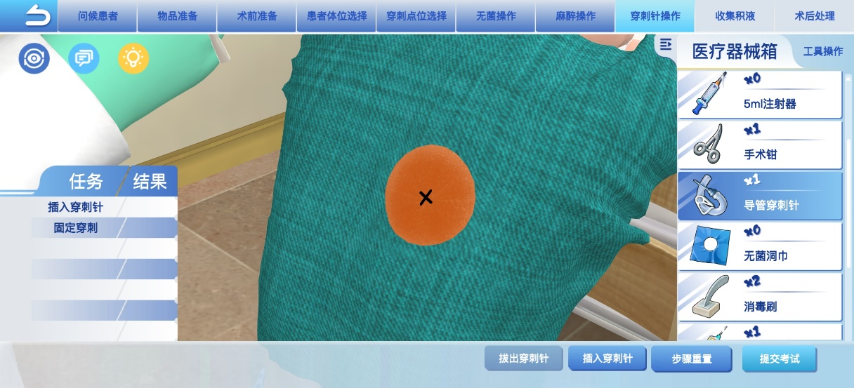
Teaching Plan
Anesthesia
07
Draw lidocaine and inject it into the puncture site skin to complete the local anesthesia process of "injection -> aspiration -> needle withdrawal", simulating anesthesia administration.
Puncture Needle Operation
08
Select a catheter puncture needle from the medical instrument box, click "Insert Puncture Needle", accurately puncture to the predetermined position, and perform fixation after completion.

Slide 13
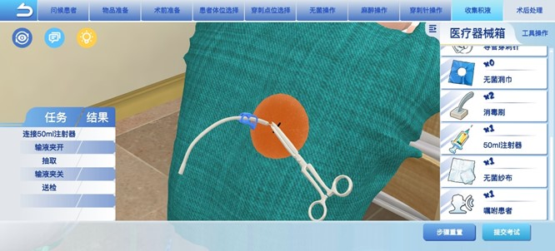
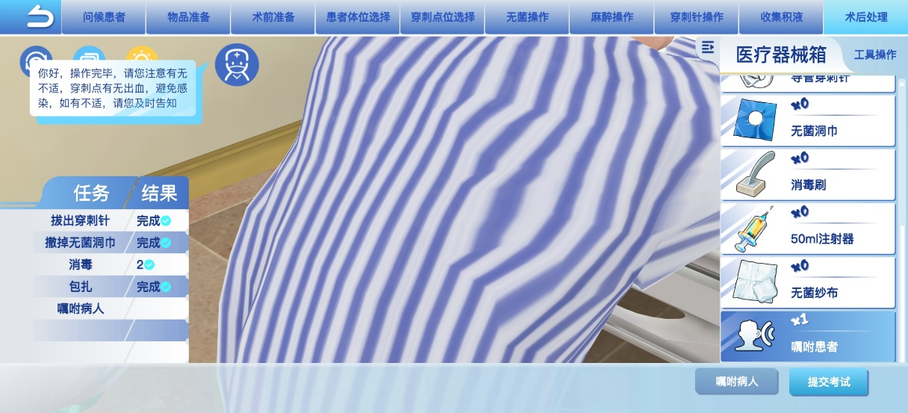
Teaching Plan
Fluid Collection
09
Connect the syringe to the puncture needle and complete the collection and processing of pleural effusion through actions such as "clamping the tube, aspirating, and sending for testing".
Postoperative Management
10
Execute "needle withdrawal, disinfection, dressing" in sequence, and finally click "Instruct the Patient" to inform postoperative precautions (bleeding, infection observation, etc.) to conclude the operation process.

Slide 14
Teaching Plan
Pre-assessment
Participatory Learning
Post-assessment
Summary
Bridge-in
Objectives
Participatory Learning: First, discuss the case in groups (to justify the necessity of thoracentesis, assess the patient's puncture risk, and develop a treatment plan). Then, use the Shengyun Medical Education Platform for thoracentesis simulation training (including puncture operation simulation and postoperative complication management).
Post-assessment: Online quizzes on Xuexitong with AI intelligent learning situation analysis; statistics on operation conditions on the Shengyun Medical Education Platform.
Summary: Organize the key points of thoracentesis and emphasize the individualized adjustment ideas when combined with underlying diseases.

Slide 15
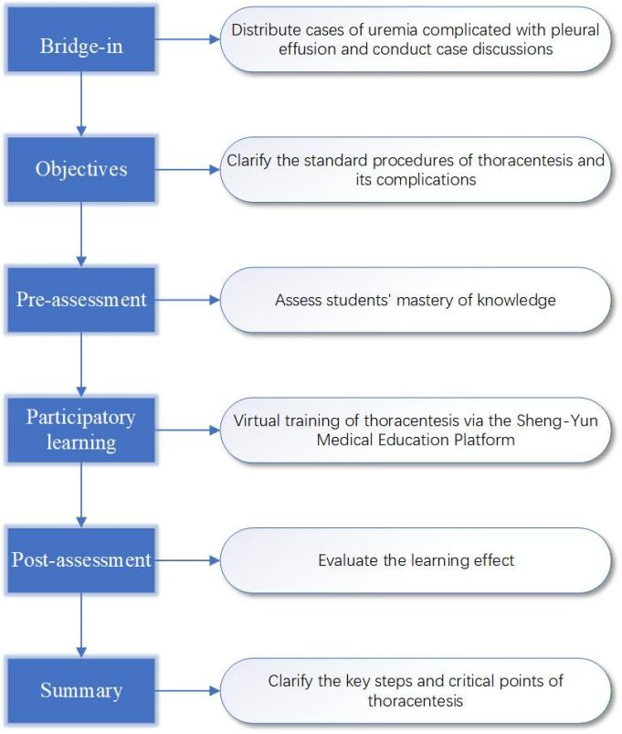
Teaching Plan
BOPPPS+AI Teaching Model

Slide 16
Thank You！

