Slide 1
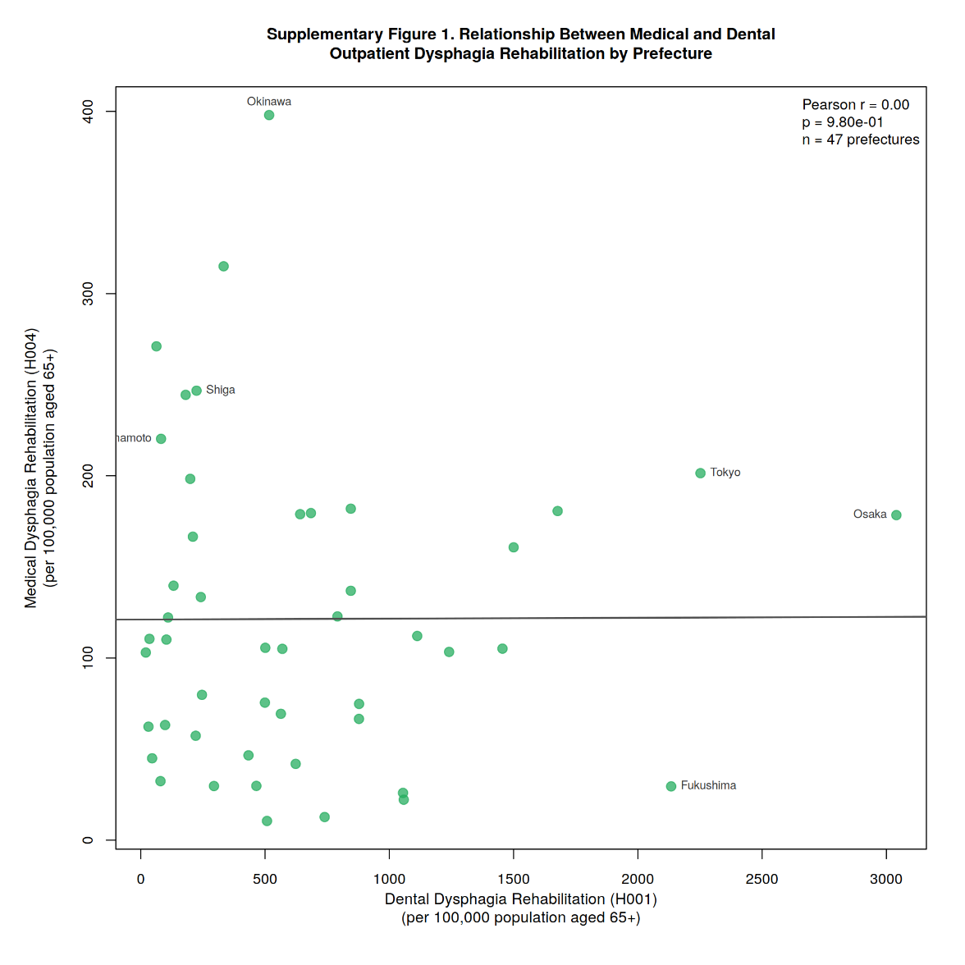
Additional file 1, Fig. 1 Relationship between Medical and dental outpatient dysphagia rehabilitation by prefecture

Slide 2
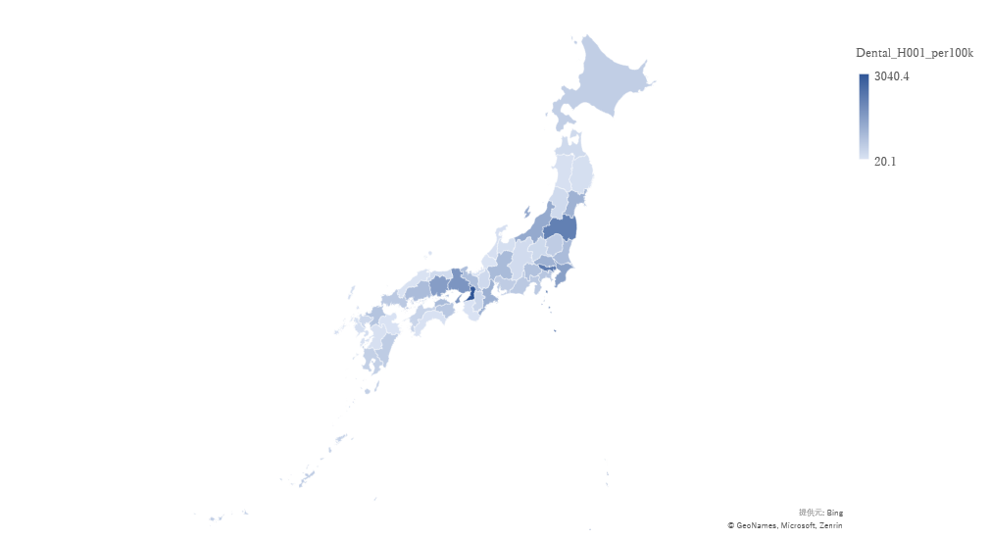
Additional file 1, Fig. 2 Dental dysphagia rehabilitation (H001) claims per 100,000 population aged ≥65 years by Prefecture, Japan (fiscal year 2023)

Slide 3
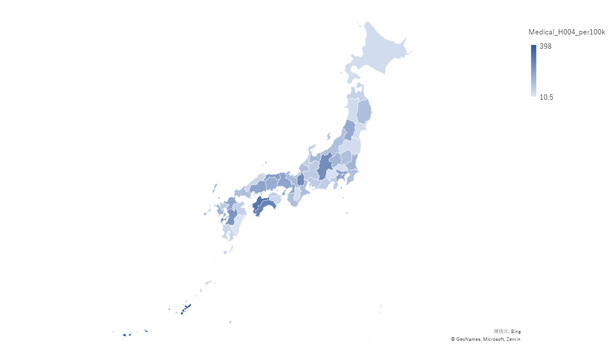
Additional file 1, Fig. 3 Medical dysphagia rehabilitation claims per 100,000 population aged ≥65 years by prefecture, Japan (fiscal year 2023)

Slide 4
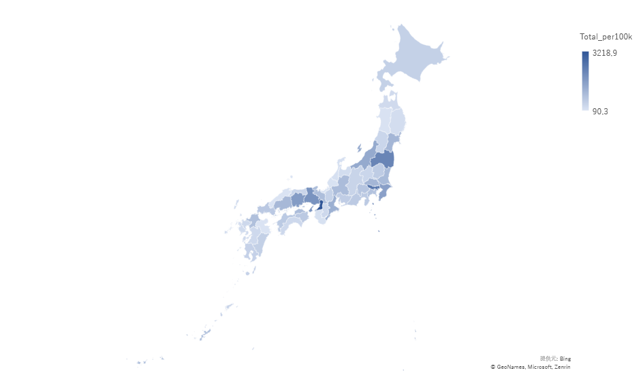
Additional file 1, Fig. 4 Total dysphagia rehabilitation claims per 100,000 population aged ≥65 years by prefecture, Japan (fiscal year 2023)

Slide 5
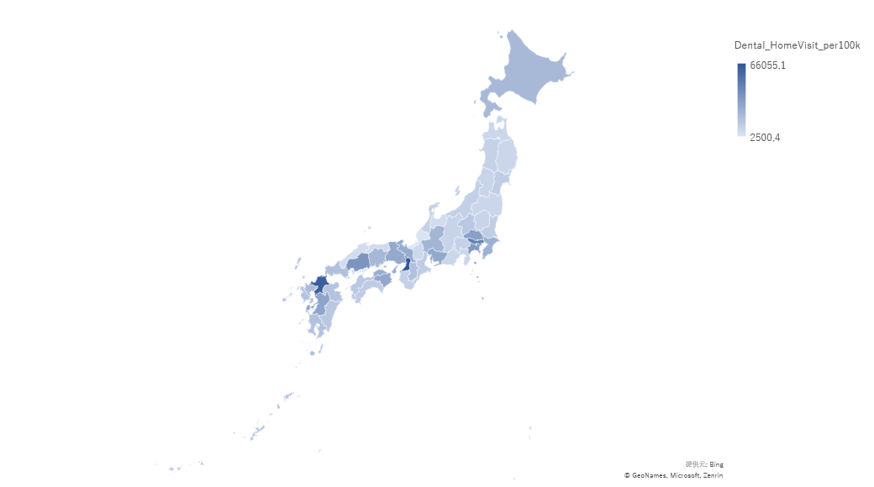
Additional file 1, Fig. 5 Dental home visit claims per 100,000 population aged ≥65 years by prefecture, Japan (fiscal year 2023)

Slide 6
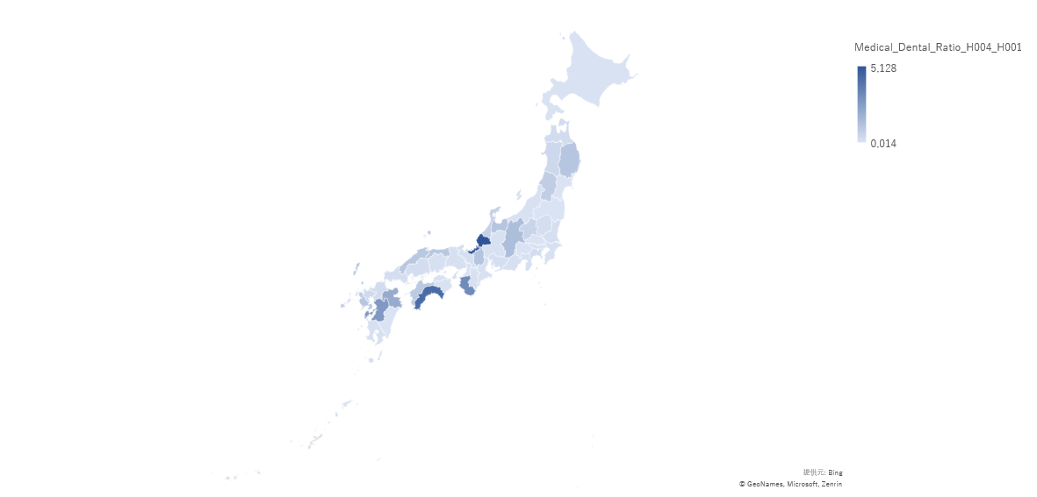
Additional file 1, Fig. 6 Medical-to-dental ratio of outpatient dysphagia rehabilitation claims by prefecture, Japan (fiscal year 2023)

