Slide 1
Figure 1: LCMS tuning analysis of Standard (Vorasidenib) Compound

Slide 2
Figure 2: LCMS tuning analysis of New Chemical Entity ((N-(2-oxo-1,2,5,6,7,8-hexahydroquinolin-5-yl)thiane-4-carboxamide))

Slide 3
Figure 3: LCMS tuning analysis of D-2-Hydroxyglutarate (Metabolite)

Slide 4
Figure 4: LCMS tuning analysis of Internal Standard (Quercetin)

Slide 5
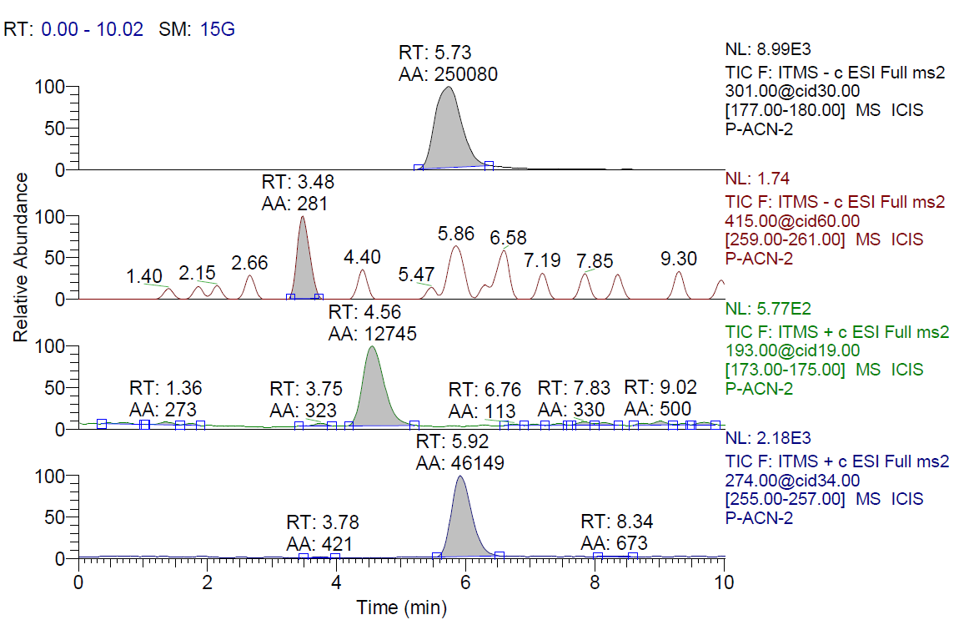
Bioanalytical Method Development in Female Wistar Rats Plasma-LC
Figure 5: Bioanalytical method development of standard, NCE, Quercetin, metabolite in Plasma

Slide 6
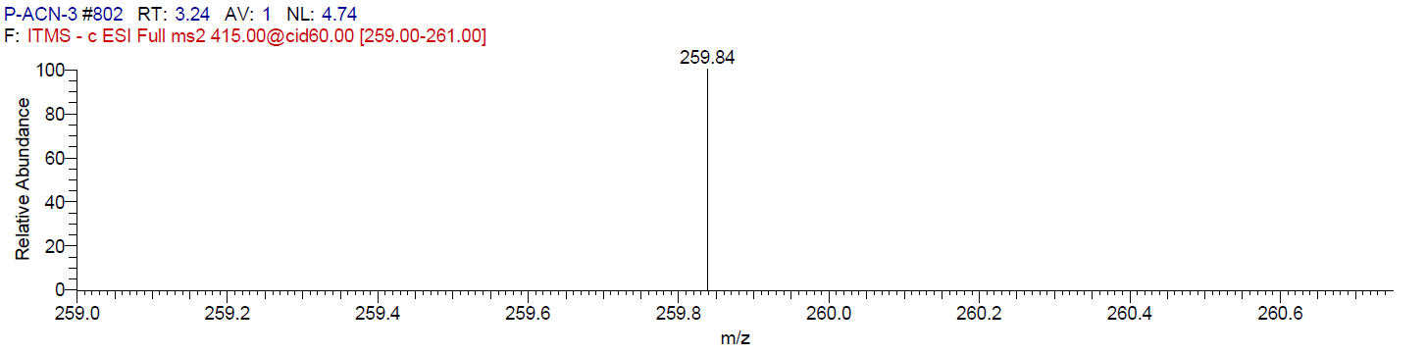
Bioanalytical Method Development in Female Wistar Rats Plasma -MS
Figure 6: Bioanalytical method development of Standard drug (Vorasidenib)

Slide 7
Figure 7: Bioanalytical method development of Quercetin (Internal Standard)

Slide 8
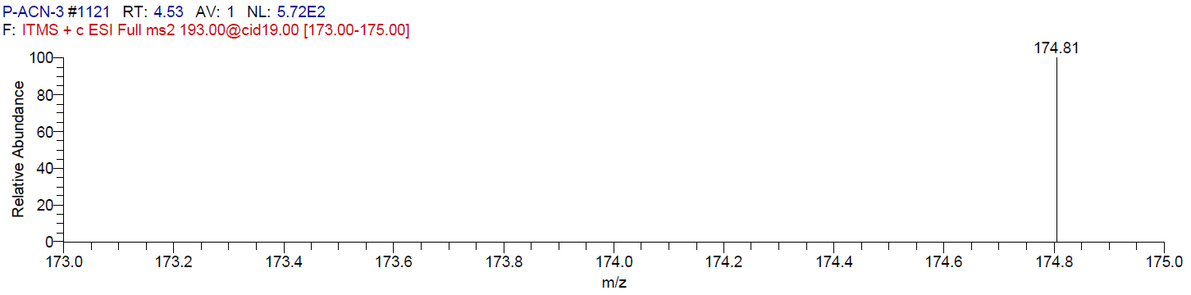
Figure 8: Bioanalytical method development of Metabolite (D-2-Hydroxyglutarate)

Slide 9
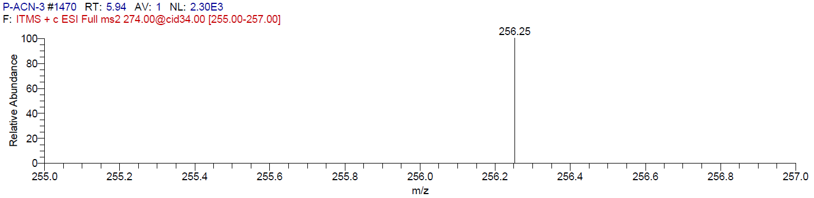
Figure 9: Bioanalytical method development of NCE ((N-(2-oxo-1,2,5,6,7,8-hexahydroquinolin-5-yl)thiane-4-carboxamide))

Slide 10
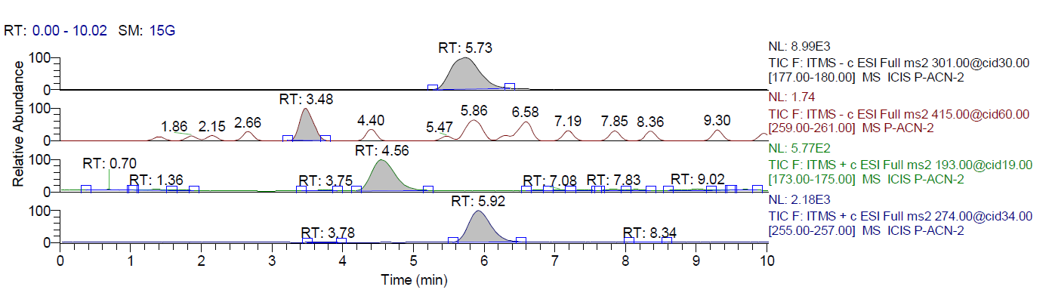
Bioanalytical Method Development in Female Wistar Rats Brain-LC
Figure 10: Bioanalytical method development of Standard, NCE, Quercetin, Metabolite in Brain

Slide 11
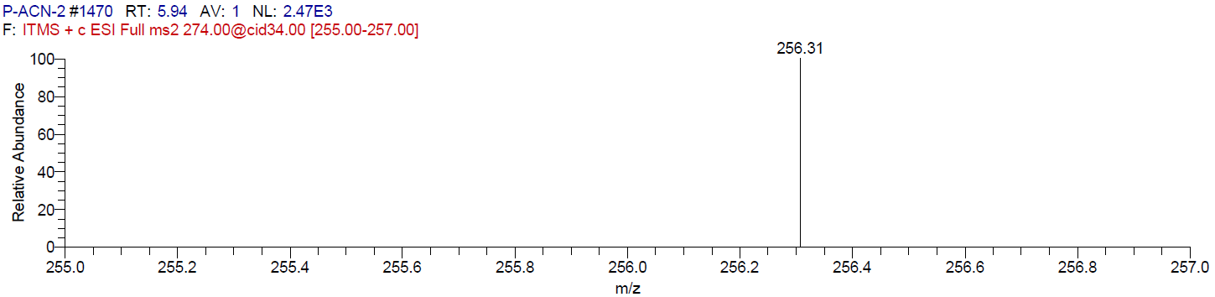
Bioanalytical Method Development in Female Wistar Rats Brain -MS
Figure 11: Bioanalytical method development of NCE ((N-(2-oxo-1,2,5,6,7,8-hexahydroquinolin-5-yl)thiane-4-carboxamide))

Slide 12
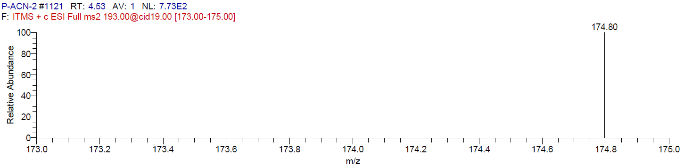
Figure 12: Bioanalytical method development of Metabolite (D-2-Hydroxyglutarate)

Slide 13
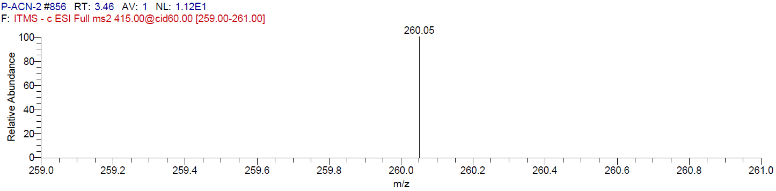
Figure 13: Bioanalytical method development of Standard (Vorasidenib)

Slide 14
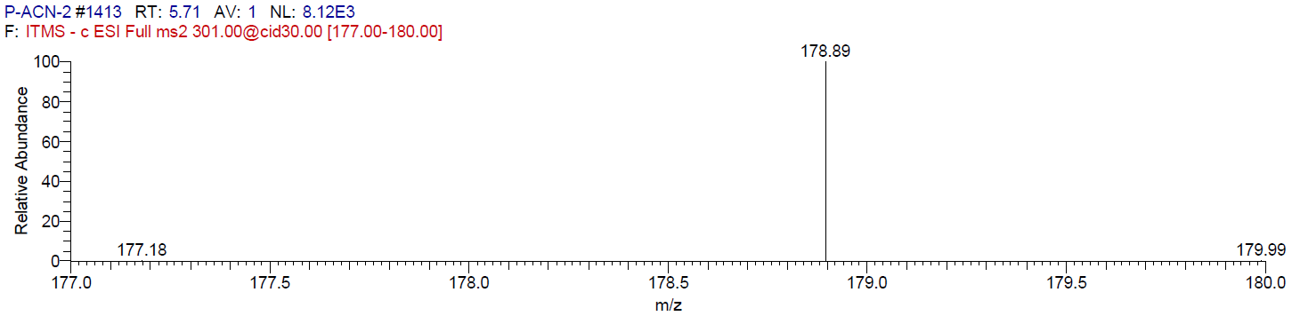
Figure 14: Bioanalytical method development of Quercetin (Internal Standard)

