Slide 1
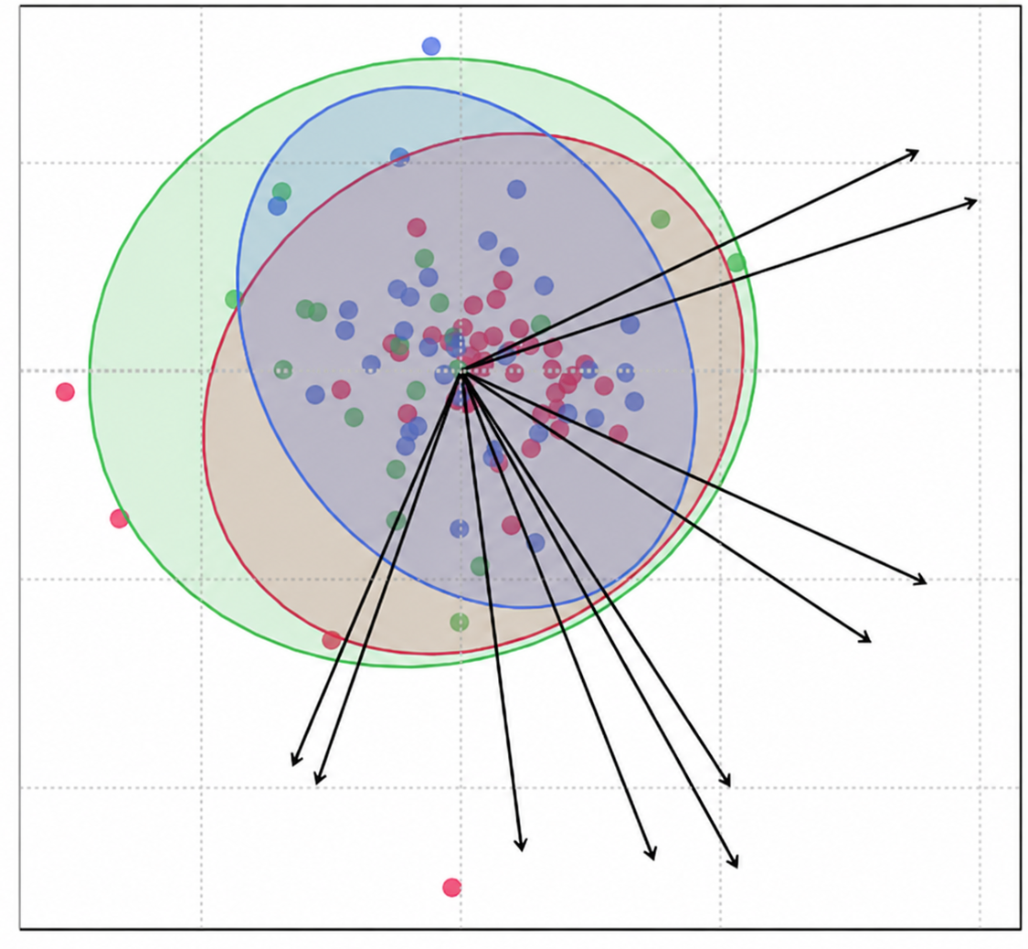
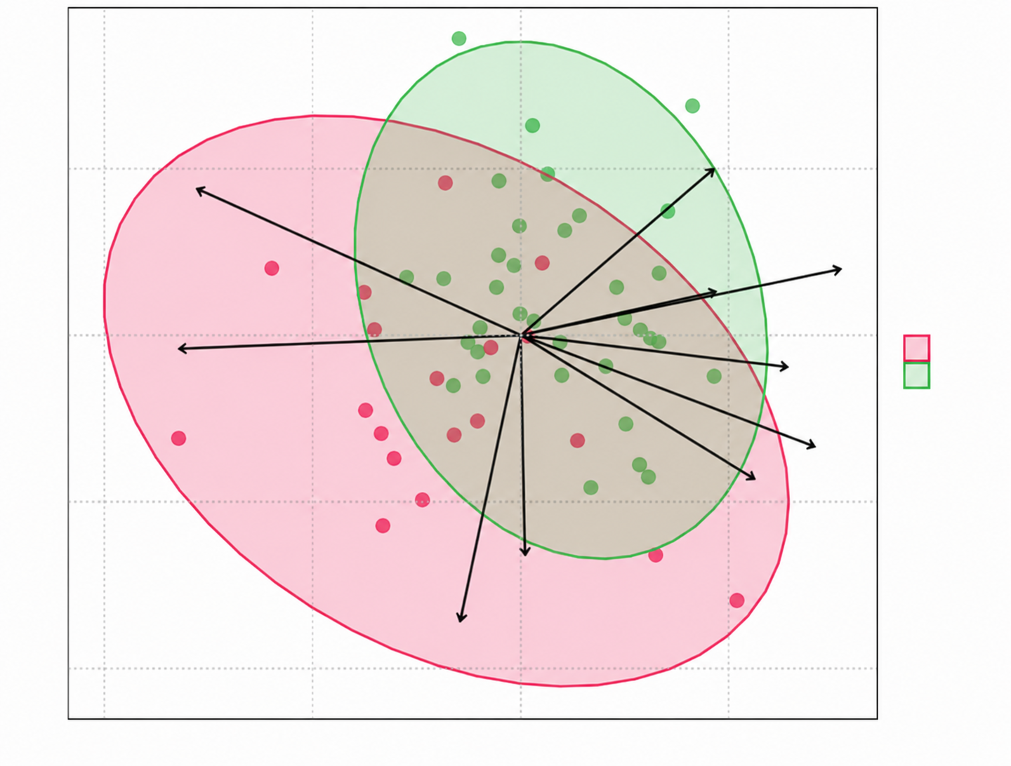
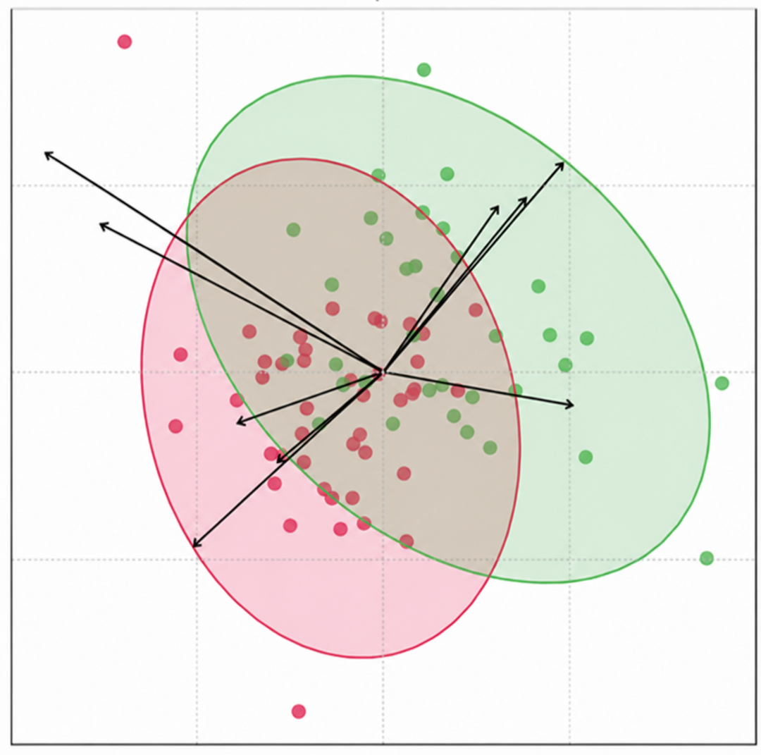
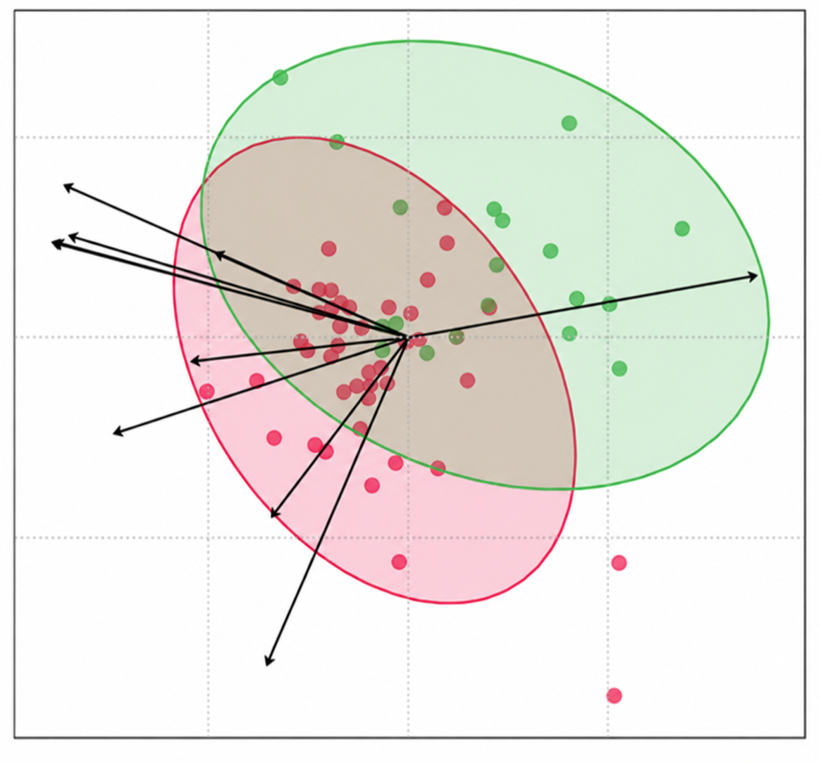
a
b
0.2
DGLA
LA
DHA
0.2
C18:1
0.0
HC
C23
C18
dcSSc
dcSSc
0.0
C20
lcSSc
Principal component 2 (11.5%)
Principal component 2 (12.7%)
C15
lcSSc
C16
EDA
-0.2
-0.2
C13
anteiso C17
DGLA
-0.4
iso C14
C14:1
iso C16
anteiso C19
iso C15
anteiso C15
-0.4
C16:1
-0.25
0.00
0.25
0.50
-0.50
-0.25
0.00
0.25
Principal component 1 (24.4%)
Principal component 1 (19.2%)
c
d
anteiso C15
C20:1
0.25
C22
0.2
iso C15
C18
C14:1
C24:1
C17
ALA
C18:1
C15
HC
0.00
iso C17
HC
0.0
Principal component 2 (12.1%)
Principal component 2 (11.7%)
C18:1
lcSSc
iso C16
dcSSc
ALA
anteiso C15
LA
-0.25
-0.2
C16
C14:1
LA
-0.2
0.0
0.2
-0.25
0.00
0.25
Principal component 1 (10.1%)
Principal component 1 (23%)

