Slide 1
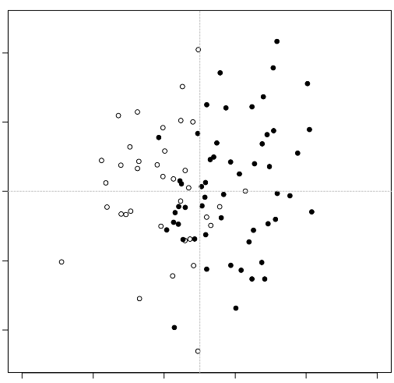
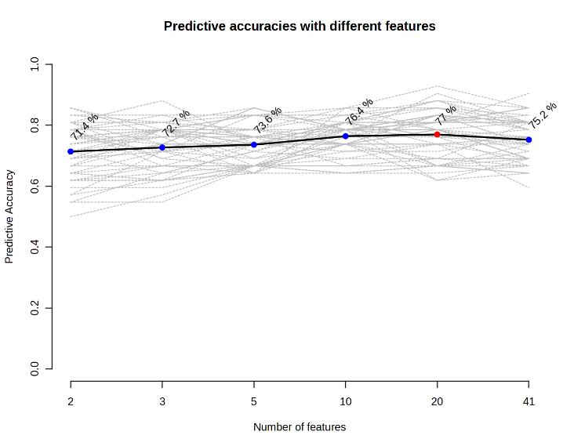
a
b
2
1.0
0.8
71.4%
72.7%
73.6%
76.4%
77.0%
75.2%
1
0.6
0
SSc
Predictive Accuracy
Samples
RA
0.4
-1
0.2
-2
0.0
0.0
0.2
0.4
0.6
0.8
1.0
2
3
5
10
20
41
Predicted Class Probabilities
Number of features

