Slide 1
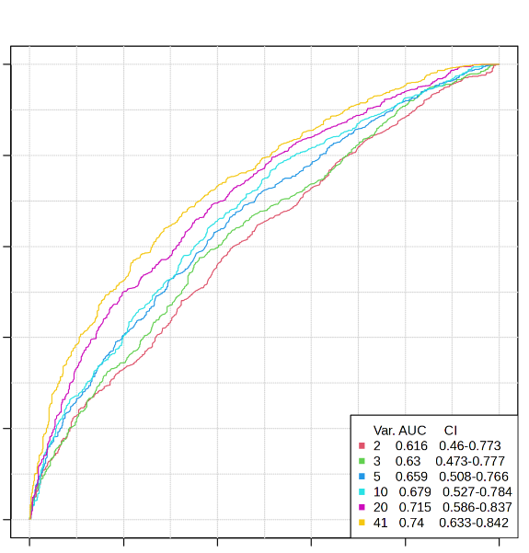
1.0
0.8
0.6
Sensitivity
0.4
0.2
Var.
AUC
Cl
2
0.616
0.46 - 0.773
3
0.63
0.473 - 0.777
5
0.659
0.508 - 0.766
10
0.679
0.527 - 0.784
0.0
20
0.715
0.586 - 0.837
41
0.74
0.633 - 0.842
0.0
0.2
0.4
0.6
0.8
1.0
Specificity

