Slide 1
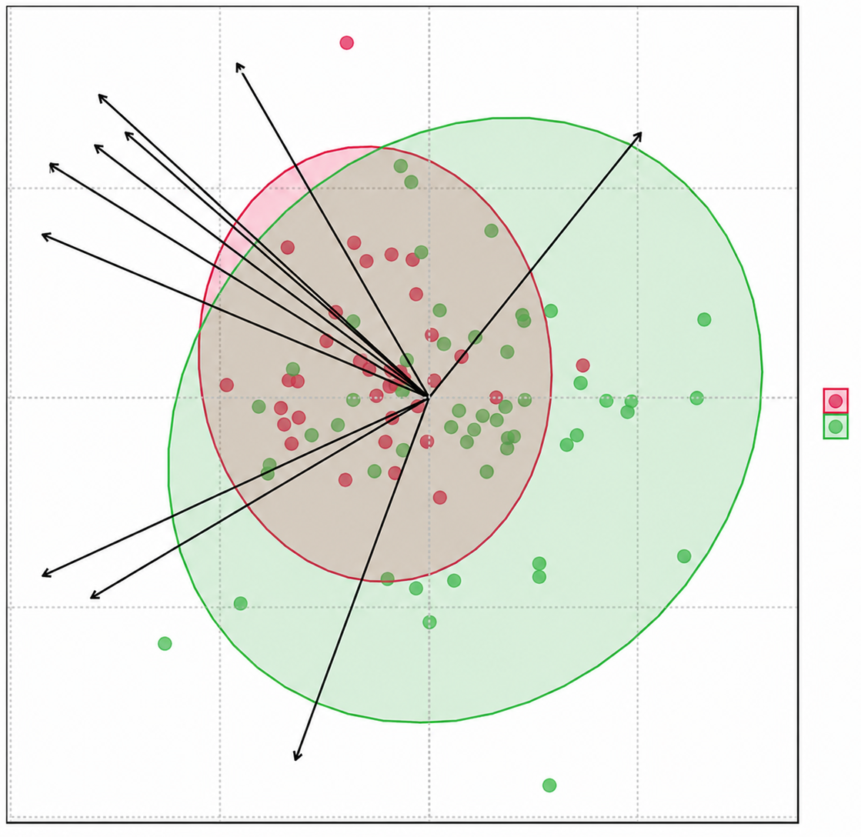
Anteiso C15
C14:1
Iso C15
C16
Iso C16
0.2
C15
Anteiso C17
0.0
RA
SSc
PC 2 (12.2%)
DPAn3
-0.2
ARA
C24:1
-0.2
0.0
0.2
PC 1 (22.7%)

