Slide 1
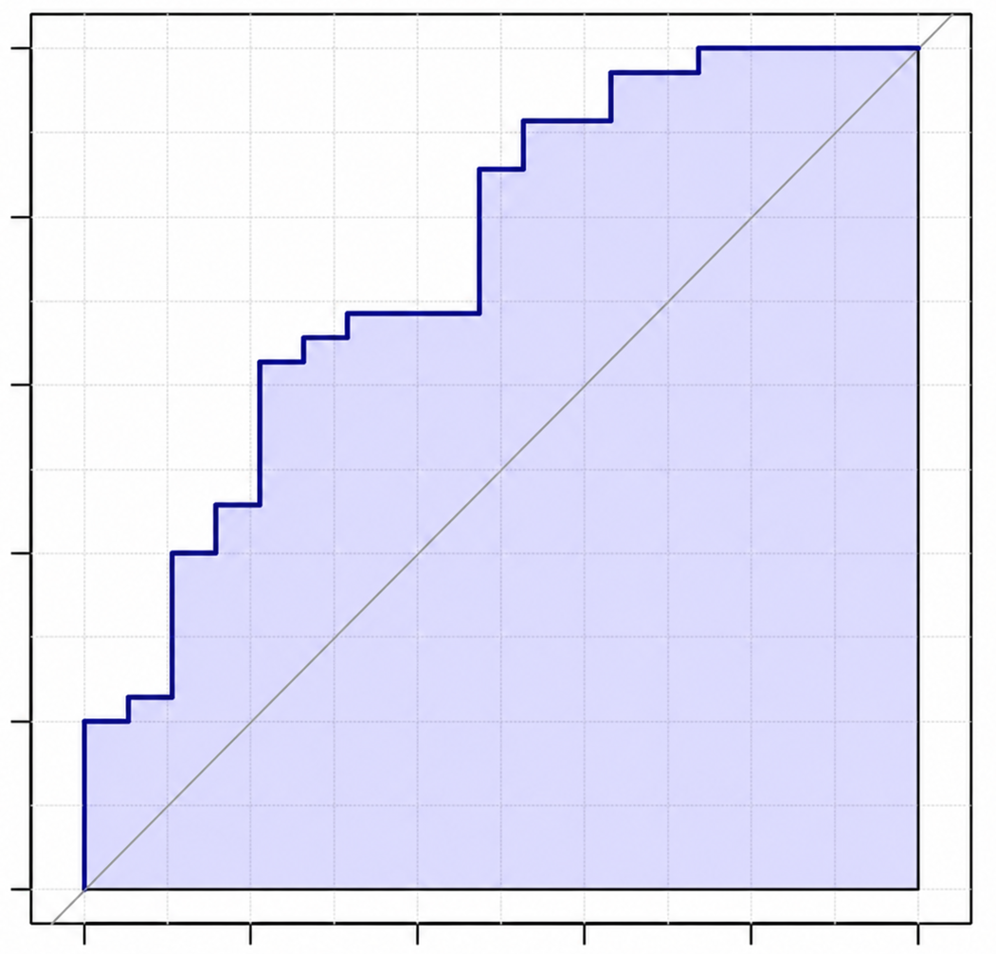
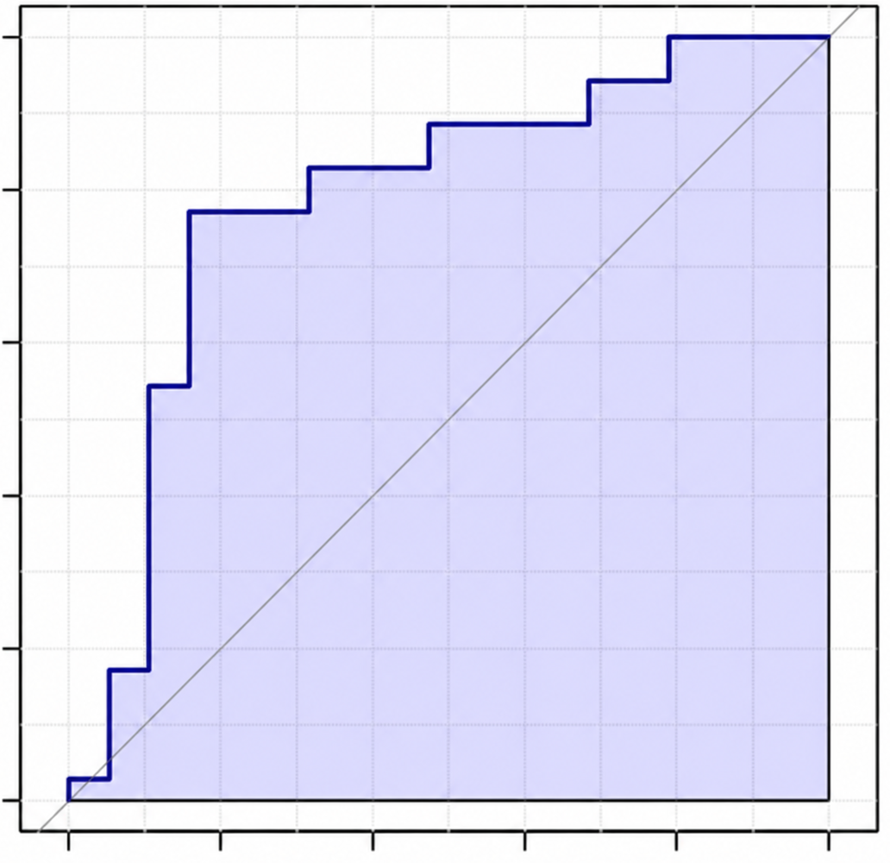
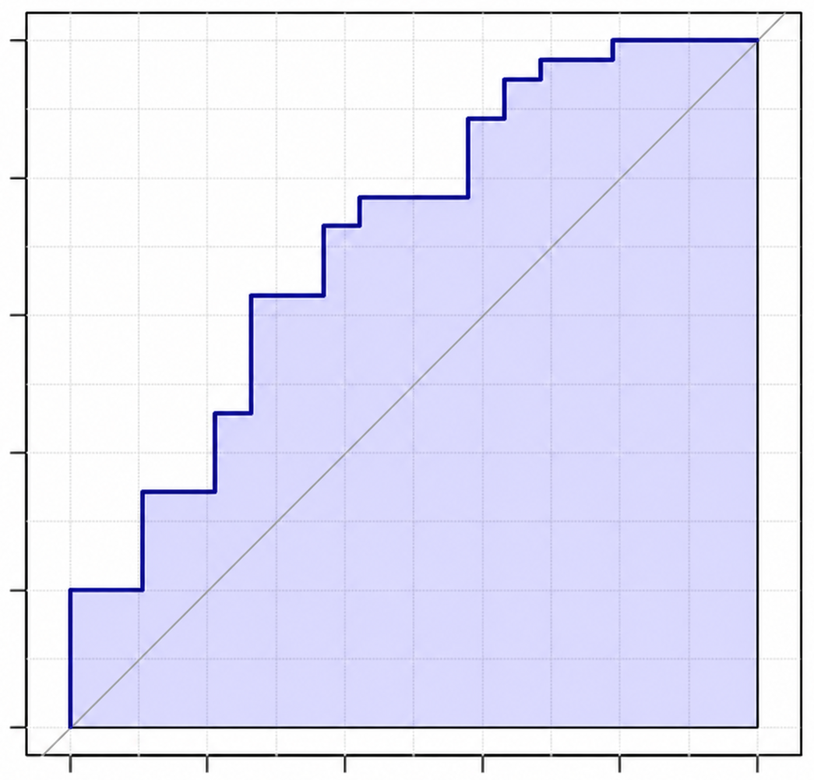
C16
C18:1
1.0
1.0
0.8
0.8
0.6
0.6
True positive rate
True positive rate
0.4
0.4
0.2
AUC: 0.753
(0.601-0.879)
0.2
AUC: 0.789
(0.633-0.912)
0.0
0.0
0.0
0.2
0.4
0.6
0.8
1.0
0.0
0.2
0.4
0.6
0.8
1.0
False positive rate
False positive rate
anteiso C19
1.0
0.8
0.6
True positive rate
0.4
0.2
AUC: 0.728
(0.566-0.843)
0.0
0.0
0.2
0.4
0.6
0.8
1.0
False positive rate

